Slide 1
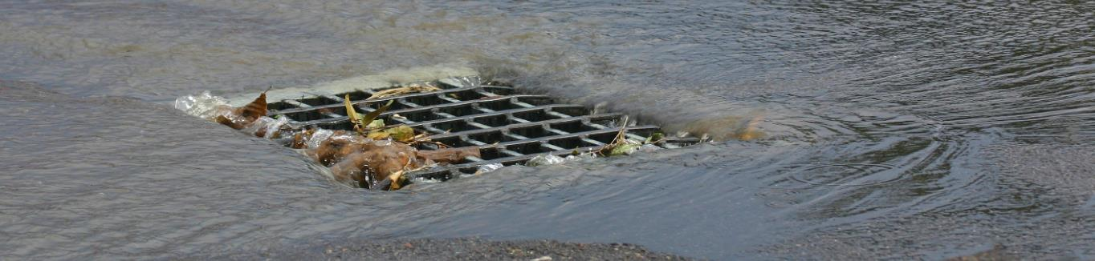


Chesapeake Bay Program Training
George Washington Memorial Parkway and Clara Barton Parkway
Stormwater Pollution Prevention Training

Slide 2
Welcome to Today’s Training
Your participation is important and appreciated:
Training is required by permits issued to the GWMP/CBP under the authority of the federal Clean Water Act.
Conservation of our natural resources is a core mission of the National Park Service.
Our economy and quality of life all depend on clean water and a healthy environment.
Notes:
That you for being here and welcome to today’s stormwater pollution prevention training.
Your participation is very much appreciated and is an important part of the mission of the National Park Service.
The training is a requirement of permits issued to the George Washington Memorial Parkway and Clara Barton Parkway. Since that is a mouthful, we will simply refer to them as our parks.
However, your participation is most important because conserving our natural resources is a fundamental part of our jobs. It is also important for the world we and our families live in. Our economy and our quality of life both depend on clean water and a healthy environment.

Slide 3

Three Key Take Aways!
At the end of this presentation, we hope to strengthen your understanding of:
Your roles and responsibilities as a member of the pollution prevention team.
Actions you can take to prevent pollution of our water resources.
How to recognize and report illicit discharges of pollutants.
Notes:
Today, we will go over a lot of information about pollution sources, plans, and procedures.
While the specifics are important – we also know that these are things you can look up and ask about.
What we want you to walk away with are three things -- an appreciation for the important role you have as a member of the pollution prevention team, knowledge about actions you can take to prevent pollution, and how to recognize and report illicit discharges.

Slide 4


Stormwater Edition!
Notes:
Before we start, let’s get a sense of what you know about stormwater with a round of Stormwater Jeopardy!

Slide 5
Stormwater Jeopardy
Stormwater is defined as water flowing over the land during and immediately after a rain storm or snow event.
TRUE
Stormwater from the Maintenance Complex is treated at a state-of-the-art wastewater treatment facility.
FALSE
Water from GWMP and CBP eventually flow to the Potomac River and the Chesapeake Bay.
TRUE
Sediment is a pollutant of specific concern for the National Park Service.
TRUE

Slide 6
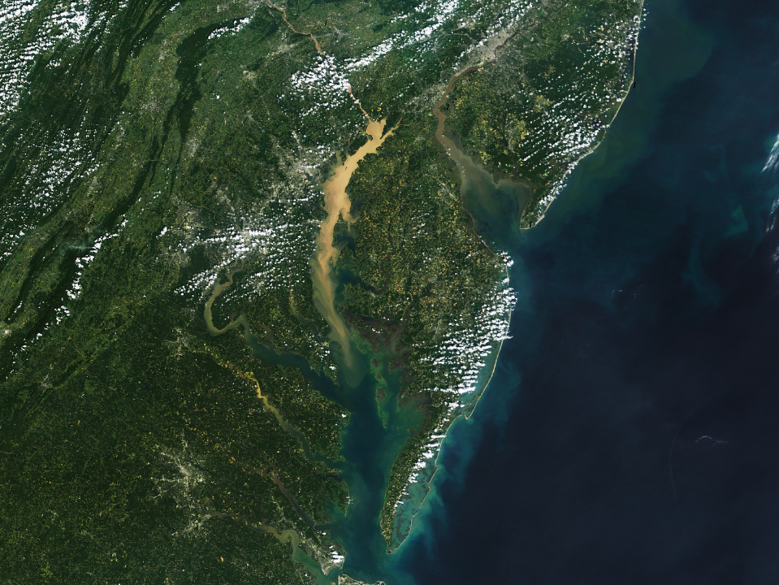
Sediment
Nutrients (phosphorus and sediment)
Fecal coliform bacteria
PCBs (polychlorinated biphenyls)
Notes:
In fact, sediment is one of our greatest challenges!
This photo shows you the magnitude of how sediment affects local rivers and the Chesapeake Bay. This particular photo shows the effects of Tropical Storm Lee in 2011. However, this is fairly typical after very large rain events.
The pollution doesn’t come from just one source – rather from literally thousands of sources, including NPS sites. That is why it is important for all of us to do our part.
In addition to sediment, other pollutants of specific concern for NPS include nutrients, fecal coliform bacteria, and PCBs.

Slide 7
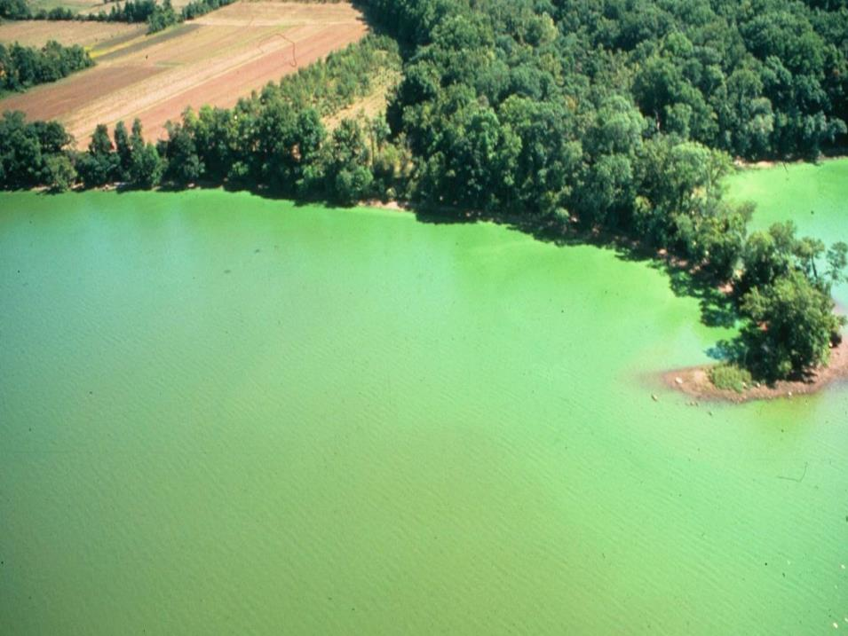
Algae Bloom Caused by Excess Nutrients
Algae bloom in the Occoquan Reservoir – one of
Northern Virginia’s two main water sources.
Chesapeake Bay TMDL Action Plan
Notes:
While the last slide showed the impacts of water pollution at a macro-level, this one shows the impacts on a local level.
This is the Occoquan Reservoir in the 1970s in the middle of a giant algae bloom caused by too many nutrients in the water.
The result is that sunlight is blocked and can’t reach beneficial aquatic plants. Also, when the algae dies, it consumes oxygen in the water, which kills fish and other aquatic species.
Finally, the water is considerably more expensive to treat – which means we all pay more for our water.

Slide 8
Stormwater Jeopardy
Preventing one ton of sediment pollution can be worth $80,000.
TRUE
Pollution costs our region $500 million in lost economic activity and clean up activities each year.
FALSE
The most effective ways to keep our streams clean is to capture the pollution and treat it before it is discharged to a stream.
FALSE
Specific plans have been developed to prevent pollution at the Maintenance Complex and Daingerfield Island.
TRUE
Notes:
Bullet 2 – Based on a recent Bay Foundation study – a restored Bay is worth $130B, which is $22B more than today. That means pollution costs our region $22B in economic activity.

Slide 9
Pollution Prevention Requirements
Notes:
So, what are our pollution prevention requirements?

Slide 10
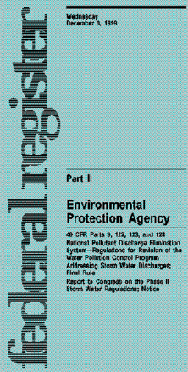
Stormwater Permits
GWMP/CBP operates under a Municipal Separate Storm Sewer System (MS4) permit.
Regulates anything that is discharged from a GWMP/CBP operated stormwater outfall.
The Maintenance Complex also operates under a NPDES industrial stormwater permit.
Notes:
Our parks and their associated operations actually operate under two types of permits. The first is called a Municipal Separate Storm Sewer System, or MS4, permit.
This permit regulates the discharge of anything from a stormwater outfall that is operated by the GWMP/CBP.
In addition, the Maintenance Complex engages in what is considered “industrial activity.” As a result, it is also subject to a National Pollutant Discharge Elimination System (NPDES) industrial stormwater permit.

Slide 11
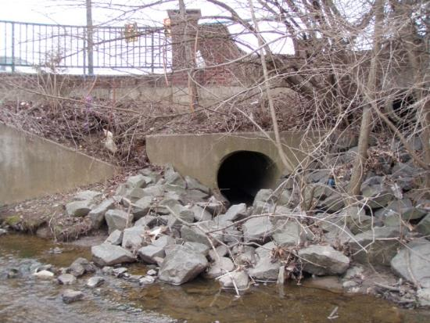
Notes:
The important thing for you to remember is that this stormwater outfall…

Slide 12
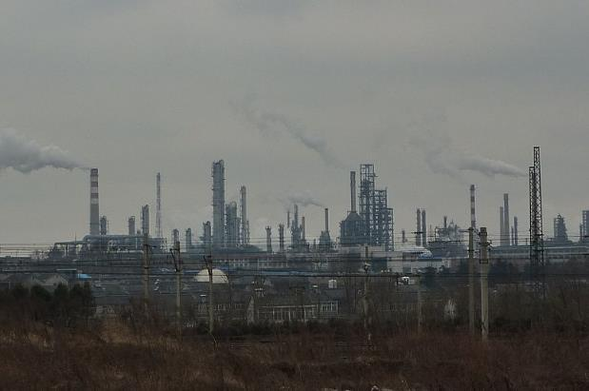
Notes:
…is regulated – including oversight and enforcement – in much the same way as an outfall from this industrial facility.

Slide 13
MS4 Permit Basics
Prohibits all non-stormwater discharges unless explicitly authorized.
Requires the development of an MS4 Program Plan.
Establishes specific documentation and reporting requirements.
Fine of up to $32,500 per violation, per day!
Notes:
While not the focus of this presentation, it is worth taking a few seconds to get better acquainted with the MS4 permit since it applies to everything we do.
First, it prohibits all non-stormwater discharges unless explicitly authorized. So, generally, if it isn’t stormwater, and it isn’t covered under another permit, it shouldn’t be discharged from the system.
Second, it requires GWMP/CBP to develop an MS4 Program Plan. This is the plan that spells out how we will reduce existing sources of pollution and prevent new sources from occurring.
Third, the permit establishes specific documentation and reporting requirements. Basically – trust but verify!
Finally, Virginia, Maryland, and the EPA have the discretion to fine up to $32,500 per violation per day. They definitely prefer compliance, but have the tools to enforce these permits if necessary.

Slide 14
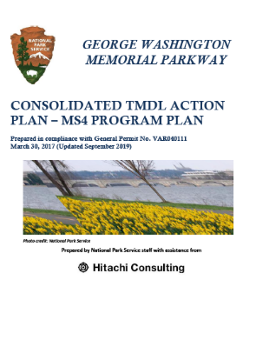
What’s in the MS4 Program Plan?
Six Minimum Control Measures
Public Education and Outreach
Public Involvement and Participation
Illicit Discharge Detection and Elimination
Construction Runoff Control
Post-Construction Runoff Control
Pollution Prevention Good Housekeeping Practices
Notes:
So, what is in the program plan?
All plans must address six minimum control measures. It is then up to each permittee to determine how best to do that based on the activities taking place.
The first two measures – public education and public involvement – are aimed at educating the public about preventing pollution and engaging NPS with the community that uses our parks.
The third – illicit discharge detection and elimination – is about making sure that any discharges other than stormwater are detected and eliminated. This is part of our training today.
The fourth and fifth control measures deal with minimizing pollution during construction activities and putting in place stormwater management structures to treat stormwater before it reaches our streams.
Finally is pollution prevention and good housekeeping. This control measure focuses on what we do as an organization to prevent stormwater pollution. That is, making sure that we “lead by example.”

Slide 15
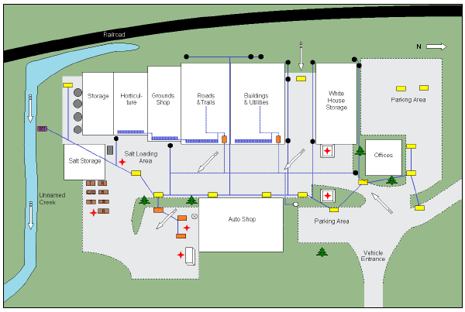
Stormwater Pollution Prevention Plans (SWPPPs)
Facility Description
Potential Pollutant Sources
Procedures and Control Measures
Training, Inspections, and Record Keeping
Notes:
In addition to the MS4 Program Plan, the GWMP is required to develop facility-specific plans where there is a higher-risk of pollutants being exposed to stormwater and entering the MS4.
These plans – known as stormwater pollution prevention plans, or SWPPPs, include a detailed facility description, identification of potential pollutant sources, procedures for reducing the risk of pollution.
These specific plans have been developed for the Maintenance Complex and Daingerfield Island.

Slide 16
Potential Source of Pollution
Notes:
What are potential sources of pollution that you may encounter while at an NPS site?

Slide 17
Maintenance Complex and
Daingerfield Island
Activities | Pollutants
Vehicle and Equipment Storage | Oil Antifreeze Grease Fuel
Equipment Fueling | Gasoline Diesel
Hazardous Materials Storage | Cleansers Paints Solvents Pesticides Lead Acid Batteries
Salt Loading and Storage | Sodium Chloride
Notes:
At the Maintenance Complex or at Daingerfield Island, pollutant sources include those associated with our everyday work.
Vehicles and equipment that are in storage or waiting for maintenance can be a source of oil, antifreeze, grease, and fuel if they are leaking.
The fueling station can become a source of pollution if tanks are overtopped during filling, or if fuel is spilled during the vehicle and equipment fueling process.
Small quantities of hazardous materials used and stored at the site can become sources of pollution if not properly managed.
Salt is also considered a pollutant and is subject to special management requirements. In fact, salt has become such a growing problem in our region that it can actually be tasted in some local water supplies at certain times of the year.

Slide 18
Maintenance Complex and
Daingerfield Island
Activities | Pollutants
Vehicle Washing | Cleansers Oil Antifreeze Grease Fuel
Stockpiles | Dirt and Other Materials
Waste Disposal | Trash Liquids
Notes:
Some other examples of pollution sources include vehicle washing, dirt and other materials washing from unprotected stockpiles, and trash and liquids from dumpsters or other trash receptacles.

Slide 19

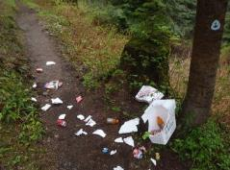

On GWMP/CBP Property
Activities | Pollutants
Vehicles | Petroleum Hydrocarbons Vehicle Parts Wear Trash
Hikers and Bikers | Trash
Dog Walkers | Pet Waste/Bacteria
Notes:
As mentioned, the MS4 permit applies to all property that drains to a GWMP/CBP outfall. This includes pollutants from vehicles, trash from hikers and bikers, as well as bacteria and nutrient-containing pet waste from our four legged friends.
While the sources of pollution are sometimes out of our control, NPS personnel still have a responsibility to act and reduce the impacts to our water resources.

Slide 20
Procedures and Control
Measures
Notes:
Now that we have a better sense of potential pollutant sources, what are the ways that we can minimize – or better yet – prevent them?

Slide 21
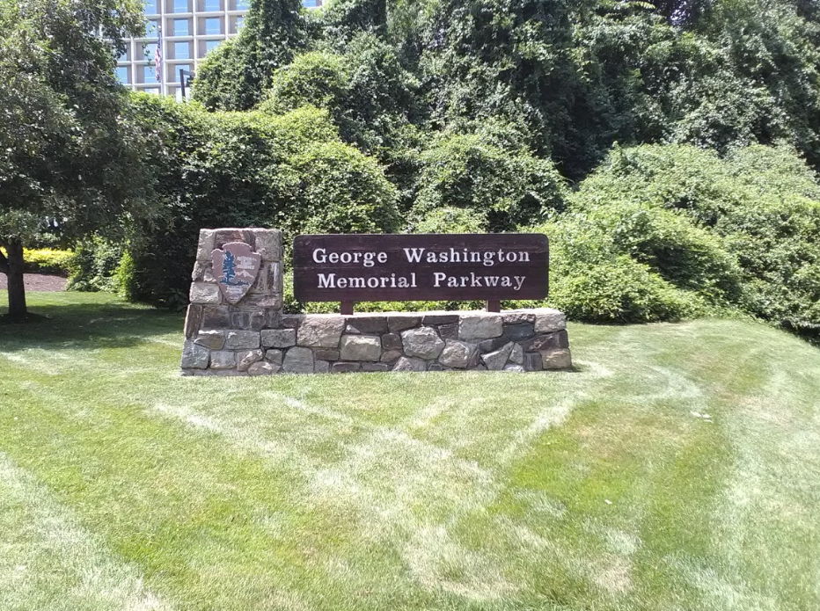
At the Maintenance Complex
Notes:
As mentioned, the Maintenance Complex is subject to very specific controls because of the nature of work being conducted there.

Slide 22
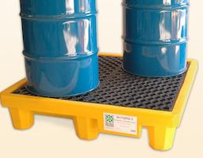
Reduce the chance for contamination.
Conduct maintenance indoors.
Store materials under cover when at all possible.
Keep liquid materials away from bay doors.
Provide secondary containment for all containers.
Ensure that caps and lids fit tight.
Use drip pans for leaks and when changing fluids.
Notes:
The most important thing is to reduce the chance for contamination in the first place.
That means conducting maintenance indoors and storing materials under cover when possible.
Many of the bay doors are equipped with trench drains to capture any spills or leaks before they reach outside. That is a great feature! But for these to be effective, it is important to keep liquid materials as far back from the bay doors as possible.
Secondary containment should be used for all containers. This doesn’t need to be fancy! A simple spill pallet or a flame retardant cabinet are perfect for ensuring that leaks and spills are contained.
Caps and lids should be checked to make sure that they are on tight – and drip pans should be within easy reach to deal with leaks or spills when changing fluids.

Slide 23
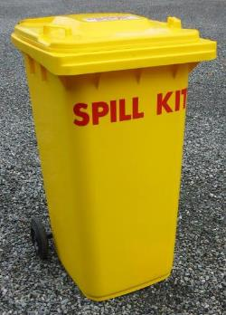
Be prepared for a leak or spill.
Know where your spill kit and safety equipment are located.
Label all hazardous substance containers in plain English.
Clear access to storage drums and other containers.
Notes:
Being prepared isn’t just for Scouts, it is also a very important part of pollution prevention.
Experience tells us that despite our best efforts, spills and leaks happen.
Know where your spill kit is located and make sure that all containers are labeled in plain language. If something spills, you will want to know what you are dealing with.
Finally, keep a tidy work area. Many leaks can go unnoticed if drums and containers aren’t visible.

Slide 24
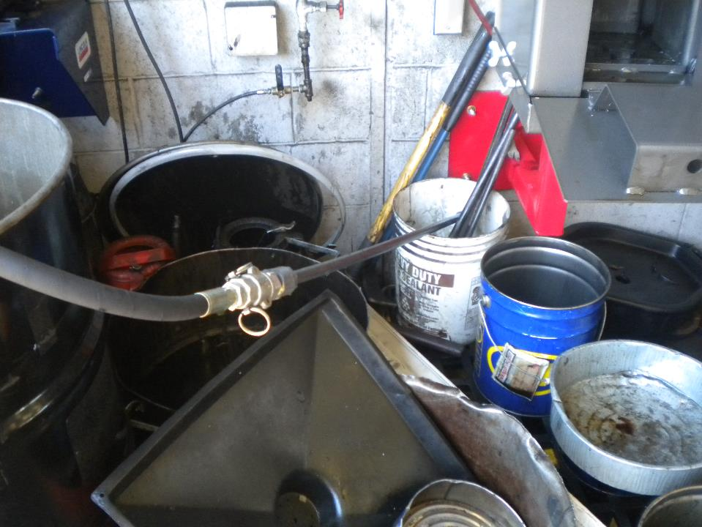
Notes:
This is an example of a work place where it would be very difficult to detect a leak in a timely manner!

Slide 25
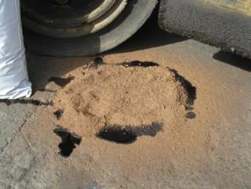
Take ownership of the situation.
Clean up spills and drips promptly.
Sweep up used dry absorb daily and dispose of properly.
Any spill requires attention. There is no minimum amount.
Notes:
Finally. Take ownership of the situation. Most people know when they see something wrong, but figure that someone else will clean it up.
Cleaning up spills is as important, if not more important, than any other part of our jobs.
Take the time to clean up the spill and dispose of it properly. No spill is too small.

Slide 26
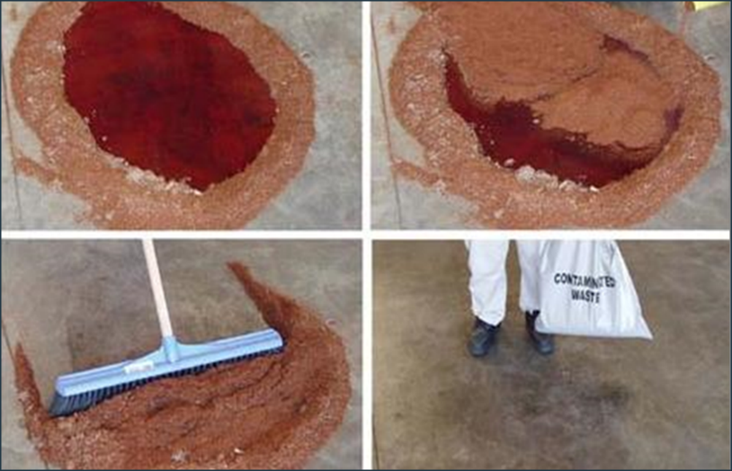
Dealing with small spills.
Notes:
To clean up the spill, first make sure you are using the right protective gear. It is always recommended that you wear gloves when addressing a spill.
Next, spread the absorbent material around the spill to keep it from spreading out.
Apply the absorbent material on top of the spill. There should be enough material to ensure that the entire spill can be absorbed.
The absorbent material should be allowed to sit for at least 10 to 15 minutes – or longer for a larger spill or a spill that has been around for a while.
Finally, use a broom and shovel or dust pan to sweep up the absorbent and place it in an approved container – such as a contaminated waste bag or metal bucket.

Slide 27
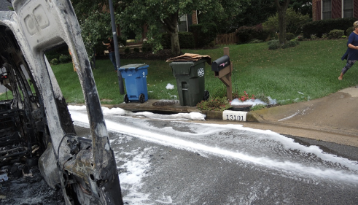
When to call HAZMAT.
Photo Credit: Fairfax County Fire & Hazardous Materials Investigative Services
Notes:
There are some times when it is critical to call in the professionals.
This is the case for any spill that you don’t feel comfortable handling. It also applies to any discharge that enters or could reasonably be expected to enter a local waterway.
In either of these situations, you MUST call 911. When in doubt, make the call!

Slide 28
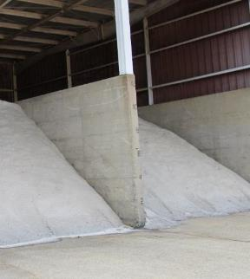
Special requirements for salt management.
Regularly sweep salt and sand into the covered structure after transfers.
Clean up any spills that may occur during transfer of salt to the brine-making area.
Cover the stormwater inlet when brine transfers are made from the mixer to the spray trucks.
Notes:
As mentioned before, salt is considered a pollutant. There are actually very specific requirements for salt storage and transfer in the Maintenance Complex industrial stormwater permit.
The “best” best management practice is already in place – which is to keep the salt under cover. So, your job is to make sure it stays there by sweeping residue back into the structure.
In addition, any spills should be cleaned up as soon as possible.
Finally, stormwater inlets should be covered during transfers of brine from the mixer to the spray trucks in case there is a large spill. If there is a spill, it must be collected and disposed of properly.

Slide 29


Special requirements for wash water.
Notes:
And finally, wash water! Recall that non-residential wash water is considered an illicit discharge.
Washing is only permitted indoors where the water goes to the sanitary sewer system, or outdoors if the water is contained, collected, and properly disposed of.
Any other outdoor washing is a violation of the permit.
NPS has a contract for off-site washing with Mr. Wash, where the water is recycled and disposed of properly.

Slide 30

Most importantly, be observant.
Observe tanks and drums for leaks and corrosion.
Inspect equipment for signs of wear, excessive noise, vibration, etc.
Look for unusual staining.
Investigate and report unusual odors.
Make sure all valves are in proper position.
Check for torn bags or bags exposed to rainwater.
Ensure used absorbents are cleaned up.
Pick up trash and debris.
Notes:
Finally, just be observant! As you walk the site, watch for leaks or corrosion. Listen for excessive noise or vibrations that may be a sign that equipment is malfunctioning.
Look for unusual staining and investigate unusual odors.
Take the time to pick up trash and debris that would enter the system.
Basically, treat your work place as if it were your home.

Slide 31
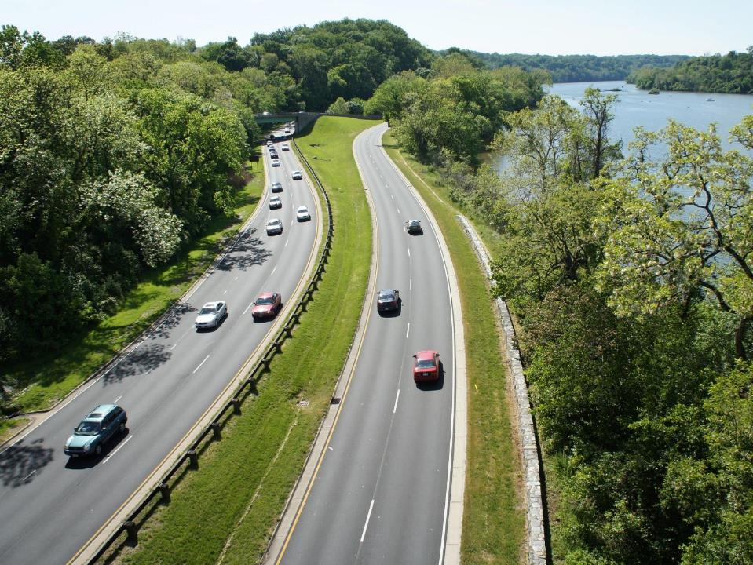
In the Field
Notes:
Many of you also work out in the field.

Slide 32
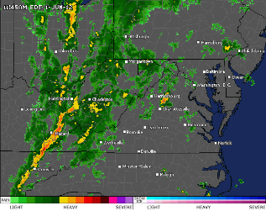
Before you leave…
Check the weather.
Bring a portable spill kit.
Bring brooms and other equipment to clean up loose materials.
Bring a tarp to cover stockpiled materials.
Ask, do I really need it at the site?
Notes:
For you, pollution prevention starts before you even leave.
Take the time to check the weather. If it will be raining, consider changing what you were planning to do if it could result in stormwater pollution.
Bring with you the tools to clean up a spill or loose materials.
If you have stockpiled materials, bring a tarp to protect it from rainfall.
And, ask yourself, do I really need something at the site? If it isn’t on site, it can’t become a source of pollution.

Slide 33
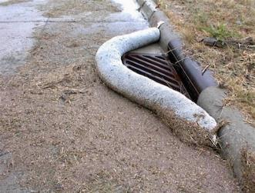
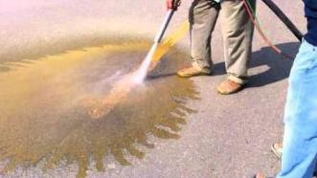
At the site…
Employ inlet protection if working near a storm drain.
Conduct routine site inspections
to observe any problems.
Broom sweep or vacuum surfaces frequently.
If it is necessary to hose or blow
materials, direct them toward a
grassy area.
Materials (including millings and paint chips) must be collected and disposed of properly.
Notes:
When you are at the site, look for where the storm drains are located and work as far away from them as possible. This will give you a chance to react if there is a spill or leak. When you must work close to an inlet, bring a boom or absorbent sock to catch any spills.
If it is necessary to hose or blow materials – direct them toward a grassy area, where it can infiltrate into the soil.
Finally, observe that famous hiking phrase “Leave No Trace.” If you have created millings, slurry, or paint chips, you must collect them and dispose of them properly.

Slide 34

Pesticides and Herbicides
Staff and contractors MUST be properly state certified.
Use method least likely to result in pollution.
Limit spraying to the problem area.
Do not apply if windy.
No spraying within 50 feet (or more if possible) of a water feature.
Notes:
Pesticides and herbicides are also potential sources of pollution out in the field. Remember, you must be state certified to apply these chemicals.
If you are certified, make sure to use the method least likely to result in pollution – beginning with whether something can simply be manually removed.
Spray should be limited to the immediate problem area and windy days should be avoided.
Finally, you should not spray near a water feature – leaving at least a 50 feet or more buffer.

Slide 35
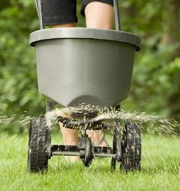
Fertilizers
Apply fertilizers only if necessary.
Adhere to the manufacturer’s recommended application rates.
If an area is greater than one acre, STOP! A nutrient management plan is required.
Notes:
Fertilizers are a source of nutrients – another big challenge for our local water resources and the Chesapeake Bay.
Fertilizer should only be applied if necessary an in accordance with the manufacturer’s recommendations.
If you are applying to a contiguous area of more than one acre – STOP! The permit requires the development of a nutrient management plan prior to any application.

Slide 36
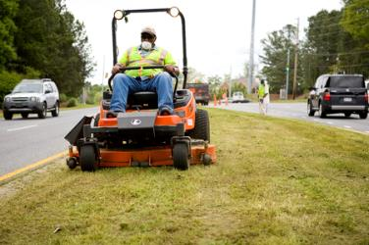
Mowing
Direct clippings away from impervious areas when possible.
Never purposefully blow or dump clippings into storm drain inlets.
Notes:
Grass clippings from mowing can also be a source of nutrients and can clog storm drains.
While not always possible, the operator should try to direct clippings away from the road or other impervious areas.
Clippings should never be purposefully blown down the storm drain inlet.

Slide 37
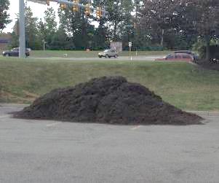
Sand, Dirt, and Gravel
Minimize the amount and time of storage.
Store under cover when possible.
Sweep area around the pile frequently.
Locate piles away from inlets.
Provide inlet protection.
Notes:
Temporary storage of sand, dirt, and gravel on a site is a normal part of landscaping and other maintenance activities.
The amount should be the minimum necessary and should be stored under cover when possible – especially if there is rain in the forecast.
The pile should be located away from inlets and the area swept frequently to keep materials from migrating away.

Slide 38
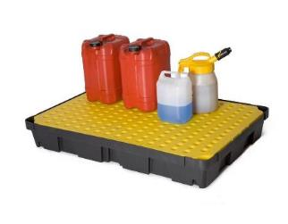
Liquid Storage
Place containers on a paved surface.
Place away from storm drain inlet.
Ensure that the containers are away from active vehicular traffic.
Keep a spill kit in close proximity.
Notes:
Finally, if you have liquids on site – such as paint, cleaners, or fuels, these should be placed on a paved surface to make it easier to clean up any spills.
Place them away from the storm drain inlet and make sure that they are located away from vehicular traffic.
And, of course, keep a spill kit on hand.

Slide 39
Let’s Review!
Notes:
So, let’s review!

Slide 40
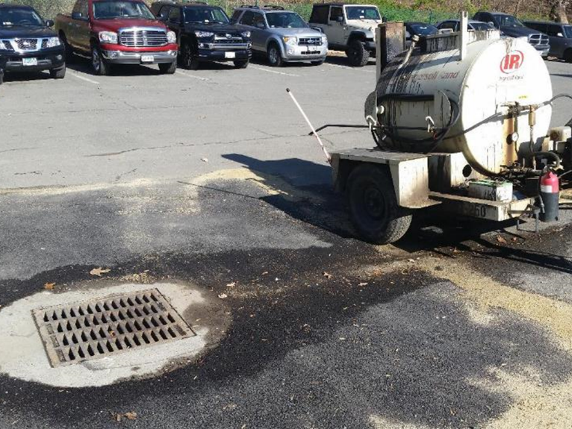
Allowed to leak for an extended period of time.
Located too close to a storm drain.
Notes:
What went wrong in this picture?
There are two things going on here. First, equipment was allowed to leak for a long period of time.
Second, the equipment was parked near a storm drain, which reduces the amount of time needed to react.

Slide 41
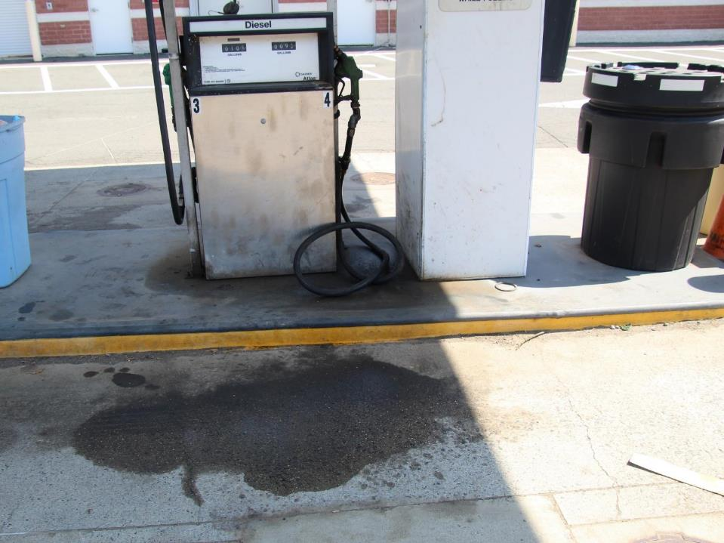
Fuel spill.
No attempt to clean up.
Dispose of used absorbent material properly.
Notes:
What’s wrong here?
This one is easy – someone spilled fuel but didn’t bother cleaning up afterwards.
Equally as common is that someone puts down absorbent material, but then fails to sweep it up later. It is important to make sure that the job is completed.

Slide 42
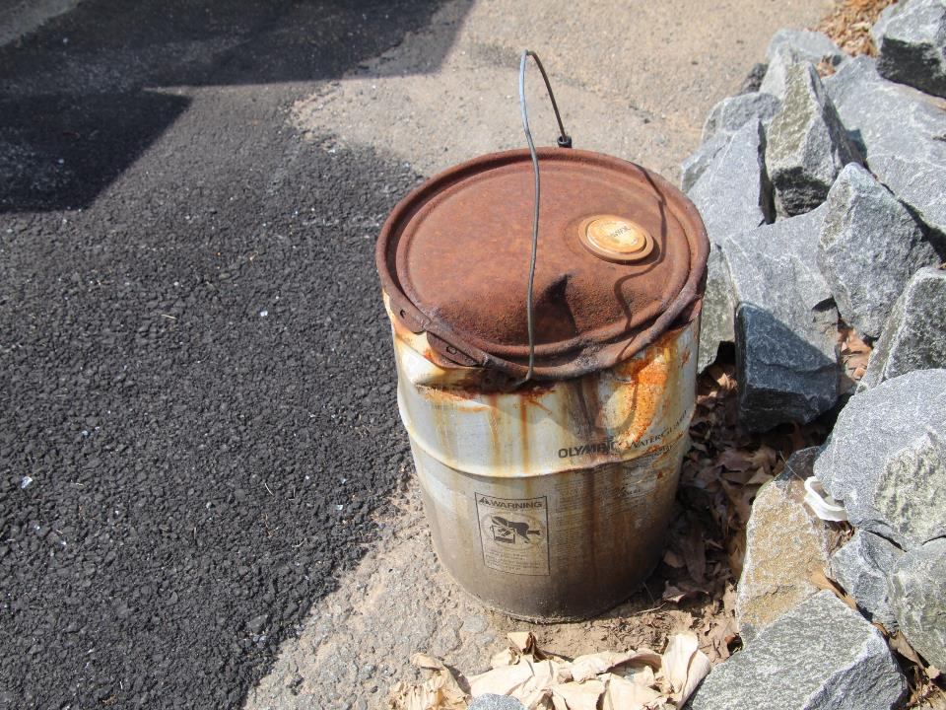
Even undamaged containers should be stored inside or provided secondary containment.
Damaged container should be immediately dealt with.
Notes:
How about this one?
First, cans and drums should be stored inside, or at least be provided secondary containment.
In this case, the can is also damaged and should not be in use at all.

Slide 43
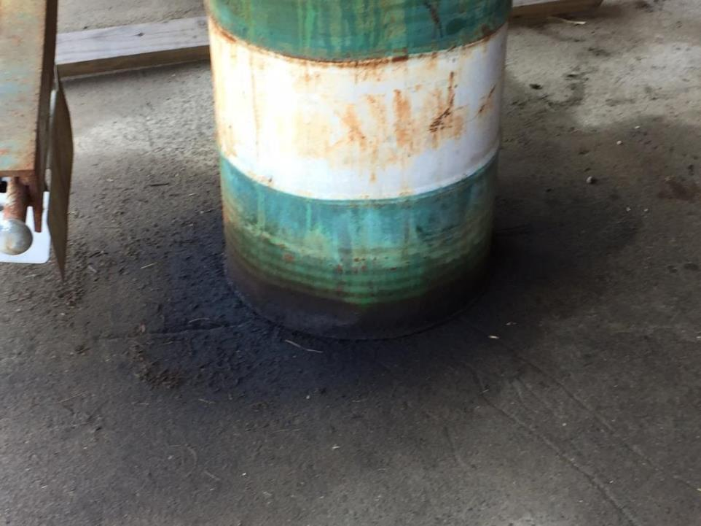
Containers should be stored inside or provided secondary containment.
Either staff weren’t observant, or no one took the initiative to take action.
Notes:
What about this one?
This is a similar situation. This drum should be inside or provided secondary containment.
In addition, the drum has obviously been leaking for a long period of time, but no one took any action.

Slide 44
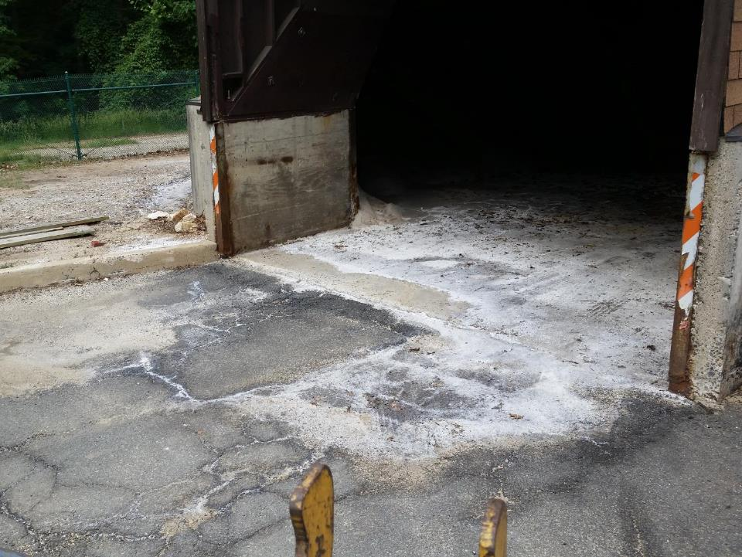
Salt must be swept back into storage areas to prevent mixing with stormwater after winter events.
Notes:
Here we have the loading/unloading area for salt spreaders.
In this case, the salt was not swept back into the barn.
As a result, it mixed with stormwater and migrated from the facility.

Slide 45
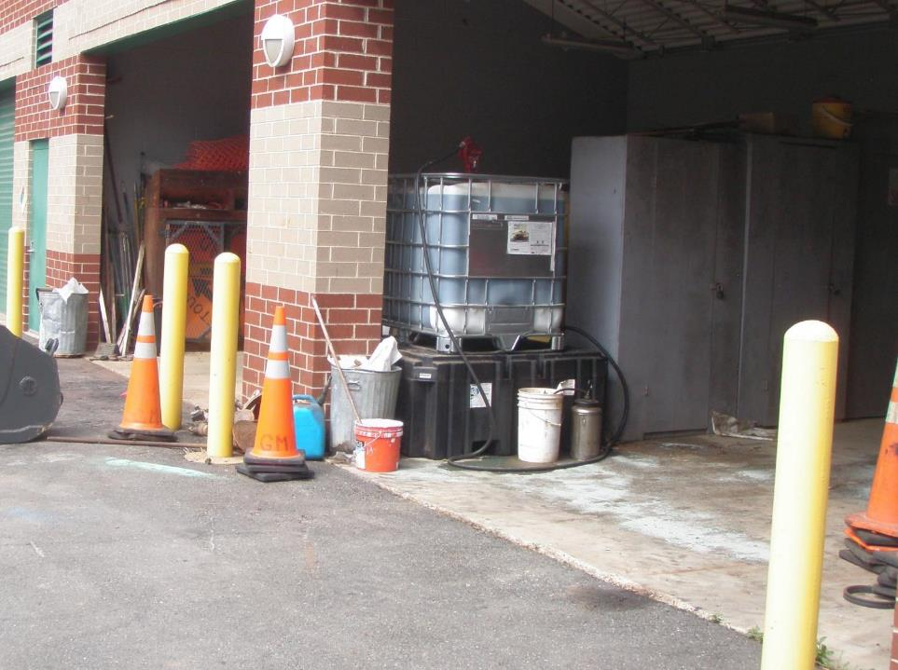
Liquids are stored too close to the bay door.
Containers should be moved back to ensure any leak or spill remains in the building.
Notes:
Why is this a concern?
These materials, while “technically” inside, are too close to the bay door. If they spill, they will almost certainly flow outside of the facility.
Personnel should move these materials back from the bay door to provide time to react and to allow trench drains to work.

Slide 46
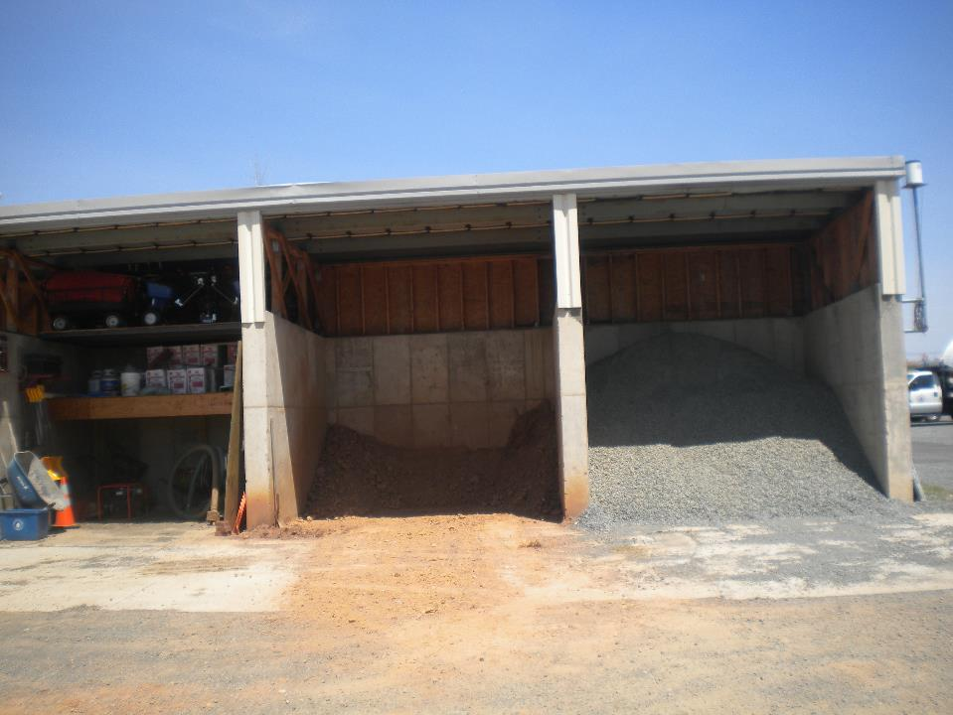
Covered storage bins are a great practice.
Materials must be swept back in after each day of use or prior to a rain event.
Notes:
How about this one?
The covered bays are a good practice – but only as long as the materials stay under the roof line.
Once work is complete, dirt and other materials need to be swept back into the storage area.

Slide 47
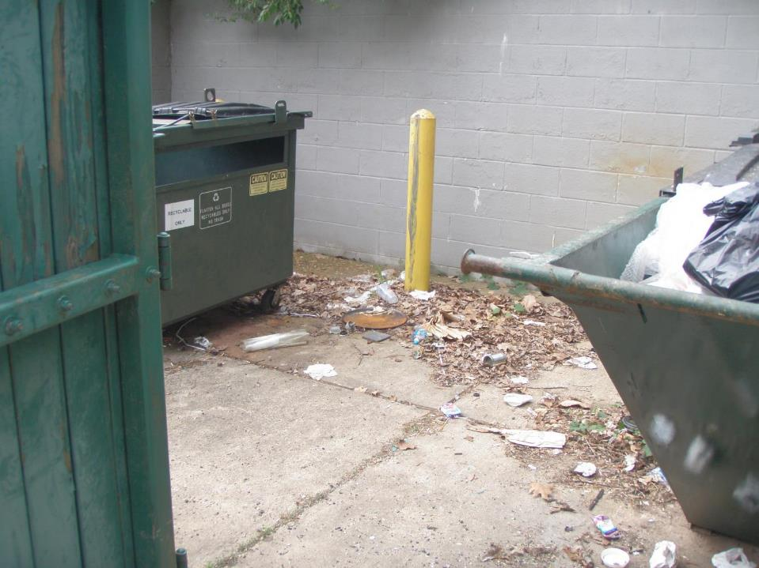
Keep trash bins and dumpster tops closed.
Frequently clean up any loose trash or debris.
Notes:
Finally – how about this one?
Trash and litter is a pollutant – and the EPA and state regulators are turning their attention on this.
Dumpster tops should remain closed when not in use to prevent loose materials from blowing out and stormwater from mixing with trash.

Slide 48
Recognition and Reporting of Illicit Discharges
Notes:
While you have lots of control over what you do while you work, you have less control over what others may do on NPS property.
But remember, if it is being discharged from National Park Service pipe, it is our legal responsibility to react.
So, part of your job is to be the eyes and ears of NPS by reporting potential illicit discharges.

Slide 49
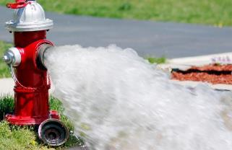
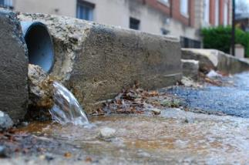
What is allowed?
Water line flushing
Landscape irrigation
Discharges of potable water
Foundation and footing drains
Air conditioning condensation
Water from crawl space pumps
Individual residential car washing
Dechlorinated swimming pool discharges
Street wash water
Notes:
So the first question is, “What is allowed.”
The answer is, not much!
Water line flushing, land scape irrigation, and things like that are allowed.
Individual residential car washing is allowed – but remember, no other kind of washing is allowed without a separate permit.
Swimming pool discharges are allowed, but only if it has been properly dechlorinated.

Slide 50
What is an illicit discharge?
Everything else that is not covered by a separate state or federal permit.
Notes:
So what is an “illicit discharge?”
Basically, anything else that is not on that list and that is not covered by a separate permit.

Slide 51
Signs of an Illicit Discharge
Some illicit discharges are obvious – but not always!
The key is to be observant.
Is the water discolored, sudsy, or oily?
Is there an unusual odor?
  Petroleum?
  Rotten Eggs?
  Sewage?
  Rancid/sour?
  Chlorine?
Are there deposits or stains visible?
Notes:
Not all illicit discharges are immediately obvious. The key to finding an illicit discharge is to be observant.
Is there an unusual odor?
Is the water discolored, sudsy or oily?
Are there deposits or stains visible that indicate something other than water came out of a pipe?
Here are some examples that you may encounter at Park Service sites or out in the community.

Slide 52
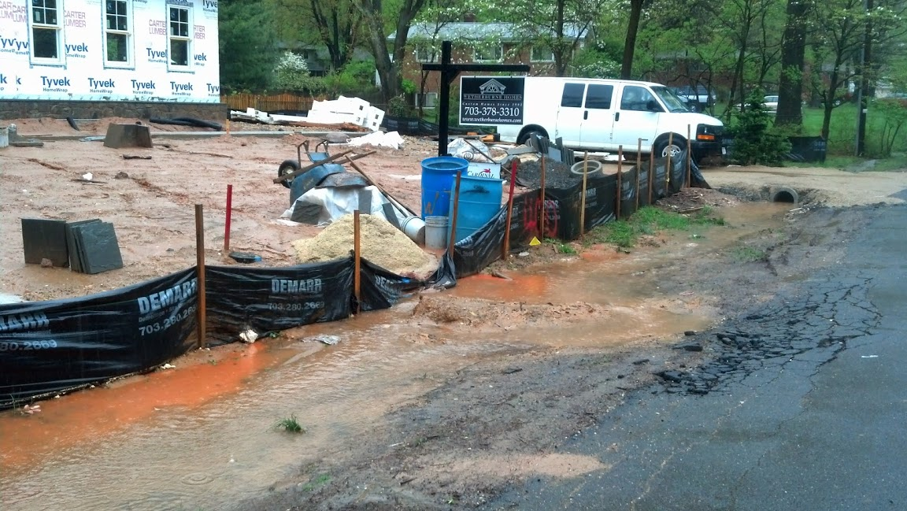
Construction Site Runoff
Notes:
Construction site runoff is one of the most common sources of illicit discharges.
Remember, sediment is one of the major pollutants of concern for the National Park Service.
On this site, silt fencing has failed and is allowing sediment to leave the site unfettered.

Slide 53
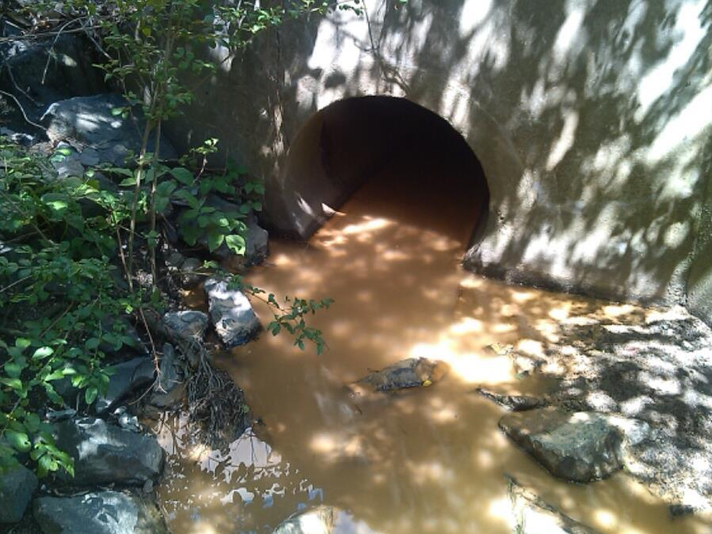
Construction Site Runoff
Notes:
And this is where the sediment goes once it leaves the site – right to the local stream.

Slide 54
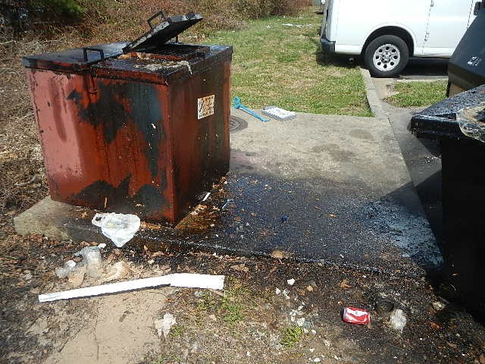
Restaurant Grease
Restaurant Grease
Notes:
Restaurant grease is another common source of pollution. Typically, it enters the storm drain as a result of spills and leaks from grease containers.
In some cases, kitchen facilities are improperly connected to the storm sewer system.
Either way, grease is a serious pollutant and should be reported.

Slide 55
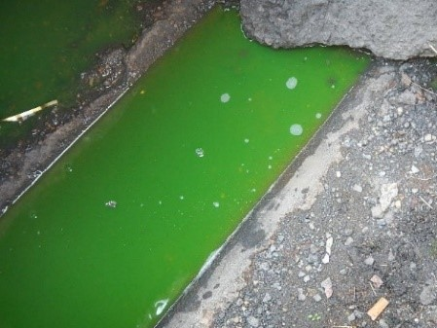
Chemical Discharge
Notes:
It isn’t really clear what this is! It could be used antifreeze or some other kind of chemical.
What is for sure is that unless it is part of a Saint Patrick’s Day celebration, it shouldn’t be in the stormwater.

Slide 56
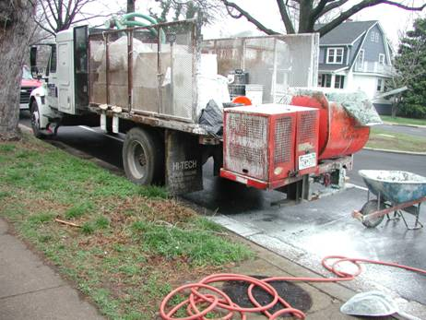
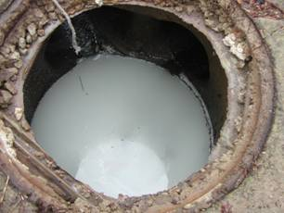
Residential/Commercial Contractors
Notes:
While most contractors dispose of their waste properly, some do take shortcuts.
In this case, a contractor is inappropriately mixing grouting that is subsequently hosed down to clean the street.

Slide 57
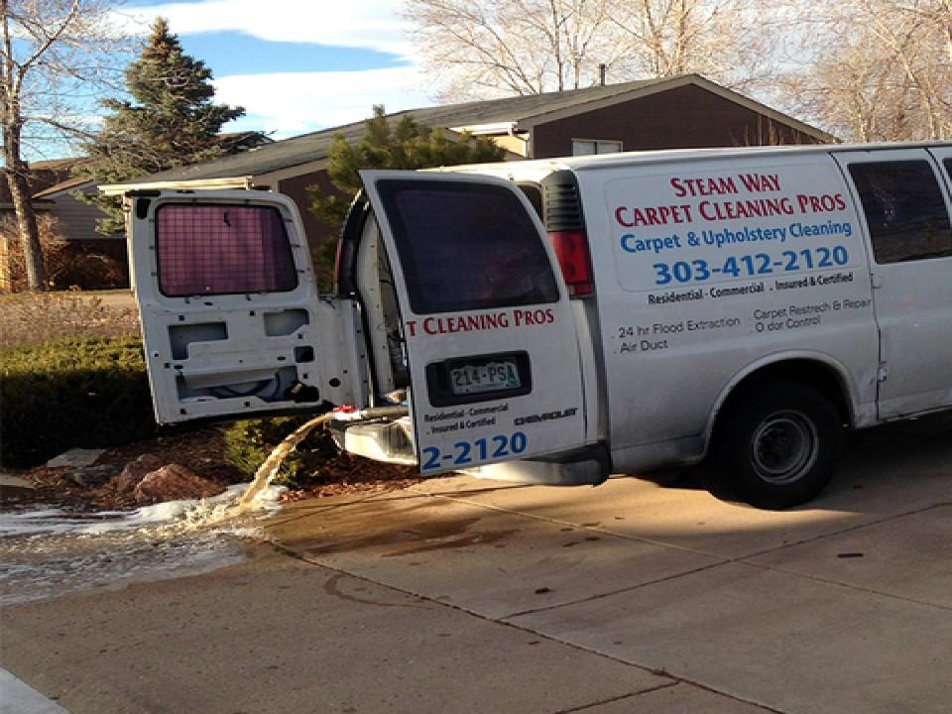
Residential/Commercial Contractors
Notes:
Here is another example of a contractor dumping materials into the storm drain.
In this case, it is a carpet cleaning company disposing of wash water.

Slide 58
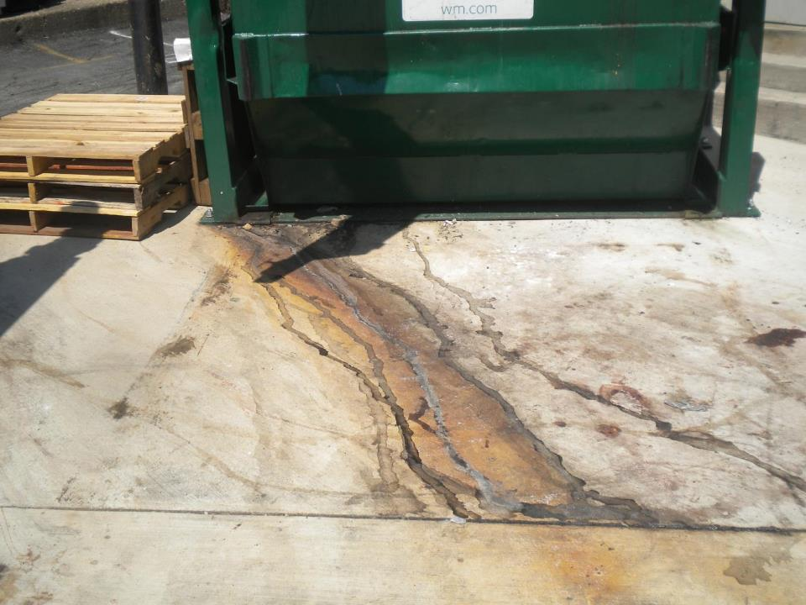
Dumpsters
Notes:
Just like dumpsters can be a source of pollution on Park Service property, they can also be a source of pollution on private property.
While some leakage is likely, cases of significant leakage should be reported.

Slide 59
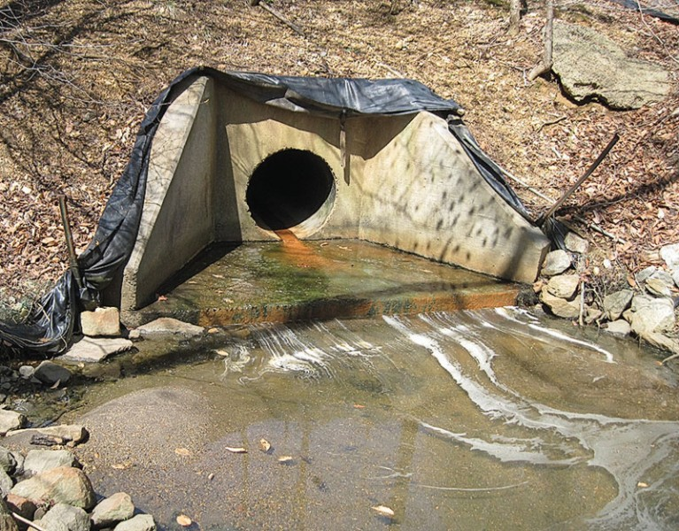
Multiple Potential Illicit Discharges
Notes:
This outfall has it all!
Signs of illicit discharges include the red film, excess algae growth – indicating potential sources of nutrients or sewage – and foam – indicating potential wash water or connection to the sanitary sewer system.

Slide 60
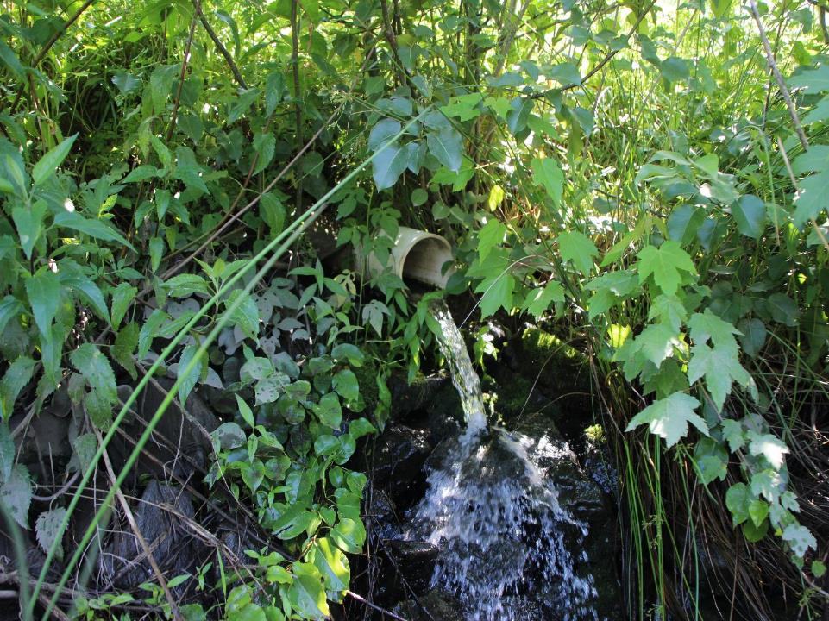
Dry Weather Discharge from a Non-Standard Pipe
Notes:
And finally, another indicator of a potential illicit discharge is a dry weather discharge.
Many larger pipes will have some level of flow all year long. That can be completely normal.
In those instances, simply check for unusual stains or odors.
However, non-standard pipes, like this white PCV pipe, should immediately raise alarm bells since it is likely coming from inside a building.
The bottom line is – when in doubt, report it.

Slide 61
What if I find a potential illicit discharge?
Observe where it is coming from.
Take photos.
Capture a sample (if safe).
Report the discharge immediately to the appropriate personnel.
All illicit discharges must be logged and annually reported to state regulators.
Notes:
What do you do if you find a potential illicit discharge?
Take a photo and mark the time.
If you can safely capture a sample, that is great! Many discharges are intermittent, and having a sample will allow it to be tested.
Then, report the discharge immediately to the appropriate personnel.
The MS4 permit requires that illicit discharges are logged and annually reported to state regulators – along with what was done to investigate and correct any illicit discharges.

Slide 62

Contact for Illicit Discharges
Rob Mocko
(703) 289-2500
Robert_Mocko@nps.gov
Park Police Non-Emergency
(703) 285-1000
Emergencies
911
best person to contact is myself (emails or 703-289-2500) or Park Police non-emergency (703-285-1000).
Notes:
If it isn’t an emergency, you can either contact Rob Mocko or the Park Police non-emergency number.
If it is an emergency, call 911 immediately.

Slide 63

Thank you! We are happy to answer your questions.
(Photos by Will Parson, Ft. Smallwood photo courtesy Karin Dodge/Maryland Department of Natural Resources)
Notes:
Thank you for your time! Together, we can do our part to protect our water resources for future generations.
If you have any questions, feel free to contact your site supervisor or Rob Mocko.

