Slide 1
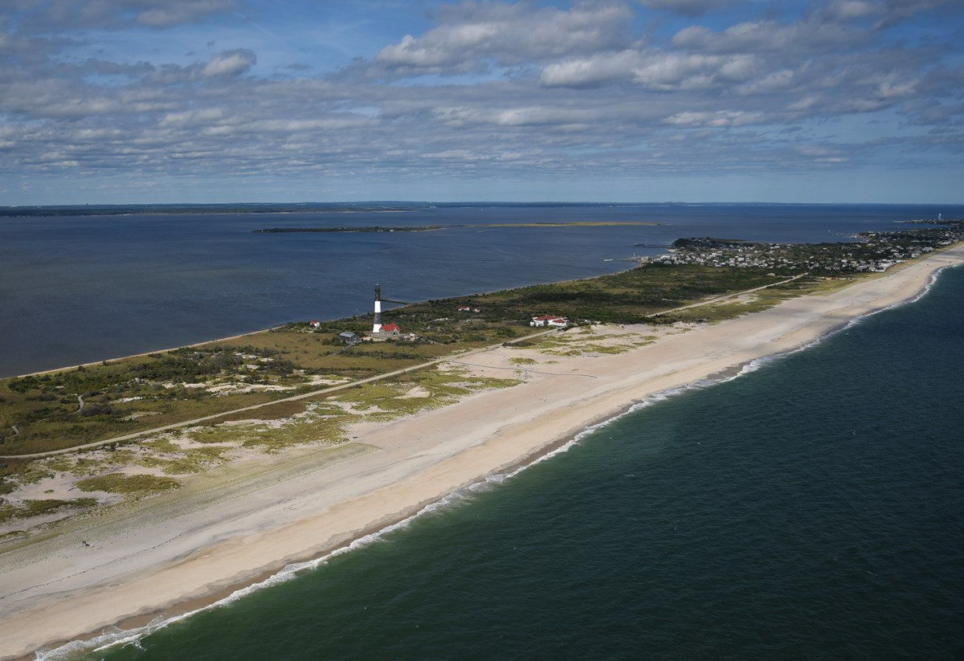

US Department of the Interior
National Park Service
Fire Island National Seashore, New York:
Off Road Vehicle Management
Civic Engagement Meetings
May 5 and 6, 2022
Notes:
(Michelle)

Slide 2
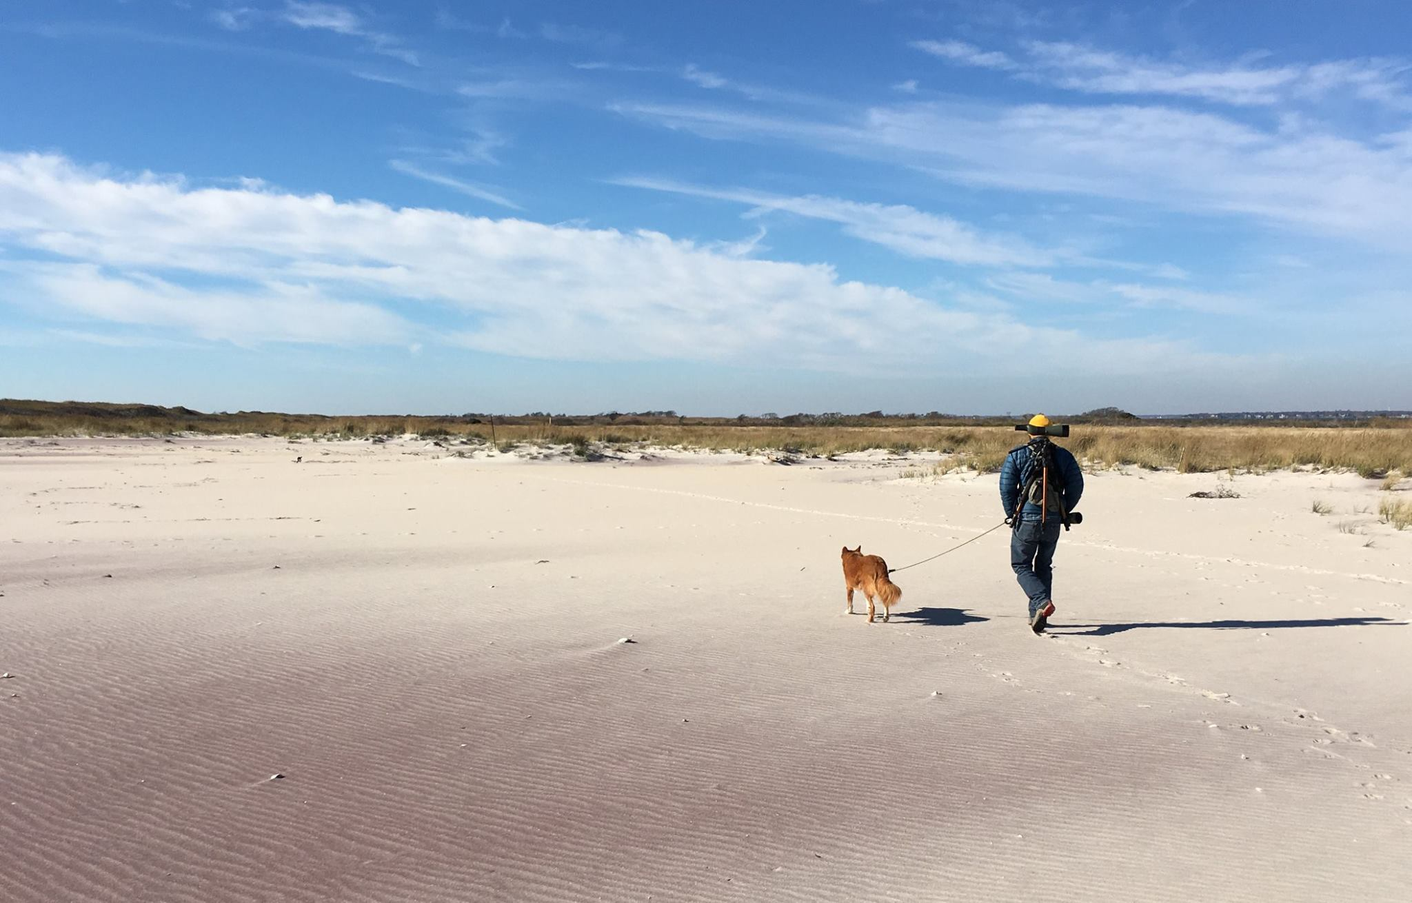
Welcome!
Off-Road Vehicle Management
Fire Island National Seashore
US Department of the Interior
National Park Service
Purpose of Today’s Meeting
Introductions and Meeting Logistics
Presentation
    Overview of ORV Driving Management
    Preliminary Proposed Action
    The Planning Process
  Question and Answer Session
Notes:
(Michelle)

Slide 3
Project Staff on Today's Webinar
Off-Road Vehicle Management
Fire Island National Seashore
US Department of the Interior
National Park Service
Alexcy Romero – Superintendent, Fire Island National Seashore
Lindsey Kurnath – Deputy Superintendent, Fire Island National Seashore
Jason Pristupa – Chief of Administration, Fire Island National Seashore
Sonia Taiani – Management Analyst, Fire Island National Seashore
Michael Bilecki– Chief of Resources Management
Michelle Carter – NEPA Project Manager, Environmental Quality Division
Notes:
(Michelle)

Slide 4
How to Provide Formal Comment
Off-Road Vehicle Management
Fire Island National Seashore
US Department of the Interior
National Park Service
Ways to provide formal comments on the project:
NPS Website
In-person at public meeting on May 6
In writing by mail at 120 Laurel Street, Patchogue, NY 11772
Comments will be accepted through May 20, 2022
Details at end of presentation
Notes:
(Michelle)
Slide shown again at the end – with more detail.

Slide 5
Overview of Off-Road Vehicle Driving Management
Off-Road Vehicle Management
Fire Island National Seashore
US Department of the Interior
National Park Service

Slide 6
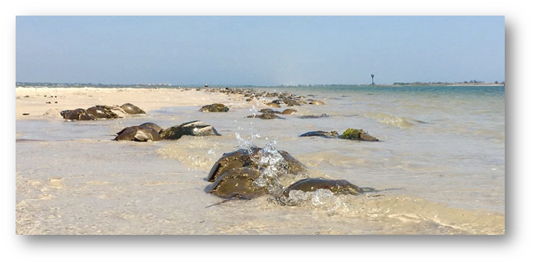
Establishment of Fire Island National Seashore (FIIS)
Off-Road Vehicle Management
Fire Island National Seashore
US Department of the Interior
National Park Service
“For the purpose of conserving and preserving for the use of future generations certain relatively unspoiled and undeveloped beaches, dunes, and other natural features within Suffolk County, New York, which possess high values to the Nation as examples of unspoiled areas of great natural beauty in close proximity to large concentrations of urban population” Public Law 88-587 (1964)
Notes:
(Mike)…..and in 1980 Congressed passed and the President signed Public Law 95-625 establishing the Otis Pike Fire Island High Dune Wilderness area which extends from just east of Watch Hill almost 7 miles east to Smith Point County Park

Slide 7
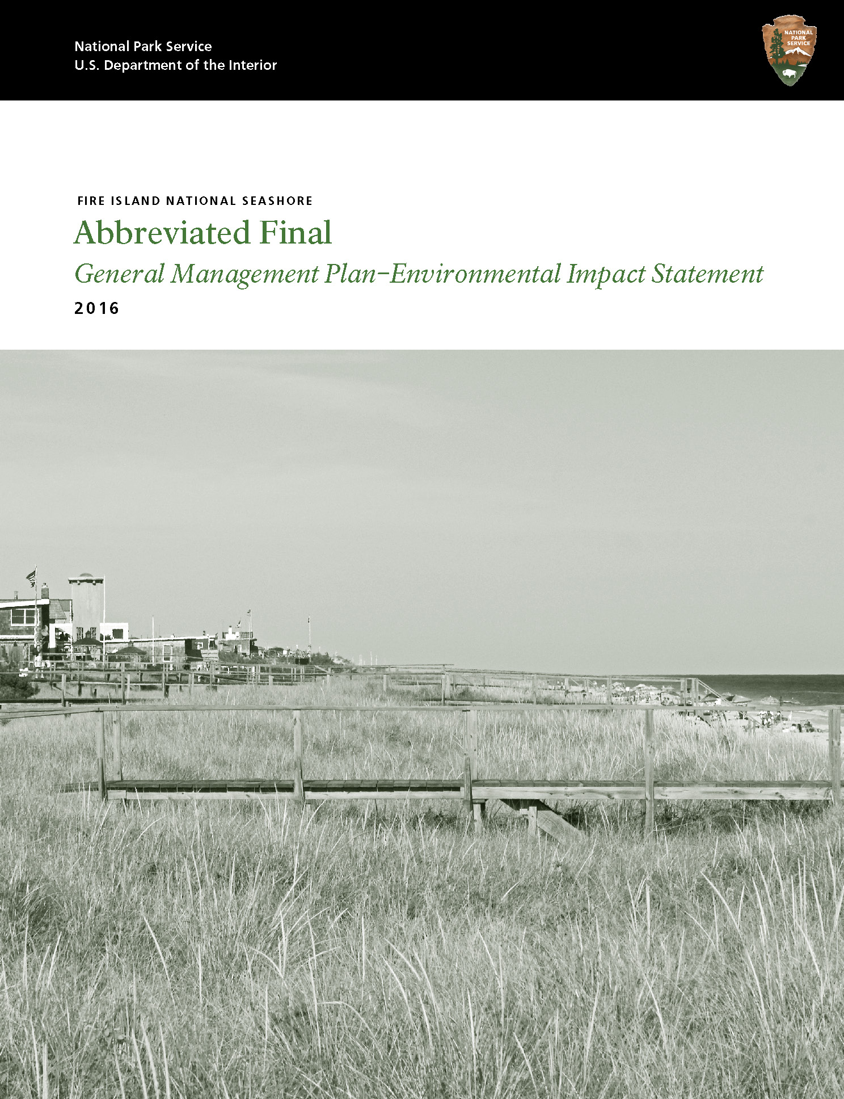
Fire Island National Seashore: General Management Plan
Off-Road Vehicle Management
Fire Island National Seashore
US Department of the Interior
National Park Service
“Preserve the “roadless” character of Fire Island and ensure that water-based transportation is the primary form of access to Fire Island whenever and wherever feasible.”
Collaborate to support a roadless environment and maintain water-based transportation
Use regulations to manage vehicle access on Fire Island
Notes:
(MIke)
UPDATE: →
The enabling legislation - value and need for protection of the environment on Fire Island. - recognition that the result of the grassroots effort by the communities and stakeholders helped create Fire Island NS.
The General Management Plan was finalized in 2016 – it details the collaboration between the 7 layers of jurisdiction on Fire Island – (you'll see those jurisdictions on a map within the next few slides)
The GMP also recognized the importance of the communities roles as stewards in the protection of Fire Island's “roadless character”...

Slide 8
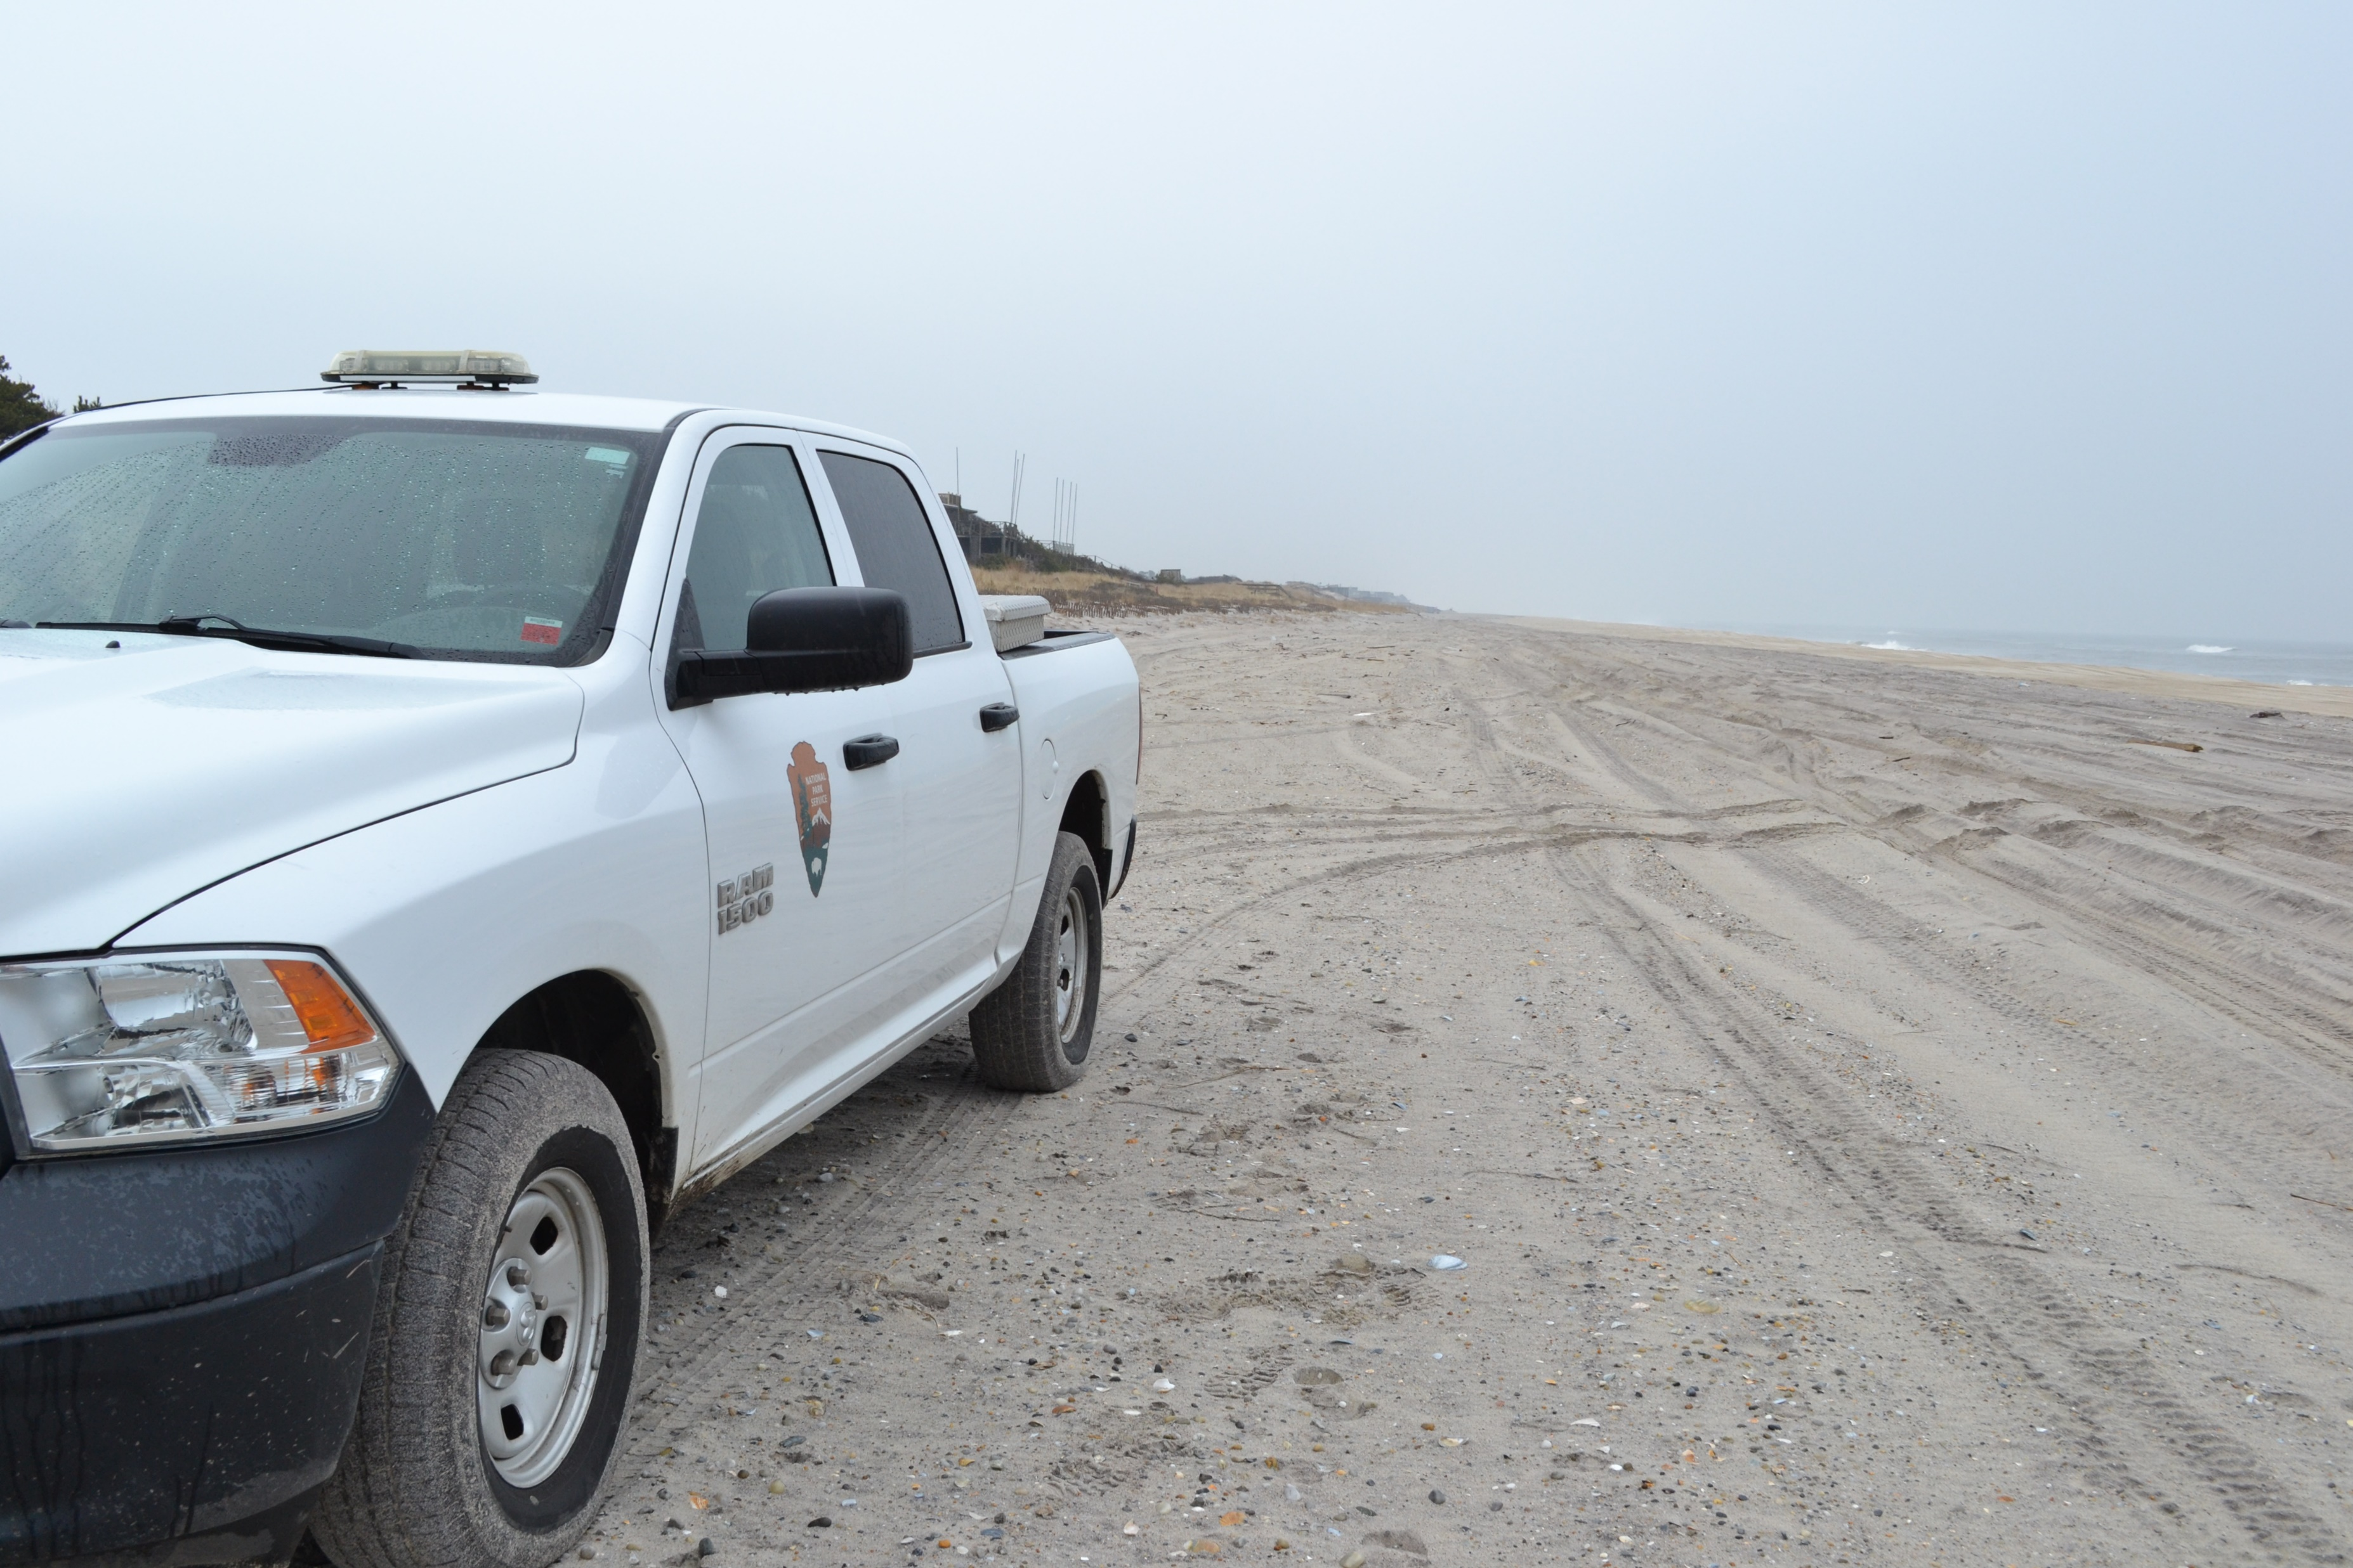
Current ORV Driving Regulation 36 CFR 7.20(a) - Overview
Off-Road Vehicle Management
Fire Island National Seashore
US Department of the Interior
National Park Service
    Defines the regulations for over-sand driving on NPS lands on the Fire Island National Seashore
    First developed in 1977 and amended in 1987, most key requirements have remained the same since
    Intended to protect the natural and cultural resources and visitor experience while allowing access to privately owned properties within the seashore
Notes:
(Sonia)
A Regulation allows for a particular use, and in our case, our ORV driving regulation allows for driving across federal lands and we manage it through a permitting system

Slide 9
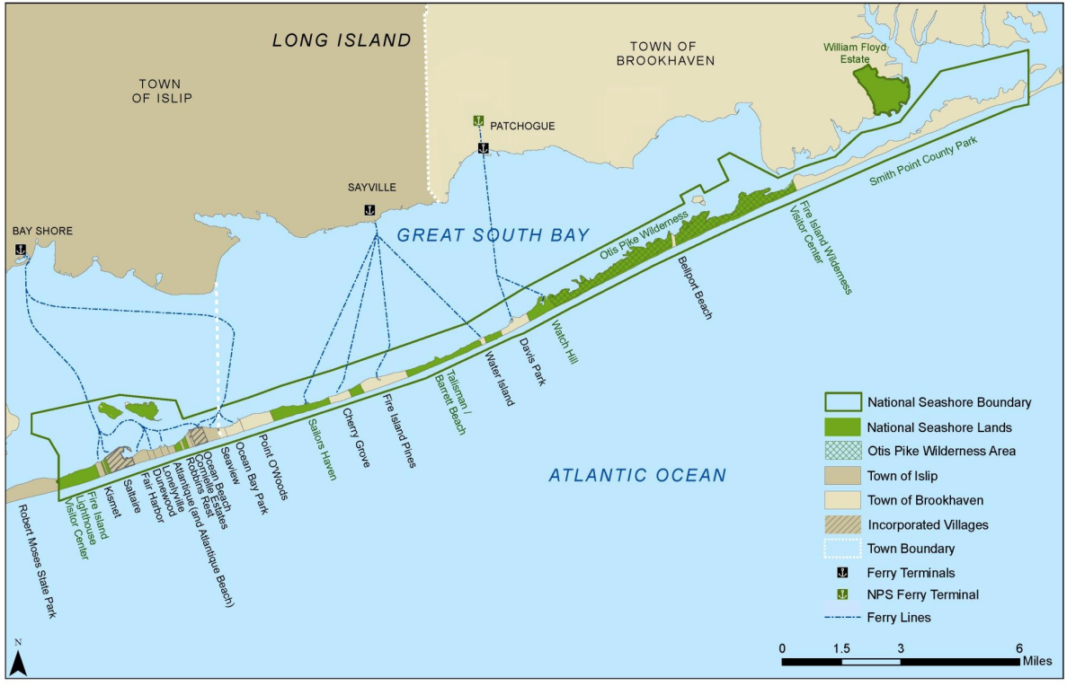
Seashore Map and Resources
US Department of the Interior
National Park Service
The Seashore:
Multiple Resources and Uses
Breach
/ FI Summer Club
Source of map: Volpe Center (with modifications)
Notes:
(Lindsey)
Main Message: NPS balances between multiple Resources and Uses
OLD – UPDATE? →:
7 layers of jurisdiction = at least 7 competing interests and missions that often do not align further requiring everyone within the boundaries of the national seashore to work together to manage our shared resource. It is not common in national parks to have this number of jurisdictions and varying uses. But the beauty of our complex mosaic of uses is that there is something for everyone on Fire Island. Between its collection of natural tracts and park lands to the vary characters of each community- there's something for everyone and protecting it needs to be balanced.
7 layers
Federal (NPS,FWS, ACOE)
State (Tribal)
County
Town (brookhaven/islip)
Village
Hamlets
Non-Profit (TNC)

Slide 10
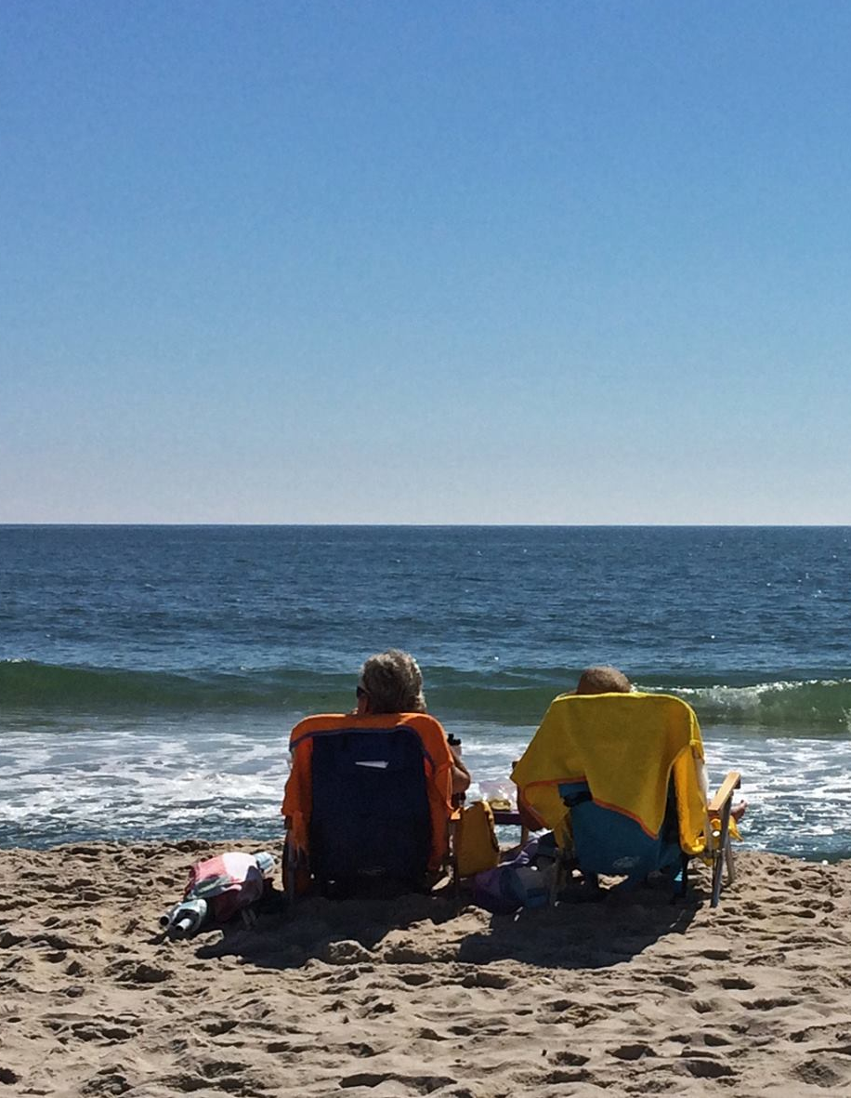
Primary Goals and Objectives
Off-Road Vehicle Management
Fire Island National Seashore
US Department of the Interior
National Park Service
Support A Roadless Character — for long-term sustainability of seashore’s natural and cultural resources, while providing essential access to communities
Protect visitor use and experience and visitor safety — to provide a safe experience for seashore visitors, especially during periods of high visitor use
Update and clarify the permitting process
Notes:
(Lindsey)
Primary goals and objectives for revised regulation for ORV Management

Slide 11
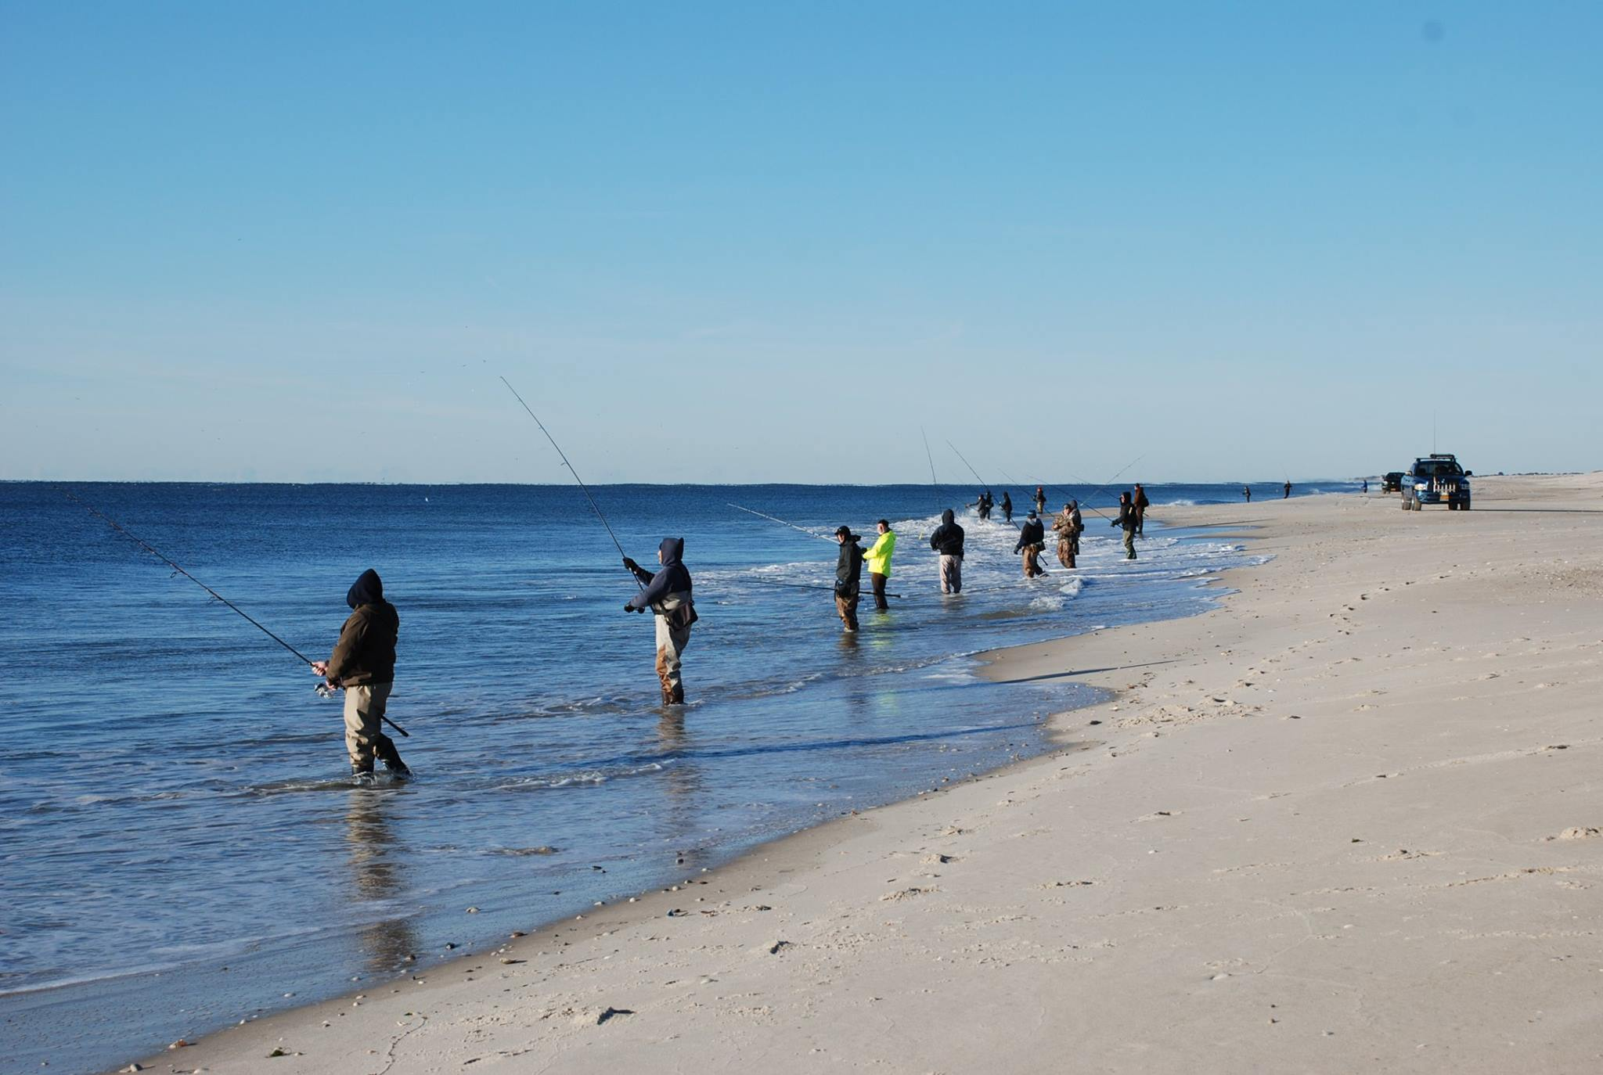
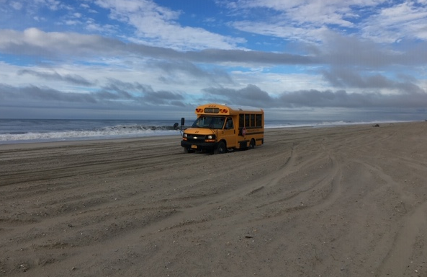
Preliminary Purpose and Need
Off-Road Vehicle Management
Fire Island National Seashore
US Department of the Interior
National Park Service
Purpose:
  Evaluate ORV use at the seashore and to review the existing ORV regulation to allow for appropriate vehicular access while protecting park resources and visitor experience
Need:
  Address changes to resources and use on the island since 1987 regulation
Notes:
(Lindsey)
PURPOSE (preliminary)
Evaluate ORV use at the seashore and to review the existing ORV regulation to allow for appropriate vehicular access while protecting park resources and visitor experience
To be consistent with the seashore’s enabling legislation.
Premise of ORV program that waterborne transportation is the primary means of transport to Fire Island and the communities.
NEED (preliminary)
Address changes to resources and use on the island since 1987 regulation.
Vehicle access and use patterns have changed because of dynamic nature of barrier island (incl. breach from Hurricane Sandy in 2012).
Updated regulation should provide flexibility as conditions continue to change. Revisions are further needed to update and clarify the process for driving permits.
Applicants are concerned that there are not enough permits, especially for residents, and confirming residency status can be problematic.

Slide 12
Preliminary Proposed Action
Off-Road Vehicle Management
Fire Island National Seashore
US Department of the Interior
National Park Service

Slide 13
Preliminary Proposed Action #1: Driving Permits
Off-Road Vehicle Management
Fire Island National Seashore
US Department of the Interior
National Park Service
Driving Permits
Permit Categories
No Caps
Roundtrips through the gate per day
Number of Permits
Notes:
(Alex)
I will discussing the preliminary Proposed Action
I want to emphasize again the word PRELIMINARY – this is not final action hence why we need your feedback on the language we developed
This is all part of the civic engagement and comment period, to hear your reaction and thoughts to Preliminary Proposed Action
As many of you know and have been part of the discussions – what I heard sitting in my chair as superintendent is
We need to attract younger families to our communities
Need to enroll more students to the FI school
Ferry service not adequate to meet the needs
Why is the waiting list so long and have to wait so many years to get a permit
We need to recruit more people into the volunteer fire department
Medical exceptions on the rise
The need to pick up/drop off students on the mainland
Work times not compatible to ferry service. People need to get off the island earlier or back later
These are some of the statements, emails, calls and feedback we have received and the preliminary proposed action addresses all of the bullets I just mentioned.
We will discuss briefly DRVING PERMITS, PERMIT CATEGORIES, NO CAPS, ROUJNDTRIPS THROUGH THE GATE PER DAY, NUMBER OF PERMITS

Slide 14
Preliminary Proposed Action #1: Driving Permits (continued)
Off-Road Vehicle Management
Fire Island National Seashore
US Department of the Interior
National Park Service
Driving Permits
Permit Categories
No Caps
Roundtrips through the gate per day
Number of Permits
Available to eligible applicants for when waterborne transportation is unavailable.
Year-round residents
Part-time residents
Essential services (including public utilities)
Construction
Recreation
Temporary (under Superintendent's discretion)
Notes:
(Alex)

Slide 15
Preliminary Proposed Action #1: Driving Permits (continued)
Off-Road Vehicle Management
Fire Island National Seashore
US Department of the Interior
National Park Service
Driving Permits
Permit Categories
No Caps
Roundtrips through the gate per day
Number of Permits
No limit on the number of permits, except for part-time residents (50 permits).
Two trips for each residential permit holder
One trip for all other permit holders
Limit of one permit per household, and one permit per contractor/business owner who can demonstrate that they work on Fire Island.
Notes:
(Alex)
No caps -
There will be no waiting list, there will be no medical exceptions, timing and ferry schedule
Roundtrip through the gate per day day
Two trips for each residential permit holder
One trip for all other permit holders
All trips will be counted from the GATE, not the mainland.
This will eliminate the picking up of people from field 5 back and forth
Illegal carting off of waste and materials or transport equipment and material that should otherwise be carted on
Trips would have to be planned rather that spontaneous and erratic
Number of Permits
Limit on permit per household, and one permit per contractor/business owner who can demonstrate that they have work on Fire Island

Slide 16
Preliminary Proposed Action #2: Permit Category Definitions
Off-Road Vehicle Management
Fire Island National Seashore
US Department of the Interior
National Park Service
Same as current categories with two clarifications:
Documents required to demonstrate year-round residency to be identified in permit application packet.
Essential services are any motor vehicle whose use on Fire Island is essential to continued use of residences. This may include vehicles actively used for (1) transporting heating fuel and bottled gas, and (2) sanitation or refuse removal, not including construction refuse.
Notes:
(Sonia)

Slide 17
Preliminary Proposed Action #3: Permitted Period – By Category
Off-Road Vehicle Management
Fire Island National Seashore
US Department of the Interior
National Park Service
Residents & Essential Services: From day after Labor Day to weekend before July 4
Construction: From day after Indigenous Peoples / Columbus Day to April 30
Recreational: From September 15 to March 15
Labor Day
Residents & Essential Services
Weekend before July 4
Indigenous Peoples / Columbus Day
April 30
Construction
September 15
March 15
Recreational
Notes:
(Sonia)

Slide 18
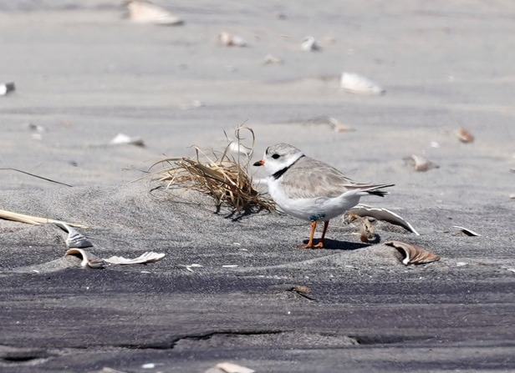
Preliminary Proposed Action #3: Permitted Period – By Category (continued)
Off-Road Vehicle Management
Fire Island National Seashore
US Department of the Interior
National Park Service
Superintendent has ability to close beach to driving to protect resources and public safety
Essential services that cannot otherwise be accomplished by waterborne transportation during no-driving summer months may qualify for driving exceptions
Notes:
(Jason)

Slide 19
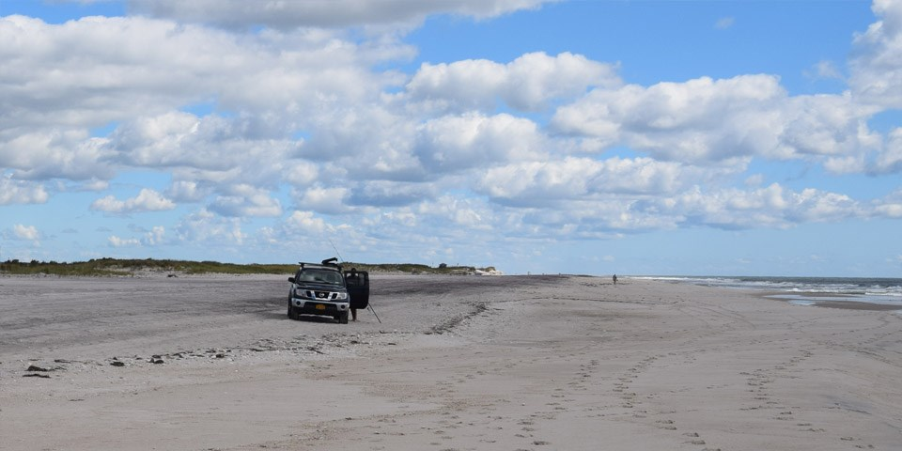
Preliminary Proposed Action #4: Vehicle Type
Off-Road Vehicle Management
Fire Island National Seashore
US Department of the Interior
National Park Service
All motor vehicles must have four- or all-wheel drive
Vehicles must be permitted
Vehicles are subject to the ORV regulation
Notes:
(Jason)

Slide 20
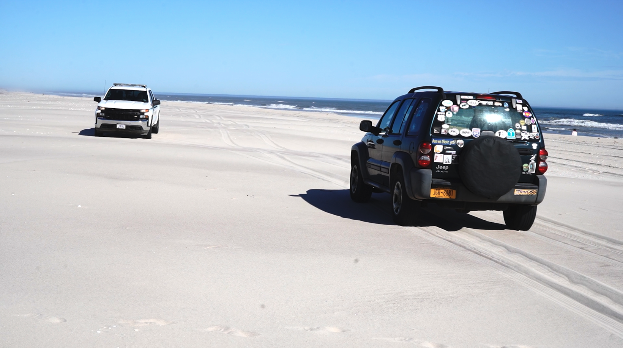
Preliminary Proposed Action #5: NPS Lands for Permitted Access
Off-Road Vehicle Management
Fire Island National Seashore
US Department of the Interior
National Park Service
Access Requiring Permit:
  Burma Road at the Lighthouse tract
  All Atlantic Ocean beaches
  Sailors Haven/Sunken Forest
  Talisman/Barrett Beach
  Watch Hill
  Otis Pike Wilderness area between Watch Hill and Smith Point
No Driving
  – Bayside beaches or the William Floyd Estate
  – Carrington Tract, except for utility companies with active right-of-way permit
  – Fire Island Lighthouse Driveway
Notes:
(Jason)

Slide 21
The Planning Process
Off-Road Vehicle Management
Fire Island National Seashore
US Department of the Interior
National Park Service

Slide 22
The Process and Where You Can Participate
Off-Road Vehicle Management
Fire Island National Seashore
US Department of the Interior
National Park Service
Pre-NEPA¹ | May 2022* | CIVIC ENGAGEMENT MEETINGS: Preliminary Proposed Action
 | Summer 2022 | Collecting additional information for NEPA and the draft regulation
NEPA | Spring 2023* | NEPA PUBLIC SCOPING: Comments on proposed action and alternatives
SUMMER 2023* | Summer 2023* | NEPA DOCUMENT REVIEW: Public review and meetings
WINTER 2023/24 | Winter 2023/24 | NPS Decision
WE ARE HERE
¹National Environmental Policy Act (NEPA) requires federal agencies to analyze environmental impacts of actions and engage the public in the decision-making process.
Notes:
(Michelle)
"Pre-NEPA" is an approximately a year-long process to achieve the following goals prior to initiating the NEPA process:
Identify planning issues that the NPS would like to address
Develop preliminary alternatives to address issues
Identify environmental issues that will require analysis
Identify data needs
Conduct civic engagement to determine public sentiment on issues
Develop a stakeholder outreach strategy
Confirm the appropriate NEPA pathway
Compile information that will allow NPS to efficiently draft the NEPA document

Slide 23
How to Provide Formal Comments
Off-Road Vehicle Management
Fire Island National Seashore
US Department of the Interior
National Park Service
Submit comments electronically at: https://parkplanning.nps.gov/FIIS_ORV
(Follow link for project & click “Open for Comment)
2. Submit written comments at in-person public meeting on May 6 in Ocean Beach
3. Submit written comments in person at park headquarters in Patchogue, NY, or by mail to:
Off Road Vehicle Management Plan
Attn: Superintendent Alexcy Romero
Fire Island National Seashore
120 Laurel Street, Patchogue, New York 11772
Comments must be received by:
May 20, 2022
Comments should be clear, concise, and relevant to the issues associated with the ORV driving program
Commenting is not a form of “voting”
Notes:
(Michelle)

Slide 24

Questions and Answer Session
Off-Road Vehicle Management
Fire Island National Seashore
US Department of the Interior
National Park Service
What questions do you have about Fire Island National Seashore’s ORV Management Preliminary Proposed Action?
Please submit your questions via the Questions Box.
Notes:
(Mikki- WSP – for Webinar.)
(Michelle - for in-person meeting, as we go to Banners in room)

