Slide 1
MS4 General Permit Training 2018-2023
March 22, 2019

Slide 2
Overview – 2018 MS4 General Permit
The information presented is intended to cover some of the changes that were made in the 2018-2023 MS4 General Permit
Please note, review of the 2018-2023 Virginia MS4 General Permit is still necessary for a complete understanding of permit requirements
The 2013 MS4 General Permit has been revised and the special condition sections for Chesapeake Bay and Local TMDL’s were moved to Part II. Part I now discusses the MS4 program plan, annual report, and Minimum Control Measures (MCMs)
In accordance with the Remand Rule, the 2018 permit contains specific and measurable requirements.

Slide 3
General 2018 Permit Facts
Permit Effective Date: November 1, 2018 Permit Expiration Date: October 31, 2023
Annual Reports must still be submitted annually - October 1st
The definition for “high-priority facilities”, “MS4 Regulated Service Area”, and “Pollutants of concern” were added as part of the definition section for 9VAC25-890.1
Part I.B – the definition of Maximum Extent Practicable (MEP) has been updated

Slide 4
Part I.C The MS4 Program Plan
For existing permittees, the MS4 program plan must be updated no later than six months after the effective date of this permit, by 5/1/2019
For a permittee receiving initial coverage under this permit, no later than six months following the date of permit coverage, submit a schedule for the development of each component of the MS4 program plan.
The MS4 program plan is no longer submitted for review, but must be posted on a webpage or be provided at a location where it can be reviewed within 30 days of updating the MS4 program plan
The permittee shall summarize revisions to the MS4 program plan as part of the annual report in Part I.D.2

Slide 5
Part I.D Annual Reports
Due dates for the Annual Reports is the same - October 1st
Reporting Period also remains the same: July 1 – June 30
The annual report and MS4 program plan are to be maintained as separate documents
Revised the requirement to make overall MS4 program evaluation and assessment of MCMs rather than BMPs part of the annual reporting requirements
Revised the required components of an annual report incorporating the TMDL annual reporting requirements

Slide 6
Part I.D Annual Reports continued
Submit electronically (condensed PDF) to regional DEQ Offices
The annual report shall include the following general information:
  a. The permittee, system name, and permit number;
  b. The reporting period for which the annual report is being submitted;
  c. A signed certification as per Part III K;

Slide 7
Part I.E.1 – MCM 1. Public Education and Outreach
Changes in this section include the addition of Table 1, “Strategies for Public Education and Outreach” in permit
The permittee is required to identify no less than three high-priority stormwater issues to meet the goal of educating the public - Part I.E.1.b
The permittee is required to select two or more strategies per year from Table 1 to communicate to the public high-priority stormwater issues – Part I.E.1.d
Added list of criteria the Public Education and Outreach program must meet to identify high-priority issues - Part I.E.1.c
Permittees will need to provide contact information associated with high-priority issues where the public can find out more information – Part I.E.1.c

Slide 8
Part I.E.2 - MCM 2. Public involvement and participation
Changes in this section include the addition of Table 2, “Public Involvement Opportunities”
The permittee is required to implement no less than four activities per year from two or more categories in Table 2 to provide an opportunity for public involvement – Part I.E.2.c
No later than three months after the permit’s effective date, 2/1/2019, the permittee is required to develop and maintain a webpage dedicated to the MS4 program and stormwater pollution prevention
There is a listing of requirements for what must be maintained on the webpage in Part I.E.2.b including posting of the annual report no later than 30 days after submittal to the department

Slide 9
Part I.E.3 – MCM 3. Illicit discharge and detection
Changes in this section include the revision of the mapping and mapping table requirements as provided in Part I.E.3.a
The permittee is required to develop and maintain an accurate MS4 map of the storm sewer system owned by the permittee within the census urbanized area, identified by the 2010 decennial census to include MS4 regulated service area and stormwater facilities owned or operated by the permittee
No later than July 1, 2019, the permittee is required to submit to the department a GIS-compatible shapefile of the permittee’s MS4 map, but can also be provided in a pdf format
No later than October 1st of each year, the permittee is required to update the storm sewer system map and outfall information table to include any new outfalls constructed or TMDLs approved during the immediate preceding reporting period

Slide 10
Part I.E.3 – MCM 3. Illicit discharge and detection, p. 2
The permittee is required to develop and maintain an accurate MS4 information table which is specified in Part I.E.3.a.(2) and includes a list of items to provide in the table including the predominant land use for each outfall discharging to an impaired water
Dry weather field screening protocols was changed to include:
  If total number of MS4 outfalls is equal to or less than 50, a schedule to screen all outfalls annually
  If total number of MS4 outfalls is greater than 50, a schedule to screen a minimum of 50 outfalls annually such that no more than 50% are screen in the previous 12-month period. The 50% criteria does not apply if all outfalls have been screened in previous three years. Part I.E.3.c.(2) (b) and (c).

Slide 11
Part I.E.4 – MCM 4. Construction site stormwater runoff control
Changes in this section include the delineation of the requirements for a Virginia Erosion and Sediment Control Program (VESCP) for the following classification of permittees:
  For a permittee that is a city, county, or town that has adopted a VESCP program;
  for a town that has not adopted a VESCP program but relies on implementation of the program by the surrounding county;
  For a state agency that has developed Annual Standards and Specifications; and
  For a state agency that has not developed a program for Annual Standards and Specifications
  For a subdivision of a local government such as a school board or other local government body

Slide 12
Part I.E.5 – MCM 5.
Post-construction stormwater management for new development and development on prior developed lands
Changes in this section include the delineation of the requirements for a Virginia Stormwater Management Program (VSMP) for the following classification of permittees:
  For a permittee that is a city, county, or town that has adopted a a VSMP program;
  for a town that has not adopted a VSMP program but relies on implementation of the program by the surrounding county;
  For a state agency that has developed Annual Standards and Specifications;
  For a state agency that has not developed a program for Annual Standards and Specifications; and
  For a subdivision of a local government such as a school board or other local government body

Slide 13
Part I.E.5 – MCM 5. Post-construction stormwater management for new development and development on prior developed lands, p. 2.
Requirements for inspection and maintenance programs for stormwater management facilities owned or operated by the permittee that discharge to the MS4 are detailed in Part I.E.5.b and include as follows:
  The permittee shall inspect stormwater management facilities owned or operated by the permittee no less than once per year. The permittee may choose to implement an alternative schedule, but not less than once per five years.
  An inspection frequency of no less than once per five years for all privately owned facilities
They must maintain an electronic database or spreadsheet of all know permittee-owned or operated stormwater management facilities that discharge to the MS4. This must be updated no later than 30 days after new facility brought online or BMP implemented. Please see Part I.E.5.e.
Electronic reporting for SWM Facilities:
  For projects installed after July 1, 2014 for projects according DEQ Construction Stormwater Program – use CGP submittal process
  With annual reporting, new BMPs are reported using the DEQ BMP Warehouse and provided template

Slide 14
Part I.E.6 – MCM 6. Pollution prevention and good housekeeping for facilities owned or operated by the permittee within the MS4 service area
Within 12 months of state permit coverage, the permittee is required to identify the high-priority facilities that have a high potential of discharging pollutants.
The permittee is required to maintain and implement a site specific stormwater pollution prevention plan (SWPPP) for each facility identified as detailed in Part I.E.6.c
An inspection frequency on no less than once per year for site specific source controls - Part I.E.6.d

Slide 15
Watershed Implementation Plan (WIP)
WIPs include detailed, specific steps each jurisdiction will take to meet the goals of the Chesapeake Bay TMDL by 2025
Phase I and Phase II WIPs were submitted to EPA in 2010 and 2012 respectively
Phase III WIPs will provide information on actions Bay jurisdictions intend to implement between 2019 and 2025

Slide 16
Watershed Implementation Plan (WIP)
Virginia in both the Phase I and Phase II WIPs has committed to using the Suburban Stormwater Scoping Scenario Level 2 Effective Net Reductions as required MS4 reduction targets
This equates to the following reductions for MS4s within the Chesapeake Bay watersheds
  Impervious Urban Acres Pervious Urban Acres
    9% TN reductions 6% TN reductions
    16% TP reductions 7.25% TP reductions
    20% TSS reductions 8.75% TSS reductions

Slide 17
Watershed Implementation Plan (WIP)
Virginia has committed to a phased permitting approach to achieve the pollutant reductions required by the L2 Scoping run
Regulated MS4s will have 3 permit cycles to make the required reductions
1st cycle - 5% of the L2 total reductions
2nd cycle – 35% of the L2 total reductions
3rd cycle – 60% of the L2 total reductions

Slide 18
Part II.A – Chesapeake Bay
TMDL Special Conditions
In the 2013 permit each river basin was provided two separate tables to calculate the cumulative reduction, but this has been combined into one table in the 2018 permit
The Chesapeake TMDL table information was revised to include the total 40% required reduction by the end of this permit cycle
Reductions required in this section will be achieved through one of the following methods: BMPs approved by the Chesapeake Bay program; BMPs approved by the department; or a trading program described in this section
Part II.A.10 details the trading program a permittee may use to acquire credits for total nitrogen, total phosphorus, and now includes sediment credits.

Slide 19
Part II.A – Chesapeake Bay TMDL Special Conditions, page 2
No later than 12 months after the permit effective date, November 1, 2019, the permittee shall submit an updated Chesapeake Bay TMDL action plan for the required reductions
  Prior to submittal of the CB TMDL action plan, the permittee must provide opportunity for public comment for no less than 15 days, to the additional BMPs proposed to meet the reductions not previously approved by the department in the first phase of the CB TMDL action plan.
The annual report must include a list of BMPs implemented during the reporting period but not reported to the DEQ BMP Warehouse and a listing of the credits acquired during the reporting period to meet all or a portion of the required reductions in this section.

Slide 20
Chesapeake Bay TMDL Definitions
Part II.A Definitions:
  Existing Sources - pervious and impervious urban land uses served by the MS4 as of June 30, 2009
  New Sources – pervious and impervious urban land uses served by the MS4 developed or redeveloped on or after July 1, 2009
  Pollutants of Concern (POC) – TN, TP, TSS
  Transitional Sources – regulated land disturbing activities that are temporary in nature and discharge through the MS4

Slide 21
Table 3a – James River, Lynnhaven and Little Creek Basins
 |  | A | B | C | D | E | F | G
Pollutant | Subsource | Loading rate (lbs/ac/yr) | Existing Developed Lands 6/30/09 (acres) | Load (lbs/yr) | Percent MS4 required CB total L2 loading | Percentage of L2 required reduction by 6/30/23 | 40% cumulative reduction required by 6/30/23 (lbs/yr) | Sum of 40% cumulative reduction (lb/yr)
Nitrogen | Regulated urban impervious | 9.39 |  |  | 9% | 40%
 | Regulated urban pervious | 6.99 |  |  | 6% | 40%
Phosphorous | Regulated urban impervious | 1.76 |  |  | 16% | 40%
 | Regulated urban pervious | 0.5 |  |  | 7.25% | 40%
Total suspended solids | Regulated urban impervious | 676.94 |  |  | 20% | 40%
 | Regulated urban pervious | 101.08 |  |  | 8.75% | 40%

Slide 22
Calculating Required Reductions
MS4 service area include the following
  986.6 Impervious Acres
  1645.7 Pervious Acres
  95.4 Forested Acres *
  0 Agricultural Acres *
  15.7 Open Water Acres *
  11.3 Wetland Acres *
  2754.7 Total Acres
  2632.3 Regulated Acres

Slide 23
Table 3a – James River, Lynnhaven and Little Creek Basins
 |  | A | B | C | D | E | F | G
Pollutant | Subsource | Loading rate (lbs/ac/yr) | Existing Developed Lands 6/30/09 (acres) | Load (lbs/yr) | Percent MS4 required CB total L2 loading | Percentage of L2 required reduction by 6/30/23 | 40% cumulative reduction required by 6/30/23 (lbs/yr) | Sum of 40% cumulative reduction (lb/yr)
Nitrogen | Regulated urban impervious | 9.39 | 986.6 |  | 9% | 40%
 | Regulated urban pervious | 6.99 | 1645.7 |  | 6% | 40%
Phosphorous | Regulated urban impervious | 1.76 | 986.6 |  | 16% | 40%
 | Regulated urban pervious | 0.5 | 1645.7 |  | 7.25% | 40%
Total suspended solids | Regulated urban impervious | 676.94 | 986.6 |  | 20% | 40%
 | Regulated urban pervious | 101.08 | 1645.7 |  | 8.75% | 40%

Slide 24
Table 3a – James River, Lynnhaven and Little Creek Basins
 |  | A | B | C | D | E | F | G
Pollutant | Subsource | Loading rate (lbs/ac/yr) | Existing Developed Lands 6/30/09 (acres) | Load (lbs/yr) | Percent MS4 required CB total L2 loading | Percentage of L2 required reduction by 6/30/23 | 40% cumulative reduction required by 6/30/23 (lbs/yr) | Sum of 40% cumulative reduction (lb/yr)
Nitrogen | Regulated urban impervious | 9.39 | 986.6 | 9264.17 | 9% | 40%
 | Regulated urban pervious | 6.99 | 1645.7 | 11503.44 | 6% | 40%
Phosphorous | Regulated urban impervious | 1.76 | 986.6 | 1736.42 | 16% | 40%
 | Regulated urban pervious | 0.5 | 1645.7 | 822.85 | 7.25% | 40%
Total suspended solids | Regulated urban impervious | 676.94 | 986.6 | 667869.00 | 20% | 40%
 | Regulated urban pervious | 101.08 | 1645.7 | 166347.36 | 8.75% | 40%

Slide 25
Table 3a – James River, Lynnhaven and Little Creek Basins
 |  | A | B | C | D | E | F | G
Pollutant | Subsource | Loading rate (lbs/ac/yr) | Existing Developed Lands 6/30/09 (acres) | Load (lbs/yr) | Percent MS4 required CB total L2 loading | Percentage of L2 required reduction by 6/30/23 | 40% cumulative reduction required by 6/30/23 (lbs/yr) | Sum of 40% cumulative reduction (lb/yr)
Nitrogen | Regulated urban impervious | 9.39 | 986.6 | 9264.17 | 9% | 40% | 333.51
 | Regulated urban pervious | 6.99 | 1645.7 | 11503.44 | 6% | 40% | 276.08
Phosphorous | Regulated urban impervious | 1.76 | 986.6 | 1736.42 | 16% | 40% | 111.13
 | Regulated urban pervious | 0.5 | 1645.7 | 822.85 | 7.25% | 40% | 23.86
Total suspended solids | Regulated urban impervious | 676.94 | 986.6 | 667869.00 | 20% | 40% | 53429.52
 | Regulated urban pervious | 101.08 | 1645.7 | 166347.36 | 8.75% | 40% | 5822.16

Slide 26
Table 3a – James River, Lynnhaven and Little Creek Basins
 |  | A | B | C | D | E | F | G
Pollutant | Subsource | Loading rate (lbs/ac/yr) | Existing Developed Lands 6/30/09 (acres) | Load (lbs/yr) | Percent MS4 required CB total L2 loading | Percentage of L2 required reduction by 6/30/23 | 40% cumulative reduction required by 6/30/23 (lbs/yr) | Sum of 40% cumulative reduction (lb/yr)
Nitrogen | Regulated urban impervious | 9.39 | 986.6 | 9264.17 | 9% | 40% | 333.51 | 609.59
 | Regulated urban pervious | 6.99 | 1645.7 | 11503.44 | 6% | 40% | 276.08
Phosphorous | Regulated urban impervious | 1.76 | 986.6 | 1736.42 | 16% | 40% | 111.13
 | Regulated urban pervious | 0.5 | 1645.7 | 822.85 | 7.25% | 40% | 23.86
Total suspended solids | Regulated urban impervious | 676.94 | 986.6 | 667869.00 | 20% | 40% | 53429.52
 | Regulated urban pervious | 101.08 | 1645.7 | 166347.36 | 8.75% | 40% | 5822.16

Slide 27
Table 3a – James River, Lynnhaven and Little Creek Basins
 |  | A | B | C | D | E | F | G
Pollutant | Subsource | Loading rate (lbs/ac/yr) | Existing Developed Lands 6/30/09 (acres) | Load (lbs/yr) | Percent MS4 required CB total L2 loading | Percentage of L2 required reduction by 6/30/23 | 40% cumulative reduction required by 6/30/23 (lbs/yr) | Sum of 40% cumulative reduction (lb/yr)
Nitrogen | Regulated urban impervious | 9.39 | 986.6 | 9264.17 | 9% | 40% | 333.51 | 609.59
 | Regulated urban pervious | 6.99 | 1645.7 | 11503.44 | 6% | 40% | 276.08
Phosphorous | Regulated urban impervious | 1.76 | 986.6 | 1736.42 | 16% | 40% | 111.13 | 134.99
 | Regulated urban pervious | 0.5 | 1645.7 | 822.85 | 7.25% | 40% | 23.86
Total suspended solids | Regulated urban impervious | 676.94 | 986.6 | 667869.00 | 20% | 40% | 53429.52 | 59251.68
 | Regulated urban pervious | 101.08 | 1645.7 | 166347.36 | 8.75% | 40% | 5822.16

Slide 28
BMP Efficiency Calculation Information
Guidance Memo No. 15-2005 – Chesapeake Bay TMDL Action Plan Guidance includes:
  Eligible BMPs and credit opportunities
  Credit Calculation Methodologies
  Chesapeake Bay TMDL Action Plan Elements
  BMP Established Efficiency Tables for the Virginia Stormwater BMP Clearing House, Chesapeake Bay Program and the calculation method for using the Chesapeake Bay Retrofit Curves/Equations
  Example Calculations

Slide 29
Part II.B – Local TMDL Special Condition
The permittee shall complete implementation of the TMDL action plans as soon as practicable. It is allowable to implement them in multiple phases over more than one permit cycle provided adequate progress is achieved
The permittees must update the previously approved local TMDL Action Plans in which an individual or aggregate wasteload has been allocated to the permittee and approved by the EPA as follows:
  prior to 7/1/2013, the permittee must update no later than 18 months after the effective date of the permit, May 1, 2020
  on or after 7/1/2013 and prior to 6/30/2018, the permittee shall develop and initiate implementation of the action plans no later than 30 months after the permit effective date, May 1, 2021

Slide 30
Part II.B – Local TMDL Special Condition, page 2
Table 5, “Strategies for Bacteria Reduction Stormwater Control/Management Strategy” has been added to Part II.B.4, Bacteria TMDLs
If the permittee is an approved VSMP authority, the permittee shall select and implement at least three of the strategies listed in Table 5.
If the permittee is not an approved VSMP authority, the permittee must select at least one strategy listed in Table 5 to reduce the load of bacteria to the MS4 relevant to sources of bacteria applicable within the MS4 service area
Part II.B.5 is a new section to list requirements for local sediment, phosphorus and nitrogen TMDLs
Part II.B.6 is a also a new section to list any requirements for Polychlorinated biphenyl (PCB) TMDLs

Slide 31
Part III – Conditions Applicable to all State and VPDES Permits
Discharge monitoring is not required for compliance purposes for this general permit. If an operator chooses to monitor stormwater discharges for informational or screening purposes, the operator does not need to comply with the requirements of Parts III A, B, or C

Slide 32
BMP Warehouse Tracking Tool
The purpose of the BMP Warehouse is to upload BMP data for state and federal reporting purposes
Requirement is addressed in MCM 5, Part I.B.5.g - Electronically report stormwater management facilities and BMPs implemented between July 1 and June 30 of each year using the DEQ BMP Warehouse and also;
MCM 5, Part I.B.5.i.(5) – Annual Reporting requirements due October 1 include a confirmation statement that the permittee electronically reported BMPs using the BMP Warehouse including the date it was submitted
DEQ updated the BMP Warehouse in 2016 to include MS4 BMP reporting

Slide 33
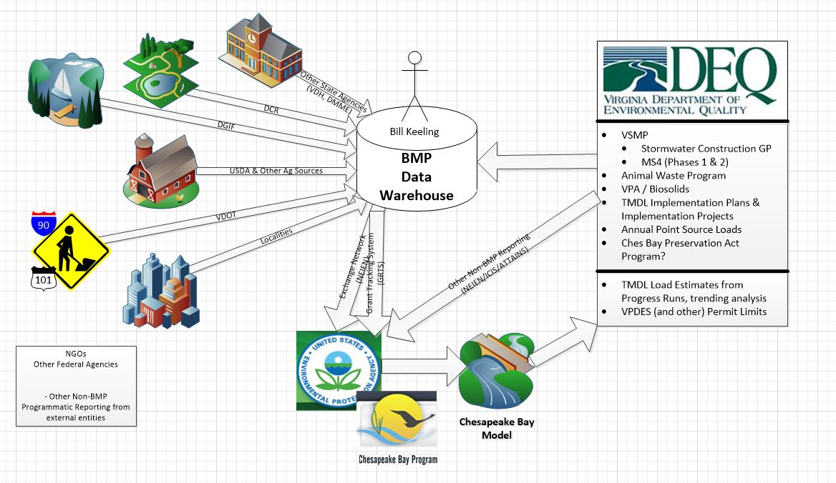
Development of the Warehouse (2014 Concept)

Slide 34
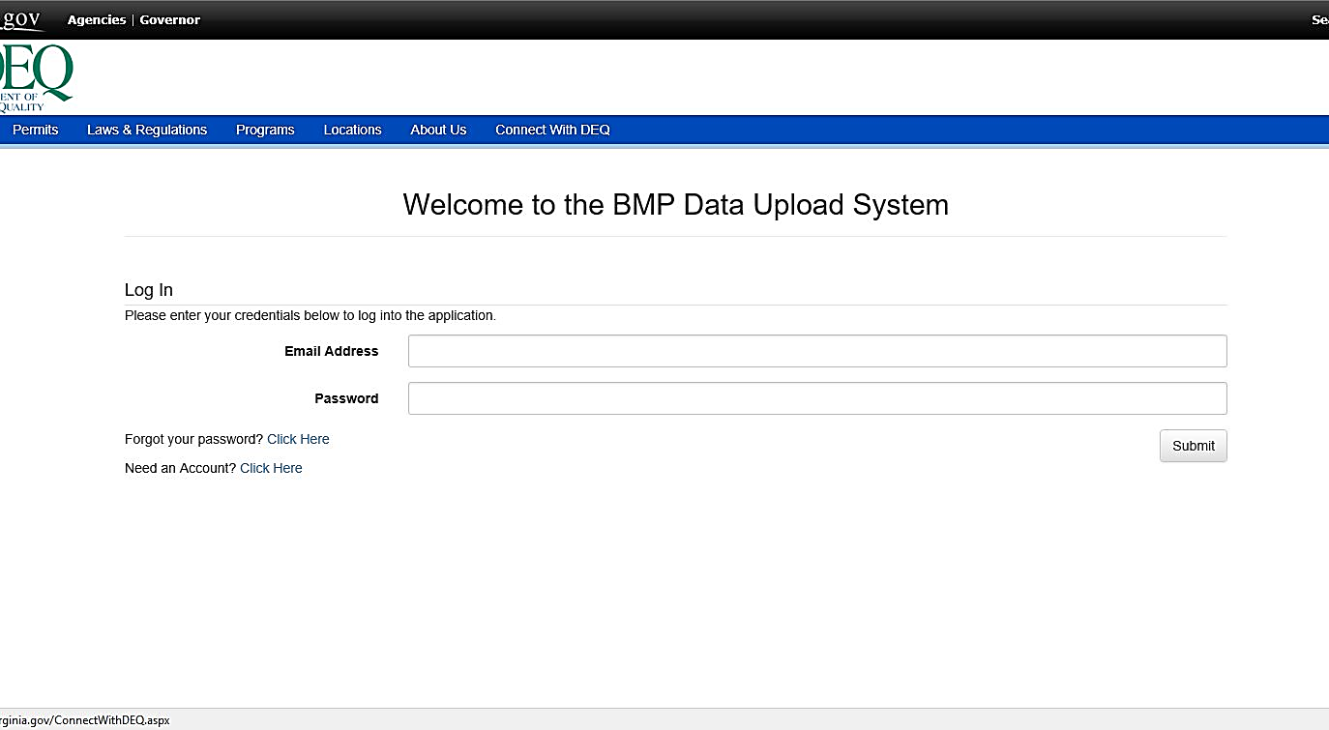
BMP Warehouse Webpage
Important facts to note on this page:
This can be found at the following link: https://apps.deq.virginia.gov/BMP/
Requires application for an account, please note the arrow location above to sign up for an account. This will allow you to download a template or spreadsheet to enter BMP information. You will use this template each time.

Slide 35
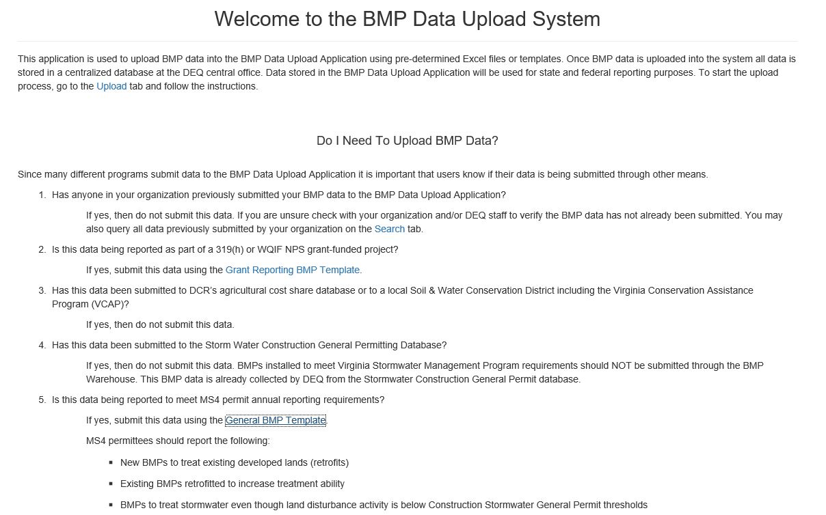

BMP Warehouse Introduction Webpage
Important facts to note on this page:
This page can be accessed after you have logged in with your Account ID and password.
The MS4 BMP data can be uploaded from item 5 using the “General BMP Template” indicated in blue. Please see the arrow above. There are other templates for upload in the BMP Warehouse including 319(h) grant-funded projects and the Storm Water Construction General Permitting, but these do not apply to the MS4 program.

Slide 36
BMP Warehouse
When do I need to Upload BMP data?
New BMPs to treat existing developed lands (retrofits)
Existing BMPs retrofitted to increase treatment ability
BMPs to treat stormwater even though land disturbance activity is below Construction Stormwater General Permit thresholds
BMPs located outside of the MS4 service area may be reported on the same template as BMPs located inside the MS4 service area
BMPs that were installed to meet Virginia Stormwater regulations prior to July 1, 2014 and not reported under the Stormwater Construction General Permit
BMPs for which an inspection occurred during the reporting period

Slide 37
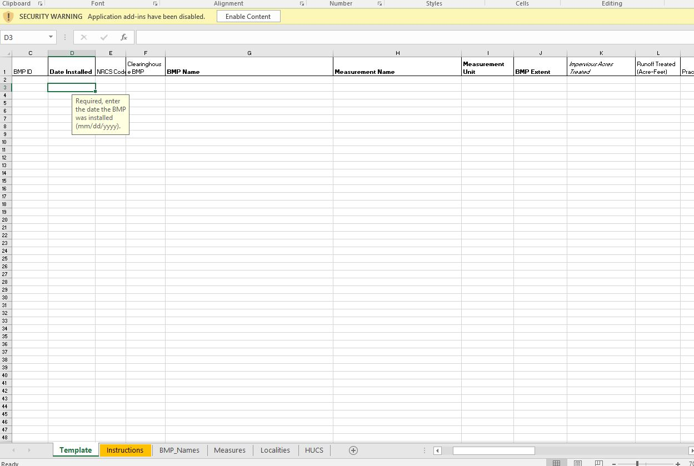
BMP Warehouse Template
This is a portion of the MS4 BMP Warehouse template:
Information will be entered into this spreadsheet and uploaded to the warehouse for the BMPs at your facility.
There is an instructions tab and tabs to provide additional help located at the bottom. Please see the yellow arrow above.
Information including BMP name, date installed and other information will need to be entered on the spreadsheet. This spreadsheet is in the process of being updated so the new version of the spreadsheet will likely be available sometime this summer.

Slide 38
BMP Warehouse Who and What
Who can view/upload data
  Registered persons (email associated with a listed organization) can upload, search, and edit that organizations data
  Contractors with confirmed organization approval
  DEQ can add new organizations at anytime
Who gets “credit”
  Location information uploaded is retained and reported as provided
  BMP distribution at finest CBP model segment scale (land river segment)
  “Submitted” verses “Credited” and Verification
What can be uploaded
  BMPs listed in the General Upload Template in a dropdown menu under “BMP Name” and also on the “BMP Names” tab
  BMP template as downloaded – any alteration of format/structure = rejection
What currently cannot be uploaded
  BMPs not listed in the General Upload Template

Slide 39
Additional Questions
Are programmatic BMPs reported in the warehouse? Not currently but could explore adding this functionality.
How do BMPs on unregulated urban lands get reported? Select Other Reporting (Non-319(h)/WQIF NPS) instead of MS4-Required Reporting on upload screen’s reason for reporting dropdown list. Conditionally required fields based on that selection.
Has DEQ considered adding an option from the home screen to view all data, sortable by county (or other geographic boundaries such as University MS4s or Federal facilities) and/or reporting organization? Application is a data collection and reporting tool. DEQ is exploring the options for a publically available searchable database. Likely a different application that accesses the import and export databases.

Slide 40
Some Planned Upgrades
Have system generate an email to reporting contact indicating which records need inspection to continue lifespan in CBP model
Remove BMP names unique to phase 5 model
Expand list of multi measure BMPs
Transform applicable Grants data for NEIEN
Improved geographic validation

Slide 41

MS4 Program Plans-Plan Contents/DEQ Expectations
This is NOT what your Program Plan should look like!!

Slide 42
MS4 General Permit (MS4 GP)
Quick Review of Main Sections
MS4 GP has 3 principle parts:
  Part I-Discharge Authorization and Special Conditions (the “meat” of the permit)
  Part II-TMDL Special Conditions (Chesapeake Bay TMDL and Local TMDL requirements)
  Part III-Conditions Applicable to All State and VPDES Permits (standard “boilerplate” language)

Slide 43
MS4 GP
Part I Overview
Part I is the “meat” of the permit, and describes requirements for:
  The MS4 Program Plan (Sections B and C);
  Annual Reports (Section D), and;
  The 6 Minimum Control Measures (MCMs) (Section E).

Slide 44
Highlights from New MS4 GP
For existing permittees, the MS4 program plan must be updated no later than six months after the permit effective date (by 5/1/2019)
The MS4 program plan is no longer submitted for review, but must be posted on a webpage or be provided at a location where it can be reviewed within 30 days of updating the MS4 program plan
Permittees must summarize any revisions to the MS4 program plan in their annual reports (Part I.D.2)
MS4 Program Plan and annual report must be maintained separately and submitted to DEQ as 2 separate documents

Slide 45
Some Key Points to Remember
Development of the Program Plan IS required by the permit.
The MS4 Program Plan is no longer submitted to DEQ for review.
The Program Plan is meant to be a planning/implementation tool that describes how the MS4 will meet permit requirements.
Permittees must update the Program Plan per new GP requirements by May 1, 2019.
MS4 Program Plan is a “living document(s)” –revisions are expected throughout the life of the permit

Slide 46
The 2016 MS4 Permit Remand Rule-How it impacted concept of MS4 Program Plan
Addressed court remand in Ninth Circuit ruling in EDC v. EPA(2003)
EPA finalized the rule December 9, 2016 (note: after e-reporting rule)
Radically changed the entire concept of purpose and scope of an MS4 Program Plan

Slide 47
MS4 Remand Rule-What it accomplished
Pre Remand Rule (old GP)
Post Remand Rule (NEW GP)
Appeared to enable the small MS4 to establish its own permit conditions through development of the MS4 Program Plan
Compliance with MS4 permit standard (MEP) depended on the MS4’s implementation of the MS4 Program Plan and meeting self-identified “measurable goals”*
Specified that “narrative limits” requiring implementation of BMPs are generally the most appropriate type of effluent limitation in small MS4 permits
Emphasized that the small MS4 General permit establishes applicable terms and conditions, NOT the MS4 Program Plan
Compliance determined by whether the MS4 meets the terms and conditions of the permit; measurable goals are no longer part of the rule
Broadened description of the appropriate requirements for small MS4 permits: (1) they can be narrative, numeric, or other type of requirement; but (2) they must be “clear, specific, and measurable

Slide 48
MS4 Program Plan
Contents-What does permit require (Part 1.C.)
Roles and responsibilities of all departments and divisions responsible for implementing MS4 permit requirements.
For EACH Minimum Control Measure (MCM):
  Specific permit requirements for each MCM
  Description of planned BMPs/strategies used to demonstrate compliance with permit conditions
  SOPs or policies used to implement BMPs
  Measureable goal by which each BMP will be evaluated\
  Positions or departments who will implement each BMP/strategy
It is an amalgamation of all policies, SOPs, Base Orders, SWPPPs, etc., used for program implementation or documentation
Documents can be incorporated by reference

Slide 49

Keeping it all Together
DEQ Expectations
Best to have one main point of contact for DEQ (MS4 Coordinator), to maintain the MS4 Program Plan, and to gather information from other departments/divisions for annual reports
Maintain MS4 Program Plan in paper copy and electronic format in a central location
Keep it organized!! Have paper copies of any and/all documents used to implement parts of the program
Electronic Copies-DEQ recommends an electronic folder of all relevant documents, that is kept on permittees website

Slide 50

EPA’s E-Reporting Rule
What it Means for MS4s

Slide 51

Background/General Information
October 22, 2015-EPA published the National Pollutant Discharge Elimination System (NPDES) Electronic Reporting Rule (“final rule”) in the Federal Register
Intent of the Rule is to modernize Clean Water Act (CWA) reporting for municipalities, industries, and other facilities
The final rule substitutes electronic reporting for paper-based reports, and requires the electronic reporting and sharing of NPDES program data
Requires permittees and regulators (ie. DEQ) to use existing, available technology to electronically report info and data related to the NPDES permit program

Slide 52
E-Reporting/Phasing Schedule
EPA is phasing in reporting requirements over a 5 year period, in 2 phases
Phase 1-Started on December 21, 2016, NPDES permittees began submitting Discharge Monitoring Reports (DMRs) electronically. States began sharing inspections, violation info, and enforcement action data electronically.
Phase 2-Will begin December 21, 2020, and will include permittees in the NPDES Stormwater sector (including MS4s!!). Those permittees that now submit certain NPDES reports (eg. Annual Reports for MS4s) will begin submitting annual report info electronically, instead of on paper.

Slide 53

What are the Benefits of Reporting Electronically?
Will provide states and EPA the ability to strategically address more serious pollution problems while using limited resources more efficiently
Enhances transparency by providing complete, more accurate, and consistent set of data about the NPDES program
Supports goal of providing better protection of nation’s waters

Slide 54
E-Reporting Benefits (continued)
Expanding EPA’s efforts to provide more data to the public
Over the long term, will save time and resources for permittees, states, and EPA
Will improve accuracy and consistency of data
Improving compliance

Slide 55
What data will MS4s report electronically in annual reports?
On October 23, 2018, EPA published the E-Reporting Implementation Technical Paper No. 9, which updated the data elements specific to NPDES stormwater sector (includes MS4s!).
General Information (MS4 name/address, permit number, annual report received date).
Information specific to each of the 6 Minimum Control Measures (MCMs).
Other applicable permit requirements (ie. TMDL requirments).

Slide 56
What does it mean for MS4s??
Becomes effective December 21, 2020, but we believe EPA will allow states flexibility (“grace period”) before E-reporting is fully implemented (to allow states time to put in place technology to transfer data).
DEQ intends to develop an “outward facing portal” to give permittees the ability to electronically upload “data elements” from MS4 Annual Reports.
DEQ will transfer data from the portal to our CEDS database, where it will be uploaded to EPA’s ICIS database.
Outward facing portal (MS4s)
CEDS (DEQ)
ICIS (EPA)

Slide 57
What does it mean for MS4s??
DEQ will also be required to share internal agency data electronically with EPA, such as compliance monitoring info (eg. inspection reports), permit information, and enforcement actions.
DEQ will provide guidance/training to MS4 permittees on E-reporting requirements and implementation.
Outward facing portal (MS4s)
CEDS (DEQ)
ICIS (EPA)

Slide 58
Contact Information
Central Office MS4 Permit Staff
Mason Harper 804-698-4023; Mason.Harper@deq.viriginia.gov
Ruth Minich-Hobson 804-698-4490; Ruth.Minich-Hobson@deq.virginia.gov
Jeff Selengut 804-698-4265; Jeffrey.Selengut@deq.virginia.gov
Bill Keeling – BMP Warehouse; William.keeling@deq.virginia.gov
DEQ Central Office
1111 East Main Street, Suite 1400
Richmond, VA 23219
804-698-4342

