Slide 1

Hazard Communication
Notes:
Welcome to Hazard Communication training. While we’re here we’ll discuss OSHA’s Hazard Communication Standard, and how it applies to you. Throughout this training we’ll refer to hazard communication as HazCom.

Slide 2
Purpose of Hazard Communication
To ensure that the hazards of all chemicals produced or imported are classified, and that the information concerning their hazards is transmitted to employers and employees.
Notes:
The purpose of the hazard communication standard is to ensure that you, as a person who may come into contact with hazardous materials, are made aware of the hazards of those materials. In order to receive this information, you need to know how to find it and understand the way hazards are communicated to you.

Slide 3
Hazard Communication
2nd most cited OSHA violation
  Written program
  Labeled containers
  SDS
  Training
  Chemical inventory
Notes:
We’re also here to make sure you understand what’s required of you as an employee or supervisor under the HazCom program. HazCom is the second most cited OSHA violation, and has been for the last 5 years. Its also one of the most common areas for findings during NPS environmental compliance audits. Citations routinely include a lack of a completed written program, unlabeled or improperly labeled containers, absence of updated SDSs for every chemical present, and failure to train or document training on HazCom topics.

Slide 4

HazCom Standard
Also known as “Right to Know”, codified in 29 CFR 1910.1200
Revised to adopt the Globally Harmonized System (GHS) in 2012.
The standards for general industry and construction are identical
Notes:
In order to understand the requirements and benefits of a HazCom Program, its helpful to first understand where it came from.
HazCom was first established in 1983 in response to unions and environmental groups fighting for protection from hazardous chemicals. In one particular instance, a group of workers in a pesticide manufacturing plant in California noticed that everyone working in a particular area of the plant had become sterile. Although university research had proven that the pesticide they were producing had reproductive hazards, the plant workers were never informed. This led the State of California to enact regulations on manufacturers producing chemicals, including a requirement to produce material safety data sheets informing employees about the chemicals they were working with. State laws such as these were used to develop the federal Standard.
Other countries have regulations on communicating chemical hazards as well. Over time, however, it became evident that products that were imported or exported across international borders didn’t always meet the requirements of the country where they were being sold. In response, the UN developed a system called the Globally Harmonized System (GHS) to standardize the way chemical hazards were communicated across participating countries. This system was integrated into the HazCom Standard in 2009 and was fully implemented in the US by 2016. We’ll talk more about GHS later in this training.
One interesting note: many of OSHA’s regulations differ between the construction industry and the general industry. Under the HazCom Standard, however, the regulations are identical. This means that the rules are consistent across every industry regulated by OSHA.

Slide 5
Who does HazCom apply to?
The HazCom standard applies to any worker who may be exposed to hazardous chemicals under normal operating conditions, or in foreseeable emergencies.
Notes:
“The HazCom standard applies to any worker who may be exposed to hazardous chemicals under normal operating conditions, or in foreseeable emergencies.”
There are two parts to this statement. The first encompasses staff who work around hazardous materials as part of their day-to-day jobs. The second part of the statement adds staff who may come upon, or be expected to participate in, an emergency.
At first, these may seem like the same groups of people and would include maintenance workers, curators, and resource managers. But consider the following examples: a ranger is working in a remote area of the Park and comes across a leaking tank or some abandoned material; an administrative worker opens a storage closet to get some cleaning supplies and picks up an unlabeled spray bottle; a law enforcement officer finds a visitor who is feeling ill after walking through an area where pesticides were recently applied and needs to find first aid information.
Now, it seems a much larger group of people could be affected. For this reason, we recommend that all Park staff receive HazCom training.

Slide 6
So What is a Hazardous Material?
Physical Hazards
  Gas under pressure
  Explosive
  Flammable
  Oxidizer
  Pyrophoric
  Self-reactive or self-heating
  Organic peroxide
  Corrosive to metal
  Emits flammable gas when contact w/H₂O
Health Hazards
  Acute toxicity (all pathways)
  Skin corrosion/irritation
  Serious eye damage/irritation
  Respiratory/skin sensitization
  Mutagen
  Carcinogen
  Reproductive toxin
  Specific organ toxicity
  Aspiration toxicity
Notes:
Your next question may be, “Well what’s considered a hazardous material?”
Simply put, a hazardous material is something that could affect your body or the environment. In fact, there are many ways a substance can affect you. Physical hazards, for example, are those that can injure or damage your body. Biological hazards may cause an immune reaction such as illness or anaphylaxis. Other examples include chemical and radiological hazards.
The HazCom standard focuses on chemicals that pose physical or health hazards. These are some examples of statements falling under each category that you may find on a chemical label.

Slide 7

Hazardous Materials
Simple Asphyxiant
Combustible Dust
Pyrophoric Gas
Hazards not otherwise classified
https://www.youtube.com/watch?v=fI-jlNqpCQ8
Notes:
Other types of hazardous materials specified by the HazCom standard include simple asphyxiants, combustible dusts, pyrophoric gases, and hazards not otherwise classified.
Simple asphyxiants are chemicals or mixtures that displace oxygen in the breathing space with no other health affects. Workers may or may not know they have been exposed to a simple asphyxiant but will be deprived of oxygen, which may lead to unconsciousness or death. The most common simple asphyxiant is carbon dioxide.
Combustible dusts have gained a lot of attention in recent years due their hazard potential and the fact that the same material may not be flammable in larger pieces. When the material particles are small enough and become suspended in air they create a highly explosive atmosphere. Materials which may form combustible dusts include grains and sugar, wood, pesticides, pharmaceuticals, coal, and metals. This video shows the result when sugar dust became airborne at a facility in Georgia, resulting in massive infrastructure damage and the loss of 14 lives. The video can also be viewed at the link provided.
Pyrophoric gases are those that will ignite spontaneously at 130°F or below. Phosphine gas, which is a byproduct of pest fumigants, is one example.
Hazards not otherwise classified (HNOC) is a designation given to chemicals that do not meet the criteria for other classes, but could pose a threat to vulnerable individuals. In other words, the hazards of these chemicals are low enough that the general population may not be affected, but those who have been sensitized or have weakened immune systems may be affected.

Slide 8
Communication Methods
Labels
SDS
Chemical Inventory
Written Program
Training
Notes:
Now that we understand what hazards are, let’s talk about how they may be communicated to you. There are 5 major components of the HazCom Standard, and each will provide you with information about how hazardous materials are handled in your workplace. We’ll cover each of these components in the slides that follow.

Slide 9
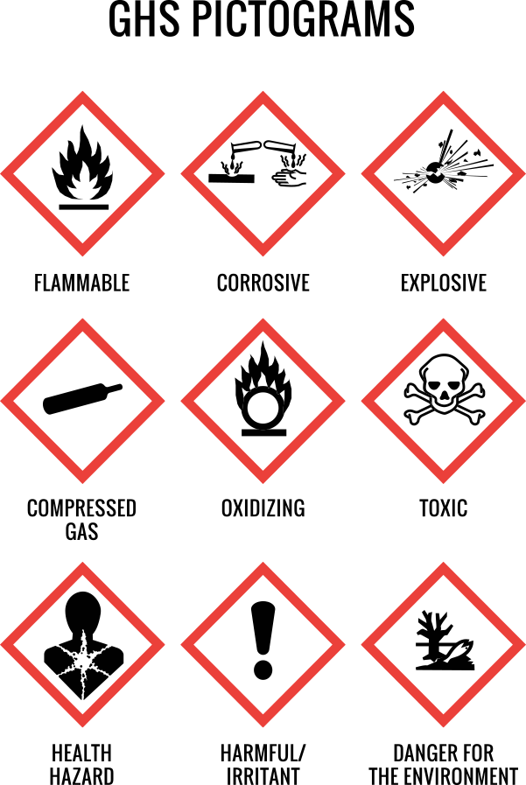
Communication Methods
Pictogram
  Symbol conveying specific information about chemical hazards
Signal word
  Indicates relative level of severity
    Danger
    Warning
Hazard statement
  Describes the nature of the hazard
Precautionary statement
  Recommended measures to minimize/prevent adverse effects
Notes:
Within most of the communication methods we’ll discuss, there are some standard elements that must be present:
A pictogram is a visual representation of the hazards of a material, and is limited to one of the twelve categories shown above. One or several pictograms may be applicable to a given material.
A signal word indicates the level of severity of the hazards associated with a material. There are only two signal words used: “Danger” being the more severe, and “Warning” being less so.
A hazard statement is a short statement about how the material may pose a hazard. For example, “May cause or intensify fire, oxidizer”.
A precautionary statement is generally a longer description about how to handle the material safely.

Slide 10
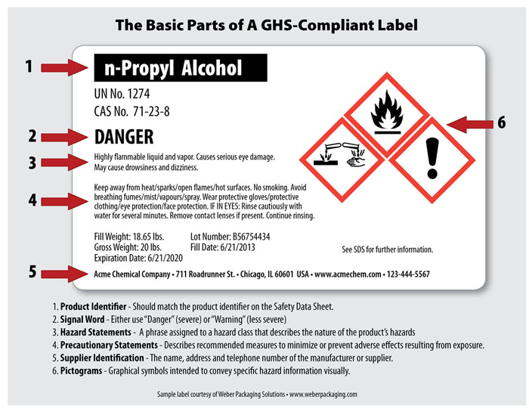
Communication Methods: Labeling
Every individual container must be labeled in English
Manufacturer labels include:
  A product identifier
  Pictogram
  Signal Word
  Hazard Statement
  Precautionary statement
  Contact information for the manufacturer
Notes:
The first method of hazard communication we’ll discuss is the product label. With a few exceptions, every container of a hazardous material must be labeled. It is important to understand the product label requirements for manufacturers under OSHA so you know how the hazards are being communicated to you. Each label must include a product identifier, a pictogram, a signal word, a hazard statement, a precautionary statement, and contact information for the manufacturer. We discussed 4 of these components on the previous slide.
The product identifier includes the name of the chemical, as it implies, but should also include any other identifier used by the manufacturer, including product number, trade names such as Chlorox®, chemical names such as bleach or sodium hypochlorite, UN numbers, or CAS numbers.
Contact information for the manufacturer allows you to quickly contact them, or their representatives, if you have any questions or concerns while using the product. It is important to note, if you mix or create a chemical yourself you should put your own contact information on the label.

Slide 11
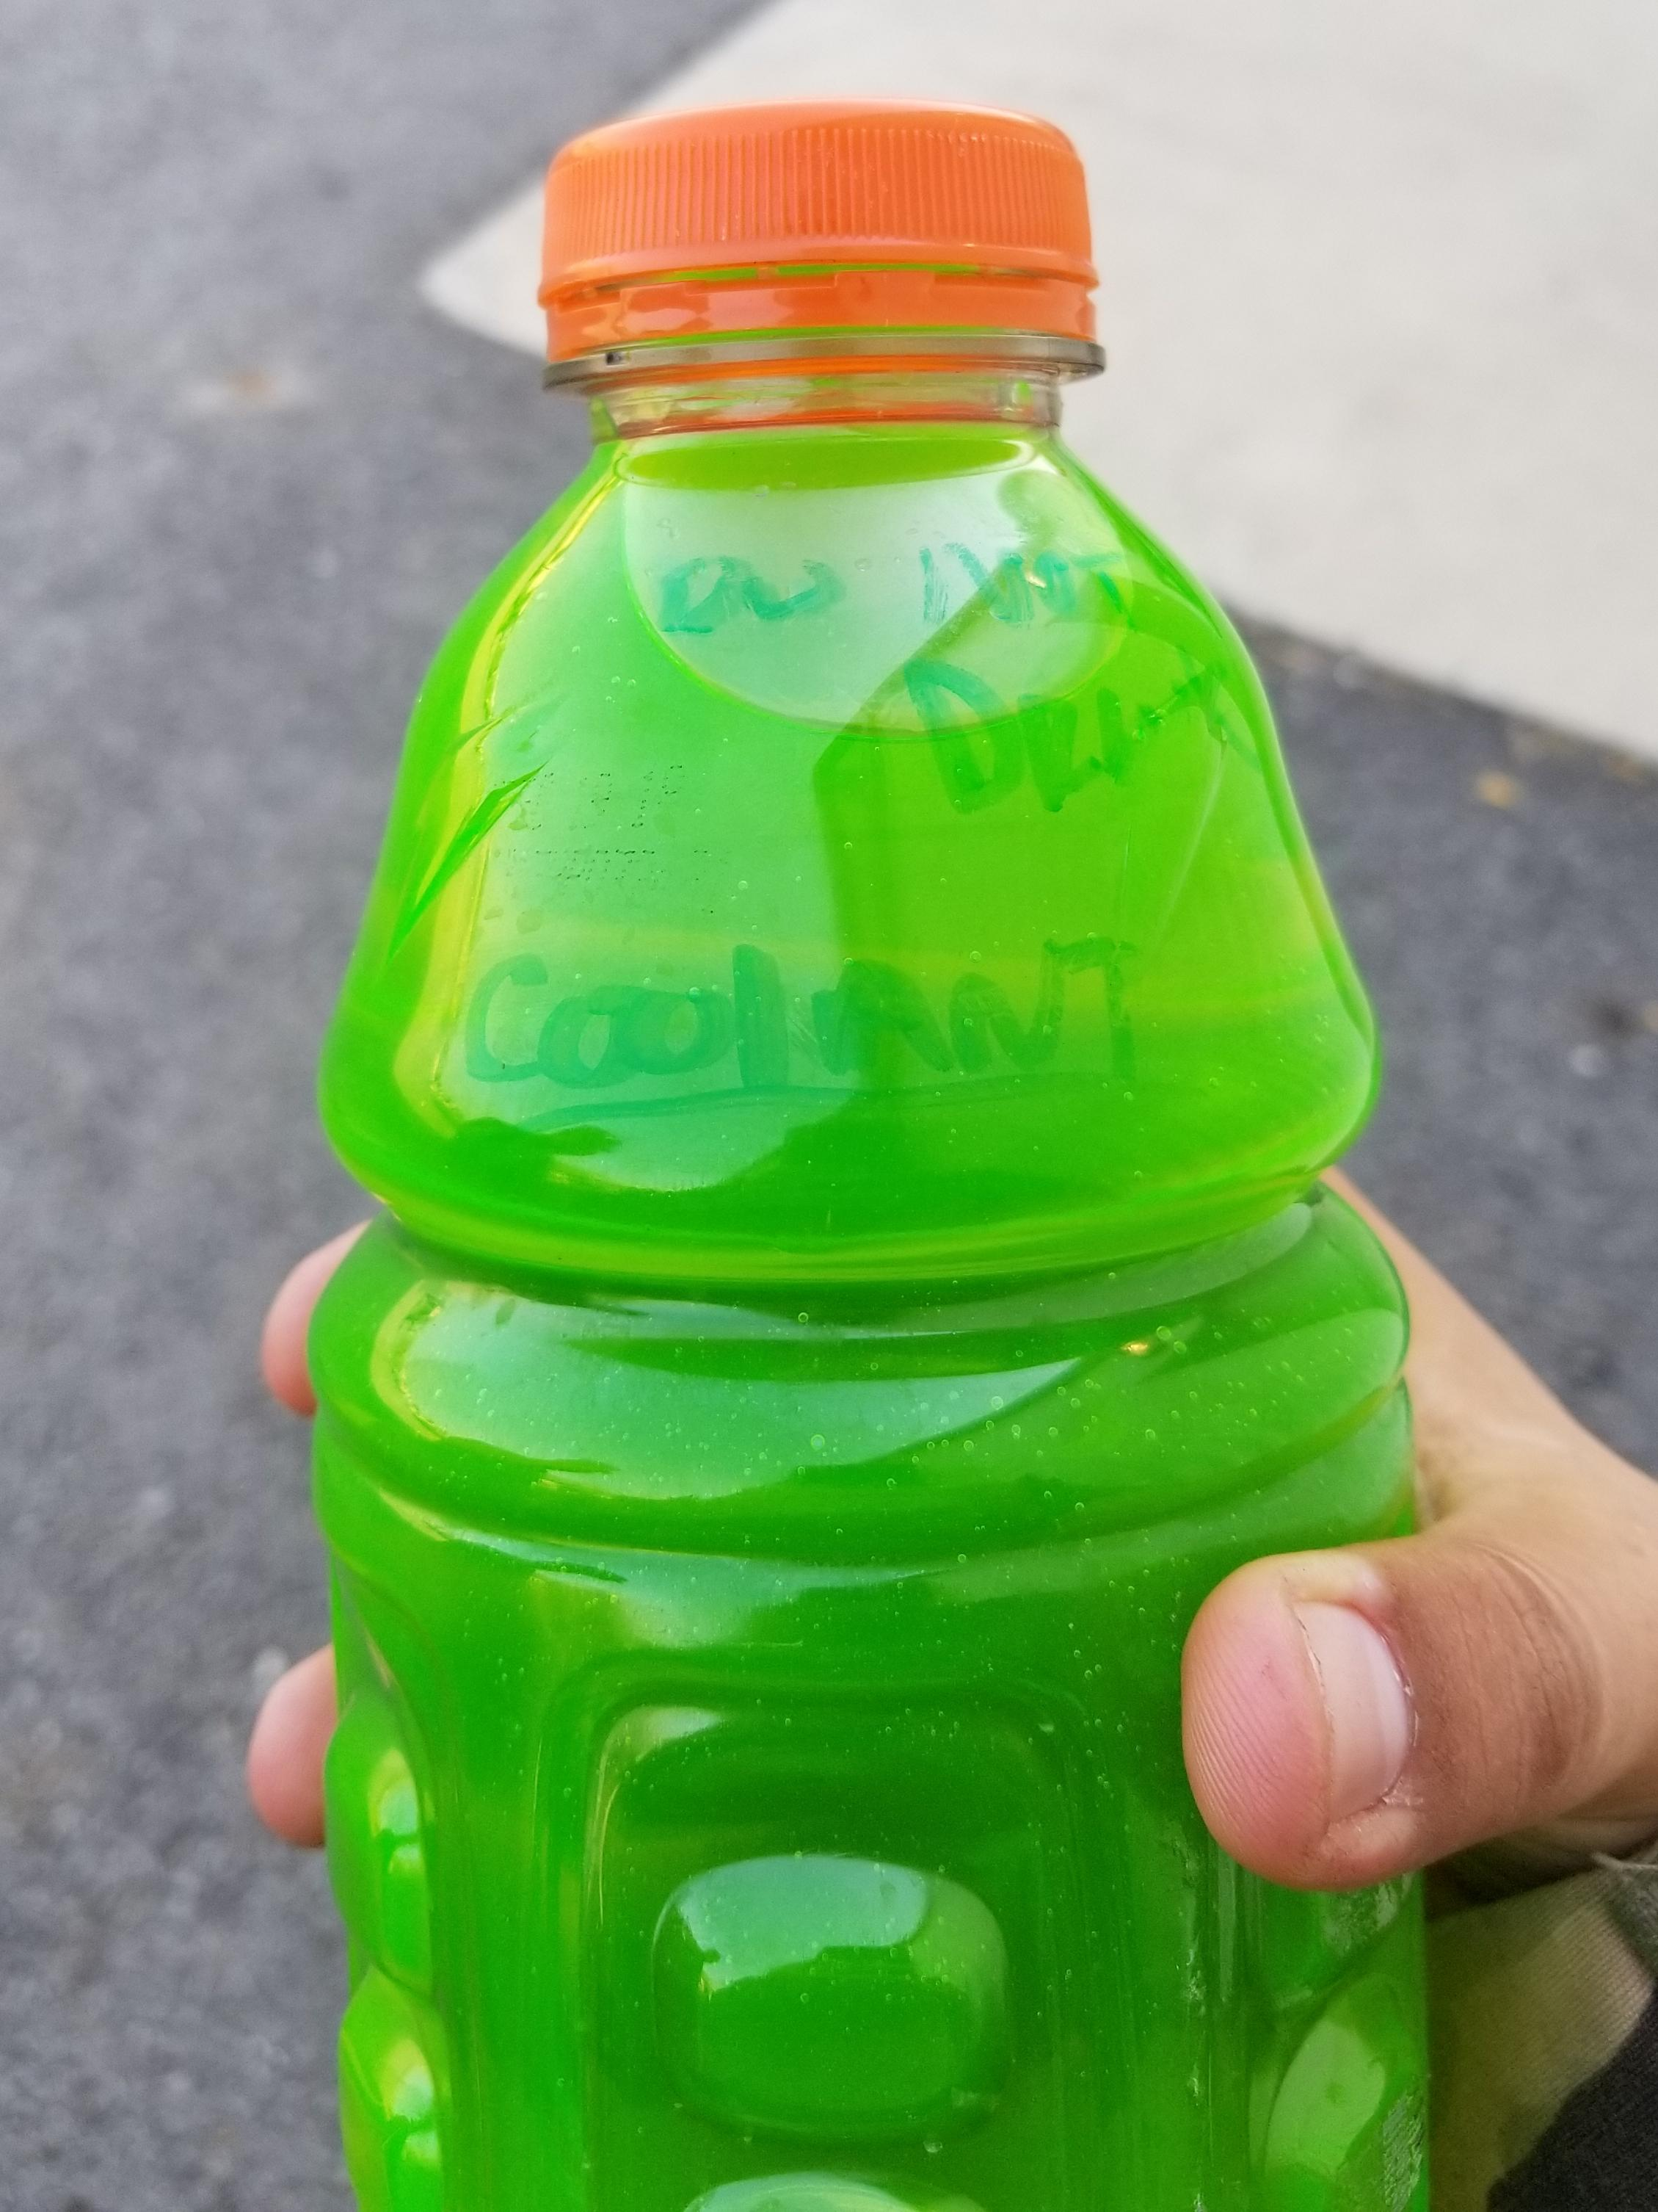
Secondary Container Labeling
When do I have to apply a label?
  Anytime chemicals are transferred from manufacturer’s container
Label options:
  Use original label
  Label with all GHS elements*
  Other label with SDS nearby
    Product identifier
    Hazard description
*Online resources like MySafetyLabels.com are helpful
Notes:
Labeling every container of hazardous chemical is easy if you only ever use chemicals in the original manufacturer’s container, with the original label in good condition. But we know that is not always possible. Often, you will need to decant, dilute, or transfer chemicals into other containers to make them easier to use. This process is called Workplace Labeling or secondary container labeling. The first example that probably comes to mind is a spray bottle used for cleaning products, but you probably have many more workplace containers than you realize. For example, buckets used to hold diluted cleaning solution or containers of disinfectant metered into a water treatment system are also workplace containers that must be labeled.
As the picture on this slide illustrates, secondary container labeling is extremely important for you and your coworkers. Many commonly used hazardous chemicals can easily be confused for innocuous products, posing a serious health and safety risk. Chemicals like antifreeze, glass cleaner, windshield fluid, Rain-X, and de-icer could all be confused with sports drinks if left in unlabeled containers (especially if they are drained into old sports drink bottles!)
So how do we appropriately label our own containers in the workplace? The easiest and safest way is to use the original manufacturers label, if possible, to make sure that all of the necessary hazard information is immediately available. The second-best way is to create a label with all the GHS elements on it. You can use the product’s SDS to help identify the correct information and use a template like the label on the previous slide that can be printed directly onto label stickers. You may also be able to find a pre-made label on websites like mysafetylabels.com. This site offers free downloads of many commonly used product labels and has pre-printed label options for purchase.
The final option for labeling workplace containers is to make a label using your own identification system, as long as the remainder of the GHS information is provided in SDSs nearby. This option allows employers to use other labeling systems like NFPA or HMIS as long as they do not conflict with GHS and as long as they completely capture the hazards associated with a chemical. If however, these systems don’t address all the hazards of a chemical (such as chronic health hazards), supplemental label information would be required. In addition, if using this system the remainder of the GHS information must be close at hand and staff must be routinely trained on any other labeling systems used. An example of this type of label is provided on the next slide.

Slide 12
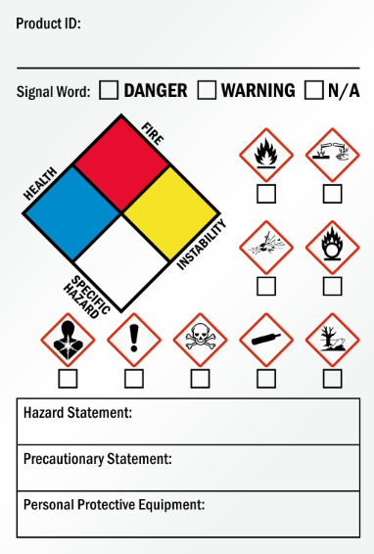
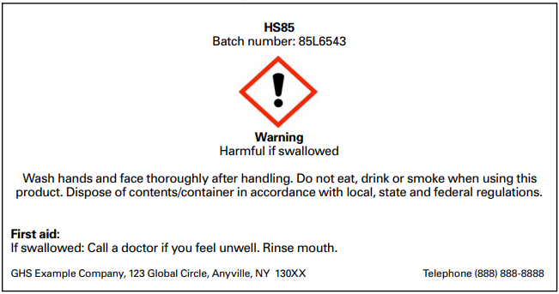
Example Labels

Slide 13
Communication Methods: Labeling
There are a few exceptions to the HazCom labeling requirements:
Portable Containers
  Must be used in one shift
  Must only be used by the person who filled the container
  Must not be left unattended at any time
Storage Areas
  Forgoes individual labeling if all contents of all containers are the same
  Must be visible at all times
  Must contain the same information as an individual label
Non-containers
  Pipes, engines, and fuel tanks
Notes:
OSHA has made a few exceptions to the HazCom labeling requirements. The first is for portable containers, like spray bottles. Portable containers do not need to be labeled if the contents are used in one shift by only one person, with the contents being used completely or returned to their original containers. The containers cannot be passed from one employee to another, and employees cannot leave unlabeled, partially filled containers unattended. These requirements greatly limit the opportunities for this exception to be used, so it is a best practice to always label portable containers.
The second exception applies to labeling of a group of containers. In areas where multiple stationary containers are stored, signs or placards may be used to identify a group of containers. The sign or placard must identify the containers to which it applies and must convey all of the same labeling information as an individual label. The employer must ensure that this signage is conspicuous at all times.
Finally, there are some things that are exempted by the definition of a container under the HazCom Standard and therefore do not follow the individual labeling requirements. This is not to say that there are not labeling requirements for these items under other regulations, however. Items under this exemption include pipes or piping systems, engines, fuel storage tanks, and other fluids in vehicles.

Slide 14


Communication Methods: Labeling
Other labeling systems
  NFPA
  DOT
Notes:
While we are discussing labels, let’s look at some other labeling systems that fall outside of HazCom or may be used in addition.
The National Fire Protection Association developed the 704M system for the identification of hazardous materials for the purpose of emergency response. The NFPA diamond shown here quickly identifies risks in four standard areas. A score of 0-4 is assigned to each colored section of the diamond, with 4 being the highest or most hazardous rating in each category. The red section represents flammability, the blue represents health, and the yellow represents instability or reactivity. The white section is left for other special information and may contain symbols to indicate risks such as water reactive, or radioactivity. While not the focus of this training session, you should be aware that NPS has adopted the NFPA standards so these labeling requirements must be followed in addition to OSHA’s HazCom labeling requirements.
The second additional labeling system you should know is the Department of Transportation (DOT) system. This system is used for labeling the vehicles used in transportation of hazardous materials. Placards are diamond shaped and will depict a word or symbol to indicate a class of hazards. Many of the pictograms used on placards are the same as those used in the GHS system. Placards may also include a four digit identifier called a UN number identifying a specific chemical. More information on DOT placards and UN numbers can be found in the Emergency Response Guidebook or the Hazardous Materials Compliance Pocketbook.

Slide 15

Communication Methods: SDS
Standard format of 16 sections
  Always in the same order
Must be readily available to all employees on their first day of employment.
Must be provided to employee within 24 hours of request
Notes:
The second communication method we’ll discuss is Safety Data Sheets, or SDSs. SDSs replaced their predecessor MSDSs when the globally harmonized system was adopted. SDSs provide a consistent format, language, and definitions over MSDSs, making them more reliable and efficient to use.
Employers must ensure that SDSs are readily accessible to employees for all hazardous chemicals in the workplace. It is acceptable to keep them digitally so long as employees can access them from the first day of their employment, and they do not have to leave their work area to do so. A best practice is to keep hard copies in a conspicuous binder in each work area.
Employers should designate at least one person to maintain the SDS repository to ensure that SDSs are added for each new chemical brought into the workplace and that SDSs are updated regularly. SDSs must also be kept after a chemical is no longer used in the event that a former employee has concerns that they may have exposure-related health impacts. These SDSs may be removed from the binders but must be kept somewhere on site for 30 years as a reference. Anytime an employee has had a documented exposure to a hazardous material, a copy of the SDS should also be kept in their personnel file.

Slide 16
Communication Methods: SDS
Product Identifier
Hazard Identification
Composition
First Aid Measures
Fire-fighting Measures
Accidental Release Measures
Storage and Handling
Exposure Controls (PPE)
Physical and Chemical Properties
Stability and Reactivity
Toxicological Information
Ecological Information
Disposal
Transportation
Regulatory Information
Other Information
Notes:
The sections listed above can be found on every SDS. Notice that many of the sections contain information you likely use or look for regularly, such as storage and handling, suggested PPE, and disposal methods. Other sections, such as first aid, fire-fighting measures, and accidental release – or spill response – are important to remember so that you can find this information quickly in the event of an emergency.
The 4 GHS elements we identified earlier - pictogram, signal word, hazard statement, and precautionary statement - can all be found in section 2.

Slide 17

Exemptions
Non-hazardous materials
Household Consumer Products
  Based on exposure
Notes:
There are a few exemptions to the SDS requirement. First, recall that HazCom refers to hazardous materials. So, SDSs are not required for non-hazardous materials.
The second exemption applies to products that are used in the workplace in the same manner they would be used in your home. OSHA defines this to mean that the duration and frequency of use (and ultimately risk of exposure) is not greater than a typical home user would experience. In other words, an SDS would not be required for a bottle of glass cleaner if it is used only occasionally to clean a mirror for a brief period of time. If, however, that bottle were used by a custodian on a daily basis, the increased exposure would warrant an SDS as well as training. It is important to note that OSHA’s definition does not mention quantity. This understandably makes interpretation of this exemption confusing for many people go but a good rule of thumb is to think about your own home – typically you only have one container of a product unless it is almost empty.

Slide 18
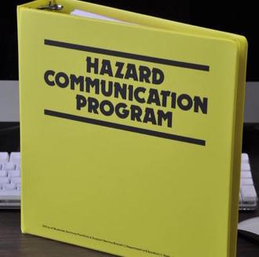
Communication Methods: Written Program
Must include
  Labeling requirements
  SDS program
  Guidelines for employee training
Also Recommended
  Roles and responsibilities
  Contractor/Concessionaire integration
  Documentation and storage
  Chemical Inventory
Notes:
The Written Program is the third component of HazCom. It provides hazard information to employees and describes the ways in which the employer plans to convey this information. It also ensures that all employers train their workers properly and assign responsibilities to maintain their Program.
Required information for a written HazCom Program includes:
Labeling requirements,
SDS program, and
Employee training guidelines
It is also recommended that the Program contain the following:
Roles and responsibilities relating to the Program, including those of supervisors and employees, and the person who will administer the Program
How contractors and concessioners integrate with the Program
Documentation and storage, such as where the Program itself and training records will be kept
The site’s chemical inventory, which we will discuss further in the next section.

Slide 19
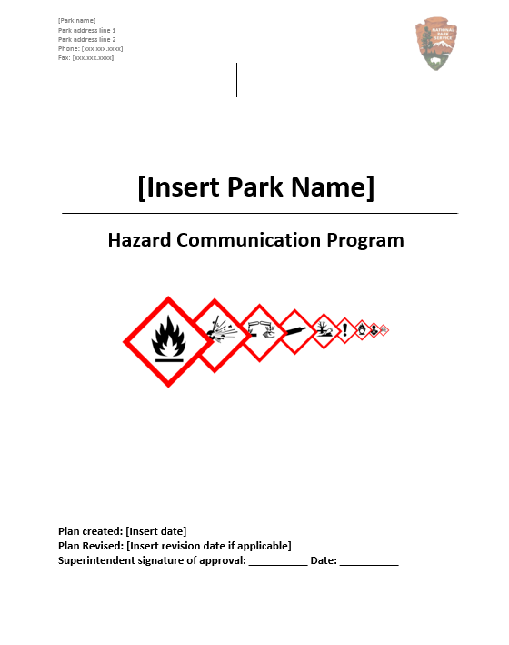
Communication Methods:
Written Program
HazCom plans should be updated:
  Each time regulations change
  Each time staff or roles change
  Each time the training program changes
  Each time new chemicals are introduced
The Regional Environmental Program Manager maintains a template that parks can use to create their written program
Notes:
A Park’s Written Program should be reviewed annually to ensure its accuracy. Updates should be made each time regulations change. Note, if your written program has not been updated since 2016, it likely does not incorporate GHS. Updates should also be made whenever HazCom responsibilities are assigned to a new person, or when employees’ job descriptions change; each time the training program is updated; and each time new chemicals or hazards are introduced. Each time the plan is updated it must be re-approved by the Superintendent.
If your park needs help developing a compliant Written HazCom Program, contact your Regional Environmental Program Manager for a template. Be sure to read through the entire template and fill in the appropriate information throughout.

Slide 20
Communication Methods: Chemical Inventory
Often included as an appendix to the written program, but may also be the Table of Contents in a complete SDS binder
Lists every chemical at the Park
  Same product identifier as the SDS
  Container size and type
  Quantity
  Location
Notes:
The fourth communication method, the chemical inventory, is what the name implies and is just as important as any of the four other components of the HazCom Standard. The chemical inventory lists every chemical at the facility in one place. The list must use the same product identifiers used on the SDS for each chemical, and should also include the container type and size, quantity, and location of each chemical.
This list should be updated regularly and maintained in a location that is easily accessible to all staff in the event it needs to be provided to emergency responders. One common practice is to include it as an appendix to the Written Program, but the Table of Contents of your SDS binder could also serve this purpose if it meets all the requirements.

Slide 21
Communication Methods: Training
A HazCom Program is only as good as the training that goes with it
Documentation is key!
Notes:
The fifth component of the HazCom Standard is employee training. This component brings together the other four, and is a vital step towards ensuring that employees understand the ways hazards are being communicated to them and where to find this information. In the next slides we’ll talk about what should be included in training and when it should happen.
Remember, if training isn’t documented, it’s hard to prove that it was done. So make sure to include a record in your files.

Slide 22

Communication Methods: Training
General and specific hazards
Methods to protect employees:
  Use of PPE
  Storage/handling practices
  Emergency procedures
Details of the Program
  Location
  Labeling system
  SDS
Notes:
HazCom training should cover general hazards, including the categories we discussed previously (simple asphyxiants, combustible dusts, pyrophoric gases and HNOC), as well as the specific hazards faced by employees. As you talk about these hazards, walk through in detail how to use them safely. Discuss what PPE should be worn when using the chemicals, how to store and handle them safely, and what to do when they are involved in an emergency situation. Be specific! The more thorough your discussion, the less likely incidents will be to occur.
This training session covers most of the elements of the HazCom Standard, but can’t address the specific locations, contacts, and procedures at each Park. At the end of this training we’ll provide some guidance on how to complete your training with your employees or supervisor.

Slide 23

Communication Methods: Training
Training should be held
  At initial assignment
  When roles change
  When hazards change
  When the program changes
  Annually (recommended)
Notes:
When should training happen? Its important that employees become familiar with the local HazCom program as soon as they start their jobs. If HazCom is not already incorporated into your local onboarding program, talk to your administrator or health and safety officer about adding it. Many health and safety incidents happen with new staff who are uncertain of their surroundings or are afraid to speak up when they are unsure how to complete a task, and the repercussions may be worse if they do not know how to find the information to safely address the situation.
Staff should be retrained as often as conditions change. This may include a change in their job duties, the types of materials they are exposed to or when HazCom procedures are updated. Very rarely does any workplace go more than a year without one of these changes taking place, so it’s a good rule of thumb to hold training annually.

Slide 24
Responsibilities
Program Coordinator
  Write and maintain the written program
  Establish training program and keep documentation
  Keep chemical inventory updated
  Maintain old MSDSs/SDSs for 30 years
Supervisor
  Informs coordinator and H&S manager of job requirements and hazard exposure of their staff
  Enforces compliance
Employee
  Use proper PPE as necessary
  Know location of emergency equipment
  Inform supervisor of potential hazardous situations/events
Notes:
Now that we have covered all the components of a HazCom Program, let’s recap what you need to do. If you are the program coordinator at your facility, you are responsible for establishing and maintaining all the components of the Program. If you do not already have a Written Program, obtain a copy of the template and tailor it to your Park, making sure to have it signed by your Superintendent and storing a copy where all staff can access it. Write a training program, or use this one, and keep records of everyone who has completed it. Work with supervisors and department chiefs to make sure your chemical inventory and SDS books are up to date and keep an archive of the old ones.
If you are an employee supervisor, your job is to be the liaison between the Program Coordinator and your staff. Make sure the Program Coordinator is fully aware of the hazards you work with so that they can be properly addressed. It is also your job to make sure that the Program is being carried out by your staff on a daily basis, including labeling containers, proper handling and storage practices, and correct use of PPE.
As an employee, you must carry out the Program. Take your training to heart and implement it in your daily routine. Use the appropriate PPE each time you work with a hazardous material. Be prepared for an emergency at all times by knowing where the closest fire extinguisher, spill kit, and first aid kit are located. And, if you see hazardous situation, or potentially hazardous situation, inform your supervisor so that it can be addressed.

Slide 25

Training Your Staff
Discuss the components of the HazCom Program at your Park
Document your training
Notes:
The most important step when providing this training internally is to discuss the specific implementation of the HazCom program at your park. Remember that HazCom emphasizes becoming familiar with the hazards in your work environment. If you are a supervisor or Program Coordinator giving this presentation you can delete this slide and use the one following to discuss the following:
Where is your written program located and who is responsible for implementing the program?
What are the site-specific procedures it contains?
What are the specific chemicals and hazards you work with?
What are the correct storage and handling, PPE, and disposal practices for those chemicals? Are you doing them?
What do you do if you notice a spill?
Do you have containers labeled appropriately? Who is responsible for making sure you do this?
Where are SDSs and chemical inventory located? What happens when a staff member buys a new chemical?
Remember, documenting your training and what you discussed is just as important as having it! Keep these records in an easily accessible location.
Thank you for your time and participation today. We hope you found this training helpful.

Slide 26
HazCom at XXXX
Program Storage Location
Site-specific Procedures
Chemical Hazards at [XXXX]
Specific Storage and Handling Practices
Spill Response
  Review the procedure
Labeling
  Update
  Responsibilities
  Location of SDS and Chemical Inventory
Notes:
**This slide is to be used by park staff when presenting this training internally**
Where is the written program located and who is responsible for implementing the program?
What are the site-specific procedures it contains?
What are the specific chemicals and hazards we work with? (Fuels, pesticides, solvents, paints, etc.)
What are the correct storage and handling, PPE, and disposal practices for those chemicals? Are we doing them?
What do you do if you notice a spill?
Do we have containers labeled appropriately? Who is responsible for making sure we do this?
Where are SDSs and chemical inventory located? What do I do if I buy a new chemical?

Slide 27
Questions

