Slide 1

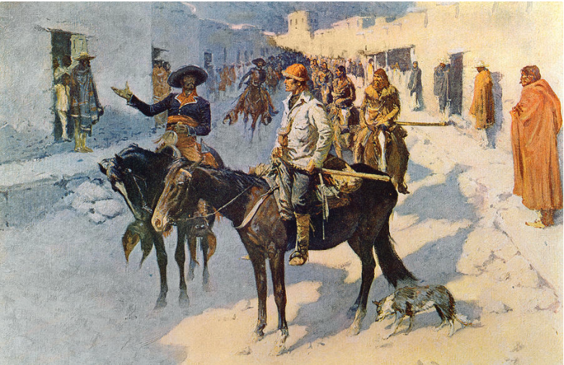
Pike National Historic Trail
Feasibility Study
National Trails - National Park Service
U.S. Department of the Interior
Virtual Public Meeting
WELCOME!
The meeting will begin shortly.
Please note:
All participants are muted.
The meeting is being recorded.
Painting by Frederic Remington (1906) entitled, “Zebulon Pike Entering Santa Fe”
Courtesy of the Library of Congress.
Notes:
Welcome to the Frederic Remington, “Spaniards Escorting Zebulon Pike into Santa Fe, N.M., 1807.” Courtesy Library of Congress
PULL PP Down for face to face intro from Aaron and Lillis’
Aaron :
Good evening, and welcome to the (STATE NAME) virtual public meeting for the Pike National Historic Trail Feasibility Study.
My name is Aaron Mahr and I’m the Superintendent of the National Park Service’s National Trails Office in Santa Fe, New Mexico. I’m joined tonight by my colleague Dr. Lillis Urban, and together we’ll lead you through the meeting this evening.
Lillis would you like to introduce yourself?
Lillis: Greetings. Thank you for joining us today. My name is Lillis Urban, I’m the Chief of Planning for the National Trails Office. I will co-presenting with Aaron today.
Aaron:
Thanks, Lillis.
Zoom – in order to comply with CDC protocol, this is a remote meeting on Zoom.
Our standard practice is in-person public meetings, and that is our preference. But in order to meet Congressional expectations for time lines, we needed to hold these meeting now – so we are on Zoom.
Lillis will talk more about how we will try to achieve the maximum access for public comment – and how to make this easy and accessible to all.
We speak in a moment about how to use and participate on the Zoom.
While this is an open forum, it is also a family friendly one, so please keep your comments and wall posts clean. In addition to keeping it family friendly, we ask that you follow our posting guidelines. If you don't comply, your message will be removed.
We do not allow graphic, obscene, explicit or racist comments or submissions, nor do we allow comments that are abusive, hateful or intended to defame anyone or any organization.
We do not allow solicitations or advertisements. This includes promotion or endorsement of any financial, commercial or non-governmental agency. Similarly, we do not allow attempts to defame or defraud any financial, commercial or non-governmental agency.
We do not allow comments that suggest or encourage illegal activity.
You participate at your own risk, taking personal responsibility for your comments, your username and any information provided.
Finally, the appearance of external links on this site does not constitute an official endorsement on behalf of the U.S. National Park Service or the U.S. Department of the Interior.

Slide 2
Meeting Objectives
Introduce the national historic trail feasibility study
What is a National Historic Trail?
What is a National Historic Trail Feasibility Study?
What is the Pike Trail, and where does it fit in American history?
Explore the study process
What are the criteria for eligibility for a potential National Historic Trail?
How are these applied in the study process?
What comes next?
Listen to feedback from you and answer any questions.
Notes:
Here’s what you can expect in our meeting today. For the first 45 minutes, or so, we will present a Presentation – and then we will turn it over to you for a question and answer session and to hear comments.
please enter comments and questions into the CHAT anytime during this presentation - Lillis and I will read and address those after the presentation portion of the meeting.
In total, the meeting will not exceed two hours.
To start -
I’m going to provide a brief explanation of the legislation that brings us here tonight, and then answer the questions What is a NHT? and What is a NHT Feasibility Study?.
I’ll then provide a very brief historical perspective that places the Pike trail in its historical context, and then focus on the trail itself and review its characteristics.
Dr. Urban will then explain the study process and how the evaluation of the Pike Trail will occur.
She’ll then Invite you to share your input into the study process. We want to hear from you and answer any questions you might have about the study process or the designation implications of a national historic trail.
The later half of our meeting today will be dedicated to answering your questions and receiving your comments.
Again, throughout the meeting, please feel free to enter any questions or comments you have in the chat box. We will address those after the slide show.
Lillis, would you please tell us about the Pike Study’s website and help us with some of the detail on how to work zoom.
_____

Slide 3
Pike study - webpage
parkplanning.nps.gov/pike
Pike study sign-up form
www.tinyurl.com/ynxdsfrn
Notes:
Absolutely.
This slide shows the website address for the study’s webpage and also a website for the Pike study sign up form.
On the study webpage - www.parkplanning.nps.gov/pike – you can download a copy of this PP presentation.
There is also additional information on the project’s webpage. And, you can download copies of all the maps that will share today in the presentation as well as other.
Please take note, those folks who may joining our meeting by phone only today, and not through the Zoom meeting, know that you access the presentation at anytime on the study’s webpage.
We have put the link to the study’s webpage in the chat box.
[IN CHAT type: www.parkplanning.nps.gov/pike]
In addition, for anyone in attendance today, if you would like to add your email address to the project mailing list, please add your contact to the Pike study sign up form.
We have placed a link to that sign up form in the chat box
[IN CHAT type: www.tinyurl.com/ynxdsfrn}
Before diving into the heart of the presentation, I am going to provide a short orientation to the Zoom platform to ensure everything runs smoothly.

Slide 4
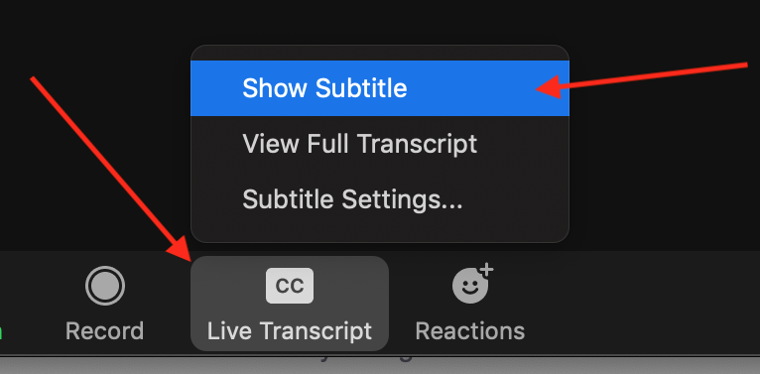

Zoom Notes
Closed Captioning
  To turn on captions, click on the “CC” button and select “Show Subtitle.”
  Views
  In upper right, select “Speaker View” in order to always see the person speaking.
Notes:
In Zoom, At the bottom of your screen is a tool bar.
For those would like to turn on Closed Captioning – click in the CC button on your tool bar and select, Show Subtitle.
You can control your view of the meeting. The default setting for this is “speaker view” if you seeing me while I am talking, you already have your view set to speaker view.
LILLIS – is the Views also in the Tool bar?

Slide 5


Zoom Notes cont.
Chat
  Submit Questions and Comments via Chat:
  Click on Chat to activate the chat box. Submit questions and comment any time. We will answer questions at the end of the presentation.
Issues?
  Send a Chat message directly to the meeting host. In the chat box, in the drop-down menu at the bottom, instead of “Everyone”, select “Jennifer Gawlowski (Host)”
Notes:
PRESENTED BY JMARK:
Before diving into the presentation, let’s take few moments to provide a short orientation to the Zoom platform to ensure that the meeting runs smoothly for you.
As a reminder, everyone is muted.
3. Chat box open. Comment or enter Qs anytime.
People are welcome to enter comments or questions at anytime during the meeting.
Aaron and Lillis will answer at end of presentation
The entire send half of the meeting is dedicated to answering questions and providing opportunity for comment.
4. How to access chat box
This slide shows you where the chat box is… We want to show you how to enter questions and comments into the chat box.
IT Issues: If you any connection or IT issues during the meeting, please either let us know through the chat box, or call (phone XXXXX) one of our IT specialists will help you. We will place that IT number into the chat box right now. - if you need to call in simply --- here is the call in number
6. Any other HOW TO INFO NEEDED
-how to turn on/off video
6. Addressing people on phone - you are muted.
Later in the presentation specifics on how you can comment on the study will be provided.
7. Pass presentation back to Aaron Mahr, Superintendent of National Trails.
close captioning, (eg This slide has a red arrow pointing to the CC icon.
“Click here to turn on Closed Captioning”.
2. All are muted.
3. Chat box open. Comment or enter Qs anytime.
People are welcome to enter comments or questions at anytime during the meeting.
Aaron and Lillis will answer at end of presentation
The entire send half of the meeting is dedicated to answering questions and providing opportunity for comment.
4. How to access chat box
This slide shows you where the chat box is… We want to show you how to enter questions and comments into the chat box.
IT Issues: If you any connection or IT issues during the meeting, please either let us know through the chat box, or call (phone XXXXX) one of our IT specialists will help you. We will place that IT number into the chat box right now. - if you need to call in simply --- here is the call in number
6. Any other HOW TO INFO NEEDED
-how to turn on/off video
6. Addressing people on phone - you are muted.
Later in the presentation specifics on how you can comment on the study will be provided.
7. Pass presentation back to Aaron Mahr, Superintendent of National Trails.

Slide 6

Zoom Notes content
Audio
  You are muted and will not be able to unmute yourself.
  If you are experiencing an audio echo, please ensure you do not have two devices connected to the meeting.
  If you cannot hear the meeting via your computer/device, you can call in via phone but still use the video on your device. Click on the microphone and select “Switch to Phone Audio.” You will be provided a phone number to call.
Video
  To turn on/off your camera, click on this button.
Notes:
A few moreAddressing people on phone - you are muted.
Later in the presentation specifics on how you can comment on the study will be provided.
[In CHAT: TYPE call in number, and associated passcode, for meeting]
To Turn on/off your vide, click on the video icon to start or stop video. Please remember that if you video is on everyone in the meeting can see y you.

Slide 7
Why we're here: The Pike National Historic Trail Study Act of 2019 (P.L. 116-9)
Amended the National Trails System Act.
The Secretary of the Interior designee—in this case the National Park Service--will evaluate the route taken by Lt. Zebulon Pike in 1806-07 for potential addition to the National Trails System.
Trail begins near St. Louis, Missouri and runs through Missouri, Kansas, Nebraska, Colorado, and New Mexico. It passes through three northern Mexican states, then reemerges in Texas, and ends in northwestern Louisiana; and includes 2,600 miles in the U.S. (and an additional 1,000 miles in northern Mexico).

Slide 8
What is a National Historic Trail?
  Part of the National Trails System created by the National Trails System Act of 1968 (P.L. 90-543). The system is comprised primarily of National Scenic and Historic Trails.
  National Historic Trails are long distance corridors that commemorate past routes of travel that are deemed to be historically significant for the United States.
  Established for both their recreational and educational value.
  To date congress has established 19 National Historic Trails (think Lewis and Clark, Santa Fe, Oregon, California, Juan Bautista de Anza, Trail of Tears, and Selma to Montgomery National Historic Trails).

Slide 9
What is a National Historic Trail?
Designation is continuous from end to end, crossing property and jurisdictional boundaries.
However, participation in trail protection and development activities for the public's benefit is entirely voluntary.
Designation legislation limits land acquisition to only willing-seller actions. Land acquisition very rare.
Trail experience usually characterized by travel on public roadways through the designated corridor to publicly-accessible sites and segments that may be protected for their historic authenticity and may have educational media.
Federal government’s role is to apply best-practices standards and to provide limited technical and financial assistance to participating public and private entities.

Slide 10
What is a Trail Feasibility Study?
National Historic Trail Feasibility Studies:
  Evaluate the eligibility, feasibility, suitability, and desirability of designating a route as a new national historic trail.
  Eligibility is based on Congressionally-established criteria found in the National Trails System Act.
  The National Park Service submits the study's findings to Congress.
  The study does not establish a new National Historic Trail.
  Only Congress through legislated action has the authority to establish a National Historic Trail.
  The study will identify eligibility and feasibility. It will not recommend designation of the Pike National Historic Trail.

Slide 11
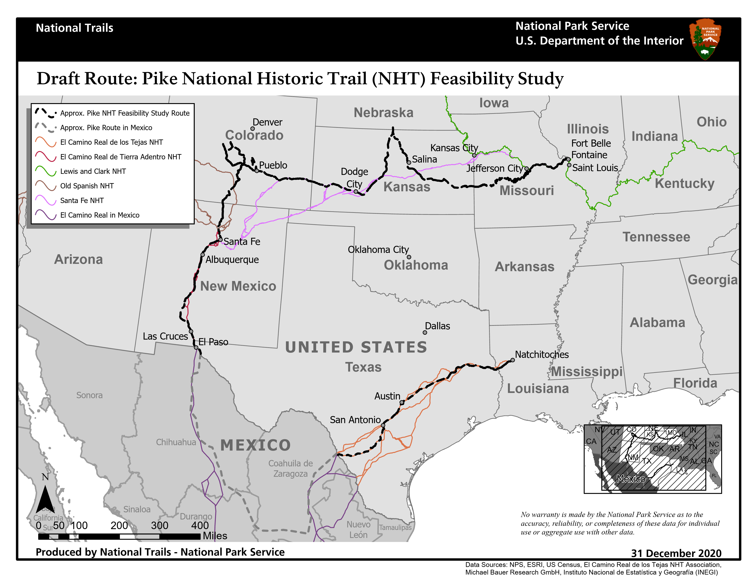
What is the Pike Trail and why should we care?
Notes:
As a broad-overview, here is a map of the proposed Pike NHT, which represents the route taken by Lieutenant Zebulon Montgomery Pike during his 1806-1807 expedition into the southern portion of the Louisiana Purchase and into what was then the northern edge of the Spanish colonial empire, and what is today, Mexico.
The map on the slide depicts the draft route in black
The route traverses 7 states: and begins in Fort Bellefontaine, Missouri and ends in Natchitoches, Louisiana. It spans approximately 2,700 miles, intersecting the states of Missouri, Kansas, Nebraska, New Mexico, Texas, and Louisiana, with an additional 1,000 miles of trail passing through three states in Mexico. The section of trail which traverses Mexico is not eligible for designation as it falls outside of the United States.
This map also depicts established National Historic Trails
The Pike NHT draft route overlays and intersects a number of established NHTs, including the Santa Fe Trail, the Old Spanish, El Camino Real de Tierra Adentro, and El Camino Real de los Tejas, as well as the Lewis and Clark Trail.

Slide 12
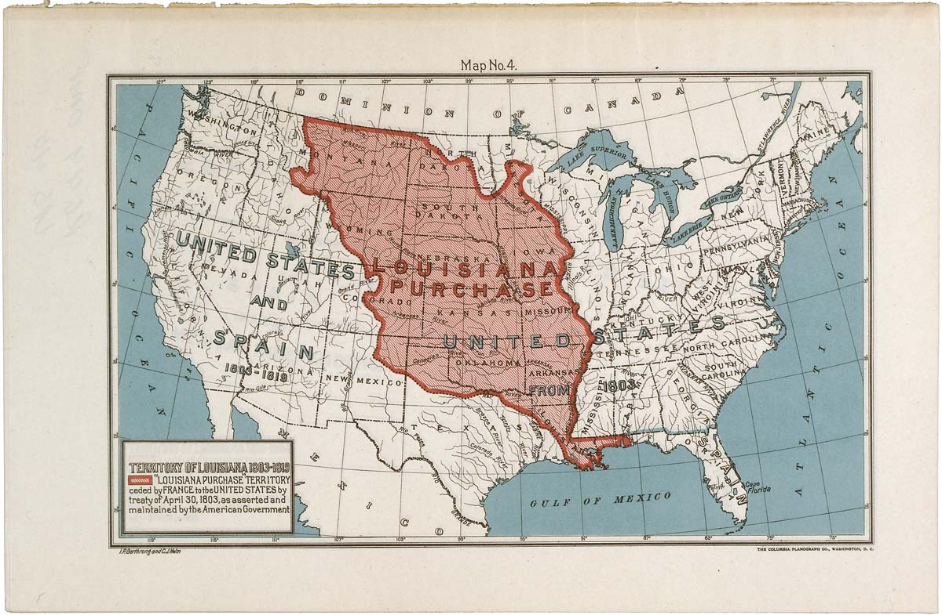
Historical Context: The Louisiana Purchase
The U.S. purchased the Louisiana Territory from France in 1803
* Doubled the size of the U.S.
* Proposed a new western border for the U.S.
* Gave U.S. sole treaty authority with the indigenous tribes
* Sale not recognized by the Spanish Crown
Courtesy Wikimedia Commons

Slide 13
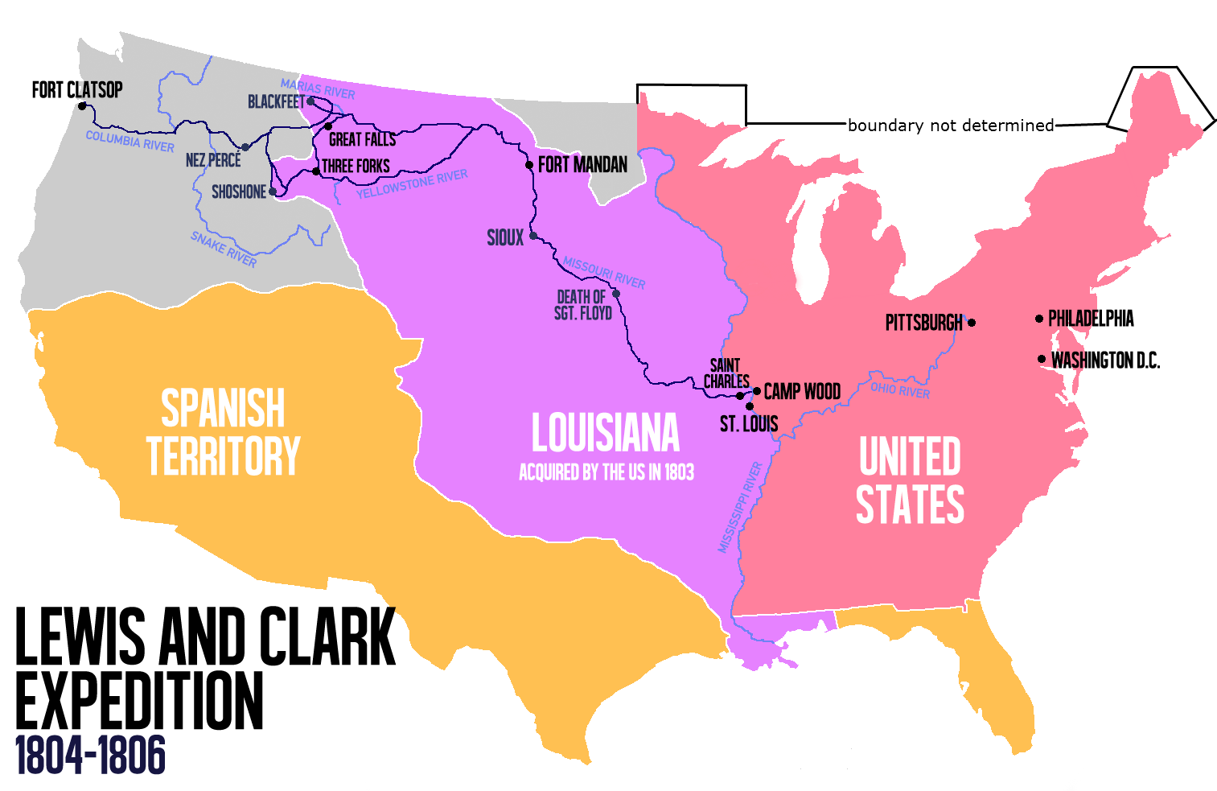
The Spanish Empire in North America
Spanish territory in North America extended from Mexico to most of the American West.
Borders were ill-defined and the Louisiana Purchase did not resolve some of the confusion.
Spanish institutions across Mexico’s northern frontier were well established after nearly two centuries of settlement.
Population numbers and economic production were low, and the territory was vast.
Mexico’s northern frontier served as a buffer against autonomous indigenous cultures, and foreign incursions from the British, French, and Americans.
Notes:
Mexico, then known as New Spain, was the focus of Spanish colonization in North America, but the Crown’s territorial holdings included most of the American West.
Spain’s territorial borders in the American West were ill-defined and the Louisiana Purchase challenged belief that the Mississippi River was the international frontier.
Spanish institutions across Mexico’s northern frontier were well established after nearly two centuries of settlement, but population was sparse, economic production was low, and the territory was vast.
For many in the Spanish Empire, the greatest value to holding these lands was to serve as a buffer to the rest of Mexico against foreign incursions from the British, French, and Americans.

Slide 14
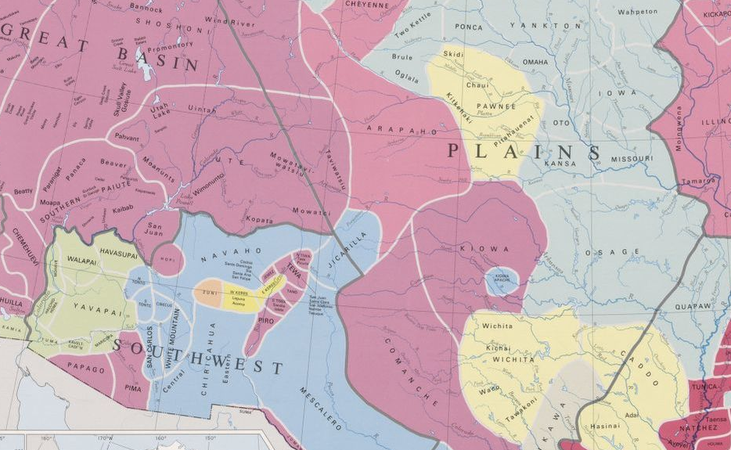
Native American Territories in the Louisiana Purchase
Indigenous cultures dominated the lands in the Louisiana Purchase.
Many had generations of experience resisting and accommodating the demands of European colonial powers, and more recently, those of the Americans.
Tribes best known to the Americans were the Osage, Kansas, and Pawnee, but there were others.
Comanche dominated to the west and formed a strong barrier to American expansion westward, and Spanish expansion northward.
Tribal homelands in the time of Pike
Image Courtesy Library of Congress
Notes:
Indigenous cultures dominated the lands in the Louisiana Purchase.
Many had generations of experience resisting and accommodating the demands of Europeanor balancing competing European colonial powers' interests in their lands and trade. Americans were new in the area, but not unknown.
Best known to the Americans were the Osage, Kansas, and Pawnee, but there were others.
Comanche dominated to the west and formed a strong barrier to American expansion westward, and Spanish expansion northward.

Slide 15
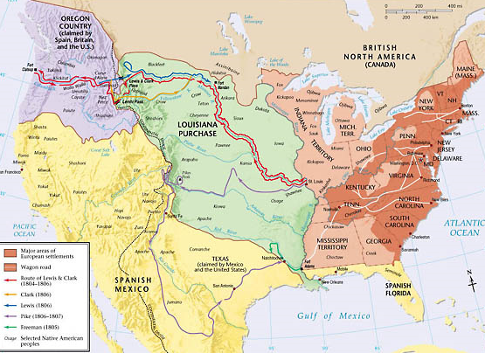
Explorations: The Lands and Peoples of the Louisiana Purchase
* President Thomas Jefferson
ordered exploration
expeditions into the new
American territory.
* The most prominent of
these expeditions was led
by Meriwether Lewis and
William Clark into the
northern tier of lands.
* A handful of lesser-known
expeditions followed until
Pike’s expedition in 1806.
Copyright @2000 by Pearson Education Inc.
Notes:
Immediately after the purcuahse of Louuisian Territory in 1803, President Thomas Jefferson ordered exploration expeditions into the new American territory.
The most prominent of these expeditions was led by Meriwether Lewis and William Clark into the northern tier of lands.
A handful of lesser- known expeditions followed until Pike’s expedition in 1806.
Meriwether Lewis and William Clark led the most famous Jefferson-sponsored expedition, but there were others with similar goals:
Lewis + Clark, 1804-06
Dunbar + Hunter, 1804-1805
Freeman + Custis, May-September 1806
Zebulon Pike: 1806-1807

Slide 16
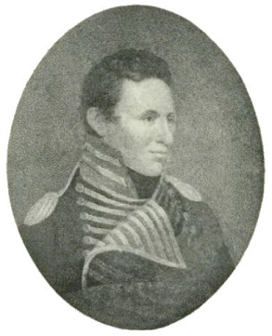
Lt. Zebulon Pike’s Southwestern Expedition
Not ordered by President Jefferson, instead a field decision by Western Department Commander James Wilkinson, who ordered Pike, a young officer, to:
Conduct Diplomacy with Tribal Nations
Return Osage captives to their villages
Encourage peaceful relations with the Osage and Kansas
Make peace with the Comanche
Pursue Exploration and Discovery
Make geographic and biologic observations of the newly-acquired territory
Identify the headwaters of the Red and Arkansas rivers
Intersect the Spanish Frontier
He would likely be in or near Spanish territory, and he was ordered ambiguously to “move with great circumspection”
Lt. Zebulon Pike
Courtesy Wikimedia Commons

Slide 17
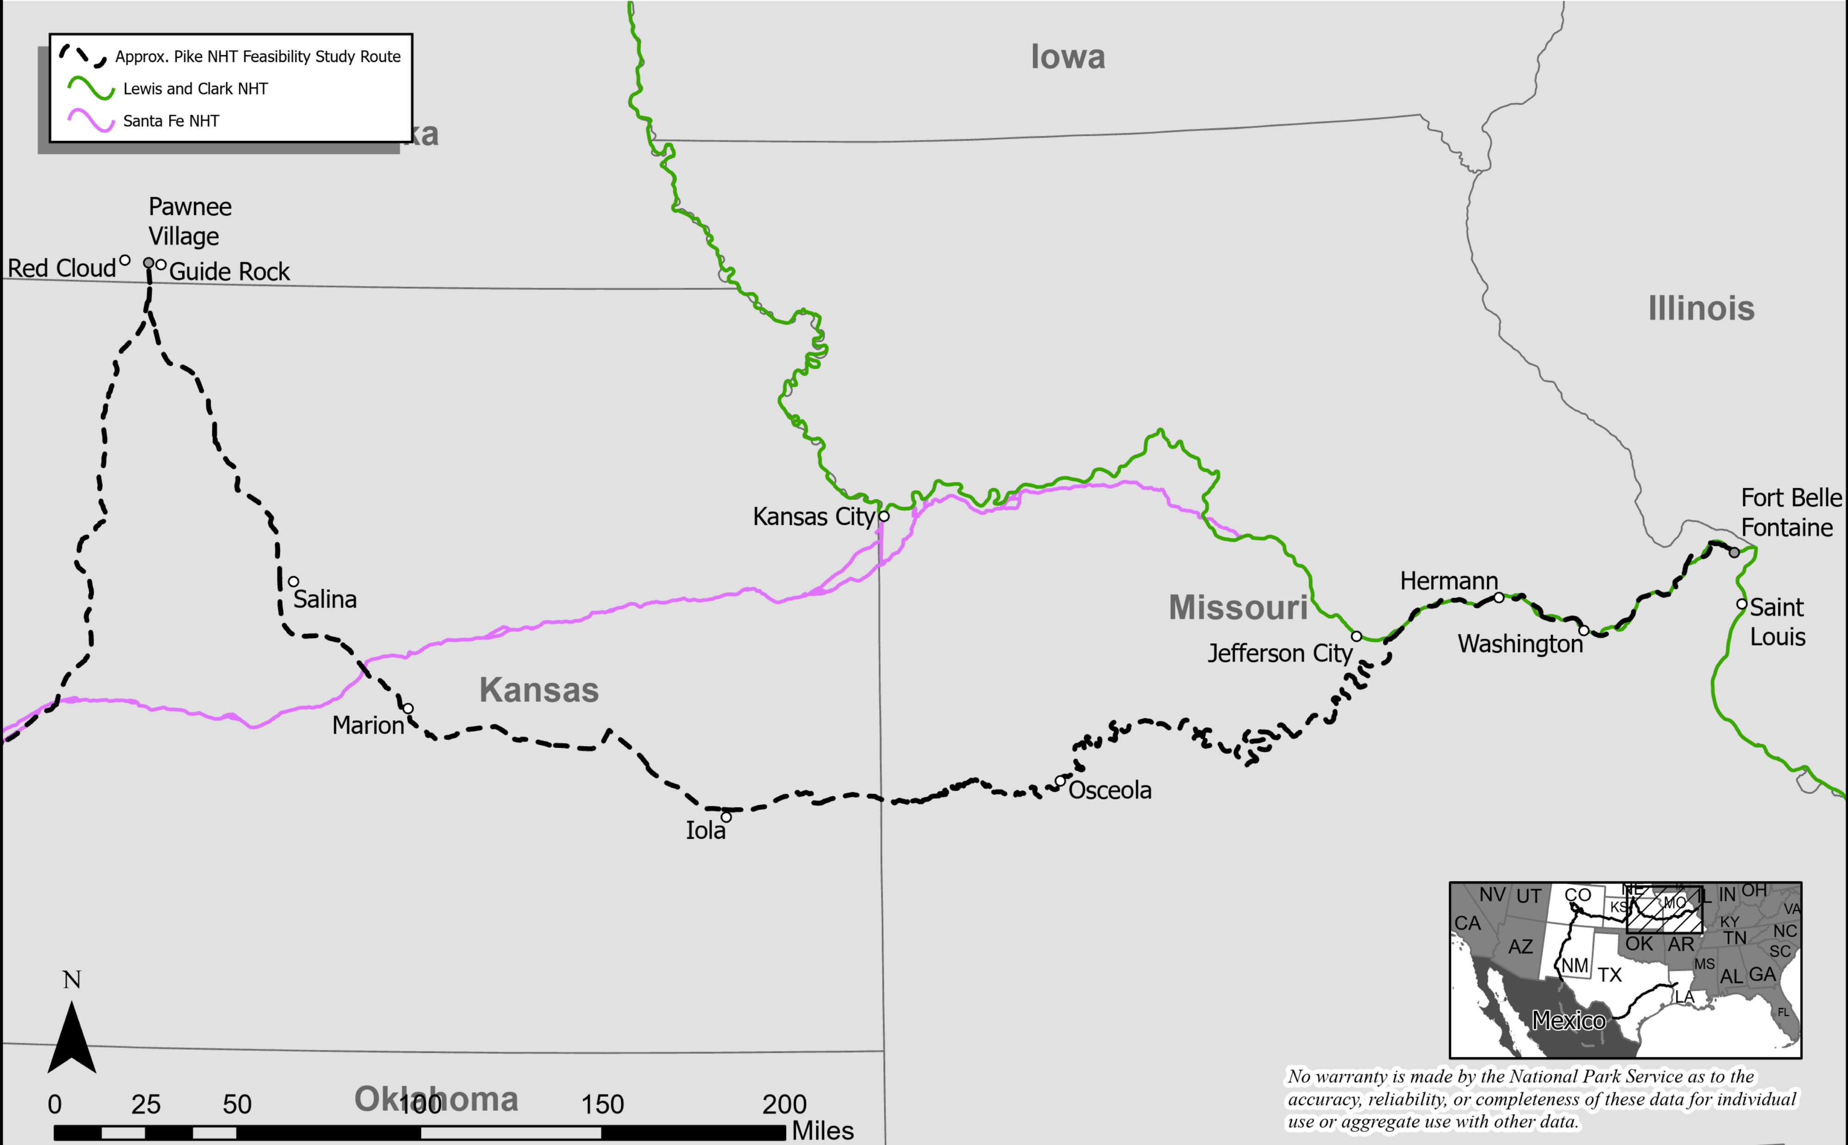
The Pike Trail from Ft. Belle Fontaine to the Pawnee Village: Diplomacy among the Osage and Pawnee
Pike left Ft. Belle Fontaine in July 1806 with 21 U.S Army soldiers, a few civilians, and 51 Osage and Pawnee.
Ascended the Missouri and Osage rivers and began overland journey near the Kansas border.
Returned Osage captives to their villages, some joined Pike to meet with the Kansas and Pawnee.
Met with Pawnee in present-day Nebraska and saw evidence of recent Spanish contact.
Notes:
Pike sets out from Ft. Bellefontaine in July 1806
Pike in charge of 23 men, plus 51 Indians
Mostly Osages, but also some Pawnees that had been visiting Washington, D.C.
After a month’s worth of arduous boat travel, reaches Osage villages is what is now western Missouri
Osages thankful for returning of lost relatives
Pike convinces a delegation of Osages to continue with him, awaiting a council with the Kansas (rivals of Osages) and Pawnee
Next, in mid-September, Pike arrives at Pawnee villages on the Republican River in present-day southern Nebraska
Took circuitous route to get there to avoid rival Kansas nation to the north
Convinces Kansas representative to smoke “pipe of peace” with Osage
Relations between two tribes improved around this time, but Pike didn’t create any kind of lasting peace
Pawnees had recently been visited by an impressive Spanish force (bearing gifts)
Yet Pike convinces Pawnees to take down Spanish flag and raise American flag
Ultimately, Pawnees do not commit to becoming US allies, nor do they help Pike locate/talk to Comanches
Pike left Ft Belle Fontaine in July 1806, leading 23 U.S army soldiers, a few civilians, and 51 Osage and Pawnee.
Travelled up Missouri and Osage Rivers by boat. Overland journey began at the Grand Osage Villages near the Kansas border.
Returned Osage captives to their villages, a delegation joined Pike to meet with the Kansas and Pawnee in Nebraska territory.
Met with Pawnee at Pawnee Village and saw evidence of recent Spanish contact. Pawnee lowered a Spanish flag and raised U.S. flag over their village.

Slide 18
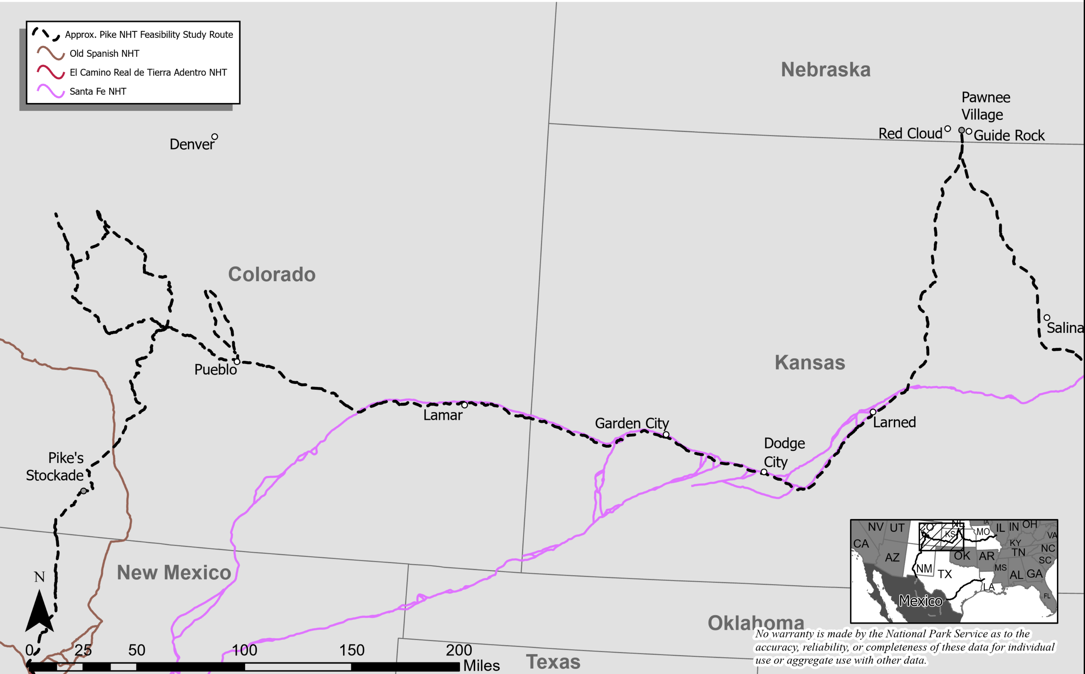
The Pike Trail from the Pawnee Village to the Conejos River: Exploration to the Headwaters of the Arkansas River
Followed indigenous trail used by Spaniards and reached Arkansas River east of Larned, Kansas, followed river west.
Entered Rocky Mountains in Pueblo, Colorado area.
Tried (and failed) to climb what eventually became Pikes Peak.
Lost, miserable, freezing, and hungry, descended into the San Luis Valley and built a stockade on banks of the Conejos River.
Notes:
Pike leaves the Pawnee village in early October 1806
Heads south/southwest on the trail of large Spanish force that visited the Pawnees before him
Later that month, at Great Bend of Arkansas, Lt. Wilkinson (James’ son) and five more soldiers detach from expedition + descend the lower Arkansas
Pike and his men follow the Arkansas upstream toward the Rocky Mountains
Just before Thanksgiving, reach present-day Pueblo (@ confluence of Arkansas and Fountain Creek)
Make ill-advised effort to climb what would become Pikes Peak (see picture at left) in only “light overalls” with “no stockings”
Continue up the Arkansas to present-day Canon City
Pike follows wrong tributary of Arkansas, leading his party on a large counter-clockwise loop
Party becomes officially lost
Spend a miserable Christmas cold and hungry
Reach mouth of Royal Gorge—where they had been a month earlier—on January 5, 1807
On the plus side: he does succeed in locating headwaters of Arkansas
Pike and co. travel south to find the headwaters of the Red River (which Pike believes begins north of Santa Fe)
Pike has to leave two soldiers incapacitated by frostbite
Crossed Sangre de Cristos and enters San Luis Valley
Reach Rio Grande (which Pike supposedly believes to be Red River) by end of January
Pike and men set up stockade along Conejos River, tributary of Rio Grande in present-day southern Colorado
Soon captured by Spanish forces and, in late February, escorted to provincial capital of Santa Fe to be interrogated by governor
Field maps seized (wouldn’t be rediscovered until early 1900s)
Left Pawnee Village and headed to Arkansas River and Comanche territory
Reached Arkansas River in Great Bend , Kansas area and followed it westward
Reached Pueblo, Colorado area in November 1806, and entered the Front Range in search of the river’s headwaters.
Climbed a portion of what became Pike’s Peak, and became lost in high country, miserable, freezing, and hungry.
Eventually ended up in the San Luis Valley, in southern Colorado and built a stockade on the Conejos River in Spanish Territory, where he was captured by Spanish force from Santa Fe.

Slide 19
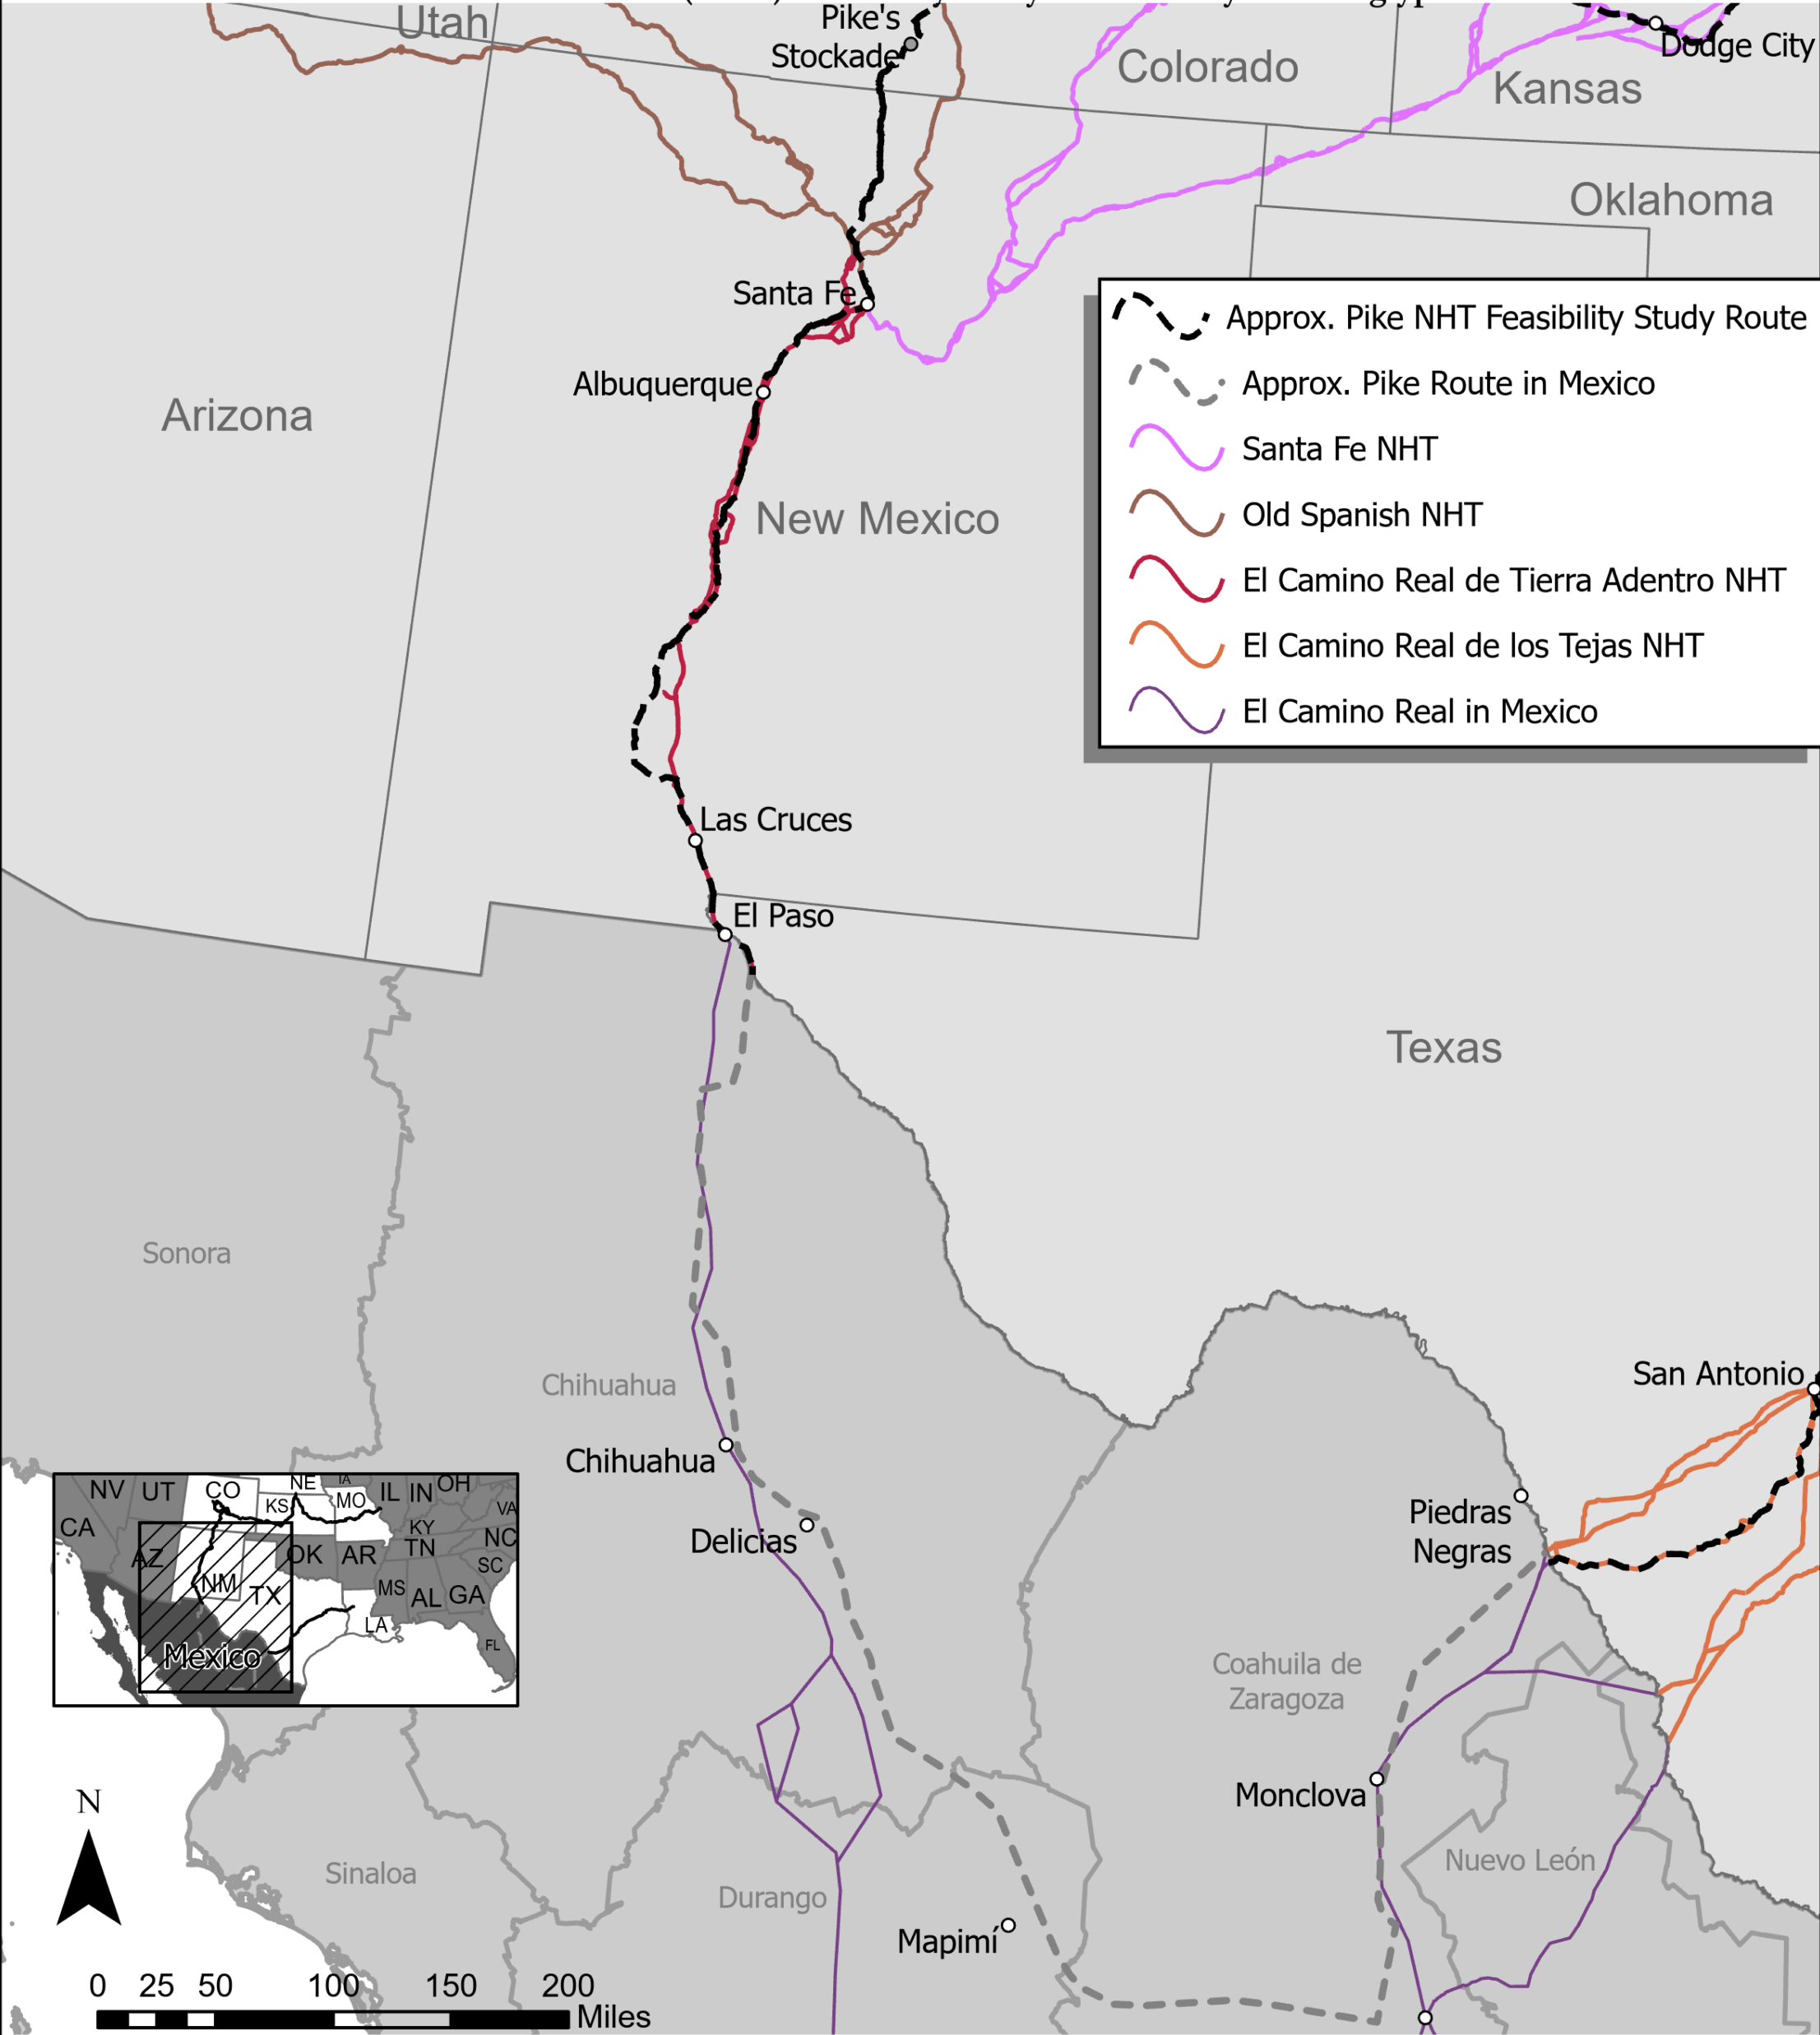
The Pike Trail in Spanish North America: Escorted through New Mexico and Northern Mexico
Illegally in Spanish territory, Pike was captured by a Spanish force out of Santa Fe and escorted to Chihuahua City along the Camino Real for the commanding general to decide his fate.
Technically a prisoner but allowed to interact with military and others, including Americans, in Santa Fe, Albuquerque, El Paso, and Chihuahua.
Commanding general decided to send him back to U.S., through Spanish Texas.
Crossed Rio Grande south of Piedras Negras, following the Camino Real de los Tejas.
Notes:
Key points:
Escorted along Camino Real to Chihuahua and then escorted back to American territory along the Camino real de los Tejas, both are National Historic Trails today.
In Santa Fe, Pike met with Gov. Joaquin del Real Alencaster
Disputed boundaries of Louisiana Territory immediately apparent
Alencaster: “You come to reconnoiter our country, do you?” Pike: “I marched to reconnoiter our own”
Alencaster concludes Pike is a “man of honor”
Pike sent south to meet Nemesio Salcedo, commandant general of the Internal Provinces
Even if Pike didn’t set out to reconnoiter Spanish territory, his trip to Chihuahua gave him a good opportunity
Escorted by Facundo Melgates, who led the Spanish forces on the Plains that Pike was trying to track
Pike treated like a guest of honor on his trip
Fandango arranged in his honor
Got to engage in intellectual discussions with military, cultural, and religious elite of northern New Spain
Spaniards treated Pike way better than they needed to
Mutual curiosity: Spaniards curious about him, and Pike about the citizens of New Spain
Even though he can’t document like before he was caught, Pike still gets lots of great detail for his published journals
Pike remains in Chihuahua for almost all of April, then sent east to Texas
Passes through San Antonio, capital of Spanish Texas and hearth of Hispanic culture
Sees important cities like Santa Fe, Chihuahua, and San Antonio, as well as the less-populated country connecting them
Pike had illegally entered Spanish Territory.
Cooperated with Spanish authorities, and was escorted to Santa Fe and through New Mexico to the provincial capital of Chihuahua City.
Technically a prisoner, but he was treated with respect and given freedom to interact with community leaders and populations along the Camino Real, including Santa Fe, Albuquerque, and El Paso through March of 1807.
Reached City of Chihuahua on April 2 where the commanding general decided to send him back to U.S. via the Camino Real through southeast Texas.
He crossed Rio Grande north of Laredo, passed through San Antonio, and returned to U.S. soil at Natchitoches, Louisiana, ending his Southwest Expedition.

Slide 20
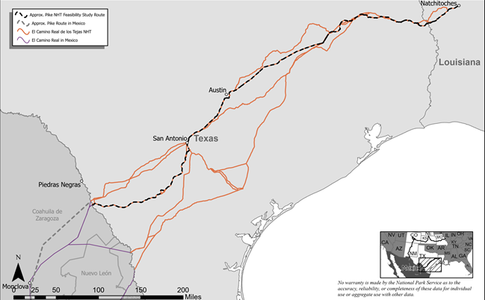
The Pike Trail through Spanish Texas: Return to U.S. and End of Trail in Natchitoches, Louisiana
Escorted through Spanish Texas, continuing to interact with Spanish military leaders and others in San Antonio and other Spanish colonial communities, encampments.
Released on east side of Sabine River on U.S. soil, and arrived at Natchitoches, Louisiana in July 1807.
Pike had traveled for almost 12 months over 3,600 miles.
Traversed the Mississippi woodlands, the Great Plains, the Rocky Mountains, the Chihuahuan Desert of New Mexico and northern Mexico, and the river valleys, hill country, coastal prairie, and southern pinelands of Texas.
Notes:
In July 1807, Pike returns to US soil at Natchitoches (in what is now Louisiana)
Five of his men remained confined in Chihua
Scandal surrounding Aaron Burr and James Wilkinson had captured public eye, damaging Pike’s reputation
All told, in the year-long expedition, Pike traveled roughly 2,700 miles (with an additional 1,000 in what is now Mexico) from Ft. Bellefontaine to Natchitoches
Escorted through Spanish Texas, continuing to interact with Spanish Military leaders and others in San Antonio and other communities and encampments
Released on east side of Sabine River and continued on U.S. soil to Natchitoches, Louisiana in July 1807.
He had traveled for almost 12 months over 3600 miles.
Traversed the Mississippi woodlands, the Great Plains, the Rocky Mountains, the Chihuahuan Desert of New Mexico and northern Mexico, and the river valleys, hill country, coastal prairie, and southern pinelands of Texas.
His journal, constructed mostly from memory and fragments that were hidden from the Spanish authorities, was published in 1810, before Lewis and Clark’s journals.
A Historical Footnote: Pike continued to serve in the U.S. Army but lost his life in 1813 at the Battle of York fighting the British near Toronto
Pike’s journals, published in 1810, represented some of the first knowledge published in United States about the Louisiana Purchase
he beat Lewis & Clark to press
Yet despite this, Pike was not rewarded as handsomely as L&C, and neither he nor his men received any extra pay or grants of land
Pike remained in the military, dying in battle during the War of 1812

Slide 21
Notable Details of Pike’s Expedition
Pike’s Journal, printed before Lewis and Clark journals, gave public a perspective on life on the Great Plains and the Spanish Colonial frontier from the viewpoint of a U.S. Army officer during critical period of frontier history.
Pike interacted with the Kansas, Osage, and Pawnee (produced no lasting peace).
Precursor to the Santa Fe Trail, and travel on the Caminos Reales.
Continued intrigue of U.S. Army presence in Spanish North America and confusion over borders.
Pike’s name lives on in popular culture, most notably with Pikes Peak (which he saw but did not summit).
Notes:
His journal, constructed mostly from memory and fragments that were hidden from the Spanish authorities, was published in 1810, before Lewis and Clark’s journals. Pike was the first American to produce printed knowledge based on exploration of the Louisiana Purchase.
Pike interactions with the Kansas, Osage, and Pawnees offered a glimpse into the complex intercultural dynamics of the Great Plains.
For part of his travels, Pike traveled along what would become the Santa Fe Trail—an important international trade route.
Pike’s presence and capture in Spanish territory raised serious questions about American motives on the southwestern frontier.
During his time in Spanish territory, he was kept under guard but treated well by Spanish military personnel.
Pike’s journey came at a unique time: the final years of colonial Spain, and the early years of the American republic.
Pike’s personal journey through Spanish territory, primarily along two Caminos Reales, offers an unparalleled perspective on life on Mexico’s northern frontier from the viewpoint of an American Army officer.
A Historical Footnote: Pike continued to serve in the U.S. Army but lost his life in 1813 at the Battle of York fighting the British near Toronto
Pike’s name lives on in popular culture, most notably through Pike’s Peak (which he saw but did not summit).

Slide 22
Trail Feasibility Study Process
Notes:
Intro to Lillis from Aaron
Thanks, Aaron.
Greetings, again, my name is Lillis.
I am going to explain more about the trail study process and guide you through on how to provide comments on the study, which are really important to us and critical to the study process.
Again, please Feel free to enter questions in the chat – we will answer those after the presentation portion of our meeting.

Slide 23
Trail Feasibility Study Process Overview
How does the National Park Service carry out the study? How is the route assessed?
Who decides if the Pike trail gets designated as a national historic trail?
What would designation mean for the public and for landowners?
Notes:
So first off, I am going to explain a bit more about the trail feasibility study process
and provide answers to questions like:
How does the Park Service carry out the study?
How is the route assessed?
Who decides if the trail gets designated as a national historic trail?
What would designation mean to the public and for landowners?

Slide 24
Trail Feasibility Study Process Question 1
How does the National Park Service carry out the study? How is the route assessed?
Notes:
Let’s tackle the first question.
How does the Park Service carry out the study And how is the route assessed?
Aaron touched on this earlier in the presentation….

Slide 25
Trail Feasibility Study Process Question 1 cont.
How does the National Park Service carry out the study? How is the route assessed?
National Trails System Act of 1968 (P.L. 90-543)
Notes:
The answer lies within the National Trails System Act – which was originally passed by Congress in 1968.
The NTSA provides an explicit framework for the study of potential new national historic trails.
It lays out specific criteria – three of them – that potential routes must meet in order to qualify for designation as a new national historic trail.
So, what are the three criteria?

Slide 26
Trail Feasibility Study Process Question 1 criteria
National Trails System Act of 1968 (P.L. 90-543)
To qualify for designation as a national historic trail, a route must meet all three (3) Criteria:
1. Must be established by historic use & be historically significant as a result of that use.
2. Must be of national significance in American history.
3. Must have significant potential for public recreational use, historic interest & appreciation.
Notes:
To qualify for designation as a new national historic trail, a trail must meet all three of the following Criteria:
The route or trail
1. Must be established by historic use & historically significant as a result of that use.
2. Must be of national significance in American history.
3. Must have significant potential for public recreational use, historic interest & appreciation.
Let’s take a closer look at these Criteria together

Slide 27
Criterion 1: Establish by Historic Use & Historical Significance as a Result of that Use
Must be a trail or route established by historic use and;
Must be historically significant as a result of that use;
Location must be sufficiently known.
Notes:
The First Criterion,
the trail or route must be established by historic use
And it must be historically significant as a result of that use.
In addition, the Location of a route or trail must sufficiently known – so, we need to know where the trail is located, not just that is existed.

Slide 28
Criterion 2: National Significance in American History
Must be of national significance with respect to any of several broad facets of American history, such as trade and commerce, exploration, migration and settlement, or military campaigns.
To qualify as nationally significant, historic use of the trail must have had a far reaching effect on broad patterns of American culture.
Trails significant in the history of Native Americans may be included.
Notes:
The second criterion states that the route must be of National Significance in American History - this is in respect to any of several broad facets of American history, such as trade and commerce, exploration, migration and settlement, or military campaigns.
To qualify as nationally significant, historic use of the trail must have had a far reaching effect on broad patterns of American culture.
Trails significant in the history of Native Americans may be included. For example, the trail of teams and the Nez Perce
A note about how National Significance is assessed - the National Park Service applies the National Historic Landmark criteria in order to determine national significance.

Slide 29
Criteria 3: Potential for Public Recreational Access, Historic Interest & Appreciation
Must have significant potential for public recreational use or historical interest based on historic interpretation and appreciation.
Presence of recreation potential not related to historic appreciation is not sufficient justification for designation under this category.
Notes:
And the 3rd and final Criteria is that A route or trail must have Significant potential for public recreational use, historic interest and appreciation.
A key point to note is that the Presence of recreation potential not related to historic appreciation is not sufficient justification for designation under this category.

Slide 30
Trail Feasibility Study Process Question 2
Who decides if the Pike trail gets designated as a national historic trail?
Notes:
So, lets turn to answer the Q of who decides if the Pike trail gets designated as a national historic trail?
And talk about possible study outcomes

Slide 31
Possible study outcomes
Study has positive findings for the 3 criteria
or
Study has negative findings for one, or all, of the 3 criteria
Study is sent to Congress
Congress acts to designate
or
Congress does not act to designate
Notes:
This slide shows possible outcomes
The Study can have a positive findings for the 3 criteria
or
The Study can negative findings for 1 or all of the 3 criteria
Upon completion of the study by the National Park Service, it is ,
Study sent to Congress=
From there -
Congress can act to designate the route as a new national historic trail or Congress can elect not to act to designate the route as a new national historic trail.
So the answer to our question of Who decides if the Pike trail gets designated as a national historic trail?
The answer lies squarely with Congress.
A couple more important points to note is that
There is no time-line for legislative action
and
Once the study is passed to congress it really become an issue of public advocacy. Public advocacy is an important point of congressional considerations.

Slide 32
Estimated Study Timeline
Projected Time Frame | Study Milestones
Winter 2020 - Spring 2021 | Data gathering & research
April - June 2021 | Public outreach *
July - November 2021 | Assess criteria and prepare study document
November 2021 - July 2022 | NPS review of study findings
August 2022 | Revise study based on NPS review
September 2022 | 30-day public comment period on the draft study*
November 2022 | Finalize study
December 2022 | Submit to Congress
Notes:
This slide has a table showing an Estimated Study Timeline.
In one column, 8 Study Milestones are listed. And in the other columns the projected time frame for that milestone is listed.
The Study process typically takes approx. 2 and a half years to complete.
I would like to call attention to two of the listed Study Milestones – both marked with a red asterisk/.
The first is public, which marks the stage that we are presently in – it runs from April to the end of June 2021.
Following this period of public outreach, the National Park Service will assess the criteria and prepare the study document.
Please note also the other red asterisks which marks A 30-day public comment period on the draft study.
This is scheduled to occur in September of 2022.
If you would like to be notified of this 30 public comment period, please add your email to the project mailing.
We will place a link to that sign up sheet again the chat
This period of public comment on the draft is not required – but the National Park Service is including this step…..
IN CHAT - type “Pike Project Sign-up Sheet: https://tinyurl.com/ynxdsfrn
We are really hoping as a part of this comment period we can provide a series of in person meetings – to this is our attempt alleviate the challenges that have come about from COVID and public engagement for the Study. As Aaron mentioned earlier, it is our preference to hold in person meetings
A final on this estimated study timeline, Of course, the projected time frames in this table are subject to change. Things could move faster or slower depending on circumstances.

Slide 33
Trail Feasibility Study Process Question 3
What would designation mean for the public and for landowners?
Notes:
Let’s turn the third question of “What would designation mean for the public and for landowners?”
Aaron also touch on some of this information earlier in the presentation, and it worth clarifying

Slide 34
Trail Feasibility Study Process Question 3 continued
  Should Congress act to designate the Pike Trail as a new national historic trail:
    The federal government would have no authority over private lands along the route.
    Participation in trail development along the route by private landowners is entirely voluntary.
    Private landowners are under no obligation to allow the public on their lands.
    Willing-seller clauses are included in national historic trail legislation.
Notes:
Should Congress act to designate the Pike Trail as a new national historic trail
It is important to know that the private government would have no authority over private lands along the route.
and
-Participation in trail development along the route by private landowners is entirely voluntary.
-Private landowners are under no obligation to allow the public on their lands.
-Willing seller clauses are included in national historic trail legislation.

Slide 35
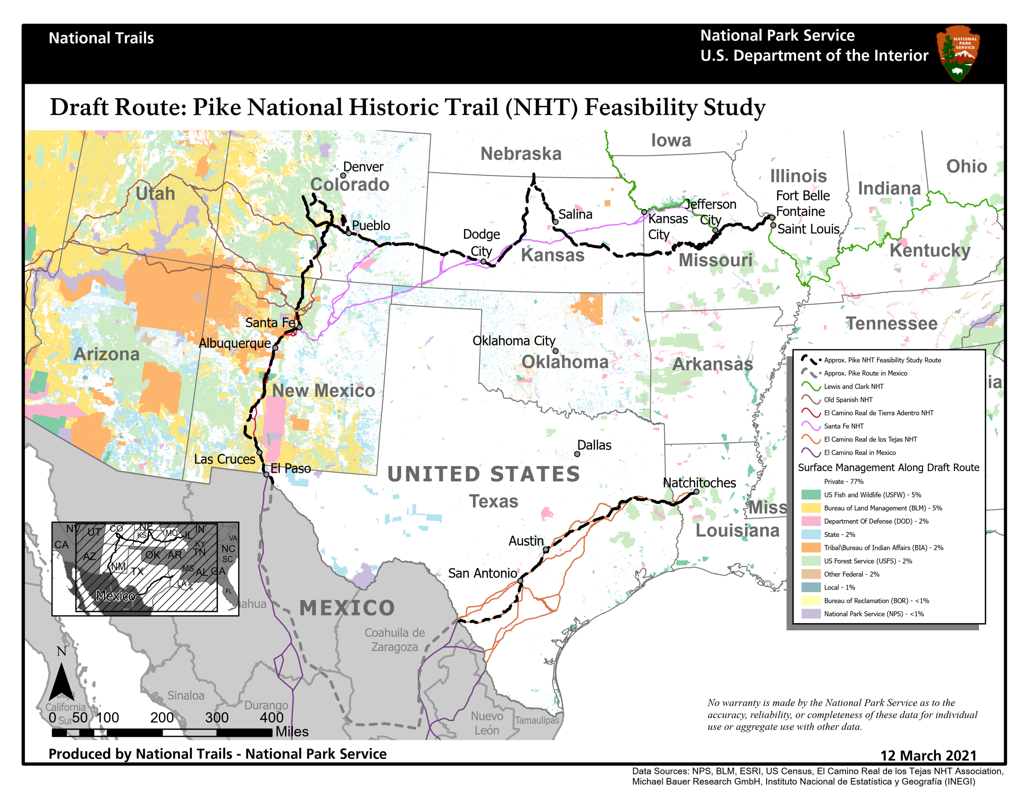
Map of the United States with Pike’s Draft Route
Notes:
This slide shows a map of the United States with Pike’s Draft Route depicted as a black dashed line.
The map also depicts land ownership type – otherwise referred to as Surface Management Agency,
The legend on the righthand side of the slide depicts each category of land ownership that occurs along Pike’s route, and each category of ownership has been assigned a color, with those colors visualized on the map.
You will note that the Pike Trail falls predominately on privately owned land.
77% of land along the route is under private ownership
The remining 23% of lands along the route are owned by various federal or tribal agencies as well as state.
So, tying to back to the question of What would designation mean to the public and for landowners?
Should Congress act to designate the Pike Trail as a new national historic trail
What that might mean on the ground in terms of access and visitor use would vary depending on landownership, the interest of private landowners, state or federal landholders to participate in trail development.
So, again, as Aaron mentioned earlier, although the designation of a national historic trail is continuous from end to end, designation does not create a through hiking trail, open to public access from end to end.
Again:
Participation in trail development or public access opportunities along the route by landowners is entirely voluntary.
Private landowners are under no obligation to allow the public on their lands.

Slide 36
Trail Feasibility Study Process Question 3 cont.
  Should Congress act to designate the Pike Trail as a new national historic trail
  Comprehensive Management Plan would be developed.
    Specifics on how the trail is to be managed.
    Trail access locations and opportunities identified.
    Interpretive/educational opportunities identified.
    Public input, public meetings.
    Consultation and coordination with federal, tribal, state, municipal governments, and the public.
Notes:
What would designation mean to the public and for landowners?
Should Congress act to designate the Pike Trail as a new national historic trail:
A Comprehensive Management Plan for the Pike National Historic Trail would be developed. This sepate and new process –entirely distinct from the trail feasibility study process.
This document is where the rubber hits the road, so to speak.
It is where specifics on how he trail would be managed are addressed, including a federally approved logo
Specific trail access location and opportunities are identified in the Comprehensive Management Plan
As well as Interpretive and educational sites and opportunities.
The development of the Comprehensive Mange Plan would very much involve a great deal of
Public Input and a there would be a fresh round of public meetings
And
Consultation and coordination with stakeholders across the length of the route – federal, tribal, state, and municipal governments, and the public – would take place.

Slide 37
Pike National Historic Trail Feasibility Study
We want to hear from you!
Submit your comments through June 30, 2021.
Notes:
Now I would like to turn to what is in many ways the most important part of our meeting today –hearing from you – getting your feedback .
The Pike National Historic Trail Feasibility Study is open to public through June 30th 2021.
Your comments are critical to the study process. They inform the National Park Service’s assessment of trail criteria that we just reviewed.

Slide 38
We want to hear from you
There are several ways to comment.
Your thoughts and comments are important to us.
Virtual meetings present challenges and opportunities.
Add your name to the project mailing list to receive study updates.
Notes:
Again, we want to hear from you.
There are several ways to share your thoughts and comments with the National Park Service on the study – which I will explain further on the next slide.
I would like to stress that you
Your thoughts and comments are important to us. They inform the study and your comments help us to accurately assess how the trail may or may not meet the three criteria that we discussed earlier.
I recognized that virtual meetings like the one we are in, present challenges and opportunities.
It is our aim to make commenting and engaging in the study process as easy and accessible as possible
In that spirit, We hope to identify opportunities for future in-person meetings, so please add your name to the project mailing list so you can receive study updates and notifications.
We have placed the link to the Pike Study’s sign up form in the chat box again.
[IN CHAT type: www.tinyurl.com/ynxdsfrn]

Slide 39
How to submit comments
1. Visit the study’s webpage to share your thoughts with us
parkplanning.nps.gov/pike
2. Or send your comments to:
Lillis Urban
National Trails
National Park Service
1100 Old Santa Fe Trail
Santa Fe, NM, 87505
Email: lillis_urban@nps.gov
3. Or comment now in the “chat” box.
Notes:
Okay – let’s talk about how to submit comments on the study.
This slide presents three ways to submit your comment.
First on the list is to Visit the study’s webpage.
www.parkplanning.nps.gov/pike
Again, we have placed a link to the study’s webpage in the chat box.
[IN CHAT___type: www.parkplanning.nps.gov/pike]
I will walk you though how to submit comments on the study’s webpage in the coming slides.
IF you have any trouble, please reach out to me directly and send me an email,.
You can also mail comment to me at the following address listed here:

Slide 40
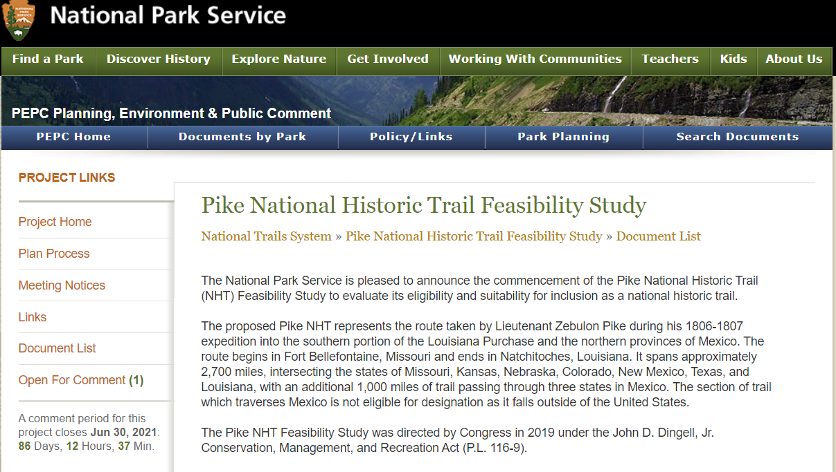
How to submit comments on the study’s webpage
parkplanning.nps.gov/pike
Notes:
This slide shows the project’s home page. This is the screen that you will see when you visit www.parkplanning.nps.gov/pike
In the lefthand side tool bar of the project’s webpage are a number of links that you can select from.
To comment, click on the “open for comment” link. It is circled in red on this slide.

Slide 41
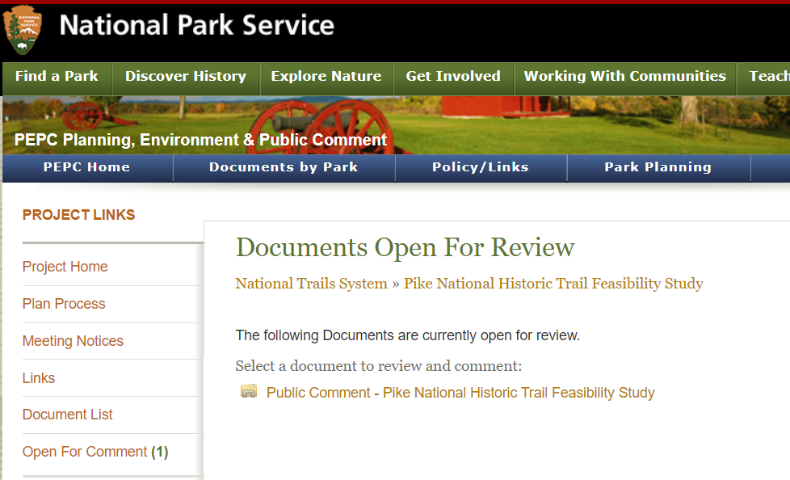
How to submit comments on the study’s webpage
parkplanning.nps.gov/pike
Screen shots of PEPC
Notes:
This slide shows

Slide 42
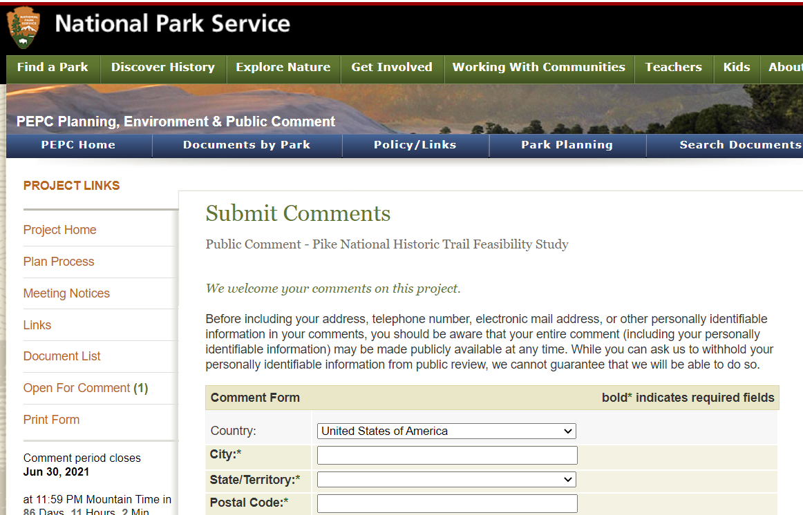
How to submit comments on the study’s webpage
parkplanning.nps.gov/pike
Screen shots of PEPC
Notes:
This slide shows.
After you submit your comments – please know that your comments ARE NOT VISIBLE TO ALL. It is not like Facebook.
Your comments will be sent directly to the National Park Service.
However,
Your comments are a part of the public record.
They will be incorporated into the feasibility study document that will be shared with Congress.

Slide 43
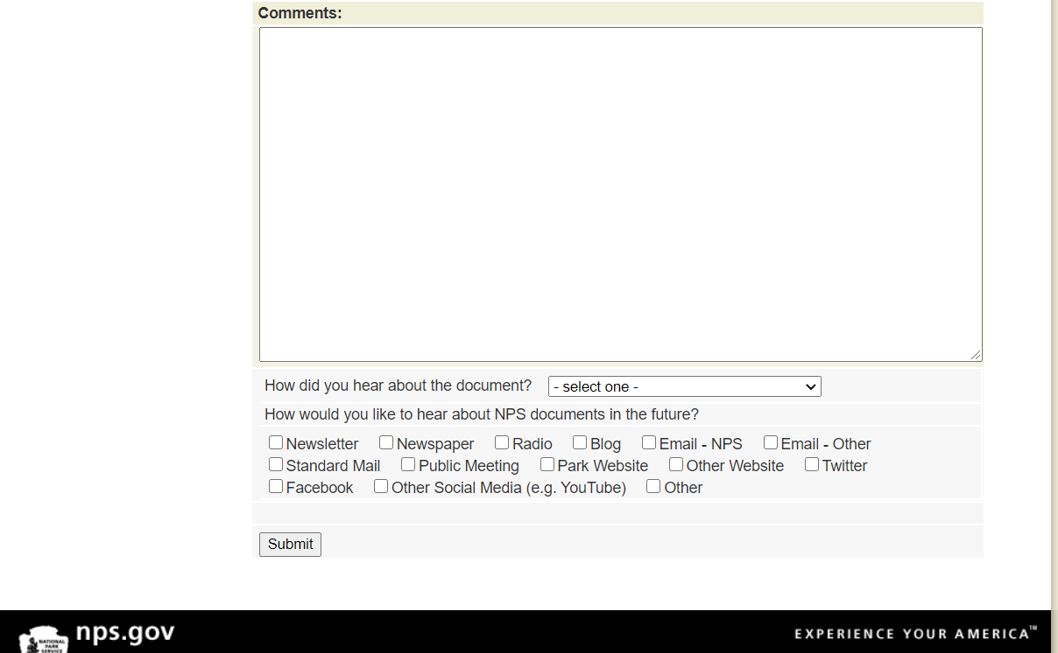
How to submit comments on the study’s webpage
parkplanning.nps.gov/pike
Screen shots of PEPC
Notes:
This slide shows
Again, if you have any trouble navigating these sites please contact me directly.
I will place my email in the chat box.
IN CHAT: lillis_urban@nps.gov

Slide 44
Study Questions
5 study questions developed by the National Park Service
Designed to provide the National Park Service with the information needed to make determinations of the Pike Trail’s eligibility as a national historic trail.
Notes:
In order to facilitate feedback, the NPS has developed 5 study questions.
There are listed in the study website when you go to provide comment. I will also walk us through them in this presentation.
The questions are designed to provide us with the info we need to make determinations of the eligibility of the Pike trail as a national historic trail.

Slide 45
Study Questions
1. Are there sites or areas on or adjacent to the route that are, or could be, visited by the public for recreational opportunities or historic appreciation (e.g. hiking or outdoor access, museums, historic sites, educational exhibits)? If so, please tell us about them.
2. Does the study route accurately identify Pike’s 1806-1807 route? If not, where does it differ? Is there anything else you want the National Park Service to know about this route and its associated sites?
Notes:
In order to facilitate feedback, the NPS has developed a series questions that are presented on the study website – Let me walk you through the Qs now.
These questions are designed to provide us with the info we need to make determinations of the eligibility.
READ THE QUESTIONS OFF THE SLIDE.

Slide 46
Study Questions (continued)
3. How might designation of this route as a National Historic Trail affect you and your community? Do you have concerns? What benefits do you see?
4. Would you like to see Pike’s 1806-1807 expedition designated as a National Historic Trail? Why or why not?
5. Do you think this route is important in America’s history? Why or why not?
Notes:
READ THE QUESTIONS OFF THE SLIDE.

Slide 47
Pike National Historic Trail
Feasibility Study
National Trails - National Park Service
U.S. Department of the Interior
- Questions and Comments -
Notes:
So now we would like to move into the Question and Answer and Comments portion of our meeting. Really, in many ways, the most important part of our meeting today. But before I pull the PP down, so we can see all of our faces again. I am going to share the state level map of Pike’s Draft Route for the State of (FILL IN THE BLANK) – so that folks can see more closely where Pike’ Routes falls within your state. Perhaps seeing the route more closely in your state may prompt comments or question.

Slide 48
The Pike’s Draft Route within the State of Colorado
Notes:
This slide shows the Pike’s Draft Route within the State of Colorado. You can see that Pike’s 1806-107 Expedition passed though present day towns of Lamar, La Junta, Pueblo, Canon City, as well as Antonito.
I can pull this map back should there be comments or questions specific to it.
But, for I am going to stop the PP so that Aaron and I can see you and take your comments and questions.
STOP SHARING PP –
Key Support Staff from National Trails:
read back, in order of appearance, and as written verbatim, questions and comments in the chat box.
IF THERE ARE No comments or questions be prepared to type into the chat, one at a time, the Study Questions. Lillis will move us through the questions.
[Potentially type into CHAT:
Study Sign up sheet: https://tinyurl.com/ynxdsfrn
Study webpage: www.parkplanning.nps.gov/pike
Lillis’s email: lillis_urban@nps.gov
STUDY QUESTIONS:
1. Are there sites or areas on or adjacent to the route that are, or could be, visited by the public for recreational opportunities or historic appreciation (e.g. hiking or outdoor access, museums, historic sites, educational exhibits)? If so, please tell us about them.
2. Does the study route accurately identify Pike’s 1806-1807 route? If not, where does it differ? Is there anything else you want the National Park Service to know about this route and its associated sites?
3. How might designation of this route as a National Historic Trail affect you and your community? Do you have concerns? What benefits do you see?
4. Would you like to see Pike’s 1806-1807 expedition designated as a National Historic Trail? Why or why not?
5. Do you think this route is important in America’s history? Why or why not?

Slide 49
The Draft Route for the Pike National Historic Trail Feasibility Study Nebraska and Kansas

Slide 50
The Draft Route for the Pike National Historic Trail Feasibility Study Louisiana

Slide 51
The Draft Route for the Pike National Historic Trail Feasibility Study Missouri

Slide 52
The Draft Route for the Pike National Historic Trail Feasibility Study New Mexico

Slide 53
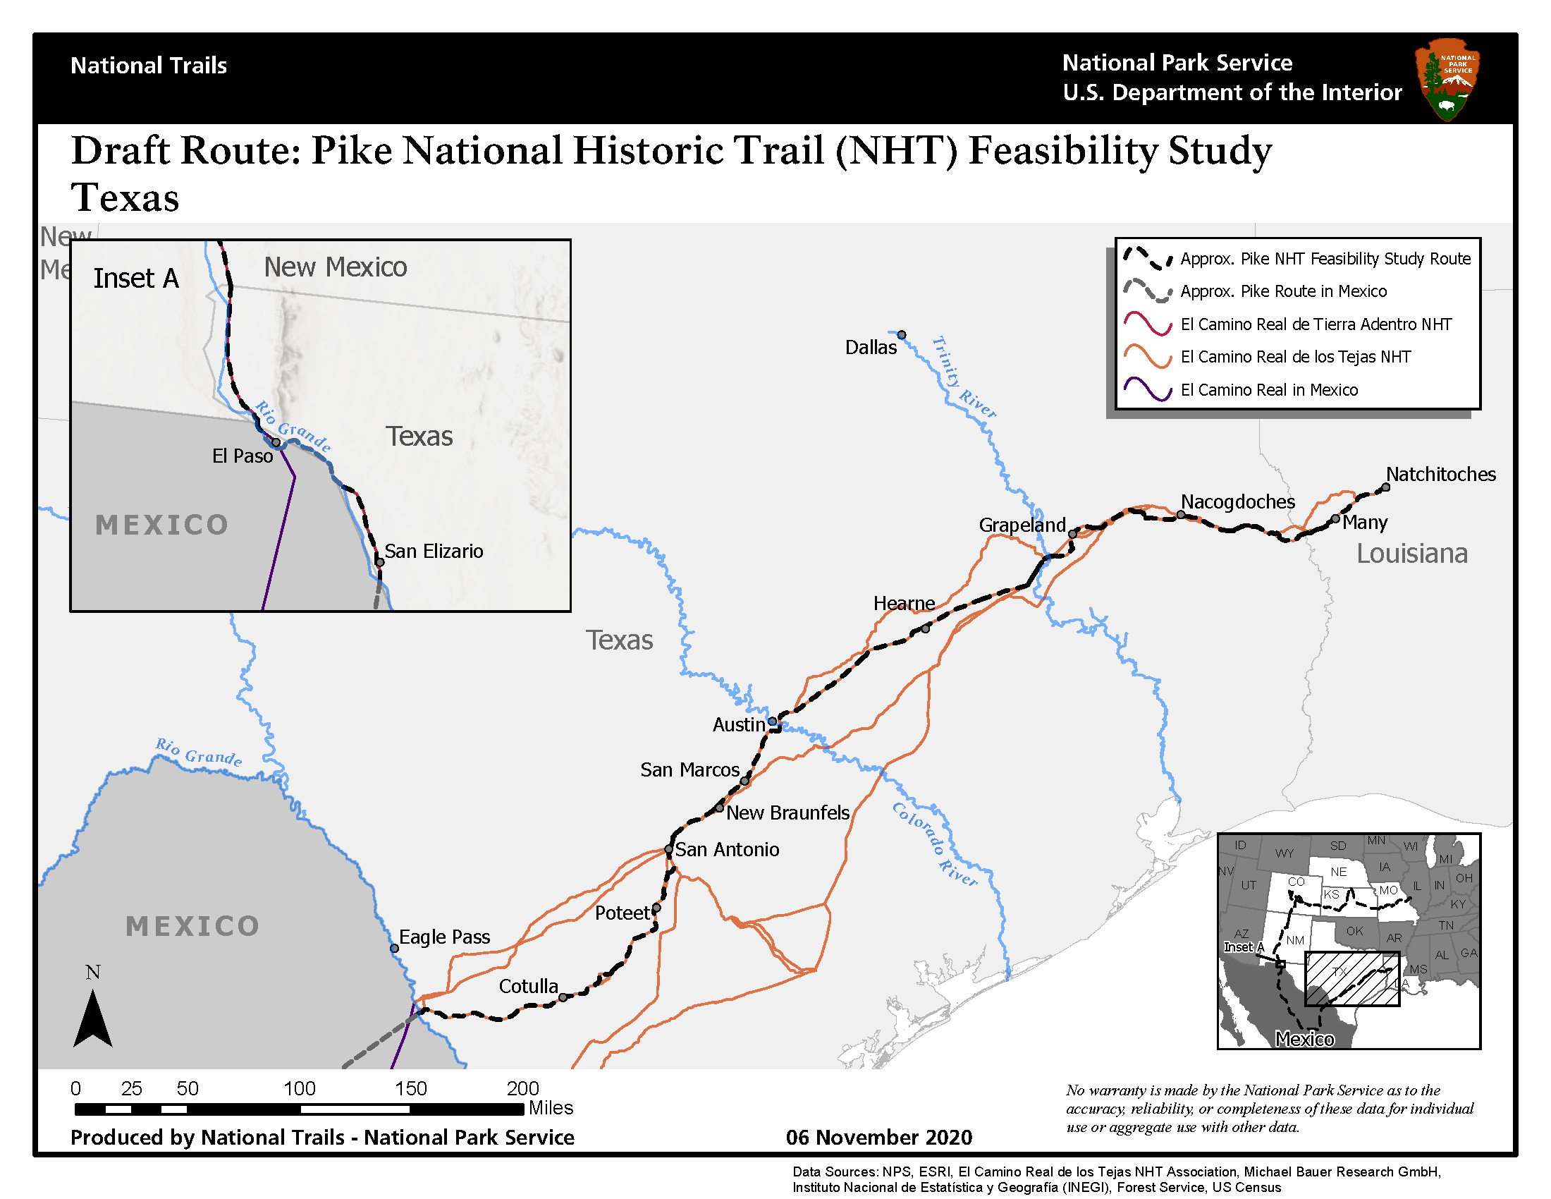
The Draft Route for the Pike National Historic Trail Feasibility Study Texas

Slide 54
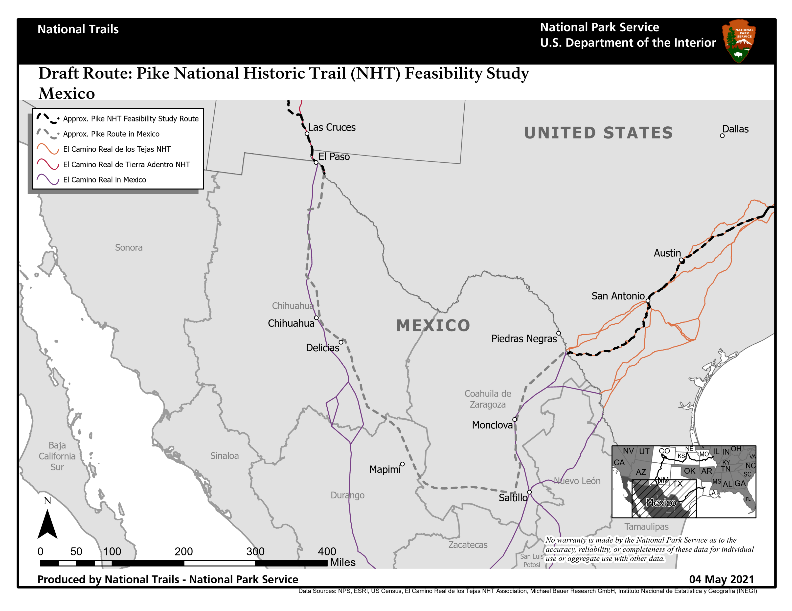
The Draft Route for the Pike National Historic Trail Feasibility Study Mexico

