Slide 1

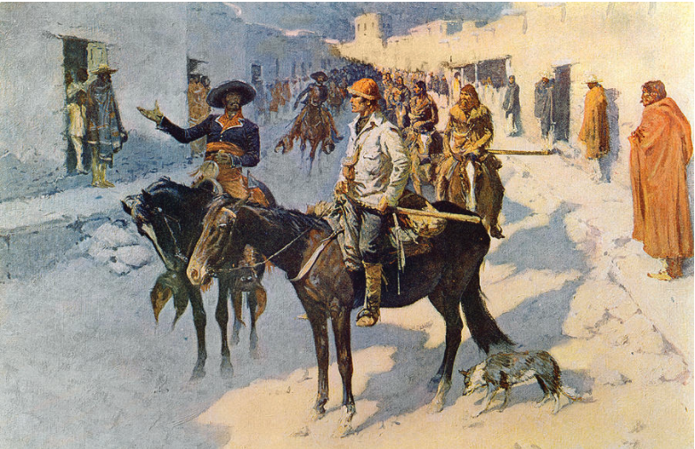
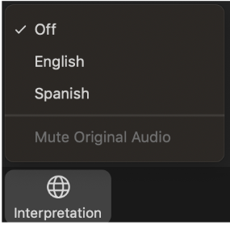
Estudio de viabilidad del
Sendero Histórico Nacional Pike
Senderos Nacionales - Servicio de Parques Nacionales
Departmento del Interior de EE. UU.
¡BIENVENIDO! La reunión comenzará en breve.
Active la Traducción al Español
De click en “Interpretation” y seleccione “Spanish”.
Puede silenciar todo el audio original o seguir escuchando a los hablantes en inglés a bajo volumen en segundo plano.
Cerciórese de que: Todos los participantes
estén silenciados. La reunión se está grabando.
Pintura de Frederic Remington (1906) titulada, “Zebulon Pike Entering Santa Fe”
Cortesía de la Biblioteca del Congreso.
Notes:
Welcome the Pike National Historic Trail Feasibility Study.
The meeting will begin shortly.
Please note that all participants are muted.
Also please note that the meeting is being recorded and is a part of the public record.
-----------

Slide 2
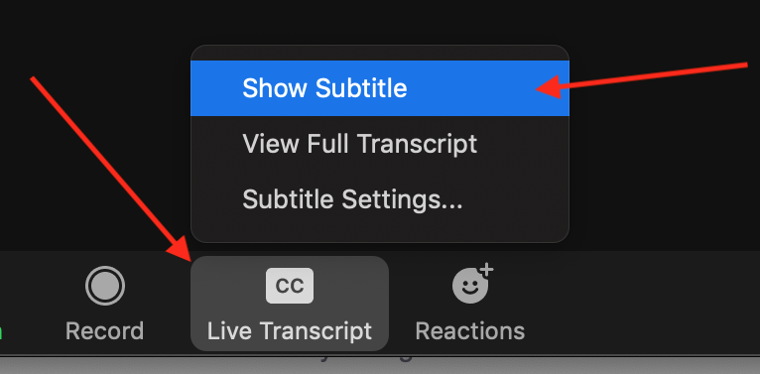
Notas de Zoom
Active la Traducción al Español
  De click en “Interpretation” y seleccione “Spanish”.
  Puede silenciar todo el audio original o seguir escuchando a los hablantes en inglés a bajo volumen en segundo plano.
Subtitulación
  Para activar los subtítulos, de click en el botón “CC” y seleccione “Show Subtitle.”
Notes:
First off, in Zoom,
To listed to the Spanish translation of the presentation today, click on the Interpretation icon, and select “Spanish”. This will bring you to a channel where you hear a Spanish translation of today’s presentation.
To fully silence our English presentation,, so that you only hear the translation in Spanish, select “mute original audio”.
We recommend that you “Mute original audio”.
In our experience this can help solve potential audio issues.
To turn on Closed Captioning for today’s meeting, click on the CC icon on the Zoom tool bar and select “Show Subtitles”

Slide 3


Notas de Zoom cont.
Audio
  Usted permanecerá silenciado y no podrá activar el micrófono por su cuenta.
  Si está escuchando un eco en el audio, por favor, asegúrese de que no tiene dos aparatos electrónicos conectados a la reunión.
Video
  Para encender/apagar su cámara, de click en este botón.
  Vista
  Arriba, a la derecha, seleccione “Speaker View” para que pueda ver siempre a la persona que está hablando.
Notes:
PRESENTED BY JMARK:
Before diving into the presentation, let’s take few moments to provide a short orientation to the Zoom platform to ensure that the meeting runs smoothly for you.
close captioning, (eg This slide has a red arrow pointing to the CC icon.
“Click here to turn on Closed Captioning”.
2. All are muted.
3. Chat box open. Comment or enter Qs anytime.
People are welcome to enter comments or questions at anytime during the meeting.
Aaron and Lillis will answer at end of presentation
The entire send half of the meeting is dedicated to answering questions and providing opportunity for comment.
4. How to access chat box
This slide shows you where the chat box is… We want to show you how to enter questions and comments into the chat box.
IT Issues: If you any connection or IT issues during the meeting, please either let us know through the chat box, or call (phone XXXXX) one of our IT specialists will help you. We will place that IT number into the chat box right now. - if you need to call in simply --- here is the call in number
6. Any other HOW TO INFO NEEDED
-how to turn on/off video
6. Addressing people on phone - you are muted.
Later in the presentation specifics on how you can comment on the study will be provided.
7. Pass presentation back to Aaron Mahr, Superintendent of National Trails.

Slide 4
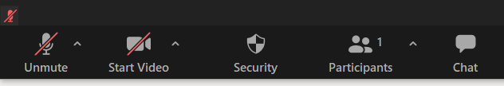

Notas de Zoom cont.
Chat
  Envíe las preguntas y comentarios vía chat:
  De click en “Chat” para activar el cuadro del chat. Envíe las preguntas y comentarios en cualquier momento. Responderemos a sus preguntas al final de la presentación.
¿Problemas?
  Envíe un mensaje de chat directamente al anfitrión de la reunión. En el cuadro del chat, en el menu desplegable de la parte inferior, en lugar de “Everyone”, seleccione “Imelda – se habla Español (Co-Host)”
Notes:
PRESENTED BY JMARK:
Before diving into the presentation, let’s take few moments to provide a short orientation to the Zoom platform to ensure that the meeting runs smoothly for you.
As a reminder, everyone is muted.
3. Chat box open. Comment or enter Qs anytime.
People are welcome to enter comments or questions at anytime during the meeting.
Aaron and Lillis will answer at end of presentation
The entire send half of the meeting is dedicated to answering questions and providing opportunity for comment.
4. How to access chat box
This slide shows you where the chat box is… We want to show you how to enter questions and comments into the chat box.
IT Issues: If you any connection or IT issues during the meeting, please either let us know through the chat box, or call (phone XXXXX) one of our IT specialists will help you. We will place that IT number into the chat box right now. - if you need to call in simply --- here is the call in number
6. Any other HOW TO INFO NEEDED
-how to turn on/off video
6. Addressing people on phone - you are muted.
Later in the presentation specifics on how you can comment on the study will be provided.
7. Pass presentation back to Aaron Mahr, Superintendent of National Trails.
close captioning, (eg This slide has a red arrow pointing to the CC icon.
“Click here to turn on Closed Captioning”.
2. All are muted.
3. Chat box open. Comment or enter Qs anytime.
People are welcome to enter comments or questions at anytime during the meeting.
Aaron and Lillis will answer at end of presentation
The entire send half of the meeting is dedicated to answering questions and providing opportunity for comment.
4. How to access chat box
This slide shows you where the chat box is… We want to show you how to enter questions and comments into the chat box.
IT Issues: If you any connection or IT issues during the meeting, please either let us know through the chat box, or call (phone XXXXX) one of our IT specialists will help you. We will place that IT number into the chat box right now. - if you need to call in simply --- here is the call in number
6. Any other HOW TO INFO NEEDED
-how to turn on/off video
6. Addressing people on phone - you are muted.
Later in the presentation specifics on how you can comment on the study will be provided.
7. Pass presentation back to Aaron Mahr, Superintendent of National Trails.

Slide 5
Estudio de viabilidad del
Sendero Histórico Nacional Pike
Senderos Nacionales - Servicio de Parques Nacionales
Departmento del Interior de EE. UU.
¡BIENVENIDO! La reunión comenzará en breve.
Active la Traducción al Español
De click en “Interpretation” y seleccione “Spanish”.
Puede silenciar todo el audio original o seguir escuchando a los hablantes en inglés a bajo volumen en segundo plano.
Cerciórese de que: Todos los participantes
estén silenciados. La reunión se está grabando.
Pintura de Frederic Remington (1906) titulada, “Zebulon Pike Entering Santa Fe”
Cortesía de la Biblioteca del Congreso.
Notes:
Aaron :
Good afternoon, and welcome to the (STATE NAME) virtual public meeting for the Pike National Historic Trail Feasibility Study.
My name is Aaron Mahr and I’m the Superintendent of the National Park Service’s National Trails Office in Santa Fe, New Mexico. I’m joined today by my colleague Dr. Lillis Urban, and together we’ll lead you through the meeting this afternoon.
Lillis would you like to introduce yourself?
Lillis: Greetings. Thank you for joining us today. My name is Lillis Urban, I’m the Chief of Planning for the National Trails Office. I will be co-presenting with Aaron today.
Aaron: Thanks, Lillis.
First let's address the elephant in the room. This is a public outreach meeting. And this is in a remote, virtual setting on the Zoom platform. Due to the considerable amount of planning that goes into these meetings, and in order to meet public, congressional, and agency expectations on the study's timeline, we needed to make the go/no go decision on holding these meetings about two months ago. Remember, this is a federal action. As such, we're guided by CDC and department of interior guidelines on travel and limits on gathering and occupancy numbers. So in compliance with those guidelines we decided to move forward with this remote setting two months ago. As we know features of those guidelines are changing now or hopefully soon, but we're still under the cautious pandemic protocols so we're moving forward in this virtual setting.
In person meetings are preferred, but in this virtual setting we've sought pathways for maximum access for public comment, and Lillis will talk more about how we will try to achieve that--and how to make this easy and accessible for everybody.
We'll also speak in a moment about how to use and participate on Zoom.
_______________
NOT TO BE READ: this is the NPS standard protocol language for public participation. It is pasted here in the case we end up needing to pull from it.
While this is an open forum, it is also a family friendly one, so please keep your comments and wall posts clean. In addition to keeping it family friendly, we ask that you follow our posting guidelines. If you don't comply, your message will be removed.
We do not allow graphic, obscene, explicit or racist comments or submissions, nor do we allow comments that are abusive, hateful or intended to defame anyone or any organization.
We do not allow solicitations or advertisements. This includes promotion or endorsement of any financial, commercial or non-governmental agency. Similarly, we do not allow attempts to defame or defraud any financial, commercial or non-governmental agency.
We do not allow comments that suggest or encourage illegal activity.
You participate at your own risk, taking personal responsibility for your comments, your username and any information provided.
Finally, the appearance of external links on this site does not constitute an official endorsement on behalf of the U.S. National Park Service or the U.S. Department of the Interior.

Slide 6
Objetivos de la reunión
Presentar el estudio de viabilidad del sendero histórico nacional
¿Qué es un sendero histórico nacional?
¿Qué es un estudio de viabilidad de un sendero histórico nacional?
¿Qué es el Sendero Pike (Pike Trail) y dónde encaja en la historia de Estados Unidos?
Explorar el proceso del estudio
¿Qué son los criterios para determinar la elegibilidad de un potencial sendero histórico nacional?
¿Cómo se aplican en el proceso del estudio?
¿Qué viene después?
Escuchar sus comentarios y cualquier pregunta.
Notes:
But before we do that, let's quickly lay out the plan for what to expect this evening. We have two basic objectives:
First, in the next 45 minutes we will make a presentation in an easy-going but informative way about the National Trails System and the proposed Pike National Historic Trail. We'll look at Zebulon Pike's Southwest Expedition, and its place in American history.
We'll then explore in depth the Feasibility Study process.
And then, we want to listen to you. We can answer any questions you have about the study process and the National Trails System. But most important is to hear your concerns and thoughts about the proposed national historic trail. To help the discussion along, we'll also propose some study questions.
The meeting will not exceed two hours. And we hope that when we finish, you'll feel more informed and satisfied that you have expressed, or have the means to express, your thoughts or concerns about this potential addition to the National Trails System.
Throughout the meeting this evening, you have the ability to enter comments and questions into the Chat box. You can do that at any time. Lillis and I will read those and address them after the presentation portion of the meeting,
And now Lillis, would you please tell us about the Pike Study’s website and help us with some of the detail on how to work Zoom.

Slide 7
Formulario de registro para el estudio Pike
Estudio Pike – página web
parkplanning.nps.gov/pike
www.tinyurl.com/ynxdsfrn
Notes:
IN CHAT type:
Pike study – webpage:
https://parkplanning.nps.gov/pike
Pike study – sign-up form:
http://www.tinyurl.com/ynxdsfrn
_____________________________________________________________
Of course. Thank you Aaron.
This slide shows two website addresses.
The first is to the Pike study webpage.
www.parkplanning.nps.gov/pike
We have placed a link to the study’s webpage in the chat.
On the study webpage you can download a copy of this presentation. In addition, on the study’s website, you can download copies of the Draft Pike Route Maps that will be shared in today’s presentation.
The other website listed on this slide is to a “Pike Study Sign up form”.
We have placed a link to the study sign-up form in the chat box
If you would like to add your email address to the project mailing list so that you can receive study new and updates directly, please visit the Pike study sign up form.
__
Okay, Before diving into the heart of the presentation, I am going to provide a short orientation to Zoom to ensure everything runs smoothly.
Again, as a friendly reminder today’s meeting is being recording and is a part of the public record. In addition, everyone is muted in today’s meeting, but we encourage questions, comments, and participation though the chat box. I will tell people how to access the chat box in a moment.

Slide 8
¿Por qué estamos aquí?: La Ley de 2019 (P.L. 116-9) sobre el Estudio del Sendero Nacional Histórico Pike
Se enmendó la Ley del Sistema Nacional de Senderos.
La entidad designada por el Secretario del Interior, en este caso, el Servicio de Parques Nacionales evaluará la ruta tomada por el teniente Zebulon Pike en 1806-07, para una posible adición al Sistema Nacional de Senderos.
El sendero comienza cerca de St. Louis, Misuri y atraviesa Misuri, Kansas, Nebraska, Colorado y Nuevo México. Pasa por tres estados en el norte de México, luego reaparece en Texas y termina en el noroccidente de Luisiana; incluye 4184km (2600 millas) en los EE. UU. (y 1000 millas en el norte de México).
Notes:
So why are we here?
Well, the US Congress passed the Pike NHT Feasibility Study Act in 2019. The legislation amended the National Trails System Act, and ordered the Secretary of Interior, or the designee, in this case the NPS--to study the exploratory route of Lt. Zebulon Pike in 1806-7.
The act identifies the route, referred frequently as Pike’s Southwest Expedition, as beginning near St. Louis Missouri and heading west through five states to El Paso Texas, then passing through northern Mexico, re-emerging in the U.S. in southern Texas, and ending in Natchitoches Louisiana. We’ll look at the route in more detail shortly.

Slide 9
¿Qué es un sendero histórico nacional?
  Parte del Sistema Nacional de Senderos, creado por la Ley de 1968 (P.L. 90-543) del Sistema de Senderos Nacionales. El sistema está compuesto principalmente de senderos históricos y paisajísticos nacionales.
  Los Senderos Históricos Nacionales son caminos de larga distancia que conmemoran rutas de viaje del pasado, las cuales se consideran históricamente importantes para los Estados Unidos.
  Establecidos tanto por su valor recreativo como educativo.
  Hasta la fecha, el Congreso ha establecido 19 Senderos Históricos Nacionales (piense en los Senderos Históricos Nacionales Lewis y Clark, Santa Fe, Oregón, California, Juan Bautista de Anza, Sendero de Lágrimas, y de Selma a Montgomery).
Notes:
Let’s look a little more closely at what National Historic Trails are, and some of their distinctive qualities.
A National Historic Trail is part of the National Trails System, which was created by the National Trails System Act of 1968. So the system is just over 50 years old, and the system is comprised primarily of National Scenic and National Historic Trails.
There are many different federal designations to commemorate events and important places in our shared histories, but National Historic Trails are meant to commemorate past routes of travel that are deemed to have national historic significance. They are usually long-distance corridors, such as the Pike route under study here.
National Historic Trails benefit the public for both their educational, as well as their recreational value.
To date Congress has established 19 National Historic Trails. And when you think of National Historic Trails consider the Lewis and Clark, the Santa Fe, the Pony Express, the California, the Trail of Tears, the Juan Bautista de Anza, the Selma to Montgomery. Those are all National Historic Trails.

Slide 10
¿Qué es un sendero histórico nacional?
La designación es continua, de un extremo al otro, cruzando propiedades y límites jurisdiccionales.
Sin embargo, la participación en actividades de protección y desarrollo de senderos para beneficio público es totalmente voluntaria.
La legislación para la designación limita la adquisición de tierras únicamente a las acciones de venta voluntaria, una adquisición muy rara.
La experiencia de un sendero generalmente se caracteriza por viajes en vías públicas, a través del camino designado, hacia lugares y segmentos de acceso público, que podrán ser protegidos por su autenticidad histórica y podrán tener medios de educación.
El papel del gobierno federal es aplicar los estándares de mejores prácticas y brindar asistencia técnica y financiera limitada a las entidades públicas y privadas participantes.
Notes:
Some other key features of the National Historic Trails are, for example, that designation is continuous from end to end, and on a map, the designation will cross property and jurisdictional boundaries.
But that doesn’t necessarily translate to action on the ground. And in fact, trail experience for the public is usually characterized by travel on public roadways through the designated corridor to publicly-accessible sites and segments that may be protected for their historic authenticity, and may have educational media associated with them.
For non-federal landholders along the trail corridor, it’s critically important to know that any participation in trail protection and development activities is entirely voluntary. And without that voluntary participation there is no impact to private land holders.
Designation legislation limits land acquisition to only willing-seller actions, and in fact, land acquisition for trail purposes is extremely rare. In the nearly 40 years of trail administration in my office the willing seller authorizations have never been used and we manage no land.
In practice, the federal government’s role in trail administration is to apply best practices standards, and to provide limited technical and financial assistance to participating private, public, and non-profit entities.

Slide 11
¿Qué es un estudio de viabilidad para senderos?
Estudios de viabilidad para senderos históricos nacionales:
  Evalúan la elegibilidad, viabilidad, idoneidad y conveniencia de designar una ruta como un nuevo sendero histórico nacional.
  La elegibilidad se basa en los criterios establecidos por el Congreso, que se encuentran en la Ley del Sistema Nacional de Senderos.
  El Servicio de Parques Nacionales envía los hallazgos del estudio al Congreso.
  El estudio no establece un nuevo Sendero Histórico Nacional.
  Solamente el Congreso, a través de actos legislativos, tiene la autoridad para establecer un Sendero Histórico Nacional.
  El estudio identificará la elegibilidad y la viabilidad. No recomendará la designación del Sendero Nacional Histórico Pike.
Notes:
Lillis will explain in much greater detail what the feasibility study process involves, but I’ll quickly introduce the topic now so that you can keep some particular thoughts in mind as we go through the historical narrative of the trail.
At this stage in the presentation it’s important to know that a National Historic Trail Feasibility Study evaluates the eligibility, feasibility, suitability, and desirability of designating a route as a new national historic trail.
The determination of eligibility is based on criteria that are found in the National Trails System Act.
When the National Park Service completes the study, it submits it to Congress for its consideration.
So it’s important to understand that the study in itself does not establish a new National Historic Trail, only congress has that authority through subsequent legislative action.
It’s also important to understand that the study will not be making a recommendation for or against designation of a Pike National Historic Trail. We simply are determining eligibility and feasibility in this study process.

Slide 12
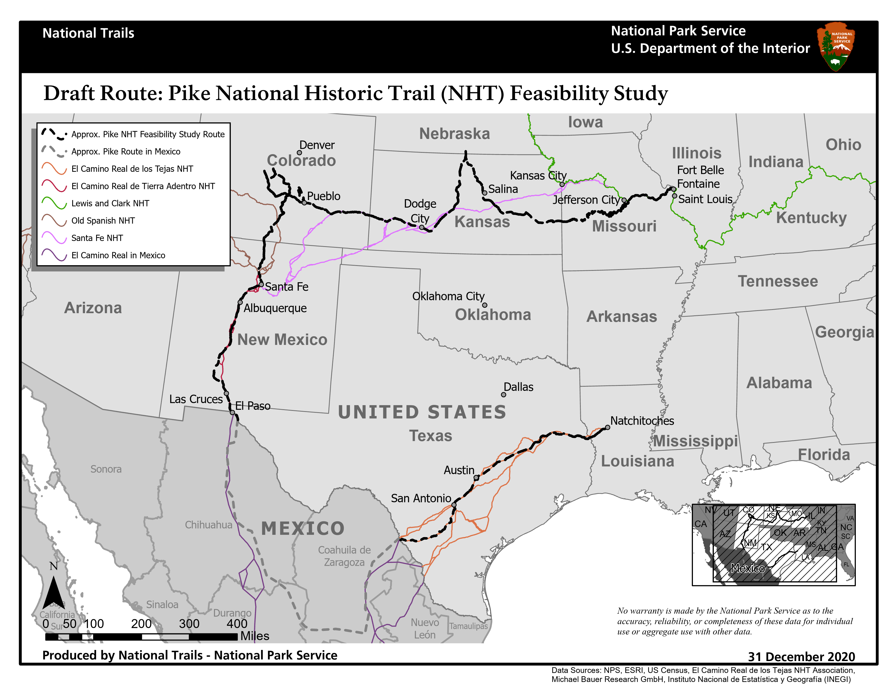
¿Qué es el Sendero Pike y por qué debería importarnos?
Notes:
For a broad-overview, here is a map of the proposed Pike NHT, which represents the route taken by Lieutenant Pike during his 1806-1807 expedition into the southern portion of the Louisiana Purchase and into what was then the northern edge of the Spanish colonial empire, and what is today the American Southwest.
The trail begins in Fort Bellefontaine, Missouri and ends in Natchitoches, Louisiana. It spans approximately 2,600 miles, intersecting the states of Missouri, Kansas, Nebraska, Colorado, New Mexico, Texas, and Louisiana, with an additional 1,000 miles of trail passing through three states in Mexico.
The section of trail which traverses Mexico is not eligible for designation as it falls outside of the United States.
So there are a couple of things to note here.
The routes under study for this proposed National Historic Trail include two dis-contiguous and lengthy segments in the U.S.
Another thing to recognize is that this map also depicts established National Historic Trails: It's notable and an important consideration in determining suitability that the proposed Pike NHT draft route overlays and intersects several established NHTs that Pike’s route is closely associated with both geographically and at times thematically, including the Lewis and Clark, Santa Fe, the Old Spanish, El Camino Real de Tierra Adentro, and El Camino Real de los Tejas national historic trails.

Slide 13
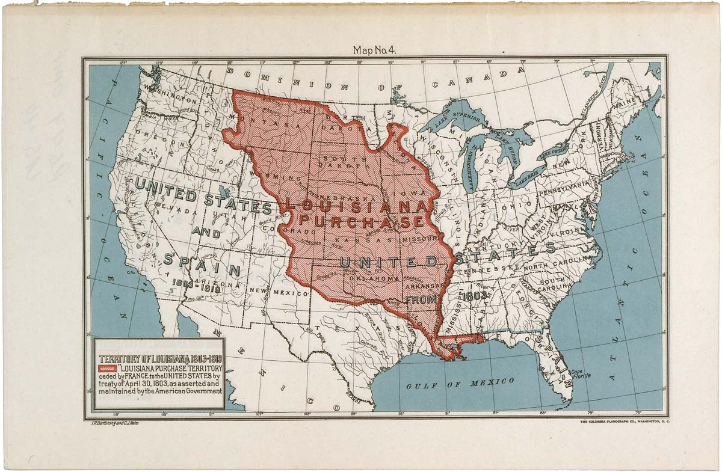
Contexto histórico: la compra de Luisiana
EE. UU. Compró el territorio de Luisiana a Francia en 1803
* Duplicó el tamaño de EE. UU.
* Ofreció una nueva frontera oeste a los EE. UU.
* Le otorgó a EE. UU. la autoridad exclusiva de los tratados con las tribus indígenas.
* La venta no fue reconocida por la Corona Española.
Courtesy Wikimedia Commons
Notes:
The context for understanding Pike's expedition and its place in American history is most easily related to a pivotal moment in American History that most of us will remember from our earliest history lessons—the Louisiana Purchase of 1803. In that action during the administration of President Thomas Jefferson, the US acquired from France, a huge swath of territory west of the Mississippi River that included most of the Great Plains up to the Rocky Mountains.
As this map shows, the purchase nearly doubled the territorial size of the U.S., and established a new western boundary for the young nation.
The terms of the purchase from France also gave the US sole treaty making authority with the indigenous tribes in the purchase lands, at least as far as France and the U.S. were concerned.
However, the purchase wasn't recognized by the Spanish government, which would have significant consequences over the next several decades, for relations between Spain, the Mexican Republic after 1821, and the United States.
.

Slide 14
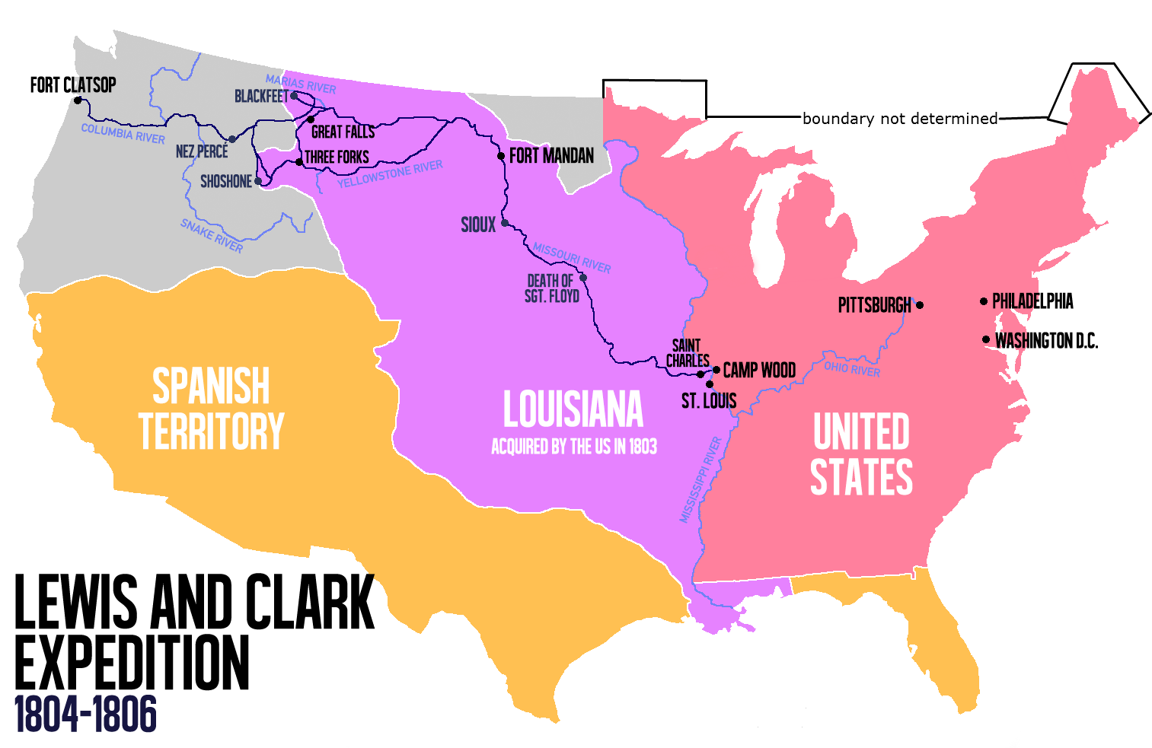
El Imperio español en Norteamérica
El territorio español en Norteamérica se extendía desde México hasta la mayor parte del oeste americano.
Las fronteras estaban mal delimitadas y la compra de Luisiana no resolvió en nada la confusión.
Las instituciones españolas en la frontera norte de México estaban bien establecidas, después de casi dos siglos de asentamiento.
La población y la producción económica eran bajas y el territorio era vasto.
La frontera norte de México sirvió como un amortiguador contra las culturas indígenas autónomas y las incursiones extranjeras de los británicos, franceses y estadounidenses.
Notes:
So there are a couple of things that are key to understanding historical context and features of Pike's trail.
Mexico, then known as New Spain, was the focus of Spanish colonization in North America, but the Crown’s territorial holdings included most of the American West, as you see in this map.
Spain’s territorial borders in the American West were ill-defined and the Louisiana Purchase challenged, for the Spanish Crown, the belief that the Mississippi River was the international frontier.
Spanish institutions across Mexico’s northern frontier were well established after nearly two centuries of settlement, but population was sparse, economic production was low, and the territory was vast.
For many in the Spanish Empire, the greatest value to holding these lands was to serve as a buffer to the rest of Mexico against incursions from the British, French, and Americans; and the indigenous empires that held sway over the expansive northern lands.

Slide 15
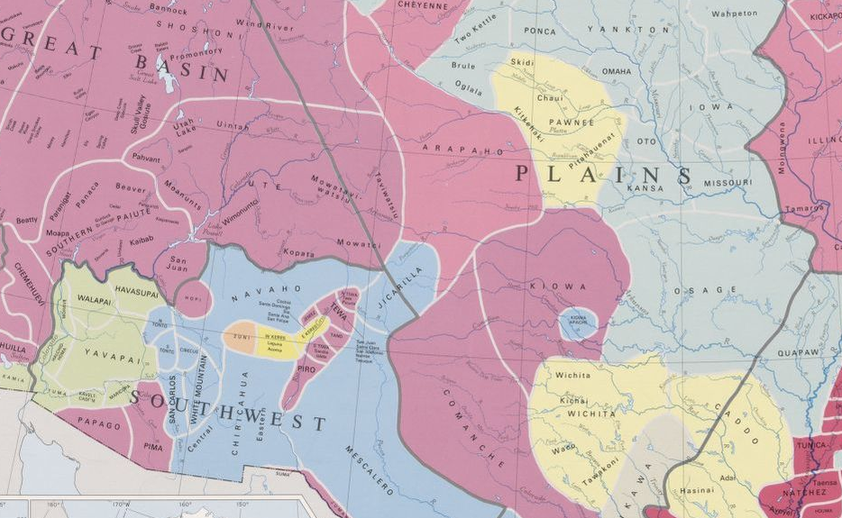
Territorios nativos americanos en la compra de Luisiana
Las culturas indígenas dominaban los territorios en la compra de Luisiana.
Muchos tenían generaciones de experiencia resistiendo y adaptándose a las demandas de las potencias coloniales europeas y, más recientemente, las de los estadounidenses.
Las tribus más conocidas por los estadunidenses eran la Osage, Kansas, y Pawnee, pero había otras.
Los comanches dominaban hacia el occidente y formaban una fuerte barrera para la expansión estadounidense hacia el oeste y la española hacia el norte.
Tierras natales tribales en la época de Pike
Image Courtesy Library of Congress
Notes:
For many people, this map will challenge sensibilities about the territorial and empire jurisdictions of the American West in the early decades of the American Republic.
The reality was that while Euro-cultures were jockeying for territorial claims over these vast lands in North America, in fact, Indigenous cultures, many of whom operated on an empire-like scale, dominated the lands in the Louisiana Purchase.
Most of the tribes had generations of experience resisting and accommodating the demands of Europeans or balancing competing European colonial powers' interests in their lands and trade. Americans were new in the area, but not unknown.
Best known to the Americans were the Osage, Kansas, and Pawnee, but there were others.
The Comanche dominated to the west and formed a strong barrier to American expansion westward, and Spanish expansion northward.

Slide 16
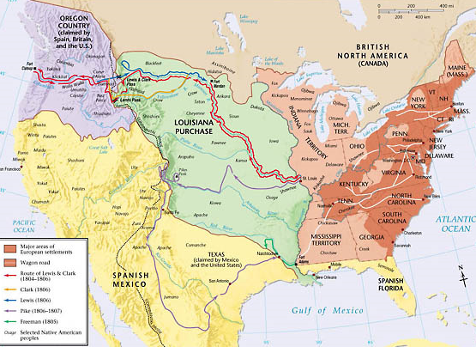
Exploraciones: la tierra y la gente en la compra de Luisiana
* El Presidente Thomas
Jefferson ordenó expediciones de exploración en el nuevo territorio americano.
* Las expediciones más prominentes fueron dirigidas por Meriwether Lewis y William Clark en el tramo norte de las tierras.
* Les sucedieron un puñado de expediciones menos conocidas, hasta la expedición de Pike en 1806.
Copyright @2000 by Pearson Education Inc.
Notes:
So it was within this context that in the immediate aftermath of the Louisiana purchase that the U.S, under President Jefferson’s leadership, sent exploratory expeditions into the new American territory.
As this map shows, the most prominent of these expeditions was led by Meriwether Lewis and William Clark into the northern tier of lands.
But there were also a handful of lesser-known and generally much shorter, and less impactful, expeditions, primarily into the southern tier of lands to explore and ultimately establish authority over, the lands north of the Red River, which the Americans considered to be the new frontier with Spanish Texas.
And then Pike’s expedition came in 1806.
[Don’t read:
Lewis + Clark, 1804-06
Dunbar + Hunter, 1804-1805
Freeman + Custis, May-September 1806
Zebulon Pike: 1806-1807]

Slide 17
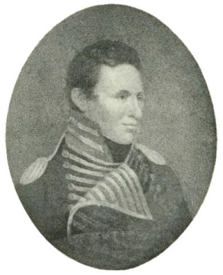
Expedición del Teniente Zebulon Pike por el suroeste
No fue disposición del Presidente Jefferson, sino una decisión de campo del comandante del Departamento Occidental, James Wilkinson, quien ordenó a Pike, un joven oficial:
Conducir la diplomacia con las naciones tribales
Regresar a las cautivas Osages a sus aldeas.
Fomentar las relaciones pacíficas con los Osages y los Kansas.
Hacer las paces con los comanches.
Procurar la exploración y el descubrimiento
Realizar observaciones geográficas y biológicas del territorio recién adquirido.
Identificar las nacientes de los ríos Red y Arkansas.
Cruzar la frontera española
Probablemente estaría en territorio español o cerca de él y se le ordenó ambiguamente que “se moviera con gran circunspección”.
Lt. Zebulon Pike
Courtesy Wikimedia Commons
Notes:
So with that context in hand, let’s look a little closer at Pike’s Trail, or what became known as Pike’s Southwest expedition.
In 1806, Lt. Zebulon Pike was a young officer in the U.S. Army who had just completed an exploratory expedition to the headwaters of the Mississippi River. Almost immediately after his return from that expedition, he received orders to begin a second expedition, this time to the Southwest from near the confluence of the Missouri and Mississippi Rivers. Unlike Lewis and Clark, Pike received his order not from President Jefferson, but from Western Department Commander James Wilkinson.
Pike’s orders contained two basic objectives, and came with an ambiguously worded warning.
Pike was to conduct diplomacy with tribal nations including the Kansas, the Osage, and the Pawnee, and hopefully make peace with the fiercely independent and dominant Comanche to the west; and to explore and observe the Plains, and seek the headwaters of the Arkansas and Red Rivers.
At that point he would likely be in or near the Spanish territory, so he was to conduct himself with “great circumspection”, a warning that contributed to the enduring debate and controversy over what the ultimate objectives were of General Wilkinson and his young protégé.
But Pike’s orders were to avoid contact with the Spaniards and to be on the lookout for Spanish or American traders who would be operating illegally in the territory now claimed by the Americans.

Slide 18
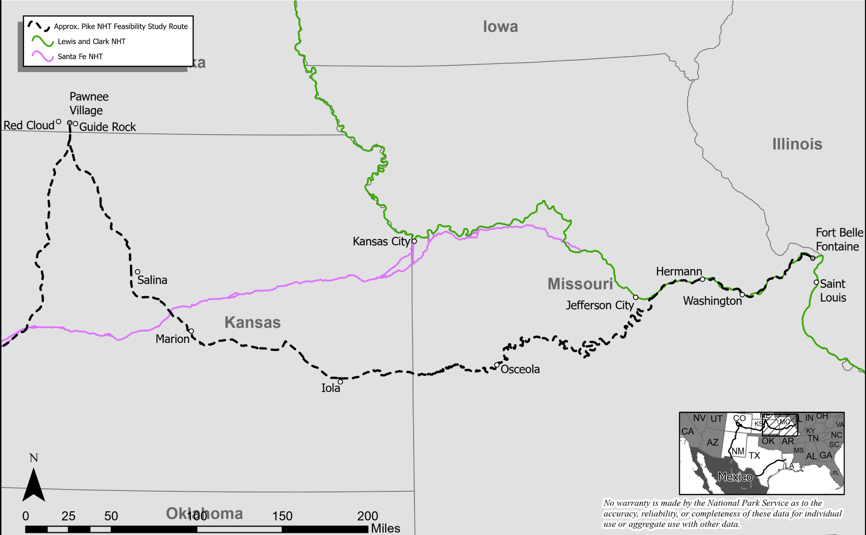
La ruta de Pike desde Ft. Belle Fontaine hasta la aldea de los Pawnee: diplomacia entre los Osage y los Pawnee
Pike partió de Ft. Belle Fontaine en julio de 1806 con 21 soldados del ejército estadounidense, unos pocos civiles y 51 Osages y Pawnees.
Ascendió los ríos Missouri y Osage, y empezó un viaje por tierra cerca de la frontera de Kansas.
Regresó los cautivos Osages a sus aldeas, algunos se unieron a Pike para reunirse con los Kansas y Pawnees.
Se reunió con los Pawnees en la actual Nebraska y vio la evidencia de un contacto español reciente
Notes:
With his orders in hand, Pike began his Southwest Expedition in July 1806, setting out by boat on the Missouri River from Ft. Bellefontaine, near St. Louis with his party of 21 U.S. Army soldiers, a few civilians, and 51 Osage and Pawnee captives.
I’ll present his expedition in three stages, and this map shows the first stage of his journey which culminated in his dialog with the Pawnee at their village in present-day Nebraska.
Pike spent a month on the Missouri and then Osage Rivers. Near the present-day Kansas border he arrived at the Osage villages. There he retuned most of his Osage captives and convinced a small delegation of Osage to continue on with him to meet with Kansas and Pawnee.
From that point the rest of his journey was overland. At the end of September of 1806, he reached the Pawnee village where he saw evidence of recent Spanish contact. At Pike’s insistence, the Pawnee lowered a Spanish flag and raised U.S. flag over their village.

Slide 19
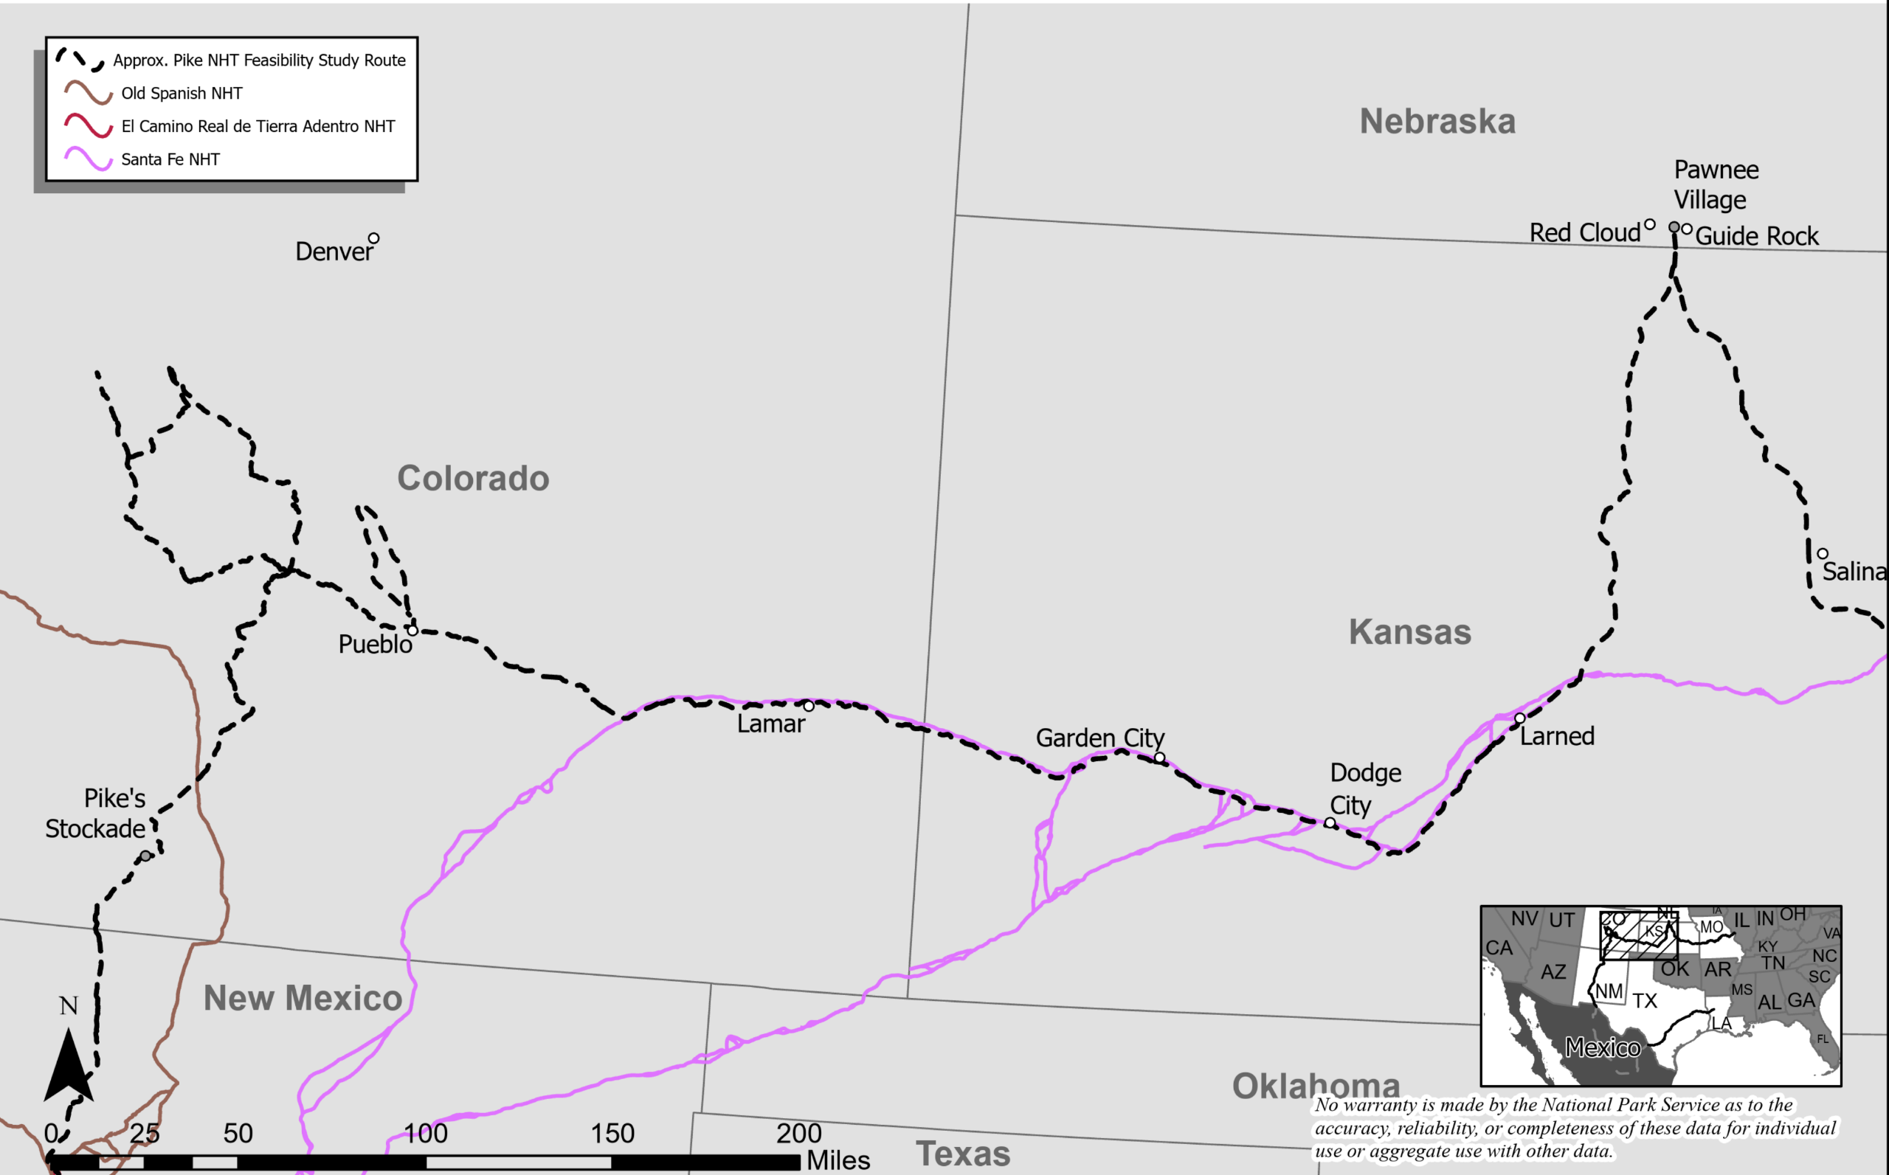
La ruta de Pike desde la aldea de los Pawnee hasta el río Conejos: exploración de las nacientes del río Arkansas
Siguió el sendero indígena utilizado por los españoles y llegó al río Arkansas al este de Larned, Kansas y siguió el río hasta el oeste.
Entró a las Montañas Rocosas, en Pueblo, área de Colorado.
Intentó (y falló) escalar lo que con el tiempo se convirtió en el Pico Pike.
Perdido, abatido, helado y hambriento, descendió al Valle de San Luis y construyó una empalizada a orillas del río Conejos.
Notes:
Upon leaving the Pawnee village and heading to the southwest, Pike’s expedition entered its second stage.
As this map shows, he began his exploration into lands less known to the Americans, with the goal of finding the headwaters of the Red and Arkansas Rivers.
He followed a well worn Pawnee trail which the Spaniards had used to reach the Pawnee village just a short time before Pike had.
Pike’s group reached the Arkansas River just east of Larned, Kansas and followed the river westward, generally continuing in the Spaniards’ footsteps, and encountering Pawnee groups and signs of perhaps the Comanche along the way.
His party reached the Pueblo, Colorado area in November 1806, and entered the Rocky Mountains in search of the Arkansas River’s headwaters. Pike and his men were ill-equipped to spend winter in the mountains, but he was determined to achieve his mission and spent most of December and January searching through the high country for the Arkansas headwaters. Most of the time his group was lost, exhausted, freezing cold, and desperately hungry.
He was unable to climb the highest mountain in the area, although he did try, and it eventually bore his name—Pike’s Peak—but he was ultimately able to identify the headwaters of the Arkansas.
By the end of January 1807, he descended into the San Luis Valley of southern Colorado in desperate condition but still intent on finding the Red River’s headwaters. He eventually set camp and bult a small stockade on the banks of the Conejos River, a small tributary of the Rio Grande, south of present-day Alamosa, where he intended to wait out the coldest part of the winter.

Slide 20
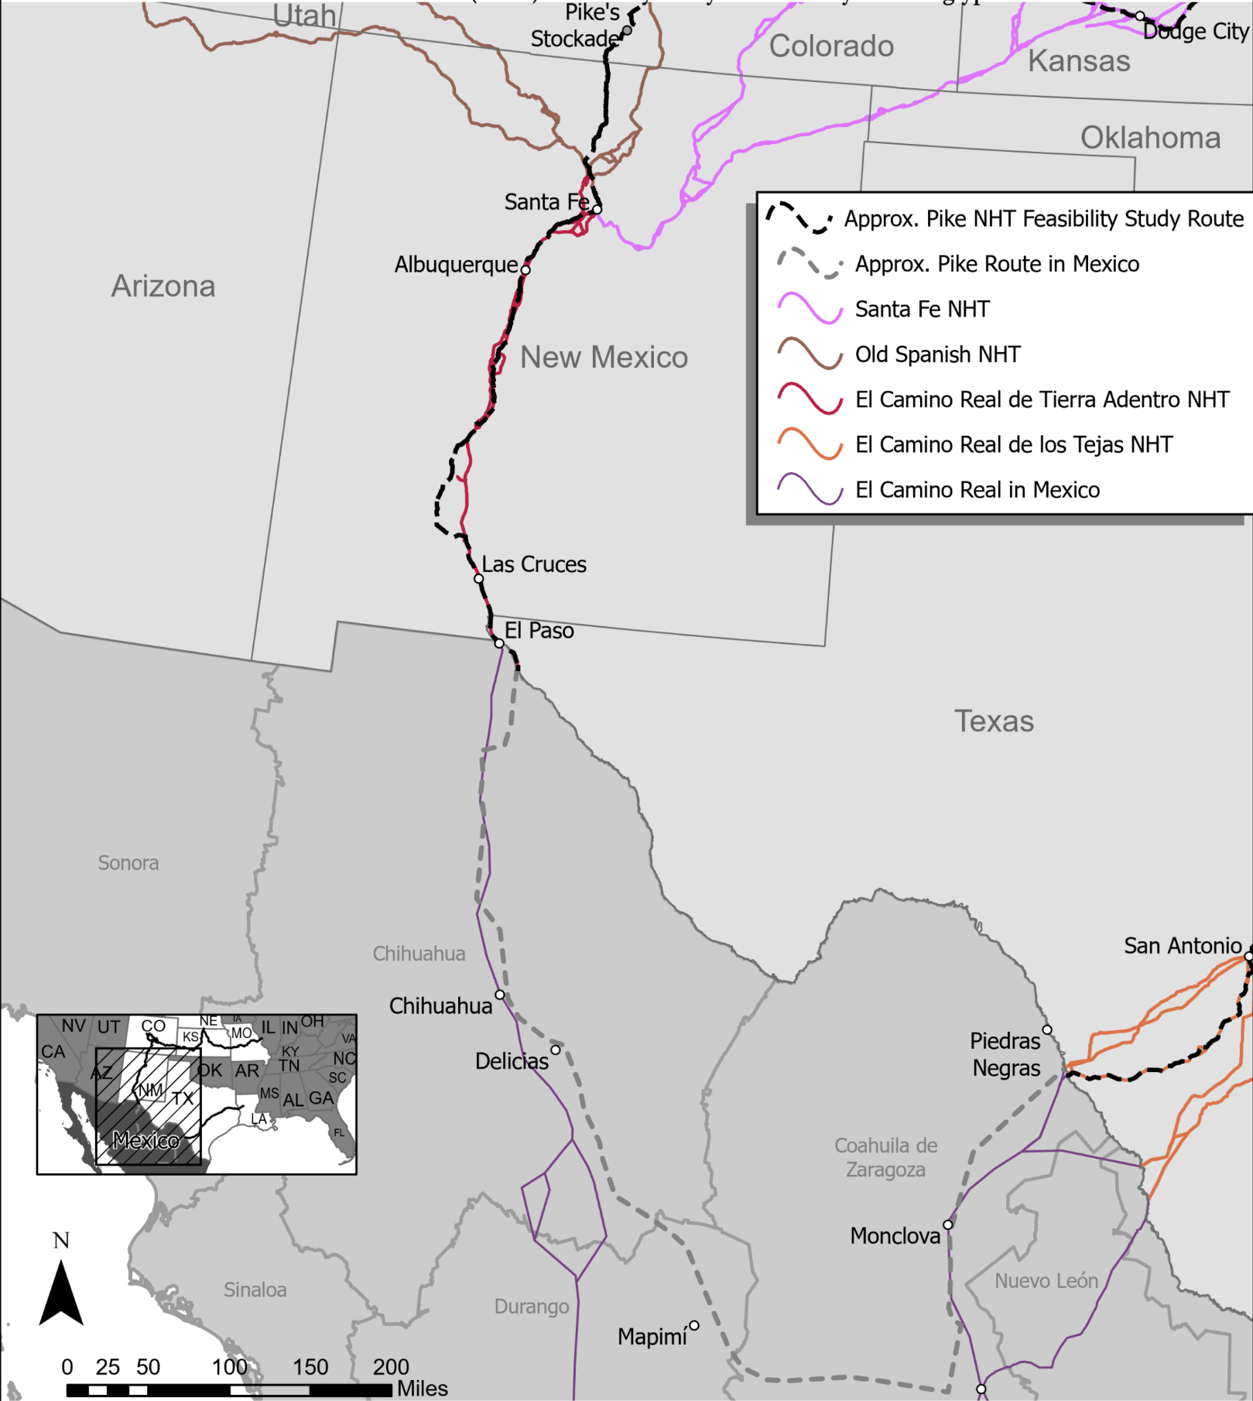
La ruta de Pike en la Norteamérca española: escoltado a través de Nuevo México y el norte de México
Ilegalmente en territorio español, Pike fue capturado por una fuerza española fuera de Santa Fe y escoltado a la ciudad de Chihuahua, a lo largo del Camino Real, para que el comandante general decidiera su destino.
Técnicamente un prisionero, pero con permiso de interactuar con militares y otros, como los estadounidenses, en Santa Fe, Albuquerque, El Paso y Chihuahua.
El comandante general decidió enviarlo de regreso a EE. UU., a través del Texas español.
Cruzó el Río Grande, al sur de Piedras Negras, siguiendo el Camino Real de los Tejas.
Notes:
It was here on the banks of the Conejos River that Pike’s journey began it’s third and final stage.
As the next couple of maps will show, Pike was now in Spanish territory, and he was about to begin his long and unexpected journey home.
Although Spain and the U.S. were not at war, Pike had led an unauthorized and unwanted military expedition into Spanish territory.
The Spaniards were aware of Pike’s presence and sent a large contingent form Santa Fe to capture his men and bring them to Santa Fe for questioning. Under guard he was brought to Santa Fe where he defended his exploration activities and Governor Joaquin Alencaster decided to send Pike and his men under guard to Chihuahua City by way of the Camino Real.
In Chihuahua City in April 1807, Commandant General Nemesio Salcedo decided to imprison most of Pike’s men, but sent the Lieutenant and a small group back to American territory, this time through northern Mexico to the Province of Texas.

Slide 21
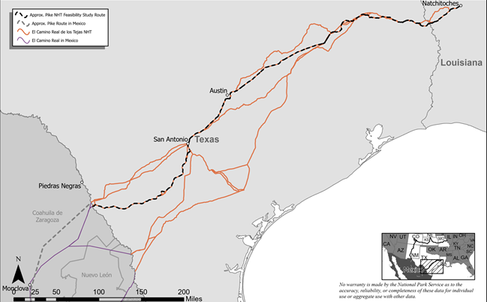
La ruta de Pike a través del Texas español: regreso a EE. UU. y final de la ruta en Natchitones, Luisiana
Escoltado a través del Texas español, continúa interactuando con líderes militares españoles y otros, en San Antonio y campamentos de otras comunidades coloniales españolas.
Puesto en libertad al lado este del río Sabine, en suelo estadounidense, llegó a Natchitoches, Luisiana, en julio de 1807.
Pike había viajado durante casi 12 meses por más de 5794km (3600 millas).
Atravesó los bosques de Mississippi, las Grandes Llanuras, las Montañas Rocosas, el desierto de Chihuahua de Nuevo México, el norte de México y los valles de los ríos, las colinas, praderas y pinares del sur de Texas.
Notes:
Under guard, Pike and his drastically-reduced party marched south and east from Chihuahua and eventually reached the Rio Grande just downriver from Piedras Negras, where they began their trek through Spanish Texas.
They passed through San Antonio, and several Spanish encampments before reaching the Sabine River in July 1807, where Pike was released in US Territory, and marched to nearby Natchitoches LA.
This was the end of Pike’s Southwest expedition.
In almost 12 months he had travelled over 3600 miles. He had traversed the Mississippi woodlands, the Great Plains, the Rocky Mountains, the Chihuahuan Desert of New Mexico and northern Mexico, and the river valleys, hill country, coastal prairie, and southern pinelands of Texas.

Slide 22
Detalles notables de la expedición de Pike
El diario de Pike, impreso antes que los diarios de Lewis y Clark, ofreció al público una perspectiva de la vida en las Grandes Llanuras y la frontera colonial, desde el punto de vista de un oficial del ejército de EE. UU., durante un periodo crítico de la historia de la frontera.
Pike interactuó con Kansas, Osage y Pawnee (no se produjo una paz duradera).
Precursor de la ruta de Santa Fe y el tránsito por los Caminos Reales.
Intriga continua de la presencia del Ejército de EE. UU. en la Norteamérica Española y la confusion sobre las fronteras.
El nombre de Pike sigue vivo en la cultura popular, sobre todo con el Pico Pike (el cual vio, pero no alcanzó su cima)
Notes:
What are the notable features of Pike’s expedition?
Well, in carrying out his mission, he interacted and continued dialog with the Osage, Kansas, and Pawnee. His meetings with these tribes produced no lasting peace, and he was unable to meet with the Comanche.
Also consistent with his orders, he found the headwaters of the Arkansas River deep in the high country of the Rocky Mountains.
Implied as part of his mission, he confirmed the feasibility of travelling over the Plains to the Spanish settlements along the Rio Grande—a precursor to the Santa Fe Trail.
He was unable to avoid the Spaniards, but in becoming their prisoner, he was permitted a certain freedom of movement and association that allowed him to make keen observations about the Spanish presence in North America, as he travelled through the towns of Santa Fe, Albuquerque, El Paso, Chihuahua, Presidio Rio Grande, and San Antonio, and he did this at a key time in the waning years of the Spanish presence in the Western Hemisphere.
He captured all of it in a journal, parts of which he was able to keep from the Spaniards and part reconstructed from memory. His journal was printed before Lewis and Clark’s journals were, and it was released to an eager public worldwide in 1810.
Pike’s name lives on in popular culture, most notably with Pike’s Peak (which he saw but did not summit).
So with that background, I’ll turn the remainder of the presentation over to Lillis, who will take us through the feasibility study process.

Slide 23
Proceso del estudio de viabilidad del sendero
Notes:
(Aaron passes Presentation to Lillis)
Thanks, Aaron.
Greetings, again, my name is Lillis.
I am going to explain more about the trail study process and guide you through on how to provide comments on the study, which are incredibly important to the National Park Service and critical to the study process.
Again, please Feel free to enter questions in the chat – we will answer those after the presentation portion of our meeting.

Slide 24
Descripción general proceso del estudio de viabilidad del sendero
¿Cómo realiza el estudio el Servicio de Parques Nacionales? ¿Cómo se evalúa la ruta?
¿Quién decide si el Sendero Pike se designa como un sendero histórico nacional?
¿Qué significaría la designación para el público y los propietarios de tierras?
Notes:
So first off, I am going to explain a bit more about the trail feasibility study process
and provide answers to questions like:
How does the Park Service carry out the study?
How is the route assessed?
Who decides if the trail gets designated as a national historic trail?
What would designation mean to the public and for landowners?

Slide 25
Pregunta 1 proceso del estudio de viabilidad del sendero
¿Cómo realiza el estudio el Servicio de Parques Nacionales? ¿Cómo se evalúa la ruta?
Notes:
Let’s tackle the first question.
How does the Park Service carry out the study And how is the route assessed?
Aaron touched on this earlier in the presentation….

Slide 26
Continuación de la pregunta 1 proceso del estudio de viabilidad del sendero
¿Cómo realiza el estudio el Servicio de Parques Nacionales? ¿Cómo se evalúa la ruta?
Ley de 1968 (P.L. 90-543) Sistema Nacional de Senderos
Notes:
The answer lies within the National Trails System Act – which was originally passed by Congress in 1968.
The NTSA provides an explicit framework for the study of potential new national historic trails.
It lays out specific criteria – three of them – that potential routes must meet in order to qualify for designation as a new national historic trail.
So, what are the three criteria?

Slide 27
Criterios de la pregunta 1 proceso del estudio de viabilidad del sendero
Ley de 1968 (P.L. 90-543) Sistema Nacional de Senderos
Para calificar para designación como un sendero histórico nacional nuevo, un sendero tiene que cumplir con todos los tres criterios siguientes:
1. Debe ser un sendero o ruta establecido por uso histórico y debe ser históricamente significativo como resultado de tal uso.
2. Debe ser de significado nacional con respecto a de la historia estadounidense.
3. Debe tener el potencial significativo para uso público recreativo o interés histórico basado en la interpretación y aprecio histórico.
Notes:
To qualify for designation as a new national historic trail, a trail must meet all three of the following Criteria:
The route or trail
1. Must be established by historic use & historically significant as a result of that use.
2. Must be of national significance in American history.
3. Must have significant potential for public recreational use, historic interest & appreciation.
Let’s take a closer look at these Criteria together

Slide 28
Criterio 1: establecimiento por uso histórico y significado histórico, como resultado de ese uso
Debe ser un sendero o ruta establecido por uso histórico; y
Debe ser históricamente significativo, como resultado de ese uso;
Su ubicación debe ser suficientemente conocida.
Notes:
The First Criterion,
States that the trail or route must be established by historic use
And it must be historically significant as a result of that use.
In addition, the Location of a route or trail must sufficiently known – so, we need to know where the trail is located, not just that a trail or route existed.

Slide 29
Criterio 2: importancia nacional en la historia estadounidense
Debe ser de importancia nacional, con respecto a cualquiera de las diversas facetas generales de la historia estadounidense, como la industria y el comercio, la exploración, la migración y el asentamiento o las campañas militares.
Para calificar como de importancia nacional, el uso histórico del sendero debe haber tenido un efecto de gran alcance en los patrones generales de la cultura estadounidense.
Se pueden incluir senderos importantes en la historia de los nativos americanos.
Notes:
The second criterion states that the route must be of National Significance in American History - this is in respect to any of several broad facets of American history, such as trade and commerce, exploration, migration and settlement, or military campaigns.
To qualify as nationally significant, historic use of the trail must have had a far reaching effect on broad patterns of American culture.
Trails significant in the history of Native Americans may be included. For example, the trail of teams and the Nez Perce
A note about how National Significance is assessed - the National Park Service applies the National Historic Landmark criteria in order to determine national significance.

Slide 30
Criterio 3: potencial significativo para uso recreativo público e interés y apreciación históricos
Debe tener el potencial significativo para uso público recreativo o interés histórico basado en la interpretación y aprecio histórico.
La presencia de potencial recreativo no relacionado con el aprecio histórico no es justificación suficiente para designación bajo esta categoría.
Notes:
And the 3rd and final Criteria is that a route or trail must have Significant potential for public recreational use, historic interest and appreciation.
A key point to note is that the Presence of recreation potential not related to historic appreciation is not sufficient justification for designation under this category.

Slide 31
Pregunta 2 proceso del estudio de viabilidad del sendero
¿Quién decide si el sendero Pike se debe designer como sendero histórico nacional?
Notes:
So, lets turn to answer the Q of who decides if the Pike trail gets designated as a national historic trail?
And talk about possible study outcomes

Slide 32
Posibles resultados del estudio
El estudio tiene hallazgos positivos para los 3 criterios
o
El estudio tiene hallazgos negativos para uno o todos los 3 criterios
El estudio es enviado al Congreso
El Congreso actúa para designar
o
El Congreso no actúa para designar
Notes:
This slide shows possible outcomes
The Study can have a positive findings for the 3 criteria
or
The Study can negative findings for 1 or all of the 3 criteria
Upon completion of the study by the National Park Service, it is Study sent to Congress.
From there -
Congress can act to designate the route as a new national historic trail or Congress can elect not to act to designate the route as a new national historic trail.
So the answer to our question of Who decides if the Pike trail gets designated as a national historic trail?
The answer lies squarely with Congress.
A couple more important points to note is that
There is no time-line for legislative action
and
Once the study is passed to congress it really become an issue of public advocacy. Public advocacy is an important point of congressional considerations.

Slide 33
Cronograma estimado del estudio
Plazos previstos | Objetivos del estudio
Invierno 2020 - Primavera 2021 | Recolección de datos e investigación
Abril - Junio 2021 | Difusión pública*
Julio - Noviembre 2021 | Evaluación de criterios y preparación de documentos
Noviembre 2021 - Julio 2022 | Revisión del NPS de los hallazgos del estudio
Agosto 2022 | Corrección del estudio con base en la revisión del NPS
Septiembre 2022 | Periodo de 30 días para comentarios públicos sobre la propuesta del estudio*
Noviembre 2022 | Finalización del estudio
Diciembre 2022 | Presentación ante el Congreso
Notes:
IN CHAT type:
Pike study – sign-up form:
http://www.tinyurl.com/ynxdsfrn
______________________________________________________________________
This slide has a table showing an Estimated Study Timeline.
In one column, 8 Study Milestones are listed. And in the other columns the projected time frame for each milestone is provided.
The Study process typically takes approximately two and a half years to complete.
I would like to call attention to two of the listed Study Milestones in the table – both are marked with a red asterisk and are in bold.
The first is Public Outreach, which marks the stage that we are presently in – it runs from April to the end of June 2021.
Following this period of public outreach, the National Park Service will assess the criteria that we just reviewed and prepare the study document.
Please note the other Study Milestone which is marked with a red asterisks. It is a a 30-day public comment period on the draft study.
This is scheduled to occur in September of 2022.
This period of public comment on the draft is not a required step– but the National Park Service is including this step in effort to ensure that the public has opportunity to comment on the study and its findings.
We are really hoping as a part of this comment period we can provide a series of in person meetings in your communities. This is our attempt acklowledge and alleviate the challenges that have come about from COVID and public engagement for the Study. As Aaron mentioned earlier, it is our preference and it the nomr to hold in person meetings for feasibility studies.
If you would like to be notified of this 30 public comment period, please add your email to the project mailing.
We will place a link to that sign up sheet again the chat box.
A final note on this estimated study timeline:
Of course, the projected time frames in this table are subject to change. Things could move faster or slower depending on circumstances.

Slide 34
Pregunta 3 proceso del estudio de viabilidad del sendero
¿Qué significaría la designación para el público y los propietarios de tierras?
Notes:
Let’s turn the third question of “What would designation mean for the public and for landowners?”
Aaron also touch on some of this information earlier in the presentation, and it worth clarifying

Slide 35
Continuación de la pregunta 3 proceso del estudio de viabilidad del sendero
  Si el Congreso actúa para designar el Pike Trail como un nuevo sendero histórico nacional:
    El gobierno federal no tendrá autoridad sobre tierras privadas a lo largo de la ruta.
    La participación en el desarrollo del sendero a lo largo de la ruta, por parte de propietarios privados, es completamente voluntaria.
    Los propietarios de tierras privadas no tienen la obligación de permitir el acceso al público a sus tierras.
    Las cláusulas para “vendedores dispuestos” están incluidas en la legislación nacional de senderos históricos.
Notes:
Should Congress act to designate the Pike Trail as a new national historic trail
It is important to know that the private government would have no authority over private lands along the route.
and
-Participation in trail development along the route by private landowners is entirely voluntary.
-Private landowners are under no obligation to allow the public on their lands.
-Willing seller clauses are included in national historic trail legislation.

Slide 36
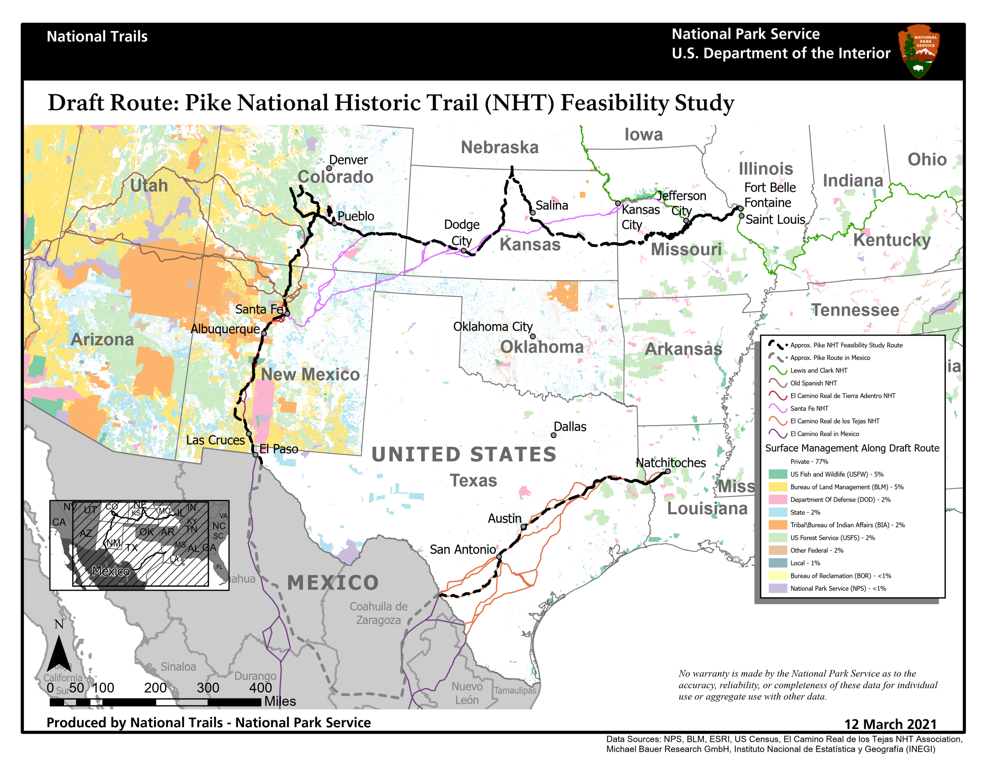
Mapa de los Estados Unidos con la ruta preliminar de Pike representada como una línea discontinua negra
Notes:
This slide shows a map of the United States with Pike’s Draft Route depicted as a black dashed line.
The map also depicts land ownership type – otherwise referred to as Surface Management Agency,
The legend on the right hand side of the slide depicts each category of land ownership that occurs along Pike’s route, and each category of ownership has been assigned a color, with those colors visualized on the map.
You will note that the Pike Trail falls predominately on privately owned land.
77% of land along the route is under private ownership
The remining 23% of lands along the route are owned by various federal or tribal agencies as well as state.
So, tying to back to the question of What would designation mean to the public and for landowners?
Should Congress act to designate the Pike Trail as a new national historic trail
What that might mean on the ground in terms of access and visitor use would vary depending on landownership, the interest of private landowners, state or federal landholders to participate in trail development.
So, again, as Aaron mentioned earlier, although the designation of a national historic trail is continuous from end to end, designation does not create a through hiking trail, open to public access from end to end.
Again:
Participation in trail development or public access opportunities along the route by landowners is entirely voluntary.
Private landowners are under no obligation to allow the public on their lands.

Slide 37
Cont. pregunta 3 proceso del estudio de viabilidad del sendero
  Si el Congreso actúa para designar el Pike Trail como un nuevo sendero histórico nacional:
  Se desarrollaría un Plan de gestión integral.
    Detalles sobre cómo se gestionará el sendero.
    Se identificarían ubicaciones de acceso al sendero y oportunidades.
    Se identificarían oportunidades interpretativas/educativas.
    Aportes y reuniones públicos.
    Consulta y coordinación con gobiernos federales, tribales, estatales, municipales y el público.
Notes:
What would designation mean to the public and for landowners?
Should Congress act to designate the Pike Trail as a new national historic trail:
A Comprehensive Management Plan for the Pike National Historic Trail would be developed. This is a separate and new process –entirely distinct from the trail feasibility study process.
The Comprehensive Management Plan is where the rubber hits the road, so to speak.
It is where specifics on how he trail would be managed are addressed, including the creation and designation of a federally approved logo, which would mark and signify the trail.
Specific trail access locations and opportunities are identified in the Comprehensive Management Plan, as well as Interpretive and educational sites and opportunities.
The development of the Comprehensive Mange Plan would very much involve a great deal of
Public Input and a there would be a fresh round of public meetings
And
Consultation and coordination with stakeholders across the length of the route would occur –to include federal, tribal, state, municipal governments, and the public.

Slide 38
Estudio de viabilidad del Sendero Histórico Nacional Pike
¡Queremos escuchar su opinión!
Envíe sus comentarios hasta el 30 de junio de 2021.
Notes:
Now I would like to turn to what is in many ways the most important part of our meeting today –which is hearing from you – getting your feedback – and answering any questions .
The Pike National Historic Trail Feasibility Study is open to public comment through June 30th 2021.
Your comments are critical to the study process. They inform the National Park Service’s assessment of the three trail criteria that we just reviewed.

Slide 39
Queremos escuchar su opinión
Hay muchas maneras de comentar.
Sus ideas y comentarios son importantes para nosotros.
Las reuniones virtuales presentan retos y oportunidades.
Argregue su nombre a la lista de correo del proyecto, para recibir actualizaciones del estudio.
Notes:
IN CHAT type:
Pike study – sign-up form:
http://www.tinyurl.com/ynxdsfrn
__________________________________________________________________
Again, we want to hear from you.
There are several ways to share your thoughts and comments with the National Park Service on the Pike study – which I will explain further on the next slide.
I would like to stress that Your thoughts and comments are important to us. They inform the study, and your comments help us to accurately assess how the trail may or may not meet the three criteria that we reviewed earlier.
We recognize that virtual meetings like the one we are in, present both challenges and opportunities.
It is our aim to make commenting and engaging in the study process as easy and accessible as possible
In that spirit, We hope to identify opportunities for future in-person meetings, so please add your name to the project mailing list so you can receive study updates and notifications.
We have placed the link to the Pike Study’s sign-up form again here in the chat box.

Slide 40
¿Cómo enviar los comentarios?
1. Visite la página web del estudio para compartir sus ideas con nosotros
parkplanning.nps.gov/pike
2. Envíe sus comentarios a:
Lillis Urban
National Trails
National Park Service
1100 Old Santa Fe Trail
Santa Fe, NM, 87505
Correo electrónico: lillis_urban@nps.gov
3. O comente ahora en el cuadro de “chat”.
Notes:
IN CHAT type:
Pike study – webpage:
https://parkplanning.nps.gov/pike
_________________________________________________________________________________
Okay – let’s talk about how to submit comments on the study.
This slide presents three ways to submit your comment.
First on the list is to Visit the study’s webpage.
www.parkplanning.nps.gov/pike
Again, we have placed a link to the study’s webpage in the chat box.
I will walk you though how to submit comments on the study’s webpage in the coming slides.
IF you have any trouble, please reach out to me directly and send me an email,.
You can also mail comments to me at the following address:
Lillis Urban
National Trails
National Park Service
1100 Old Santa Fe Trail
Santa Fe, NM, 87505
My Email is lillis_urban@nps.gov
And the third way that you comment on the study, is right now in the chat box. We will be reading your comments back at the end of the presentation.
And the entire chat record from our meeting today will be reviewed by the National Park Service. Comments that were received on the study though the chat will be incorporated into the feasibility study document that will shared with Congress.
Ok, let’s walk through the project’s webpage and show you how to submit comments.

Slide 41
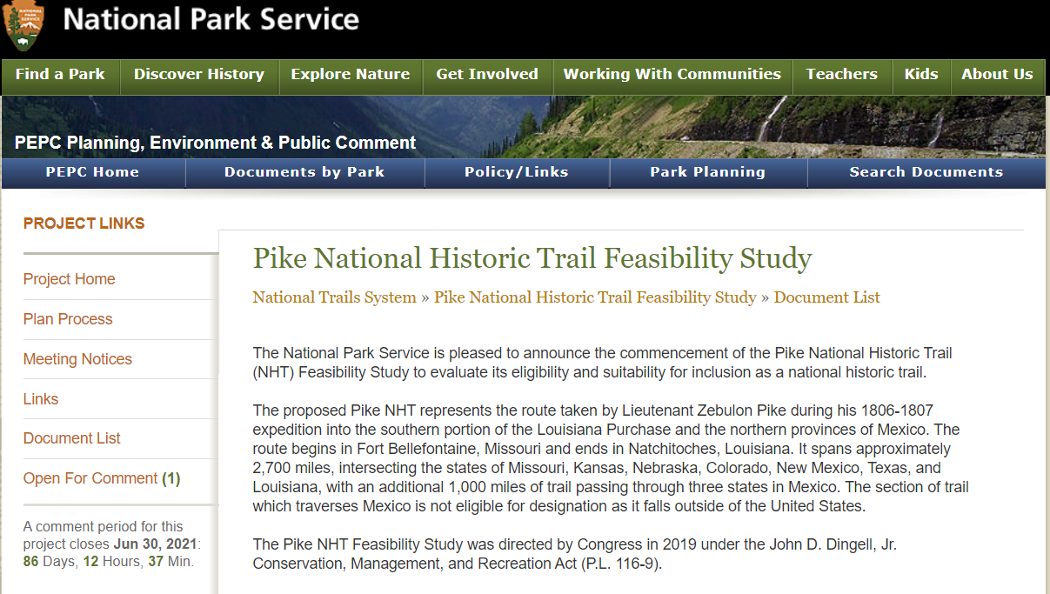
¿Cómo enviar los comentarios a través de la página web del estudio?
parkplanning.nps.gov/pike
Screen shots of PEPC
Notes:
This slide shows the project’s home page. This is the screen that you will see when you visit www.parkplanning.nps.gov/pike
In the left hand side tool bar of the project’s webpage are a number of links that you can select from.
To comment, click on the “open for comment” link. It is circled in red on this slide.

Slide 42
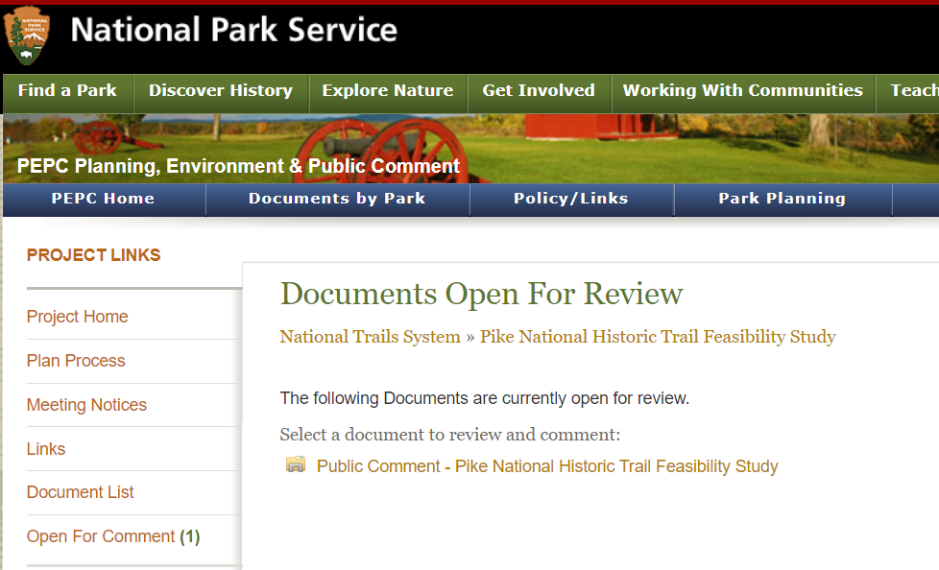
¿Cómo enviar los comentarios a través de la página web del estudio?
parkplanning.nps.gov/pike
Screen shots of PEPC
Notes:
When you click on ‘open for comment’ you will be brought to this page –
The title of the page is Document Open for Review.
To comment on the Study, Click on the folder – “Public Comment – Pike National Historic Trail Feasibility Study”
That folder is circled here in red.

Slide 43
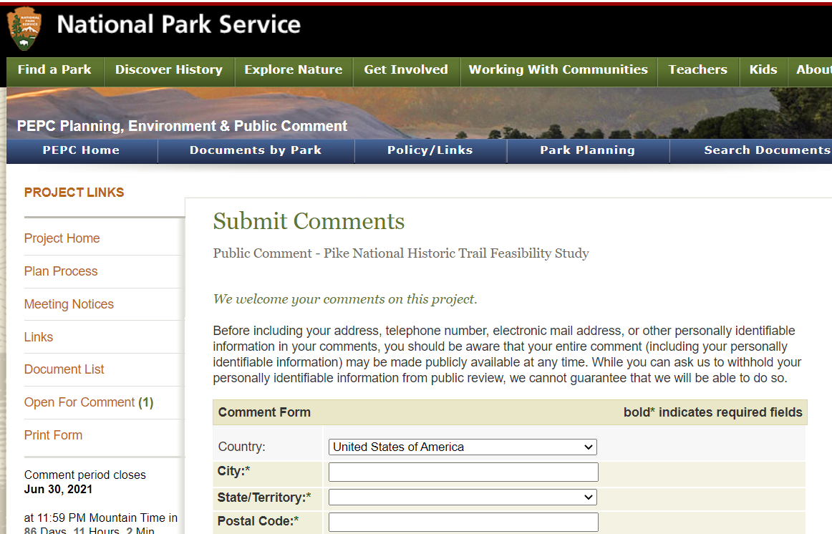
¿Cómo enviar los comentarios a través de la página web del estudio?
parkplanning.nps.gov/pike
Screen shots of PEPC
Notes:
After clicking on Documents Open for Review, you will be brought to the Submit Comments slide – shown here on the Power Point.
On this page you will submit your comments.

Slide 44
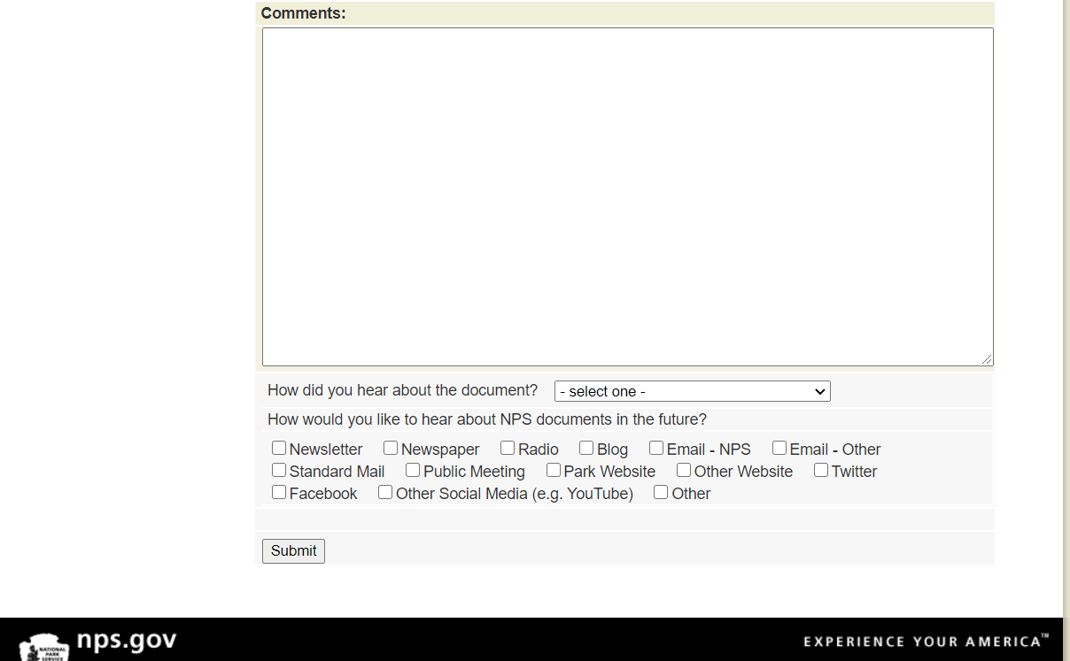
¿Cómo enviar los comentarios a través de la página web del estudio?
parkplanning.nps.gov/pike
Screen shots of PEPC
Notes:
IN CHAT type:
Problems submitting comments
Email: lillis_urban@nps.gov
__________________________________________________________________________
At the bottom of the Submit Comments page – after you have provided you comments, there is a ‘Submit’ button.
The submit button is circled in red on the slide here.
Be sure to click Submit when you are done commenting.
After you submit your comments – please know that your comments ARE NOT VISIBLE TO ALL. It is not like Facebook.
Your comments will be sent directly to the National Park Service.
However,
Your comments are a part of the public record.
They will be incorporated into the feasibility study document that will be shared with Congress.
Again, if you have any trouble navigating these sites please contact me directly.
We will place my email in the chat box.

Slide 45
Preguntas del estudio
5 preguntas del estudio desarrolladas por el Servicio de Parques Nacionales.
Diseñadas para proporcionar al Servicio de Parques Nacionales la información necesaria para tomar decisions sobre la elegibilidad del Sendero Pike como un sendero histórico nacional.
Notes:
In order to facilitate feedback, the NPS has developed 5 study questions.
There are listed in the study website when you go to provide comment. I will also walk us through them in this presentation.
The questions are designed to provide us with the info we need to make determinations of the eligibility of the Pike trail as a national historic trail.

Slide 46
Preguntas del studio
1. ¿Hay lugares o áreas en o adyacentes a la ruta que son, o podrán ser, visitados por el público para oportunidades recreativos o aprecio histórico (por ejemplo: excursionismo o acceso al aire libre, museos, sitios históricos, exhibiciones educativas)? De ser así, por favor cuéntenos sobre ellos.
2. ¿El estudio de la ruta identifica con exactitud la ruta de Pike en los años 1806-07? De no ser así, ¿dónde difiere? ¿Hay algo más que usted quiere que el Servicio de Parques Nacionales sepa de esta ruta y sus sitios asociados?
Notes:
In order to facilitate feedback, the NPS has developed a series questions that are presented on the study website – Let me walk you through the Qs now.
These questions are designed to provide us with the info we need to make determinations of the eligibility.
1. Are there sites or areas on or adjacent to the route that are, or could be, visited by the public for recreational opportunities or historic appreciation (e.g. hiking or outdoor access, museums, historic sites, educational exhibits)? If so, please tell us about them.
2. Does the study route accurately identify Pike’s 1806-1807 route? If not, where does it differ? Is there anything else you want the National Park Service to know about this route and its associated sites?

Slide 47
Preguntas del estudio (continuación)
3. ¿Cómo podrá la designación de esta ruta como un sendero histórico nacional afectarle a usted y a su comunidad? ¿Tiene alguna preocupación? ¿Qué beneficios ve?
4. ¿Le gustaría ver la expedición de Pike de 1806-07 designada como un sendero histórico nacional? ¿Por qué o por qué no?
5. ¿Cree usted que esta ruta es importante en la historia de los Estados Unidos? ¿Por qué o por qué no?

Slide 48
Estudio de viabilidad del Sendero Histórico Nacional Pike
Senderos Nacionales - Servicio de Parques Nacionales
Departmento del Interior de EE. UU.
- Preguntas y Comentarios -
Notes:
So now we would like to move into the Question and Answer and Comments portion of our meeting. In many ways, this is the most important part of our meeting today.
But before I pull the PowerPoint down, so we can see all our faces again, I am going to share the state level map of Pike’s Draft Route for the State of (FILL IN THE BLANK OF STATE MEETING WE ARE IN) – so that folks can see more closely where Pike’ Routes falls within your state. Perhaps seeing the route more closely in your state may prompt comments or question.

Slide 49
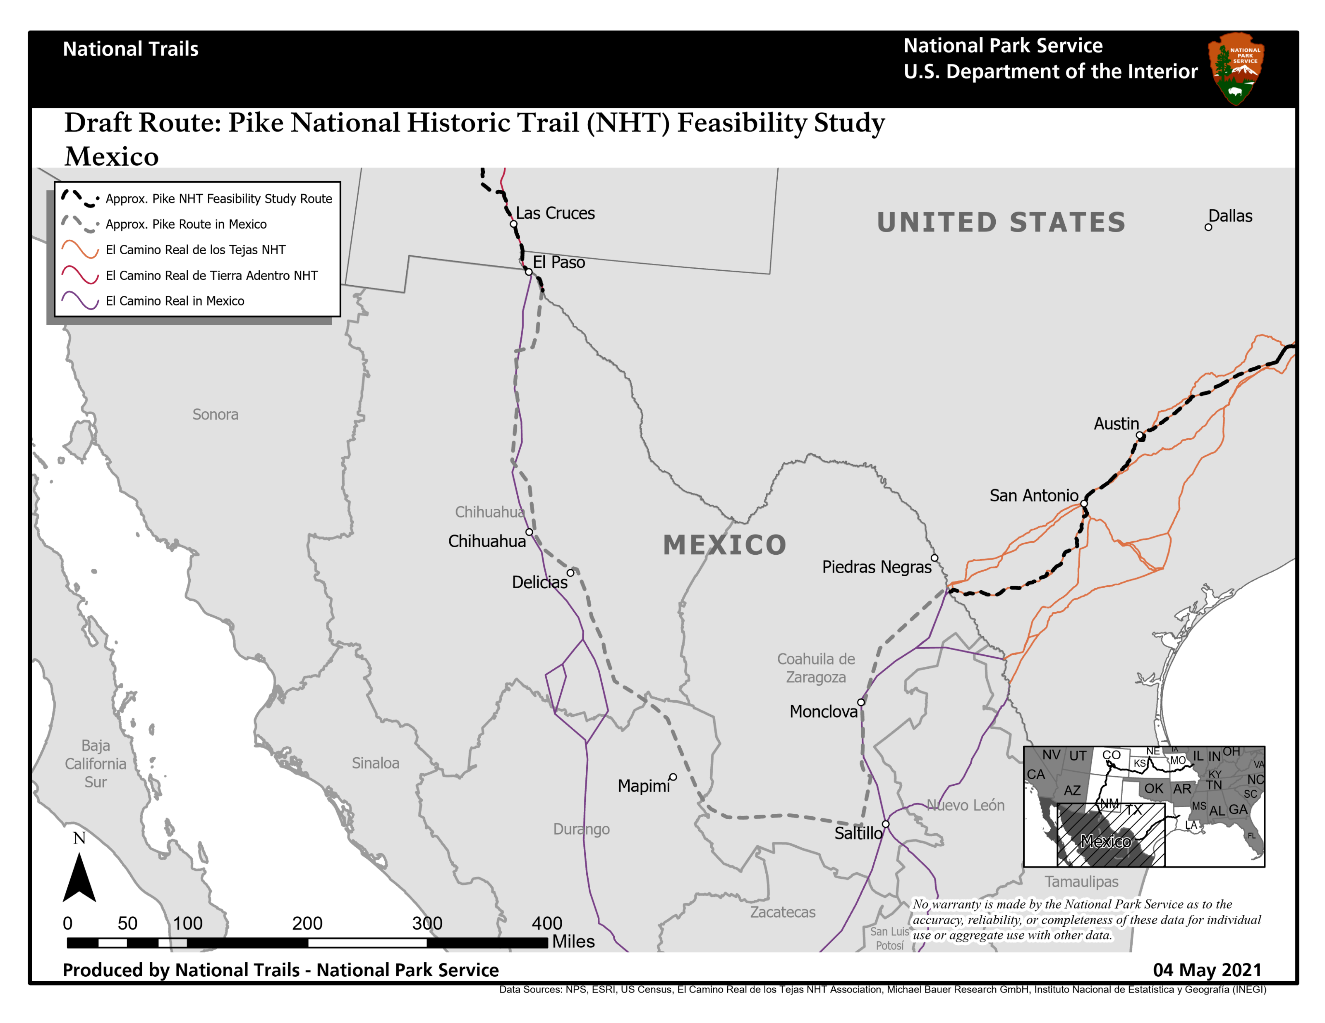
The Draft Route for the Pike National Historic Trail Feasibility Study Mexico
Notes:
This slide shows the Pike’s Draft Route within the Mexico. You can see that Pike’s 1806-107 Expeditionc passed though present day towns X, X, X.
I can pull this map back should there be comments or questions specific to it.
For now I am going to stop the PP so that Aaron and I can see all of you and take your comments and questions.
A member of our team at National Trails staff, Carol Clark, will be serving as chat moderator today, reading back your comments and questions to Aaron and I.
STOP SHARING PP –
[Key Support Staff from National Trails:
read back, in order of appearance, and as written verbatim, questions and comments in the chat box.
IF THERE ARE No comments or questions be prepared to type into the chat, one at a time, the Study Questions. Lillis will move us through the questions.]
[Potentially type into CHAT:
Study Sign up sheet: https://tinyurl.com/ynxdsfrn
Study webpage: https://parkplanning.nps.gov/pike
Lillis’s email: lillis_urban@nps.gov
STUDY QUESTIONS:
1. Are there sites or areas on or adjacent to the route that are, or could be, visited by the public for recreational opportunities or historic appreciation (e.g. hiking or outdoor access, museums, historic sites, educational exhibits)? If so, please tell us about them.
2. Does the study route accurately identify Pike’s 1806-1807 route? If not, where does it differ? Is there anything else you want the National Park Service to know about this route and its associated sites?
3. How might designation of this route as a National Historic Trail affect you and your community? Do you have concerns? What benefits do you see?
4. Would you like to see Pike’s 1806-1807 expedition designated as a National Historic Trail? Why or why not?
5. Do you think this route is important in America’s history? Why or why not?

