Slide 1
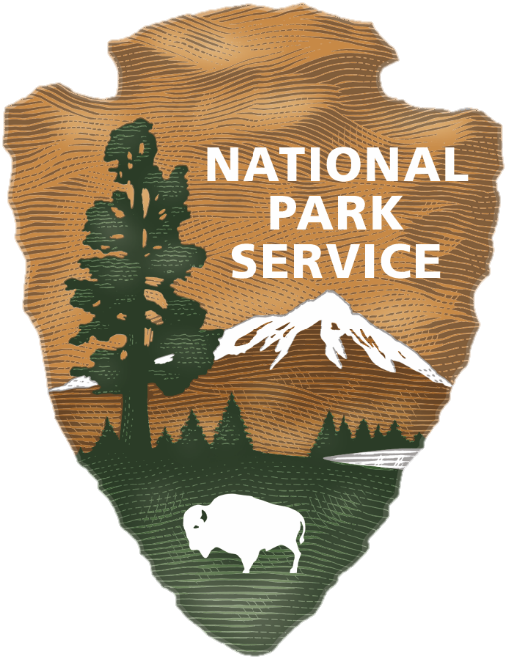
Welcome Slide

Slide 2
Welcome!
Please MUTE your microphone for the introductory portion of the presentation.
Check out the Project Website while you wait: https://parkplanning.nps.gov/pinehurst
Use the Participants feature to view who is in the Zoom meeting. At the bottom of the menu, there is also a “raise hand” option, which will be utilized in the public input portion of the meeting.
Use the Mute and Stop Video features to turn your microphone and camera on and off. Please stay muted until the public input portion of the meeting.
Use the Chat feature to communicate with meeting organizers and share your input throughout the meeting. Relevant links will also be placed in the chat.
Use the Leave button to exit the meeting at any time.
This meeting is being recorded for internal purposes only.
Notes:
FIRST SLIDE
Welcome! + introduction of McAdams team
Basic outline of agenda for today
Before we get this meeting started, we did want to go over some of the basic Zoom functions that will be relevant today:
Muting (stay muted for duration of presentation – will have a chance to speak & discuss during the )
Chat: If you have a question or comment, feel free to drop it in the chat! The staff will be monitoring the chat throughout the presentation.
Practice Activities:
CHAT: In the chat box, please drop one or two words that come to mind when you think of the Village of Pinehurst!

Slide 3
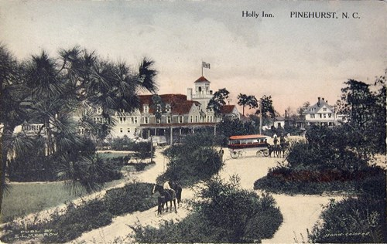
Agenda and Purpose
Welcome –Meeting Facilitators, McAdams
NHL Program Introduction and Project Background – Ellen Rankin, National Historic Landmark Program, National Park Service
Study Approach – Ellen Turco, Project Manager, Richard Grubb & Associates
Audience Question and Comment Period
Rivers, Trails & Conservation Assistance Program
Notes:
Thank you to everyone for attending todays virtual public meeting. I’m Ellen Rankin and I work with the National Historic Landmarks Program. Today I’ll give a brief overview of the NHL program and the process for the Pinehurst NHL District Integrity and Condition Study. Afterwards I will turn the presentation over to Ellen Turco, the Consultant hired by the NPS for this Study. Last we will open up the meeting for a question and comment period which will be moderated by McAdams.

Slide 4
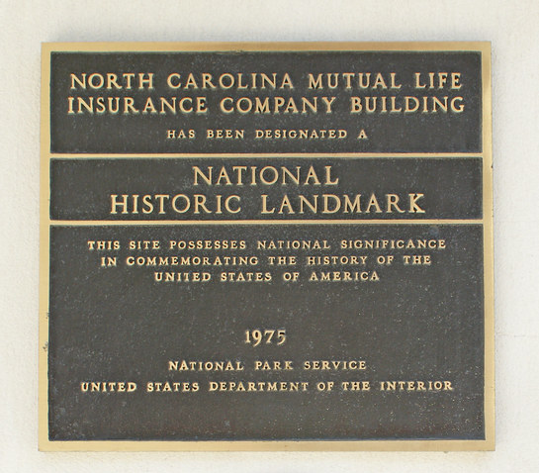
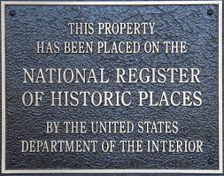
NR vs NHL Designation
vs.
Notes:
First of all, I wanted to give a brief overview of the National Historic Landmarks (or NHL) program as well a clarify some misconceptions of what NHL designation entails.
So you’ve probably seen a bronze plaque, like those on the screen, on a historic building, but what exactly do those plaques mean? There are the two programs the federal government has in place to recognize historic properties: the National Register of Historic Places and the National Historic Landmarks Program.
At this time, I will note that Pinehurst also has a local historic district which is not one of these two programs although there is some overlay, and I will touch briefly upon later.

Slide 5
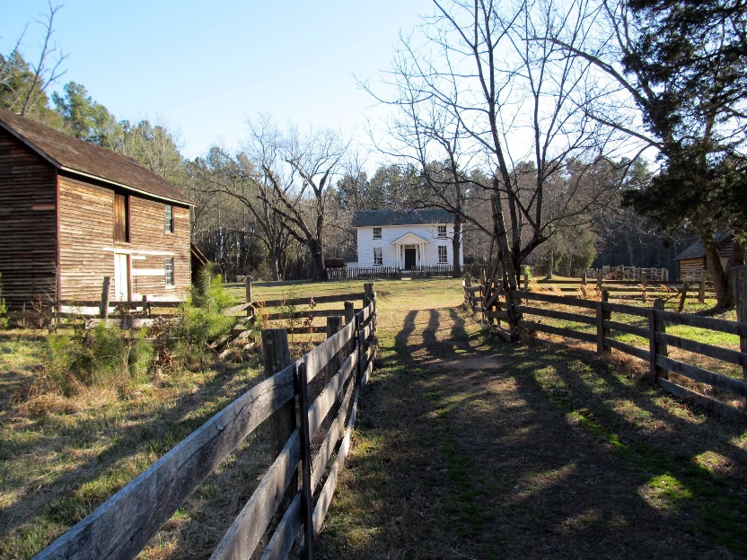
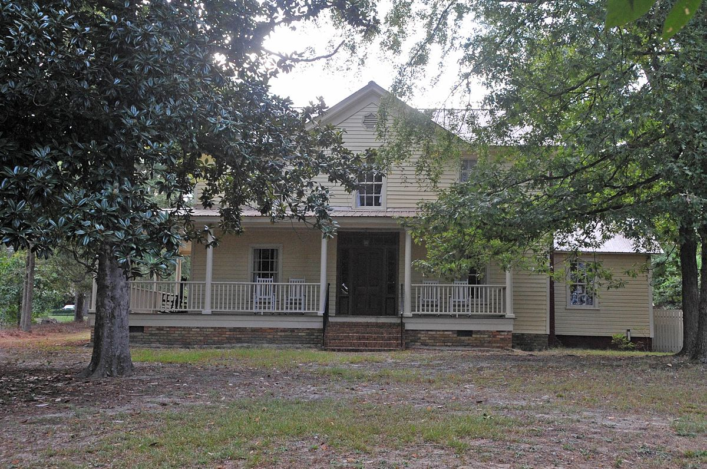
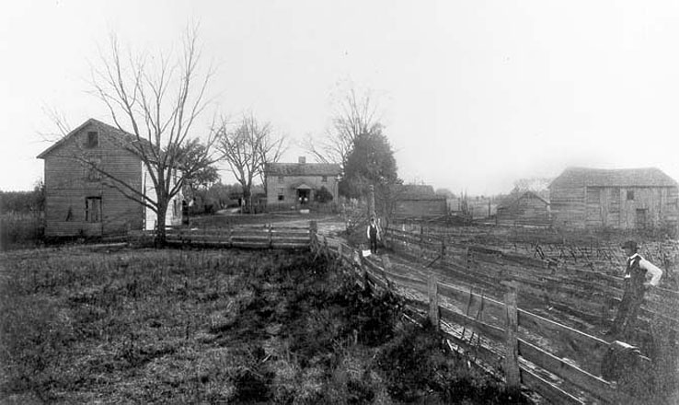
NR vs NHL Programs
This house, located on South Street in Aberdeen, NC, is typical of the residences in the historic town core of Aberdeen (Image from 1998 National Register Files).
Duke Homestead and Tobacco Factory, top photograph taken in 2010 bottom photograph 1890s.
Notes:
The National Register is the broader of the two programs. Properties listed in the National Register illustrate stories that have meaning either to the local community, the residents of a specific state, or to the citizens of the nation as a whole. National Historic Landmarks, illustrate stories that are important to the nation as a whole and are considered the best examples of a property type. Often National Historic Landmarks represent a turning point in American history.
On the screen are examples of a National Register and a National Historic Landmark property. The building on the left is significant at the local level because it represents an architectural style common to a particular community.
On the right is the Duke Homestead and Tobacco Factory NHL. The Property is nationally significant for its association with the family that played a major role in the development of the tobacco industry in the post-Civil War South. It was in this complex of small wooden buildings that Washington Duke and his son James Buchanan Duke founded the family business that became the American Tobacco Company.
Just to give you a sense of the difference: out of the approximately 90,000 properties listed in the National Register only about 3% are National Historic Landmarks, or just over 2600 properties.

Slide 6
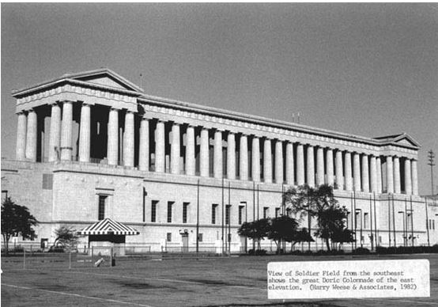
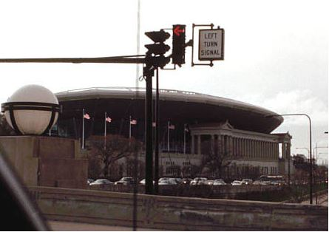
NHL Property Restrictions
Grant Park Stadium (Soldier Field), Chicago, IL, 1982 image of the stadium.
Grant Park Stadium (Soldier Field), Chicago, IL, 2003 image.
Notes:
Most National Historic Landmarks and National Register listed properties are owned by private individuals or groups. Listing or designation places no restrictions on private property owners, including state or local governments. The National Park Service may recommend to owners various preservation actions but owners are not obligated to carry out these recommendations. Property owners are free to make whatever changes they wish if Federal funding, licensing, or permits are not involved which I will briefly discuss on the next slide. Owners should keep in mind that state laws or local ordinances may affect National Historic Landmarks if these legal mechanisms recognize and protect Landmarks, independent of Federal law.
Although the programs place no restrictions on properties, if an owner alters their property so that it is no longer recognizable as historic the National Register listing or National Historic Landmark designation may be withdrawn.
On the screen is Grant Park Stadium, also known as Soldier Field, which was dramatically altered in 2003 and as a result of this change its National Historic Landmark designation was withdrawn. The 2003 remodel and expansion destroyed many historic features and spaces throughout the stadium and introduced a new seating bowl that rises above and, on one side over, the colonnades. The NHL designation was withdrawn because of the incompatible construction and destruction of substantial historic material resulted in an unacceptable loss of integrity.

Slide 7
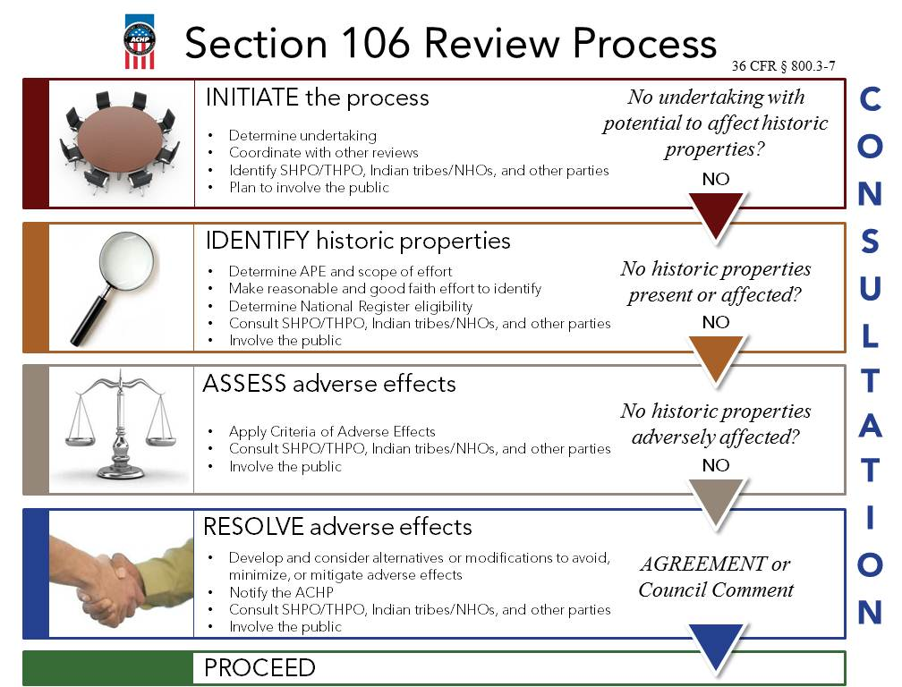
Section 106 and NR/NHLS
Read about other Section 106 success stories on the Advisory Council on Historic Preservation’s website: http://www.achp.gov/sec106_successes.html
Notes:
As I illuded to, if federal funding, licensing or permitting is involved in a project the federal agency must comply with Section 106 and possibly Section 110 of the National Historic Preservation Act. This requires the federal agency to consider how their actions will affect the historic property and encourages federal agencies to preserve of historic properties. I would note that properties need not be listed in the National Register to receive consideration under the law.
In the case of the Pinehurst NHL, if a Federal activity will "directly and adversely affect" the Landmark, Section 110(f) of the Act also calls for Federal agencies to undertake "such planning and actions as may be necessary to minimize harm to such Landmark."
I would note that what I am discussing here does not mean that a project will not proceed, it is only affording protection to the historic properties and trying to ensure the features that convey why these properties are historically significant are retained.

Slide 8
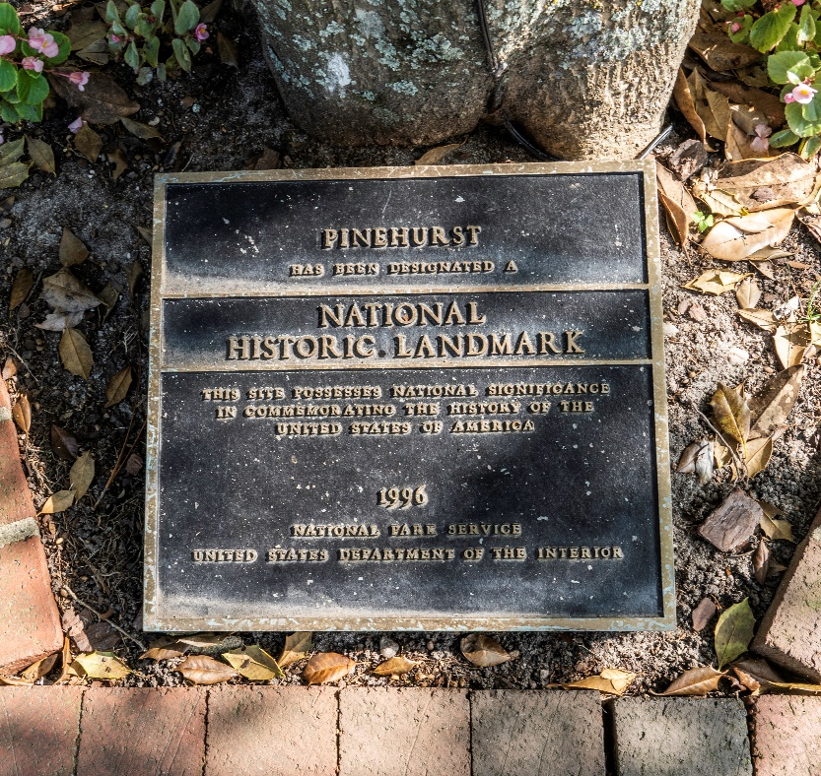
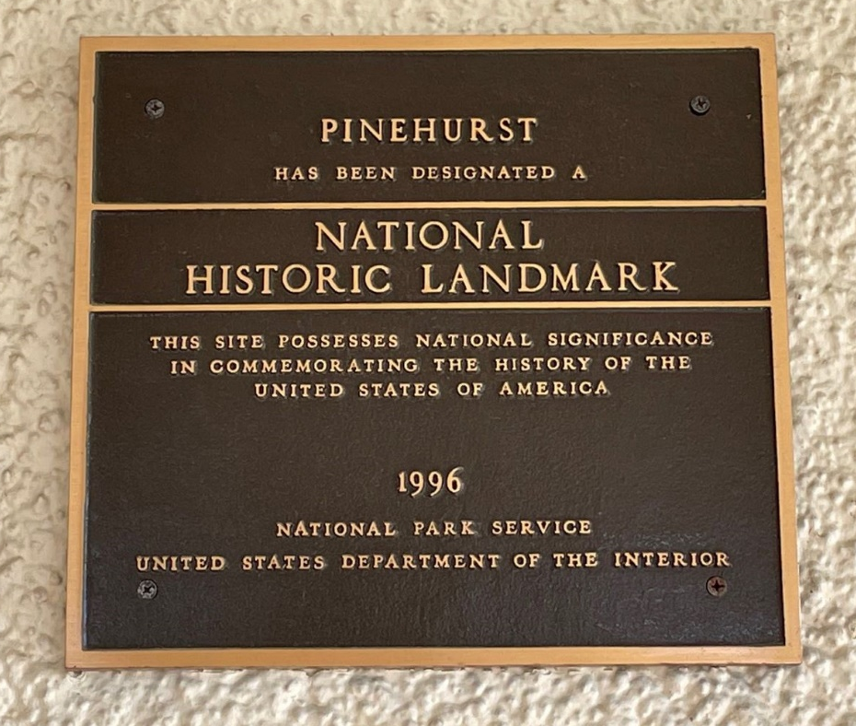
Introduction to Pinehurst
https://www.nps.gov/subjects/nationalhistoriclandmarks/benefits.htm
Notes:
As noted on these plaques, in 1996 the Secretary of the Interior designated the Pinehurst National Historic Landmark District for its nationally significant role in the development of the sport of golf and resort communities and for its association with golfer and golf course designer Donald Ross. The District’s period of significance is 1895-1948. As an NHL, Pinehurst is among an elite group of properties that convey the Nation’s history and is one of the larger NHL districts in the country.
Many ask what are the benefits?
This ranges from access to grants such as Save Americas Treasures, tax incentives, assistance with preservation, tourism and education assistance, and federal preservation funds among others. You can see all of these programs at the link on the slide here.

Slide 9
Pinehurst Map
Map of Pinehurst NHLD as designated in 1996 on 2020 aerial map.
Notes:
Here’s a map of the district established by the Secretary of the Interior. On this map the area outlined in red is what is within the NHL District Boundaries and the area outlined in blue is the local historic district.
In North Carolina, the state legislature authorizes local governments, like Pinehurst, to appoint Historic Preservation Commissions to administer locally zoned historic districts. This program is completely separate from the NHL program, and as you can see from the map the Pinehurst NHL and Pinehurst local district boundaries are not the same.
Even though the districts are separate and were established through different programs and laws, the rules regulating the local district may impact the NHL since many exterior and landscape changes must receive a Certificate of Appropriateness from the Village Historic Preservation Commission.

Slide 10
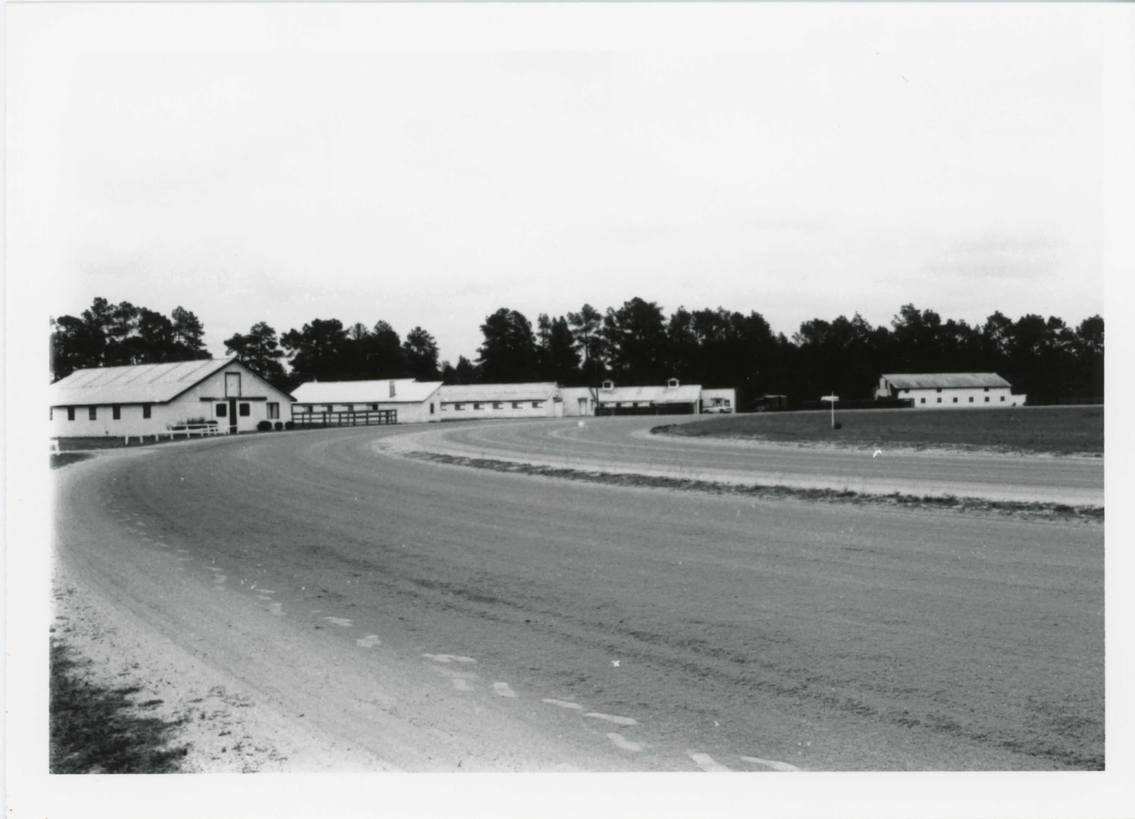
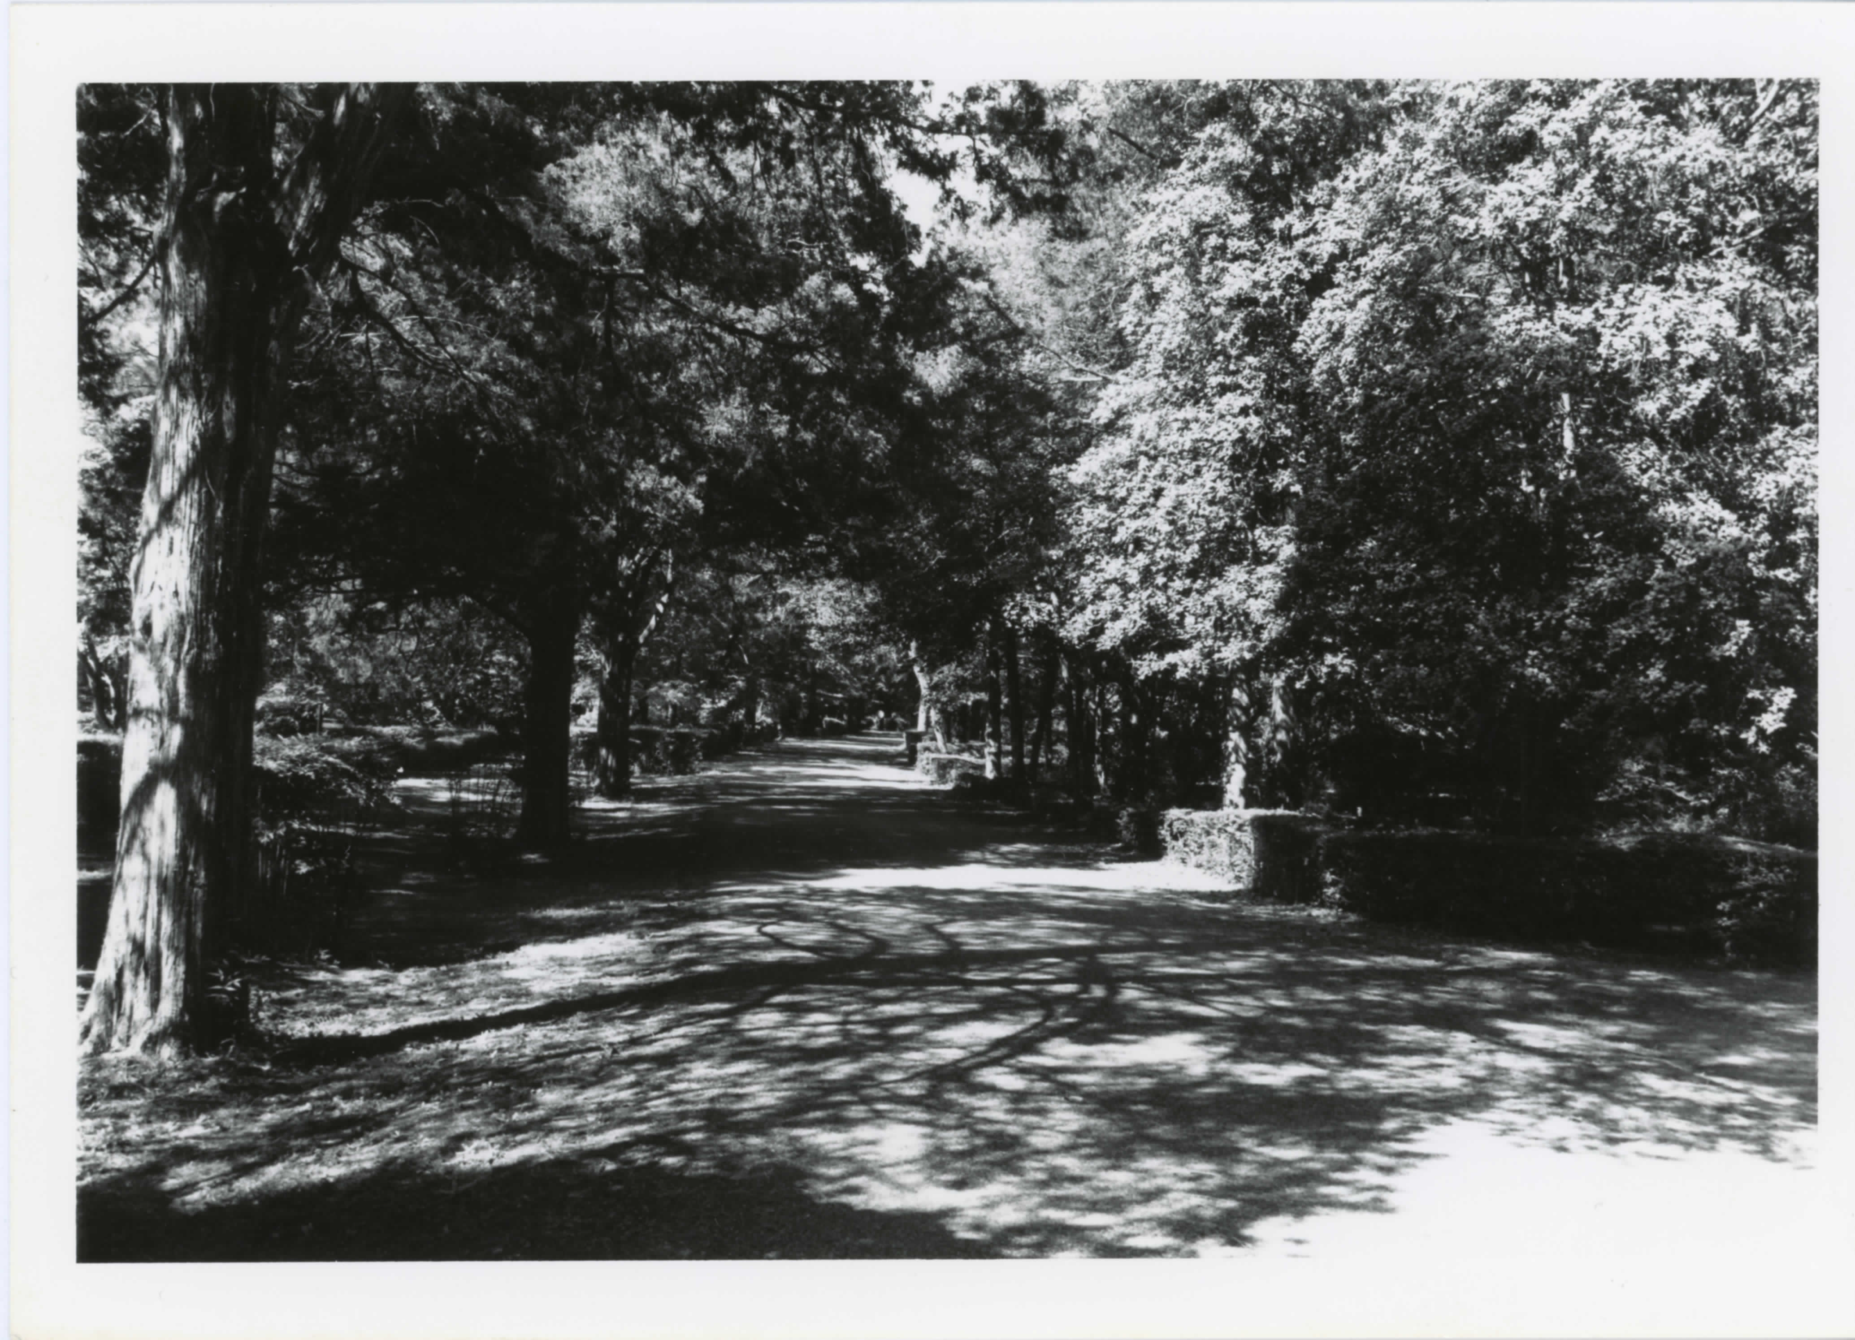
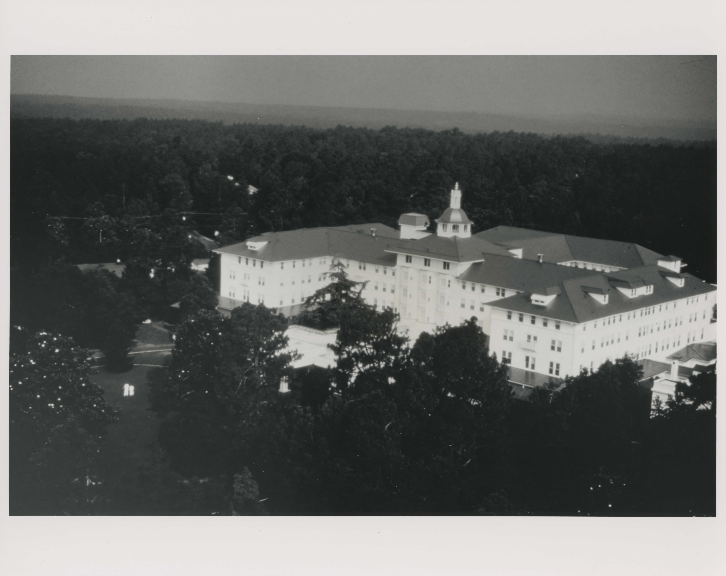
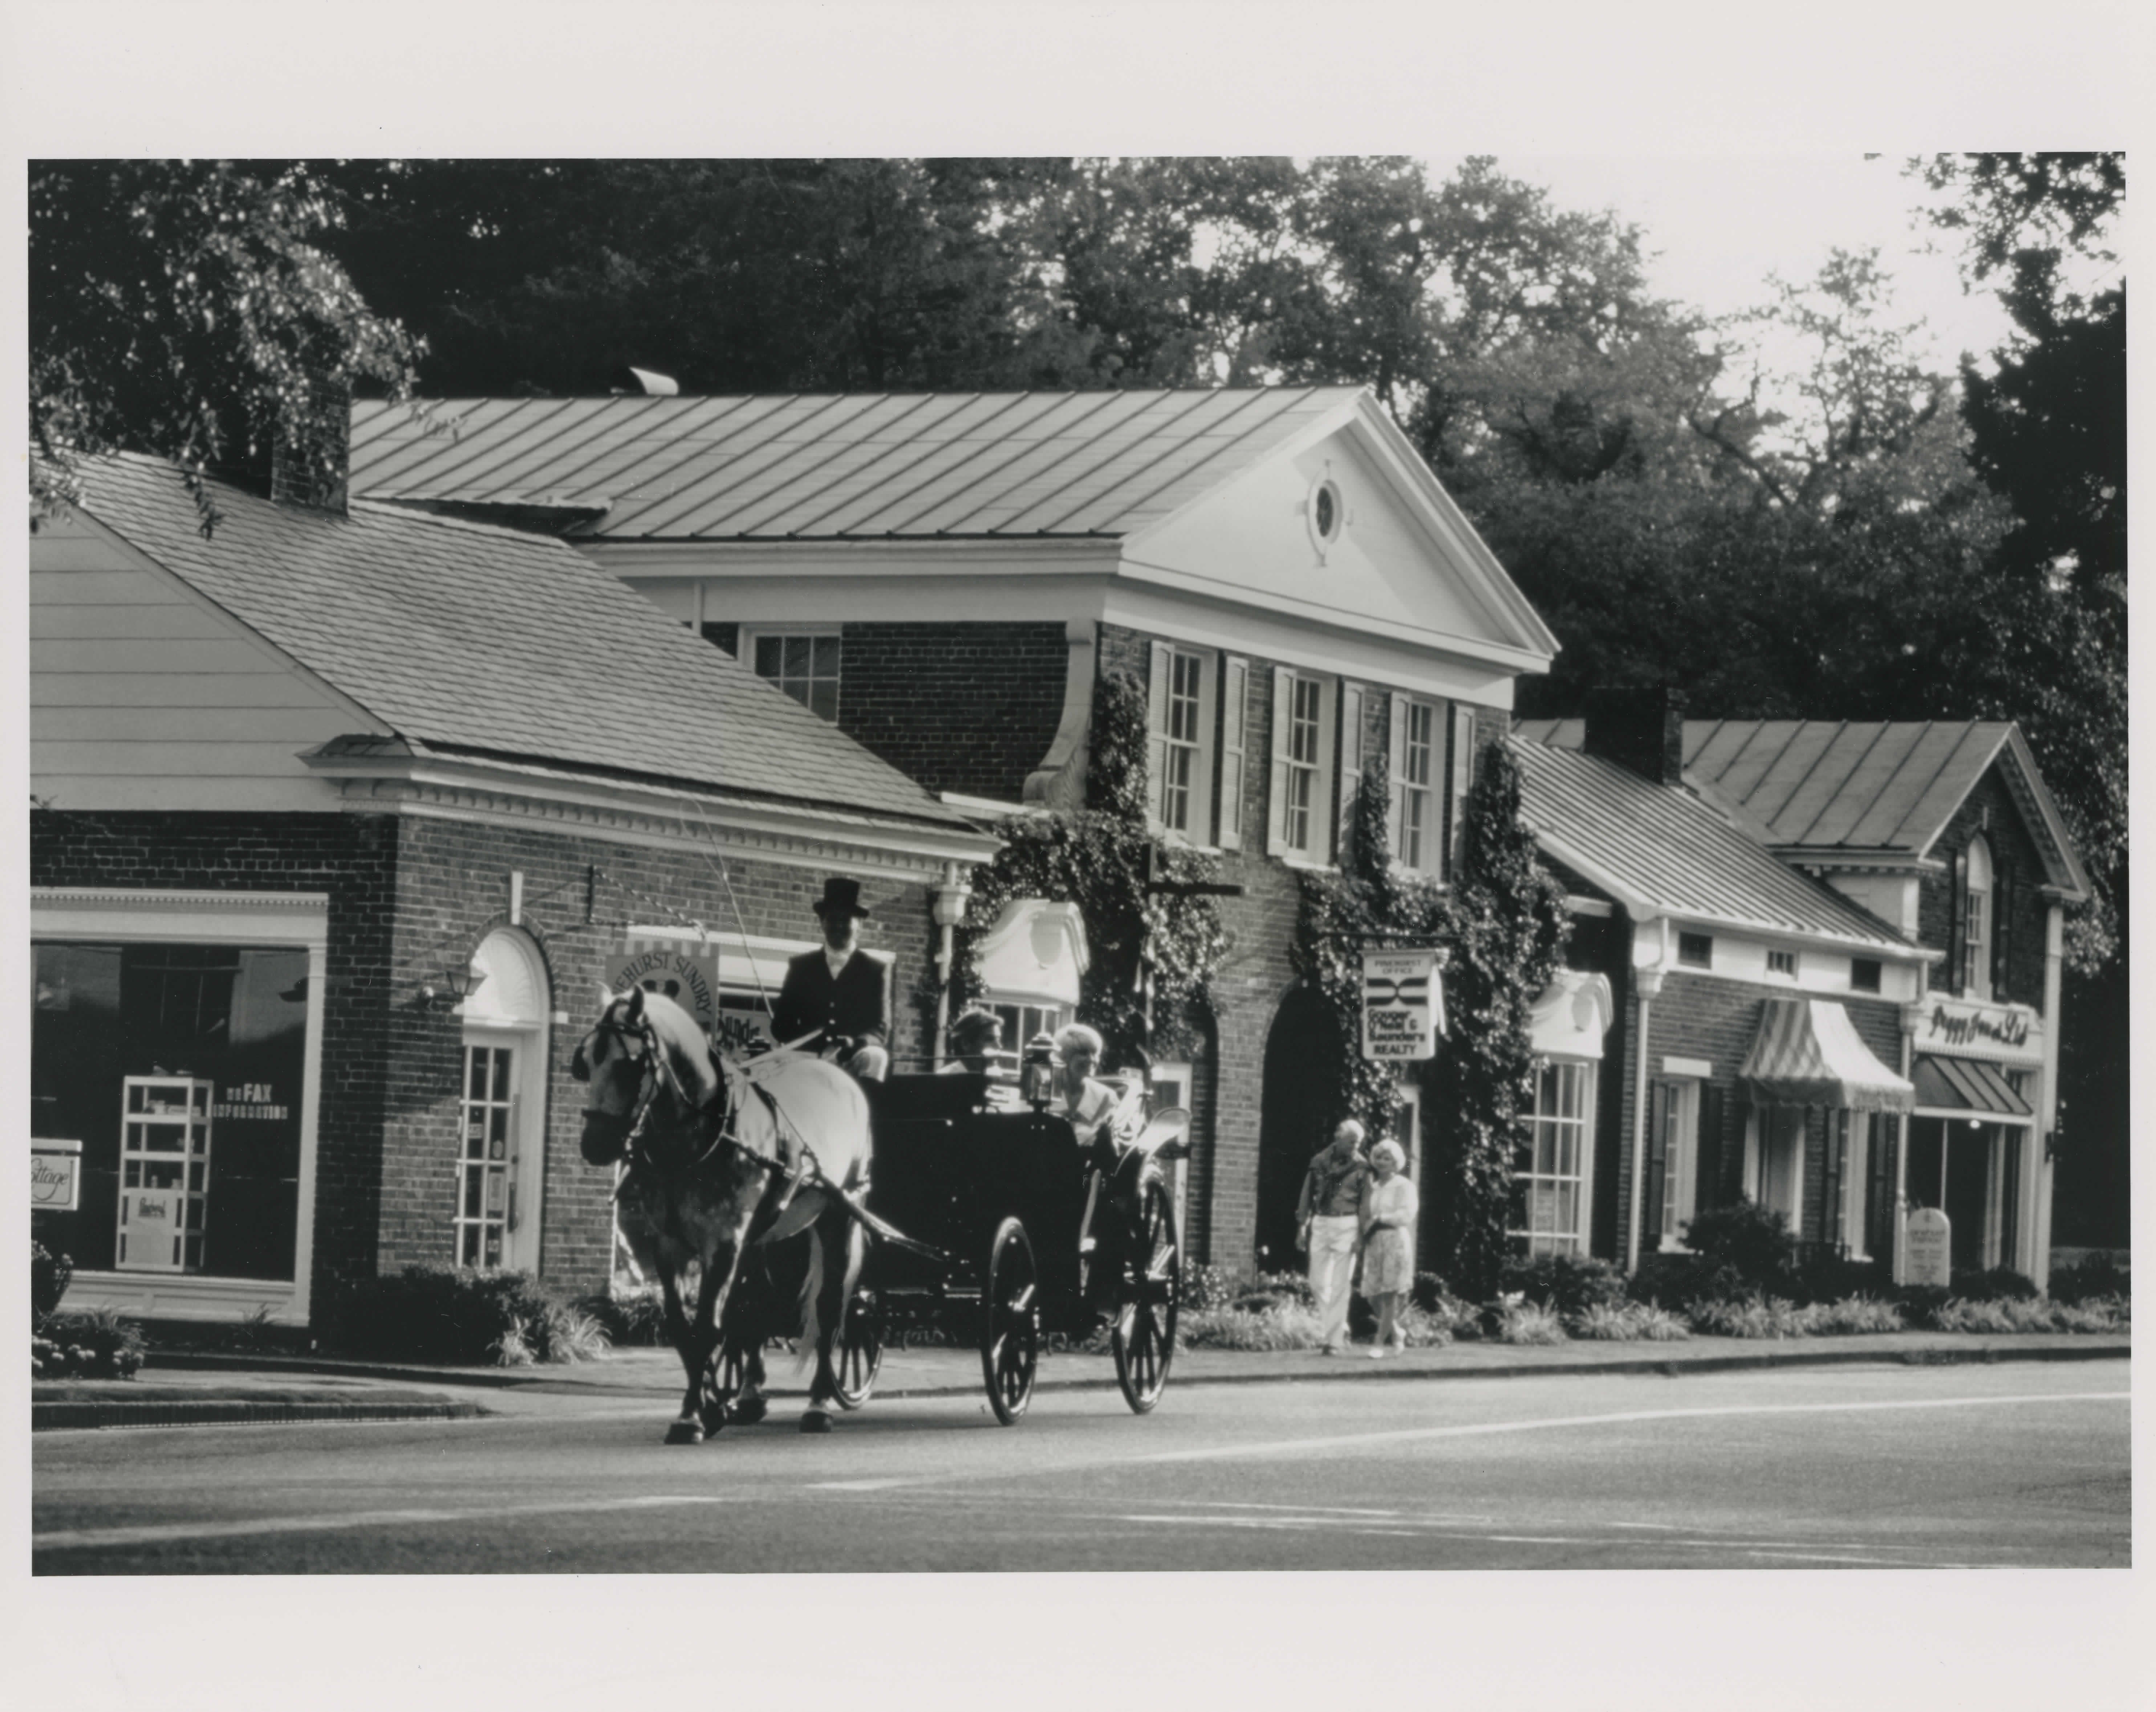
Pinehurst Study Purpose and Monitoring
Photos Pinehurst National Historic Landmark District from 1996 nomination.
Notes:
Speaking of alterations and changes, the NPS is charged with maintaining a continuing relationship with NHL owners, monitoring NHLs, and advising owners on accepted preservation standards and techniques. NPS monitors and provides information about the health of landmarks so that owners, stewards, policy makers, and the public can take steps to preserve NHLs. In the past, this was accomplished by placing the resource within 1 of 4 categories: Satisfactory, Watch, Threatened, and Emergency. I would like to note at this time that the program is currently reflecting on ways to improve the NHL condition monitoring program and it is our intent to develop a program that offers helpful and constructive feedback to stewards.
Keeping what I said in mind, NPS placed the Pinehurst NHL district in the “threatened” category in 2013. Since that time NPS staff have not visited Pinehurst nor have had substantive communications with the community regarding the condition of the NHL District. Without information regarding the current condition, NPS cannot place the district in any condition category and considers the Pinehurst NHL district to be unevaluated and no longer in the threatened condition category.

Slide 11
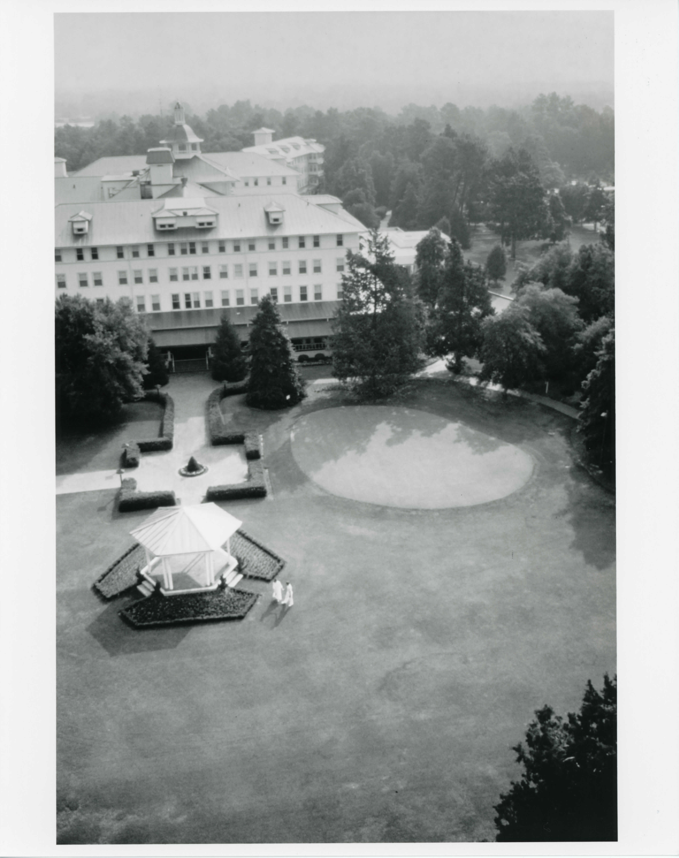
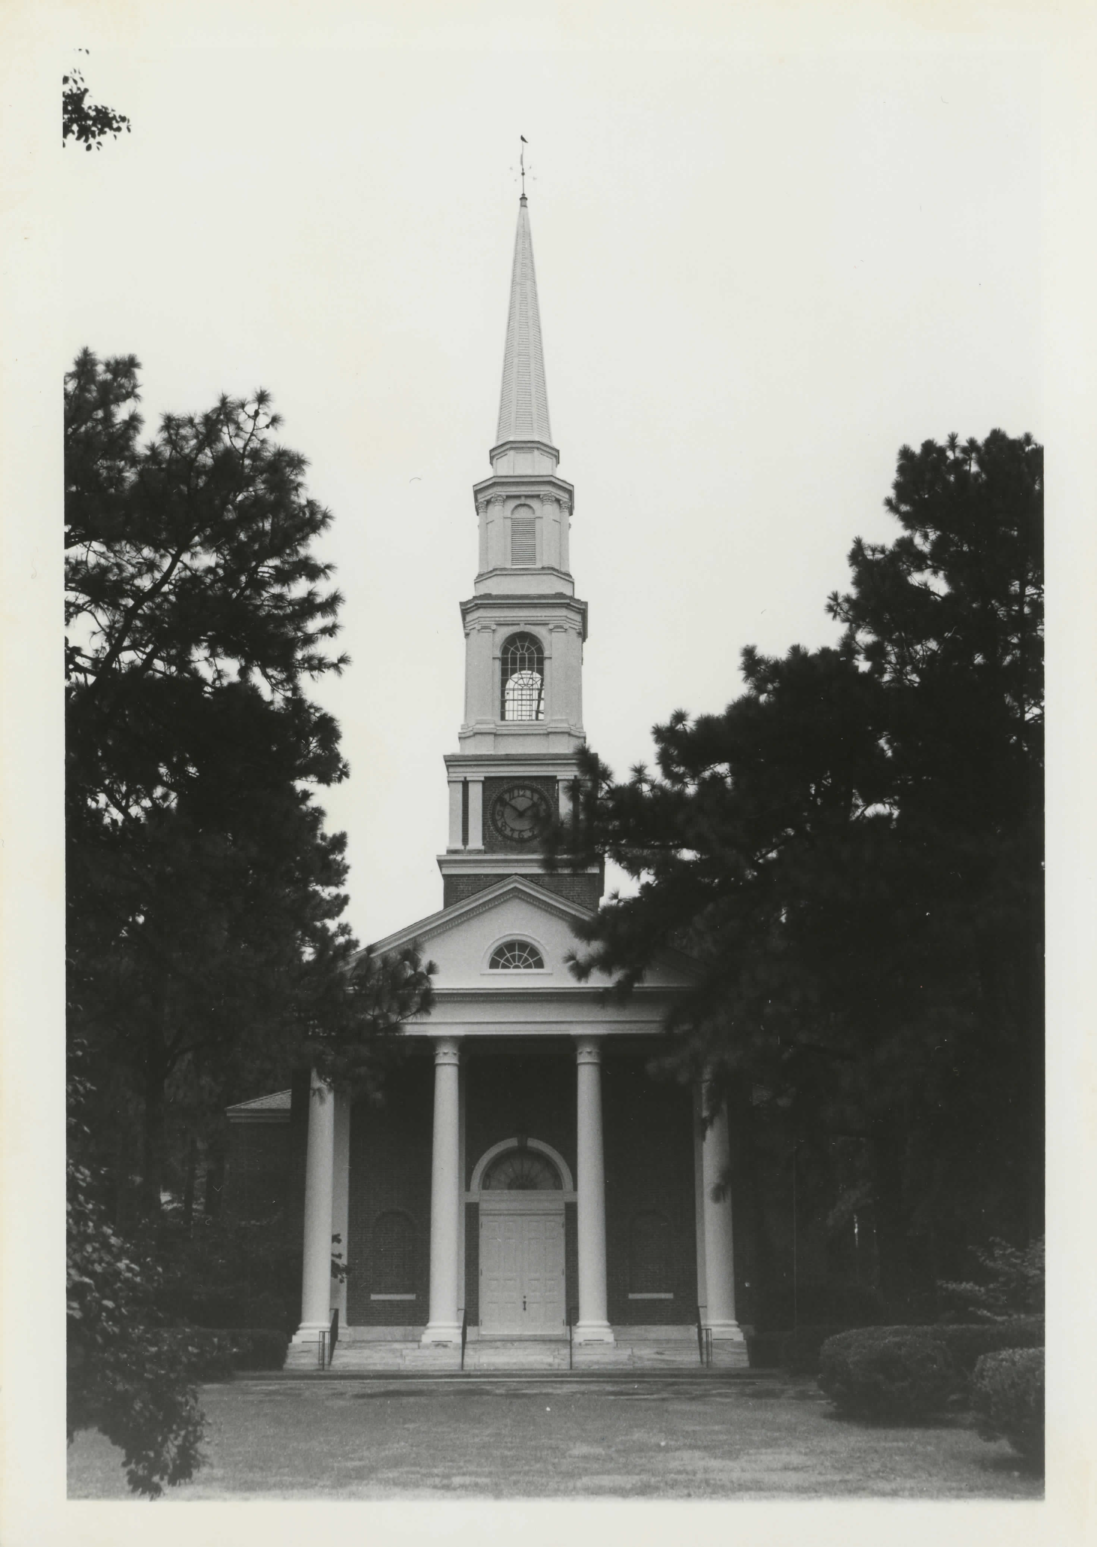
Pinehurst Study Purpose
Photos Pinehurst National Historic Landmark District from 1996 nomination.
Notes:
The NPS believes a comprehensive study, which can serve as a guidepost for those involved in future decision making will be a helpful tool to build a better relationship with members of the Pinehurst community and a better understanding of the Pinehurst NHL district.
NPS has asked Richard Grubb & Associates to look at the district and document how it has changed since it was designated in 1996. In a few minutes, Ellen Turco will go into more depth about the study that RGA will be preparing.

Slide 12
Pinehurst NHL District Study Process
Step 1. Project Initiation
Step 2. Public Meetings - Project Introduction*
Step 3. Preparation of Integrity and Condition Study
Step 4. Public Meetings - Present Preliminary Findings
Step 5. Public Review of Study
Step 6. Analysis of Public Comment
Step 7. Prepare Final Integrity and Condition Study
Step 8. Release Final Study to the Public
Project website: https://parkplanning.nps.gov/pinehurst
Notes:
If you have not had a chance to visit the project website, I encourage you to follow the link on this slide. As you can see, we are only at the beginning of the study and this will be the place where drafts are published for review and comment.

Slide 13
Share your thoughts:
1.What is going well with regards to historic preservation within the Pinehurst National Historic Landmark District?
Are there specific projects, initiatives, or trends that you feel are beneficial to the District?
2.What is not working well with regards to historic preservation within the Pinehurst National Historic Landmark District?
Are there specific projects, initiatives, or trends that you feel may harm the historic character of the District?
Project website: https://parkplanning.nps.gov/pinehurst
Notes:
As I turn the presentation over to Ellen Turco and RGA, I wanted to leave these preliminary questions to think about. On the project website, we encourage you to leave your comments for this phase under the open comment tab on the left side of the screen. We will be accepting comments on this step from today until March 15th; but as you saw on the previous screen there will be other opportunities to comment.

Slide 14
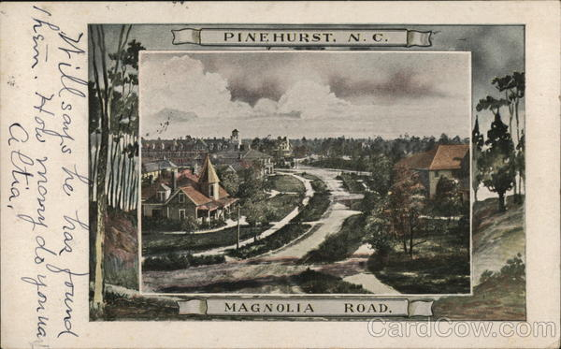
RGA Introduction
Pinehurst National Historic Landmark District Integrity and Conditions Study
Notes:
Ellen Turco, MA
I am the principal senior historian at Richard Grubb and Associates in Wake Forest, NC
I am familiar with Pinehurst as I worked on two other large survey projects here including:
Village of Pinehurst Historic Resources Survey and Local Designation Report in 2006.
2018 study of the local district boundaries. I think Ellen Rankin commented earlier about the difference between the locally zoned historic district and the NHL one, but I am happy to answer any questions about that during the question period.
The RGA team will complete four main tasks: research, field survey, reporting, and public engagement.
This meeting marks the beginning of the public engagement piece; and fieldwork is underway but not complete.
RGA is tasked with documenting the integrity and conditions of the NHL district. We will do this by comparing the district as it is today, with how it appeared in 1996 when the NHL was created. We will do this at the micro (individual buildings) and macro levels (overall landscape and setting). To a much lesser extent we will be looking at what the district looked like in historically, say in the early 1900s. 1996 is really our baseline because that is when the NHL district was created. The NHL nomination is on the project website that Ellen Rankin mentioned.
Our final report must not only assess the integrity of the buildings and landscape but do so with an eye to the historic themes and areas of significance identified in the 1996 NHL documentation: Entertainment/Recreation, Architecture, Social History, and Landscape Architecture.

Slide 15
Definitions
Integrity: Is the ability of a property to convey its historic significance through its: location, design, setting, materials, workmanship and association with historical people or events.
Condition: The physical state of a property.
Notes:
What is a study of Integrity?
Integrity as defined by the National Park Service is: the ability of a property (building or district) to convey its historic significance through its: location, design, setting, materials, workmanship and association with historical people or events.
A property can be in poor condition, but still effectively convey its significance, meaning that it would still have a high level of integrity.

Slide 16
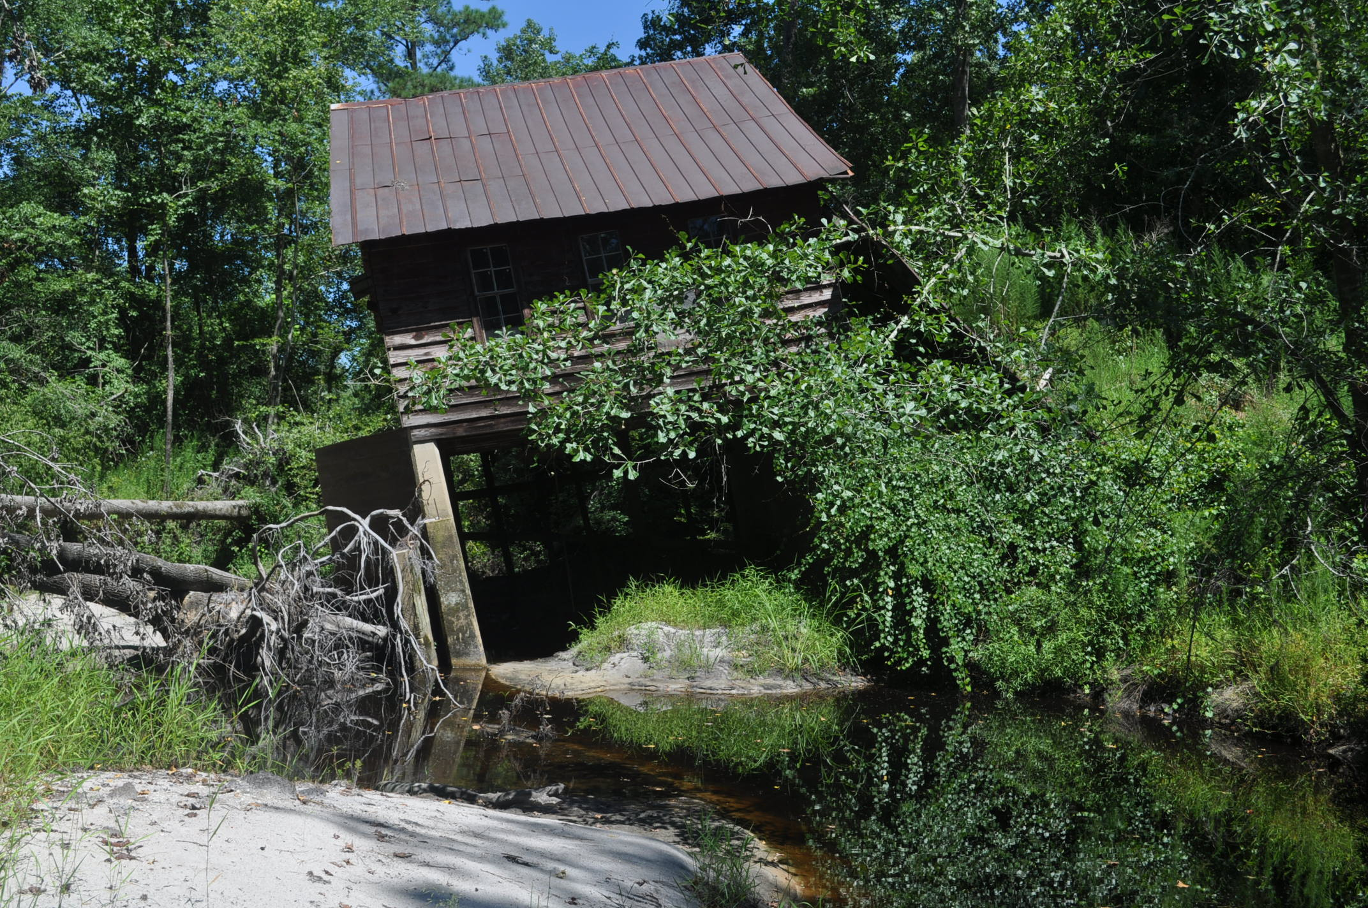
Good integrity and poor condition
Boney Mill, Sampson County NC
Notes:
This is Boney Mill in Sampson County NC. It is an example of a building with good integrity that is in poor condition.
The mill retains much of its original building materials such as, framing, siding, windows, roof and even its milling equipment.
However, floodwaters washed out the foundation and as you can see from the photo the building was shifted on its foundation, and at the time this picture was taken, was in danger of collapse.

Slide 17
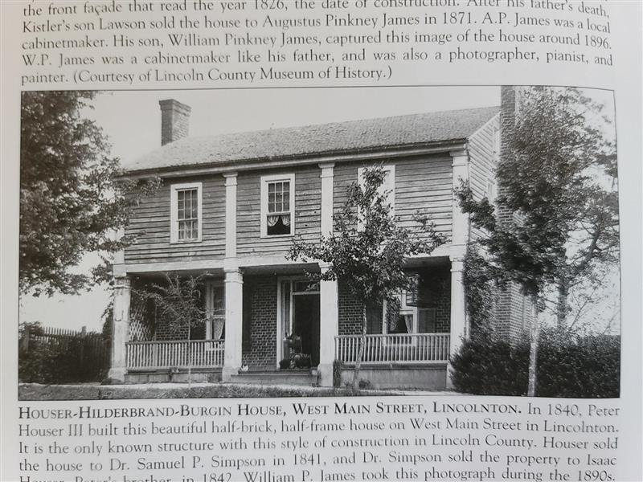
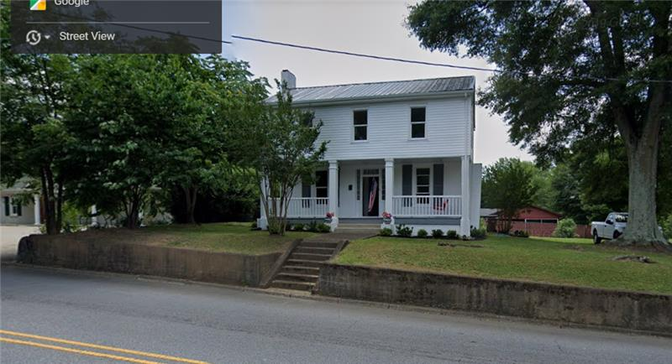
Good condition/poor integrity
Notes:
This is an example of a building in good condition/with poor integrity.
This is circa 1840 building in Lincoln County, NC.
The photos are of the same house, one documentary (left) and one recent (right).
The photo on the right is an example of a building in good condition, but with poor integrity of historic building materials.
In the photo on the left you can see that the brick on the lower story brick, 2nd story pilasters, and the wood siding has been concealed with vinyl siding; the chimney removed; windows replaced, and shutters added.

Slide 18
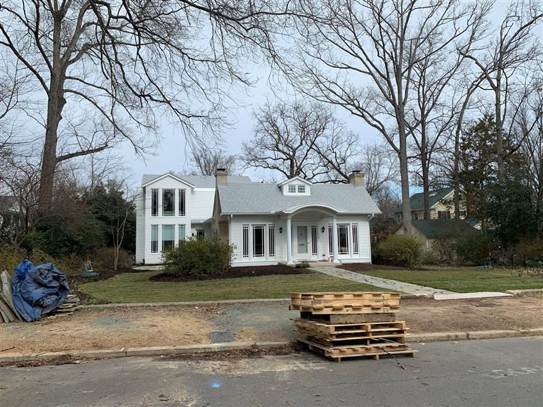
Poor Integrity due to addition
Notes:
Integrity can also be affected by additions which alter the building’s overall shape or massing, as seen above on an example in Chapel Hill, NC, or if substantial changes are made to the yard or landscape if that was an important part of the building’s setting or design. Lot subdivisions can also impact the overall integrity of a property, such as estate that has been subdivided and is now surrounded by new construction on smaller parcels.

Slide 19
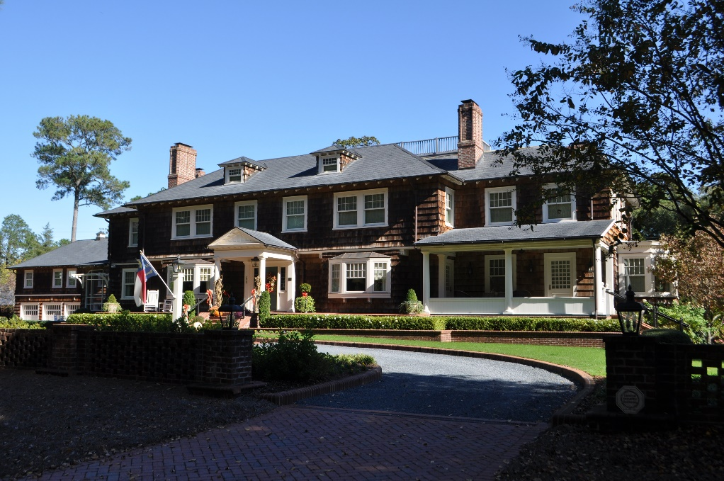
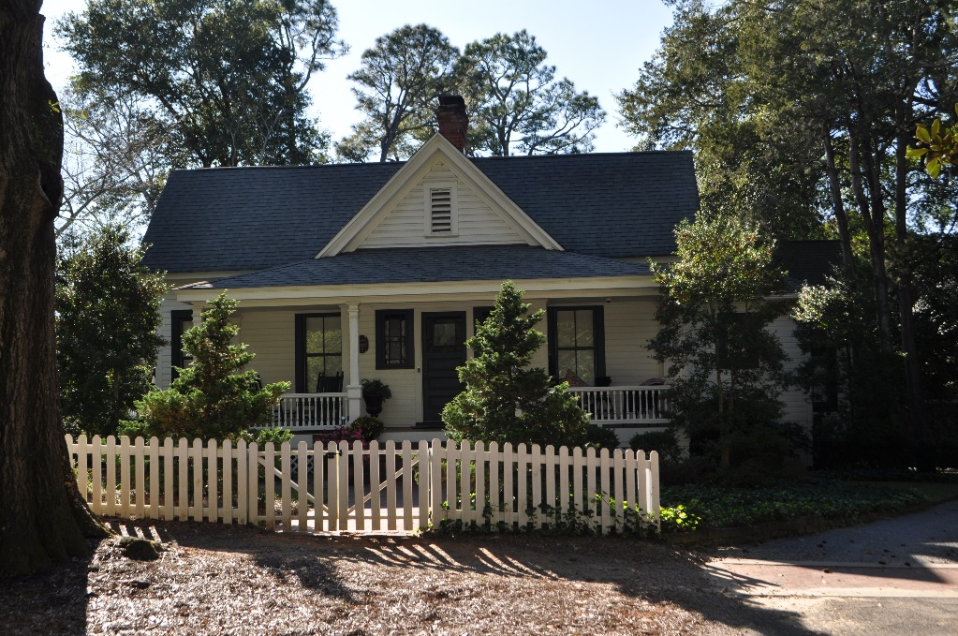
Architecture: Individual Buildings
(389!)
Notes:
Example of micro level analyses. Comparing individual buildings with their appearance in 1996 with today and documenting changes.
60 E Village Green/25 Dogwood

Slide 20
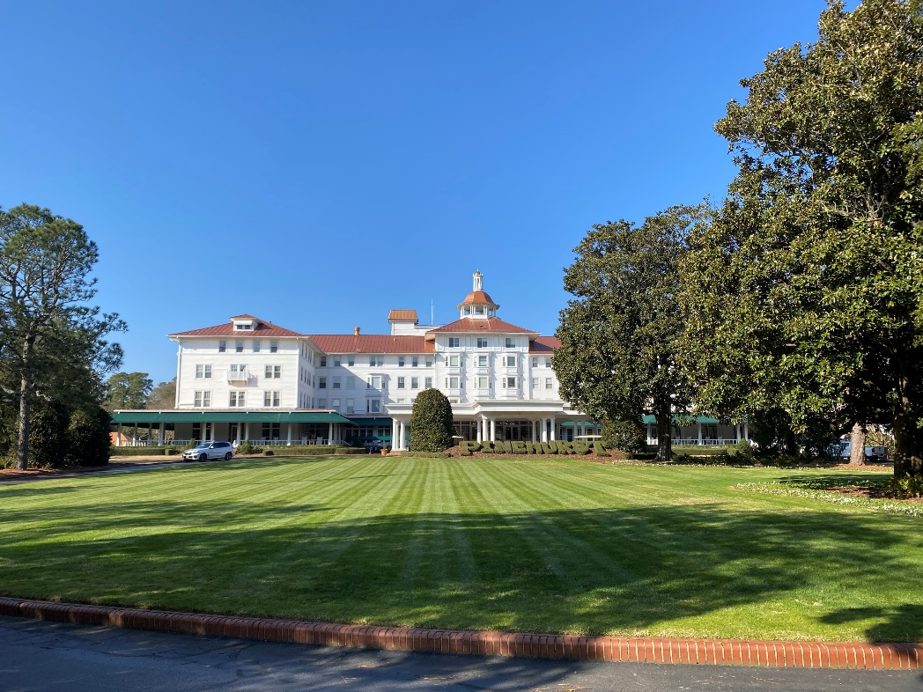
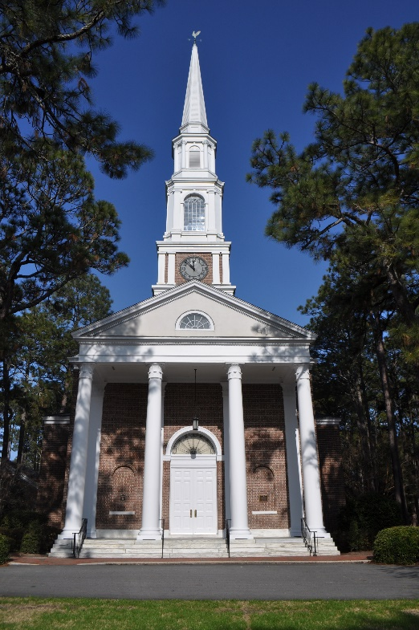
Architecture: Principal Buildings
Notes:
Village Chapel/Carolina Hotel
For the district’s larger building we will also be looking at any changes that may have occurred, but the surrounding landscape may be more of a factor.

Slide 21
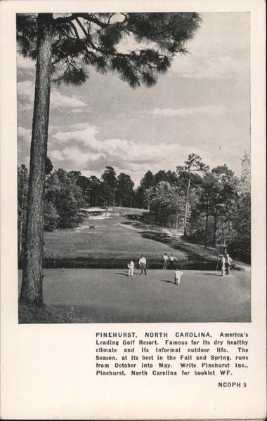
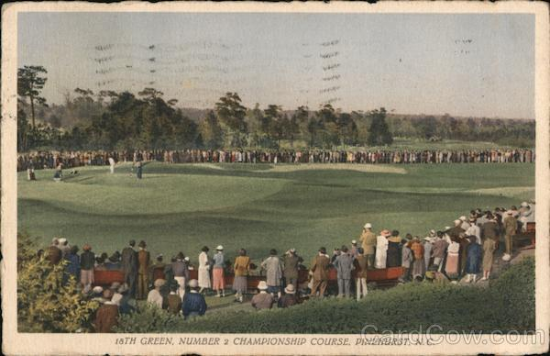
Pinehurst Landscape: Golf Course
Notes:
Of the community’s landscape the NL nomination says “The Village of Pinehurst today is a lush resort paradise, green in all seasons and filled with the buildings of its birth and development during the last years of the nineteenth century and first several decades of the twentieth century. The core of wooded village green, hotels, shops, churches, and late nineteenth-early twentieth century cottages spreads outward along curving and concentric roads to include the larger estates of the 1910s and 1920s. Throughout, mature landscaping envelopes the various parts into a unified whole.”
The NHL nomination calls out the following features as import to the historic character of Pinehurst:
The Donald Ross designed No 2 and No 4 golf courses

Slide 22
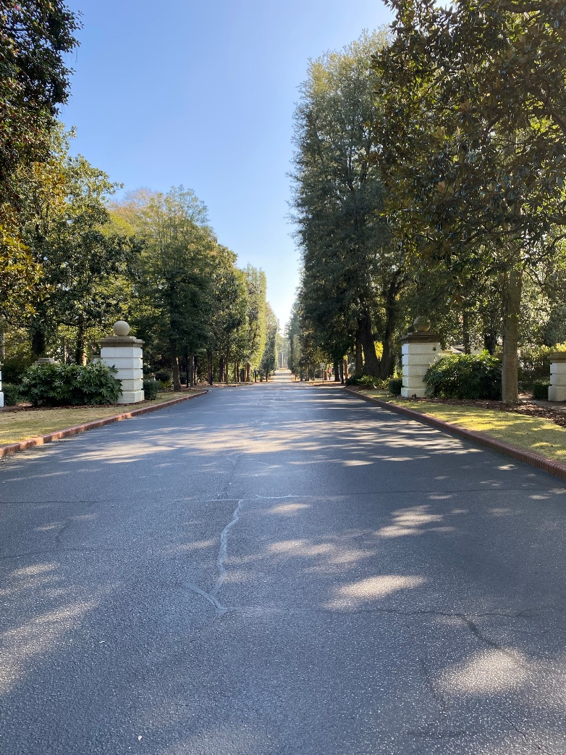
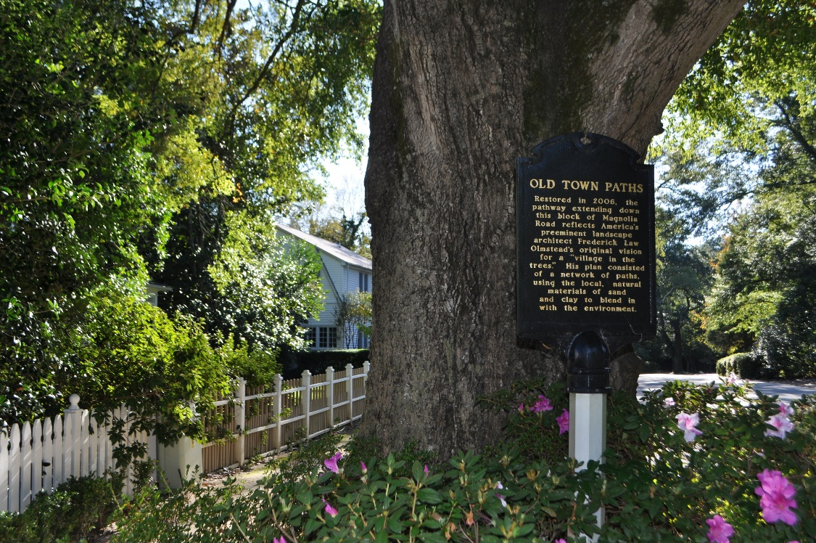
Pinehurst Landscape: Circulation
Landscape Features
Notes:
Circulation/transportation patterns both vehicular and pedestrian; alleys and clay paths.

Slide 23
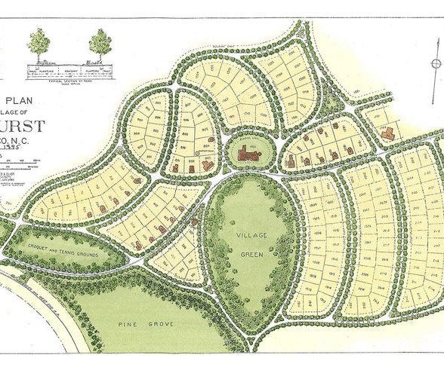
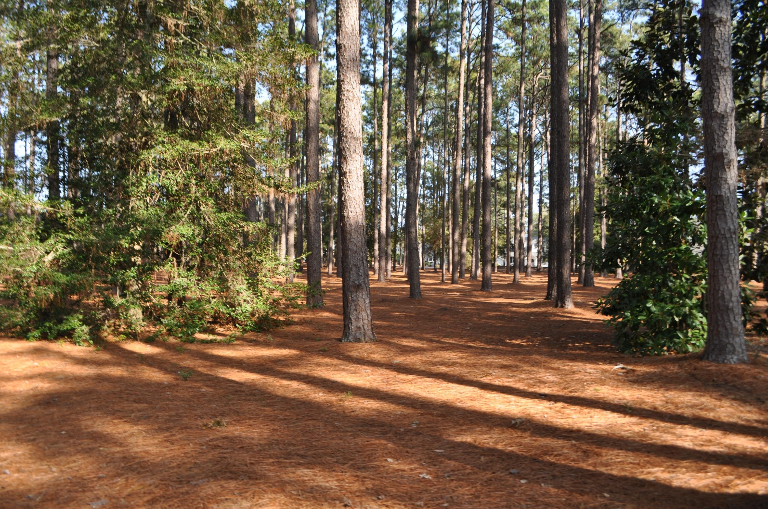
1895 Designed Landscape vs today
Notes:
1895 Olmsted Plan/Village Green
The landscape and plantings as designed by the Massachusetts firm of Olmstead, Olmstead and Elliot, and Warren H. Manning.

Slide 24
Anticipated Schedule
Late Spring/Summer 2021: Draft report available for public review and comment
Summer 2021 (date TBD): Second round of public meetings after draft report release
Late Summer/Fall 2021: Final report to be submitted to NPS within 45 days of comment period closing
Fall/Early Winter 2021: NPS will release final findings to the public

Slide 25
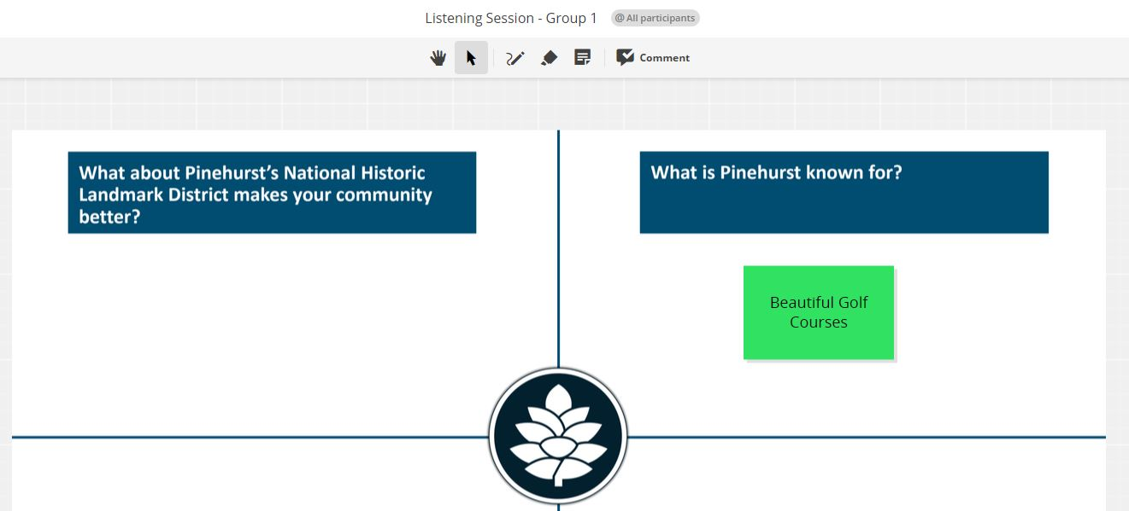
Public Input: Conceptboard
Sticky Note feature
Click to place sticky note under question and type response
Conceptboard Link:
https://app.conceptboard.com/board/ph3q-tosz-nodt-u0no-0aqp
Notes:
PUBLIC INPUT PART 1 - CONCEPTBOARD
For the public input portion of this presentation, we will be using an online program called Conceptboard. It is easy to use and doesn’t require any downloads & it allows us to collect a greater volume of feedback!
To access the program - go to link on the bottom of the screen – we are also dropping it in the chat, so that you can click on it and easily access the board!
When you click on the link, it will bring you to the conceptboard website.
Select “Guest Access” and then enter your name on the following screen. Click “access as guest” and then you will be brought to the board which contains the main questions that we want to explore in today’s meeting.
Please use the “sticky note” function – which we have shown here on the slide – to place your feedback under the respective question. Simply select your sticky note, click to place it on the board, and then click on the sticky note to stop typing. When you are done with the comment, click anywhere outside of the sticky note, and you are ready to add more!
Feel free to add as many sticky notes as you want – they can be as brief or as a long as you want!
We will break here to give you 5 minutes to get on the Conceptboard and put your initial thoughts & then we will meet back here to discuss. Please do not close out of your Zoom window – it can be in the background while you work on Conceptboard.

Slide 26
Share your thoughts:
1.What is going well with regards to historic preservation within the Pinehurst National Historic Landmark District?
Are there specific projects, initiatives, or trends that you feel are beneficial to the District?
2.What is not working well with regards to historic preservation within the Pinehurst National Historic Landmark District?
Are there specific projects, initiatives, or trends that you feel may harm the historic character of the District?
Notes:
PUBLIC INPUT PART 2 - DISCUSSION
Alright, thank you for your comments on the Conceptboard – feel free to continue adding comments during the rest of this meeting or immediately afterwards as well. Now we want to pivot to more of an open-forum for discussion. Please, if you would like to speak, use the “RAISE HAND” feature to get our attention and we will call on you – so that the Zoom doesn’t get too crazy!
So, looking at the board I’m seeing lots of comments about XXX…
Are any of these comments jumping out at you?
Remember, as we discuss, you can continue to add feedback on the Conceptboard or in the chat, if you don’t feel comfortable speaking up!

Slide 27

Thank you for your participation!
Project Website:
https://parkplanning.nps.gov/pinehurst
Contact Information:
National Historic Landmarks Program ser_nhl@nps.gov
Notes:
**FINAL SLIDE**
**Drop link to project website in chat:
https://parkplanning.nps.gov/Pinehurst
Thank you all for joining us today!
We have dropped the project website link in the chat – please add any further comments or feedback that you have there! This website will also have information when the next public meeting is held, which will be in a few months after the Integrity and Condition Study is completed – we will share preliminary findings at that time. Hopefully, we are able to connect with you all in person at that time, COVID situation pending. Regardless, the website will have all information about meeting dates, times, and locations.
The email to contact the NHL program is listed on this slide – please feel free to contact us with any questions you may have!
Have a good evening everyone!

