Slide 1
George Washington
Memorial Parkway South
Traffic and Safety Context Sensitive Solutions Assessment
December 2019 Public Open House

Slide 2
Meeting Format
Introductions
Poster session with one-on-one questions and comments
Group presentation
Group question and answer
Adjourn

Slide 3
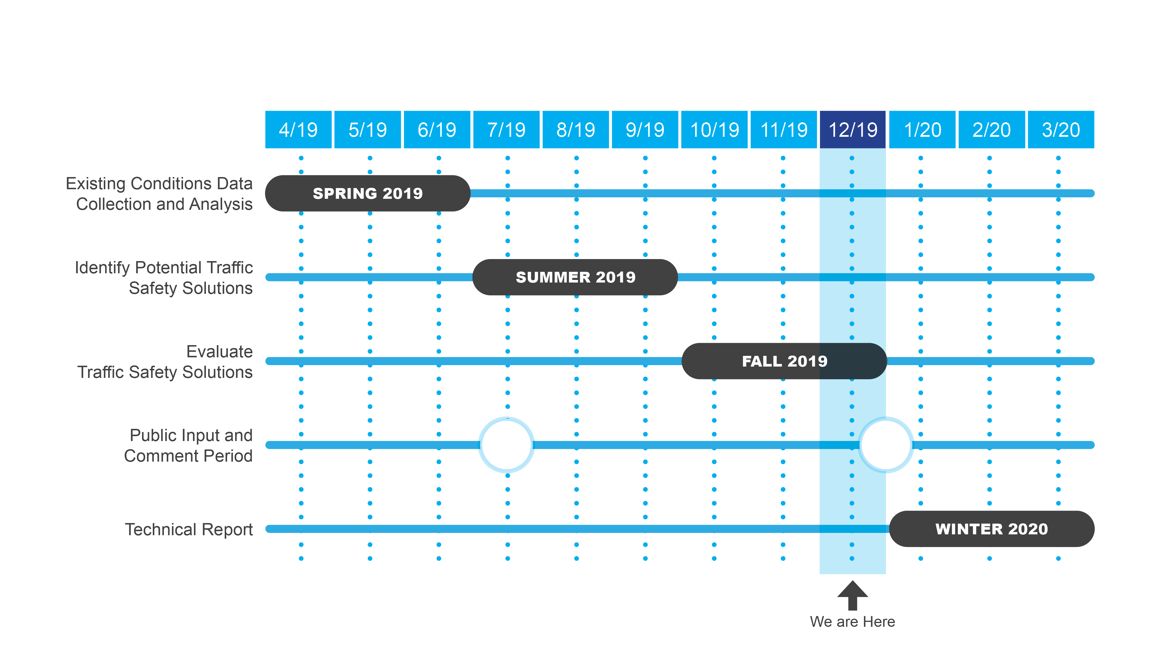
Project Schedule

Slide 4
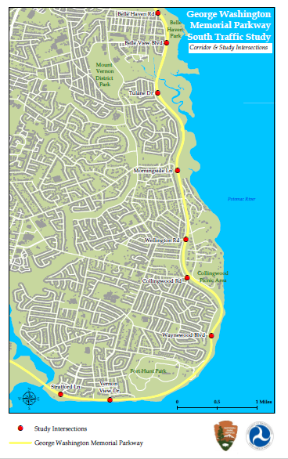






Traffic & Safety Context Sensitive Solutions Assessment
What is being studied?
The Parkway between the City of Alexandria and Mount Vernon.
11 selected intersections, bus stops, bicycle routes, crash history and the Mount Vernon Trail.
Study Purpose
Respond to community concerns about traffic safety.
Revisit previous safety studies and their recommendations.
Develop context-sensitive safety solutions appropriate for a historic and scenic roadway in a National Park
Study Outcome
Engineering, Education and Enforcement solutions to balance the needs of park visitors, pedestrians, cyclists, transit riders and commuter traffic.
Park managers will have to make critical decisions between managing the roadway for modern use while honoring the intent of the historical design.
Study is sponsored by the Federal Highway Administration and the National Park Service

Slide 5
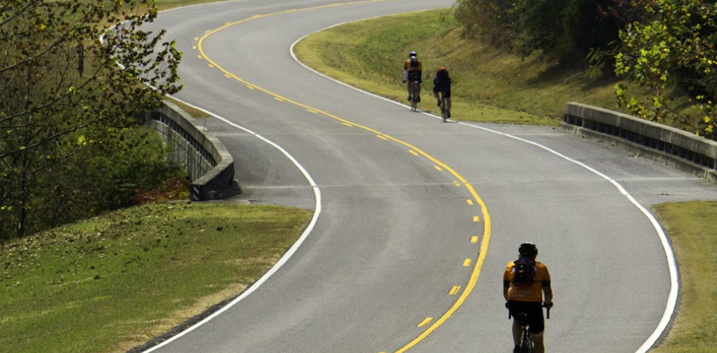
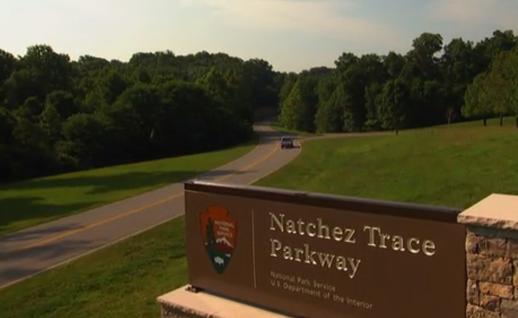
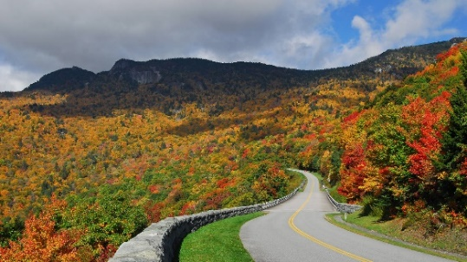
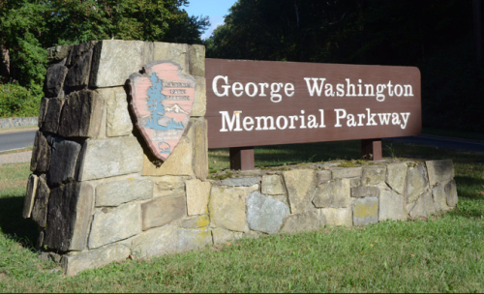
What is a National Parkway?
Parkway Characteristics:
Owned and maintained by the National Park Service (NPS) to provide scenic, recreational driving experiences.
National Parkways were built for ‘auto touring,’ a popular recreational activity. Many parkways were built in the 1930s when the driving speed was usually no more than 30-40 mph.
National Park Service roadways are designed for slower speeds than highways.
Design and safety features respect the natural areas and preserve the unique visitor experience.
George Washington Memorial Parkway
Opened in 1932 when the automobile was becoming more common.
This parkway, a memorial to our first President, was designed to provide a safe and scenic transportation experience, not as a commuter road.
Park lands along the Potomac River to the Mount Vernon Estate define this unique roadway.
Listed in the National Register of Historic Places the scenic vistas of and from Washington, D.C. provide a unique visitor experience.
Habitat for local wildlife includes many rare, threatened and endangered plant and animal species.

Slide 6
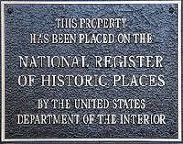
Context Sensitive
National Register of Historic Places
Special status to protect unique places and cultural resources of national heritage
Limits the amount and type of physical changes that can be made
Requires formal review before any construction, repair, and ground/ visual disturbances through Section 106 of the National Historic Preservation

Slide 7
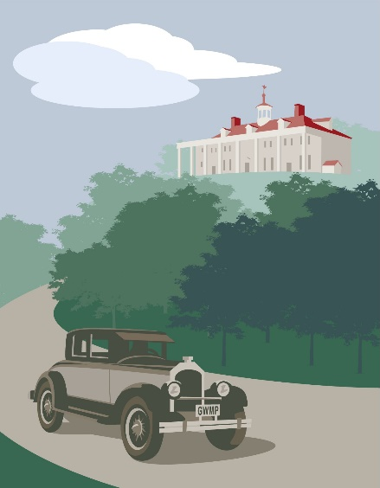
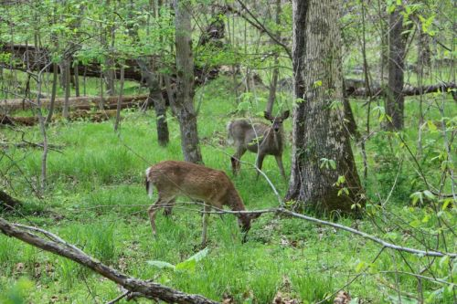
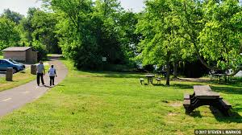
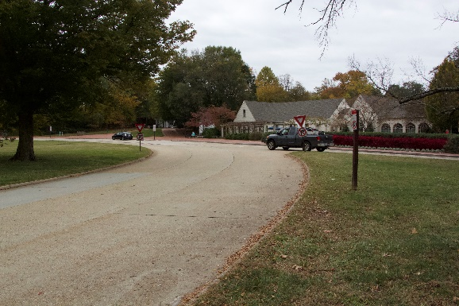
Context Sensitive: Key Themes
  Honor the legacy of George Washington
  Provide recreational opportunities
  Maintain ceremonial entrance
  Provide transportation
  Preserve views and vistas
  Connect historic sites, scenic overlooks, memorials, monuments, stories, and people.

Slide 8
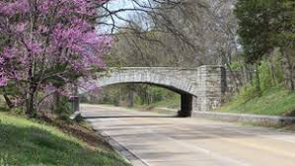
Context Sensitive: Roadway Design Features
Bridge design- local conditions and picturesque variety
Limited number of intersections/ access points
Vegetative transitions between parkway and woodlands
Following natural contours
Rural character
Concrete road construction

Slide 9
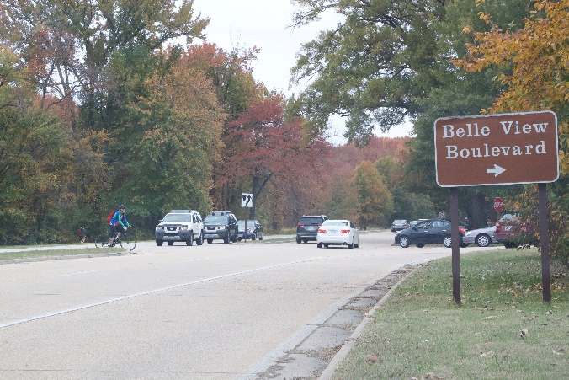
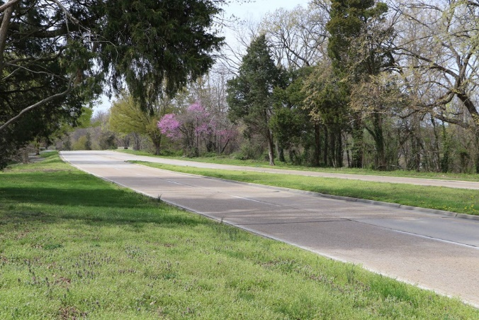
Context Sensitive: Roadway Design Features
Mountable curb
Rustic guard rails
Rustic bus shelters
Stone treatment of headwalls and swales
Memorialization through tree plantings or groves
Frequent pull-offs
Limited clutter (signs, billboards, businesses)

Slide 10
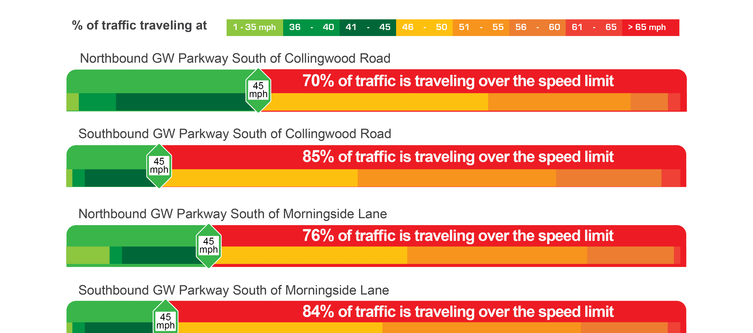
Existing Conditions – Traffic Speeds

Slide 11
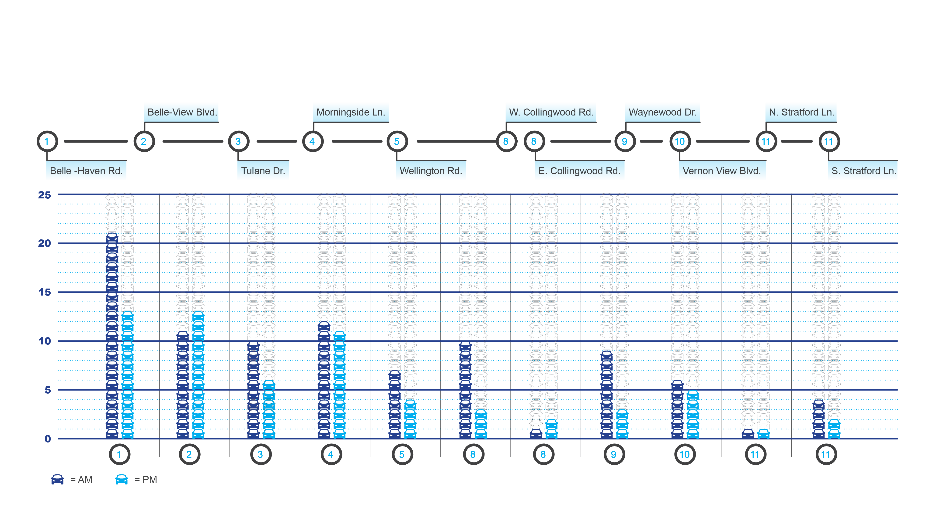
Existing Conditions – Traffic Queues

Slide 12
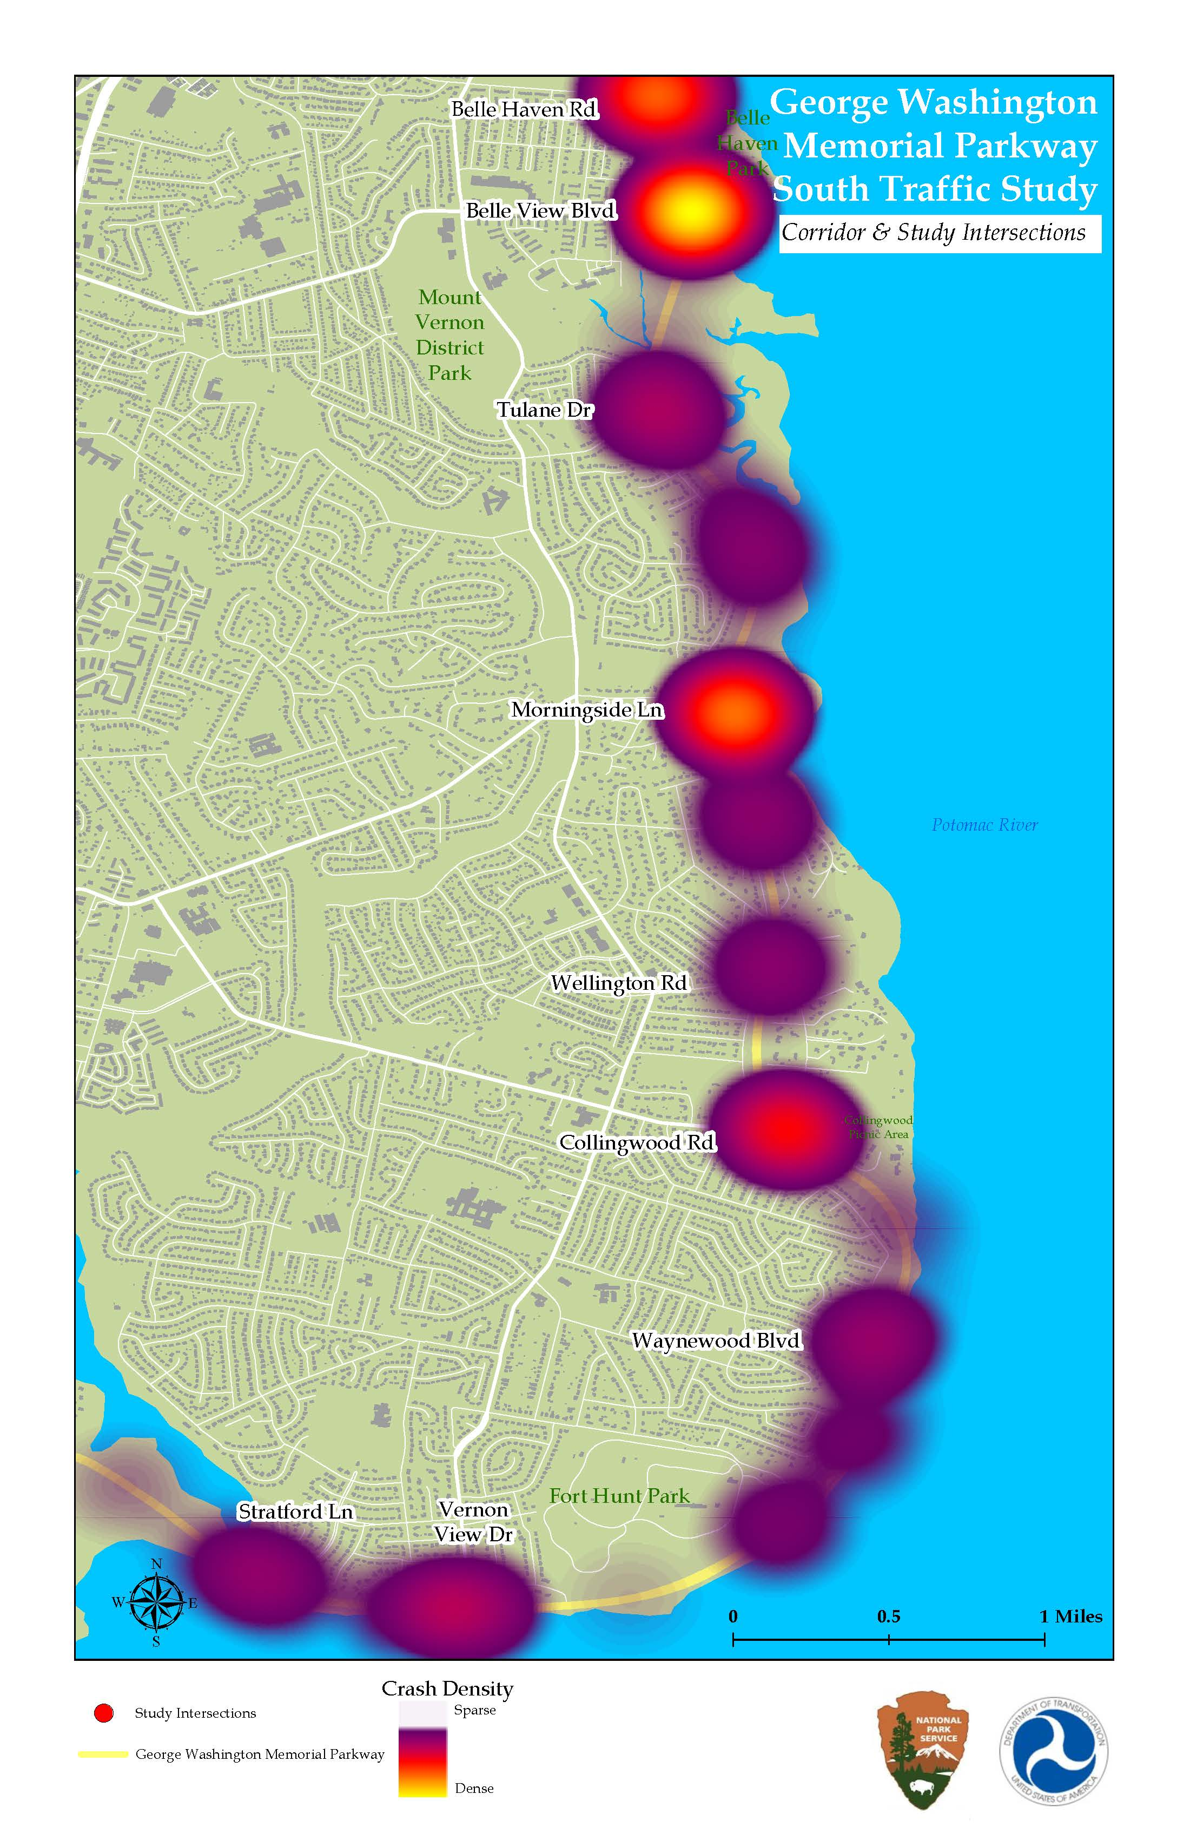
Existing Conditions – Crash Experience
Intersection with GW Parkway | Number of Crashes (5-year total)
Belle Haven Road | 56
Belle View Blvd | 68
Tulane Drive | 22
Morningside Lane | 64
Wellington Road | 17
Collingwood Road | 41
Waynewood Blvd | 13
Vernon View Drive | 24
Stratford Lane | 8
Heat map

Slide 13



What we heard
More than 700 Comments from the Public

Slide 14
Major Concerns identified by the Public
Item | Concern | Count | Percentage
1 | Pedestrian Safety and Access (to trail, bus stops) | 71 | 10%
2 | Need for Speed Enforcement | 65 | 9%
3 | Difficult Intersection Geometric Design | 63 | 9%
4 | High Rate of Vehicle Speeds | 56 | 8%
5 | High # of Conflicts Making Left-Turns (in/ out of neighborhood streets) | 48 | 7%
6 | Limited Intersection Sight Lines | 35 | 5%
7 | Bicycle Safety and Access (to trail) | 34 | 5%
8 | Illegal Use of the Parkway by Trucks | 30 | 4%
9 | Lack of Appropriate Intersection Traffic Controls | 30 | 4%
10 | Faded or Lack of Roadway Markings | 19 | 3%
11 | Other | 253 | 36%
 | Total | 704

Slide 15
Public Comments By Intersection
Suggested crosswalk locations
Belle View Boulevard – 451 survey responses
Belle Haven Road – 312 survey responses
Collingwood Road – 238 survey responses
Tulane Drive – 218 survey responses
Morningside Lane – 163 survey responses
Vernon View Drive – 162 survey responses
Stratford Landing – 144 survey responses
Wellington Road – 139 responses
Waynewood Boulevard – 128 responses

Slide 16
Alternatives Screening
90 unique alternatives
47 applicable alternatives
Grouped by Improvement Categories/ Typology
  Education (driver behavior)
  Enforcement (driver behavior)
  Engineering
    Signing and Marking
    Geometric Design
    Operational
    Multi-modal
    Roadway Departure
    Maintenance
    Environmental

Slide 17
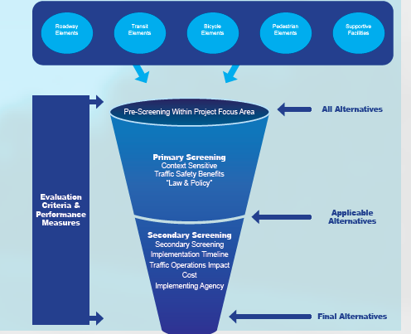
Initial Evaluation Criteria/ Screening Filters
Pre-Screening
  Within project focus area
Primary
  Context sensitivity
  Traffic safety benefits
  Law, policy & regulations
Secondary
  Implementation timeline
  Traffic operations impact
  Cost
  Implementing agency
  Right-of-way needs
  Community support
  Stakeholder Input (VDOT, Fairfax County)

Slide 18
Initial Screening Criteria

Slide 19

Potential Location Application
Intersection | Access Management
Belle Haven Road
Belle View Boulevard
Tulane Drive
Morningside Lane
Wellington Road
Collingwood Road
Waynewood Boulevard
Vernon View Drive
Stratford Lane
Identify optimal placement
Some alternatives mutually exclusive
Site specific investigation
  Safety analysis
  Traffic analysis/ modeling
  Conceptual geometric design
  Environmental/ right-of-way impacts
  Construction cost
System level evaluation
  Potential diversions, impacts to neighborhoods

Slide 20
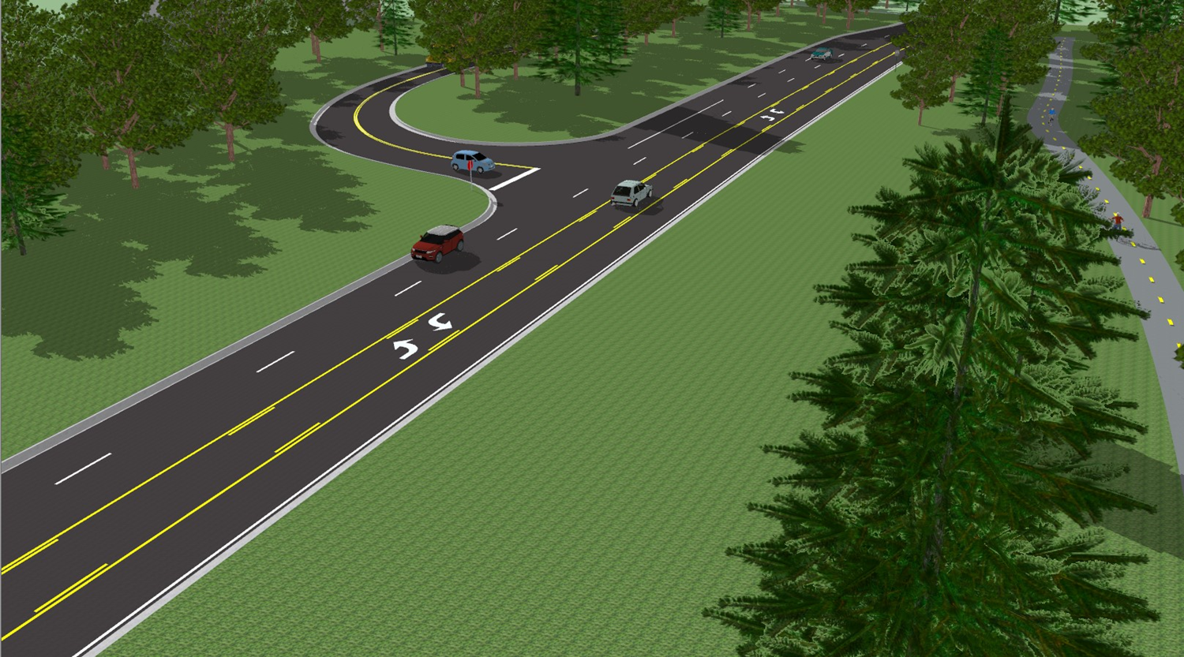
Safety Treatment Information
Benefit
Description
Precedent images
Concept design/ renderings
Potential location applications
Cost
Implementation timeline

Slide 21
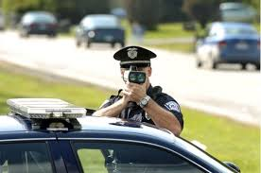
Candidate Alternatives
Enforcement
  Speeding (manual and automated)
  Impaired driving
  Distracted driving
  Commercial vehicles
  Crowdsource/ citizen reporting application

Slide 22

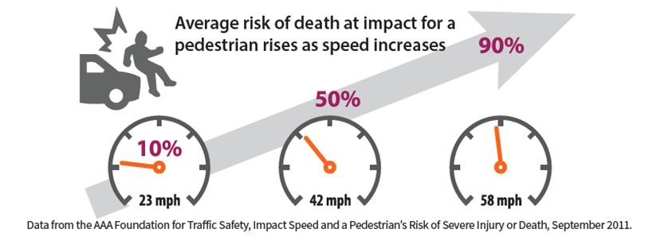
Candidate Alternatives
Education
  Parkway awareness campaign
  Speed management Action Plan
  Pedestrian safety campaign
  Distracted driving campaign
  Commuter options information
  Neighborhood education event
  Dynamic message signs for traveler information
  Speed vs. time savings infographic
  Website for public comments/concerns

Slide 23
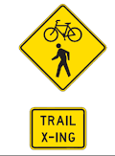
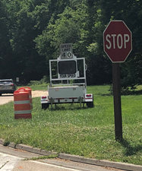
Candidate Alternatives
Engineering
  Signing and marking –
    Upgrades to warning signs to meet current standards
    Turn lane pavement arrows
    Higher reflectivity pavement line markings
    Do Not Block Intersection signs and pavement markings
    Driver speed feedback radar signs

Slide 24
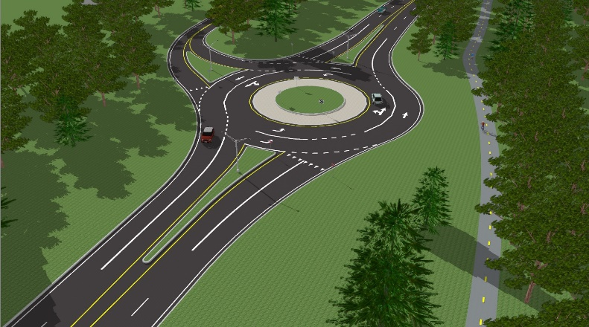
Candidate Alternatives
Engineering
  Geometric Modifications
    Roundabout
    Road diet
    Two-way left-turn lane installation
    Separate left-turn lane installation
    Intersection widening for median islands
    Separate right-turn lane installation
    Channelized right-turn islands
    Intersection closure/ removal
    Reduced conflict (left-turn displacement to U-turn movement)

Slide 25

Candidate Alternatives
Engineering
  Operational Changes
    Corridor access management
      Channelization for right-turn in and out only
      Z-Median left-turns from Parkway only
    Reduced speed limits
    Turn prohibition signing
    Adjust signal timing on Route 1
    Speed tables

Slide 26
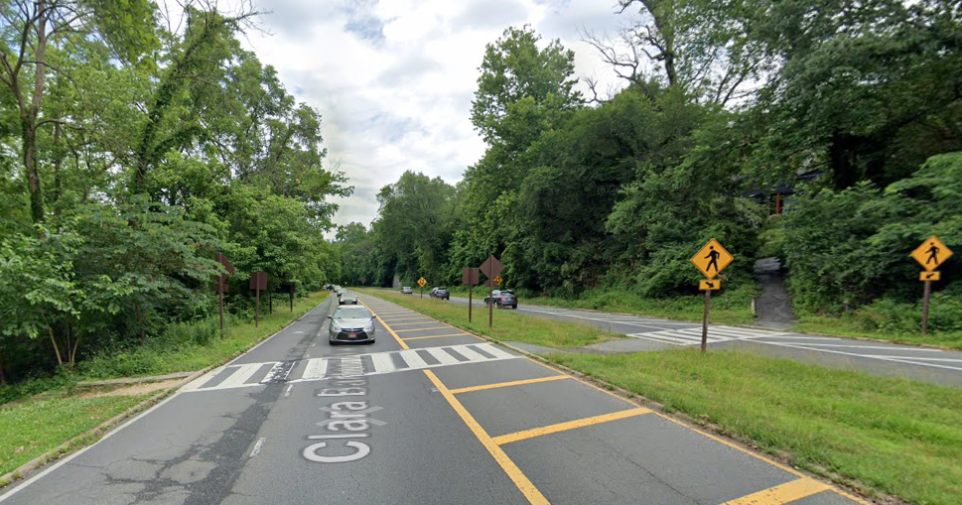
Candidate Alternatives
Engineering
  Multi-modal
    Marked pedestrian crosswalk
    Enhanced marked pedestrian crosswalk with medians/ crossing island
    Enhanced marked pedestrian crosswalk with pedestrian-activated beacons/ signals
    Transit service evaluation
    Driver pedestrian warning application (App)
    Add capital bikeshare stations

Slide 27
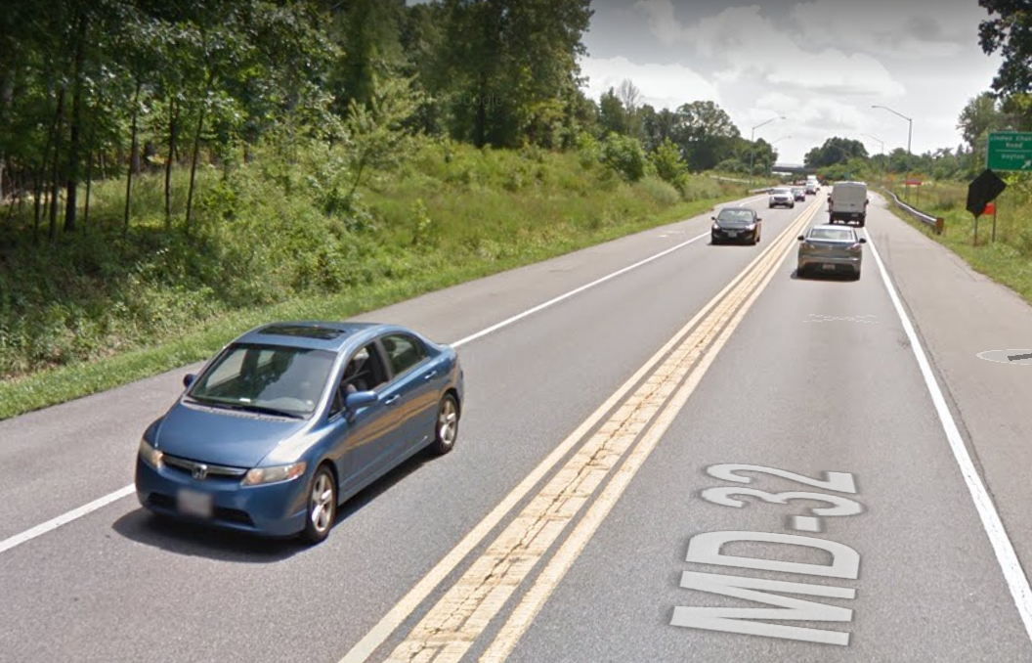
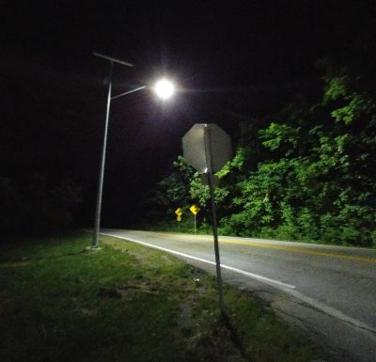
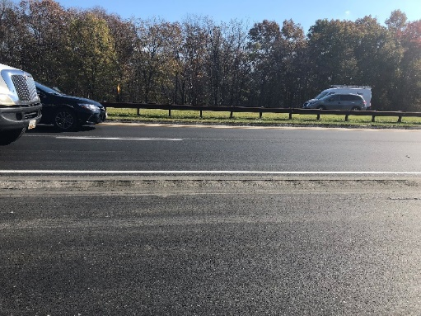
Candidate Alternatives
Engineering
  Roadway departure
    Roadside design improvements along curves
    Centerline buffer
    Intersection lighting
    Longitudinal rumble/mumble strips

Slide 28
Candidate Alternatives
Engineering
  Roadway maintenance / Environmental
    Tree trimming
      Arborist study
    Pavement repair
    Inlet cleaning
      Drainage study
    Pavement restriping

Slide 29
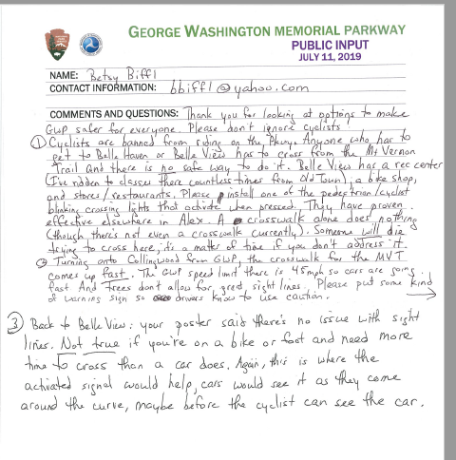
Feedback and Comments
Do you see your input reflected?
What do you think are the best treatments at your location of concern?
  Alternative preferences
  Location applications
  Design elements
  Potential impacts
  Priority
Other comments

Slide 30
Next Steps
Public comment period until 1/10/20
  Comments accepted via website, email, mail and at this meeting
Review public comments
Additional traffic, safety and preliminary engineering design
Final report
Final improvement selection
Funding identification (timeline is dependent upon securing funding)
Implementation program

