Slide 1

Reconnecting the Circle of Forts:
From Parkway to Trails
National Park Service
U.S. Department of the Interior
Civil War Defenses of Washington
Rock Creek Park, National Capital Parks East, and
George Washington Memorial Parkway
June 2011
E X P E R I E N C E Y O U R A M E R I C A

Slide 2
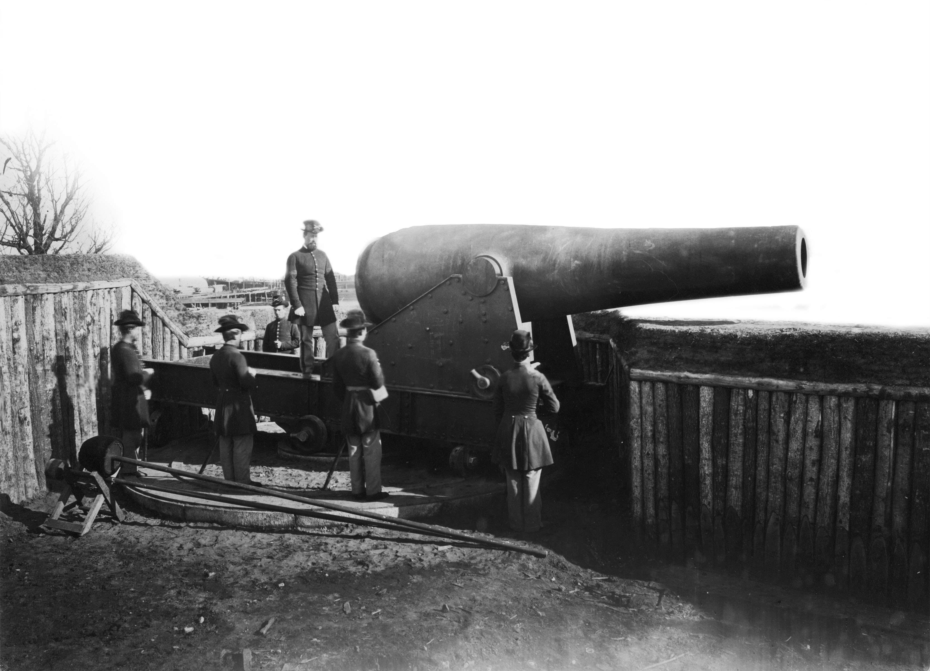

Protecting the Nation’s Capital
In April 1861, preliminary footholds of the fort network were quickly established in Arlington.
The secession of Virginia
from the Union underscored
the precarious location of
the Union capital.
Battery Rogers (City of Alexandria, VA)
Section View Earthworks
Notes:
At the beginning of the Civil War, the defensive system for the city of Washington was inadequate and vulnerable.
In April of 1861, Federal troops moved into Virginia to take up positions and build earthwork fortifications in Alexandria, across the Long Bridge
Prior to the construction of the CWDW, the fortifications of DC were limited to a fort/arsenal (ca. 1794) at the site now known as Fort McNair, the Washington Navy Yard (1799), and the Marine Barracks (ca. 1801). Fort Warburton (Fort Washington) was constructed in 1809, burned during the War of 1812, and re-built afterwards.

Slide 3
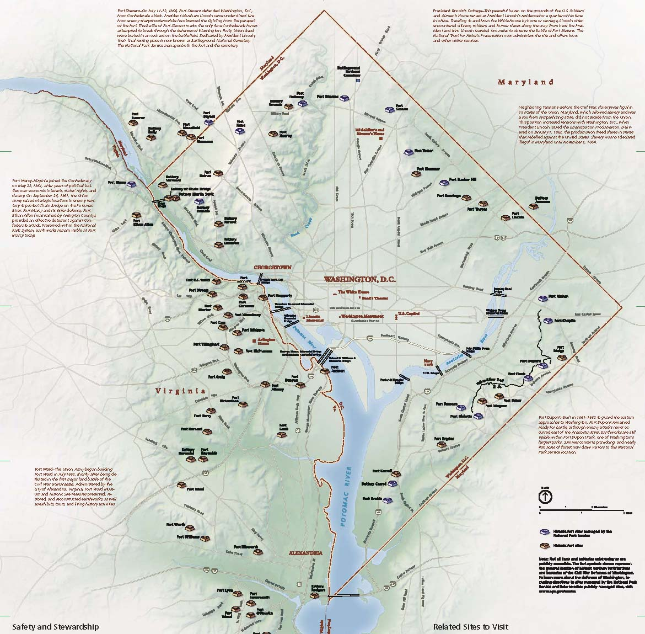
Notes:
Final construction of a total of 68 forts. The forts were built on the ridge lines, at key river crossings and strategic highpoints surrounding Washington, DC.
While the system of fortifications would be continually strengthened and expanded throughout the war,
war-time Washington was buzzing with activity and a population boom as result of the war effort. The city teemed with hospitals, soldiers’ camps and troop movements.
Louisa May Alcott served as a volunteer nurse in Washington during the Civil War and wrote in her memoirs of Washington, “Sentinels tramp around it all night long, their muskets glittering in the wintery moonlight…(she continues).. Causing one to conjure up romantic visions of guarded forts, sudden surprises, and daring deeds. For in these war times the hum drum life of Yankedom has vanished.”
The perceived threat on the Union capital ebbed and flowed, as did the staffing levels at the forts. Soldiers were often stripped from the Defenses to aid campaigns in other areas.

Slide 4
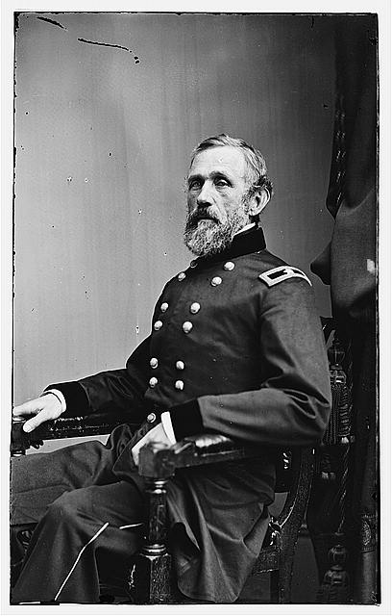
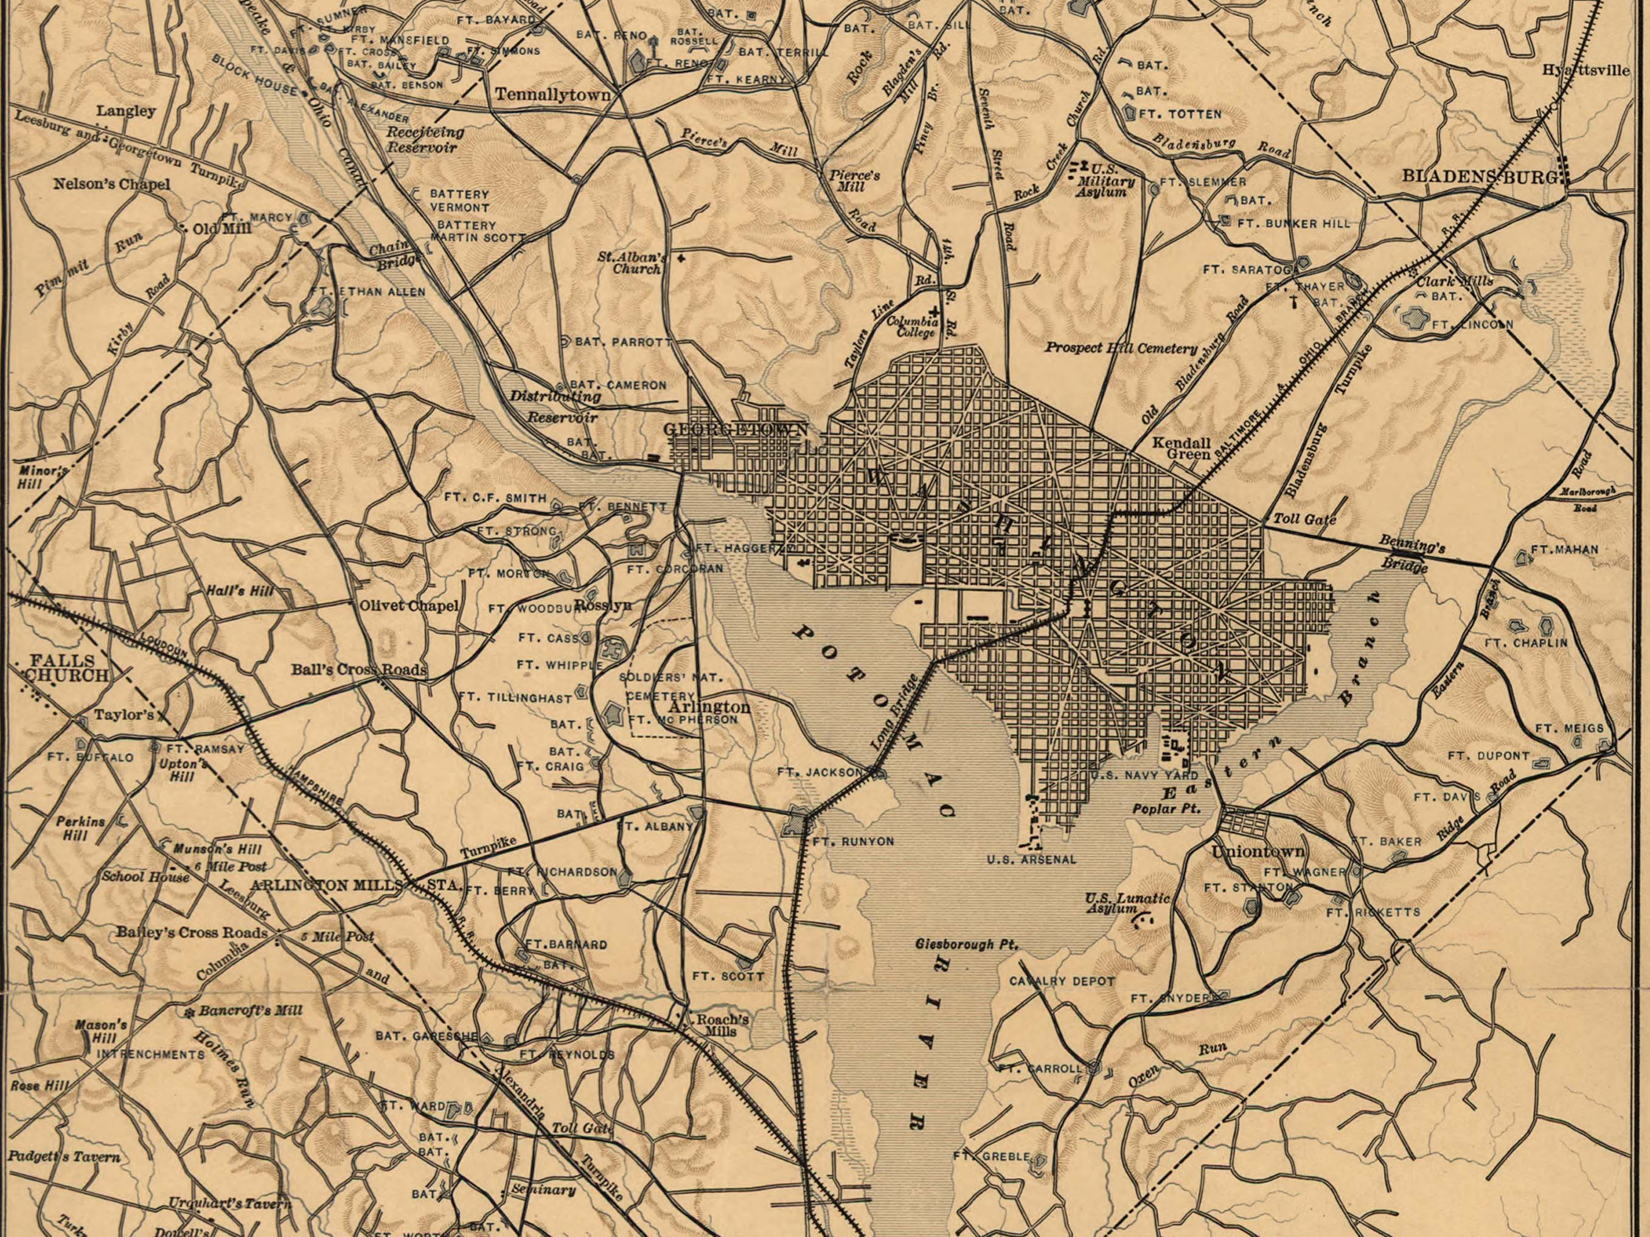
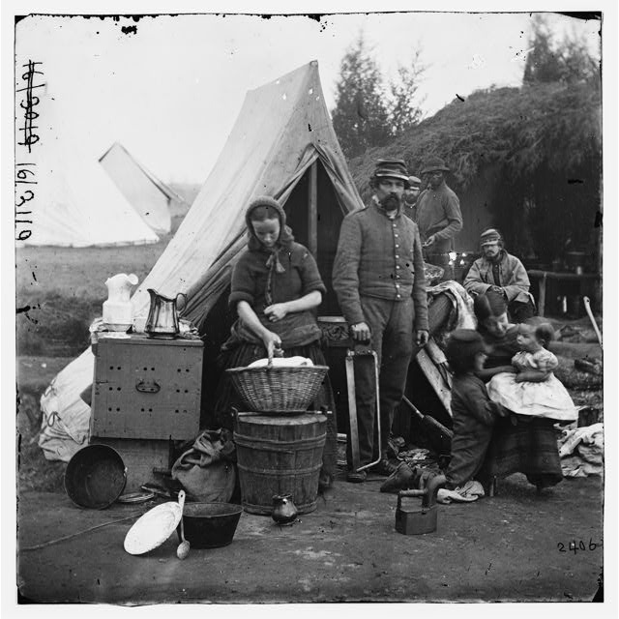
Civil War Defenses of Washington (1867)
John G. Barnard
Encampment near Fort Slocum
Notes:
Major John G. Barnard was appointed to execute the construction of a System of Defenses to protect the capital.
The system of fortifications was constructed by:
Soldiers
Prisoners of War
Paid Civilians
And paid escaped slaves, know as “contrabands”, a reference to the wartime authority used to keep these individuals free, rather than returning them as property to their slave owners.
By the end of 1861, 48 defensive earthworks encircled the city with the larger forts located at the southern perimeter.
Just two years later, by the end of 1863, the city was protected by 60 forts, 93 batteries, and a total of 837 guns.
The efficient movement of troops, supplies, and communications between the forts, batteries, and rifle lines was an integral part of the system’s overall success. As a result, 32 miles of connecting military roadways were constructed as well.
Communities sprung up around the forts in what were previously mostly rural farm areas.

Slide 5
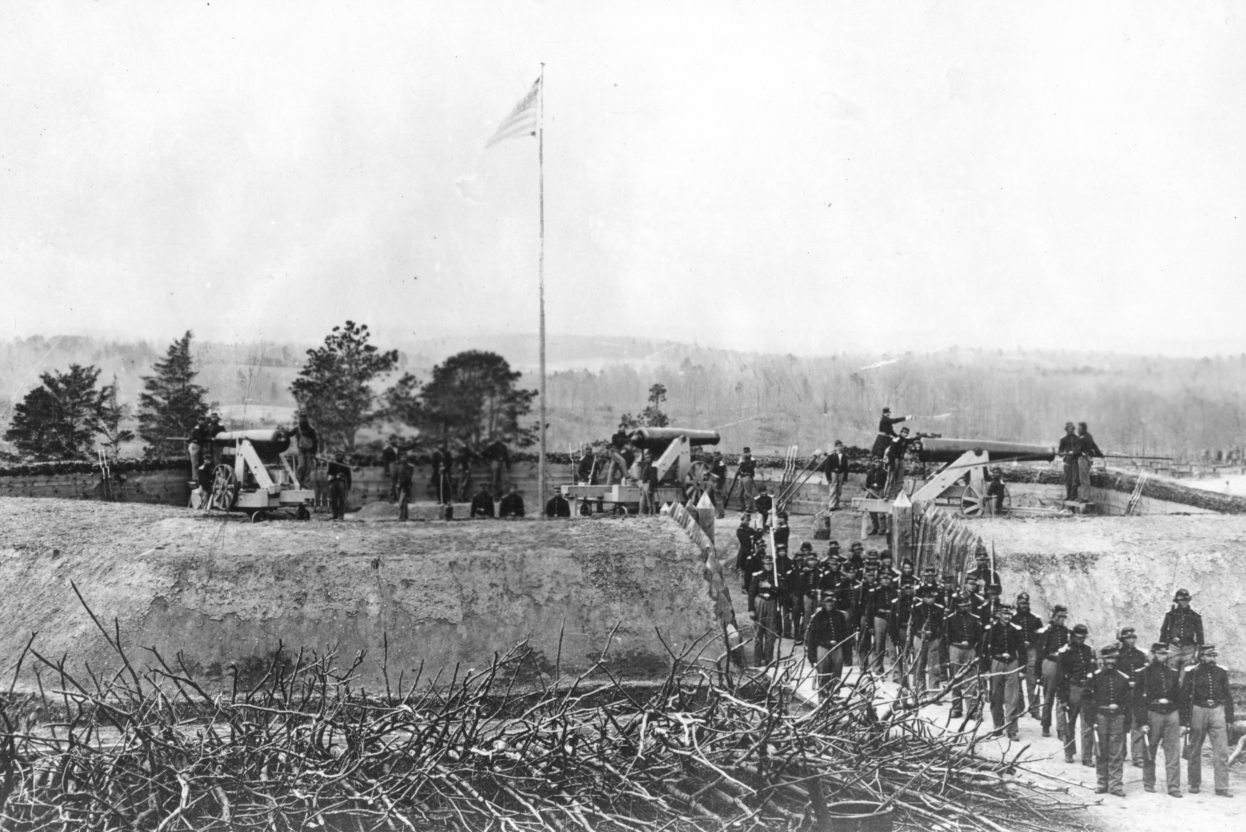
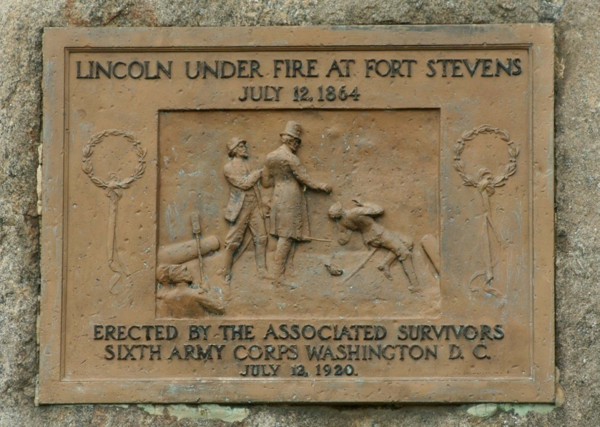
The Battle of Fort Stevens
On July 11-12, 1864, General Jubal Early and the Confederates attacked Union forces on the outskirts of Washington at the Battle of Fort Stevens.
Fort Stevens 1864
1930s marker at Fort Stevens
Notes:
In 1864, in an effort to distract Union forces in the south, Confederate General Robert E. Lee sent General Jubal Early to attack Washington, D.C.
On July 11-12, 1864, the city’s main forces had been pulled to support General Ulysses S. Grant’s campaign in Virginia.
Washington DC was lightly defended by short-term, untrained recruits. Gen. Early was delayed by the battle at Monocacy River, south of Frederick, MD, and the Union rushed to man the forts, even pulling members of the Veteran Reserves (i.e. wounded soldiers) to man the forts. The delay at Monocacy afforded time for reinforcements to be called back to Washington who arrived on July 12th and the Defenses of Washington held.
On a side note, the Battle of Fort Stevens, was the only time a sitting U.S. President has come under enemy fire. President Lincoln visited the field of battle and famous climbed the parapet, where he was shot upon by Confederate sharp shooters.

Slide 6
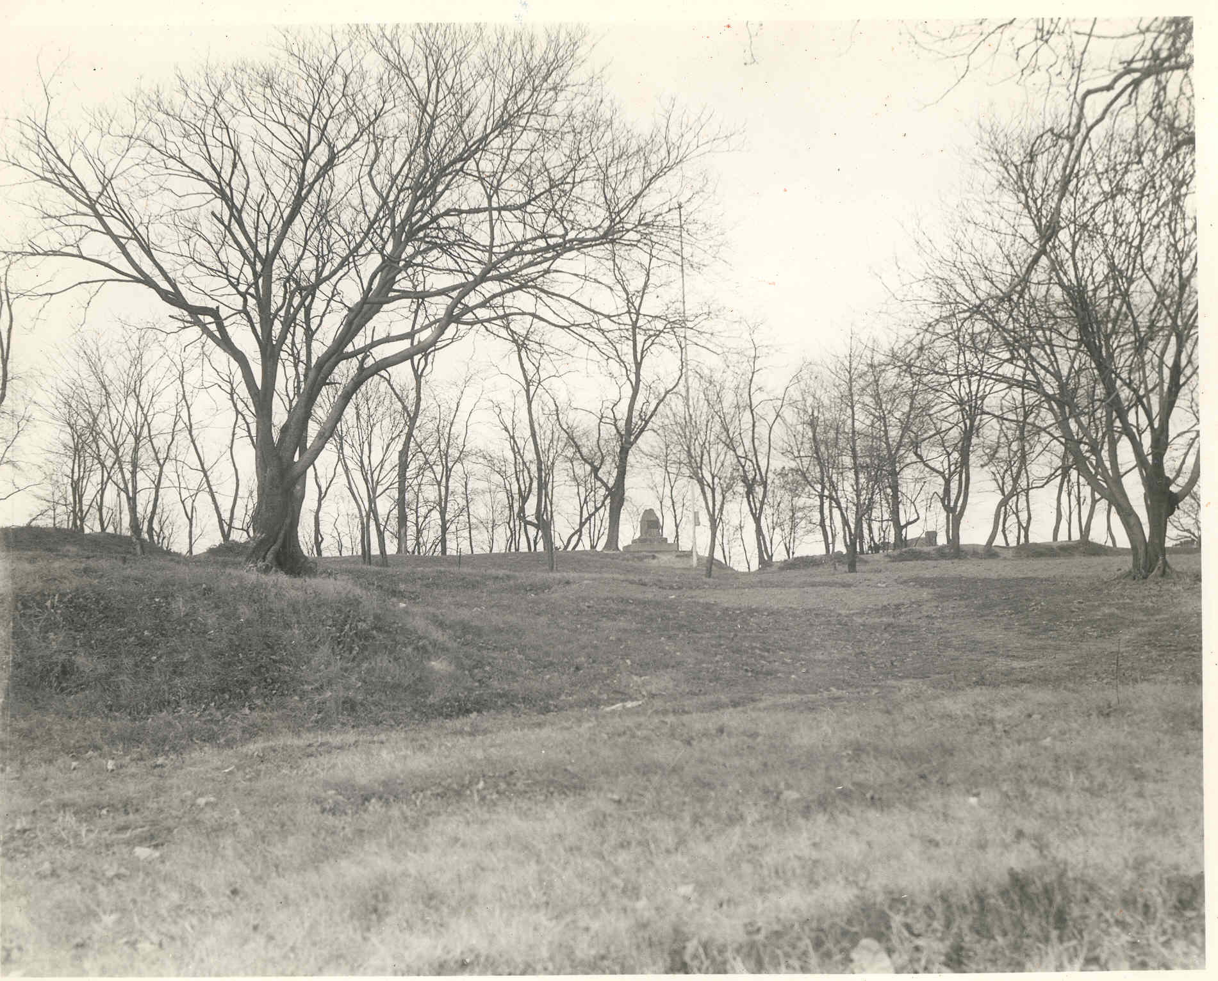
“Nature is unrestingly making war upon War”
Washington, Outside and Inside (1873)
Initially a small number of roughly a 1/3 of the forts were retained.
Ultimately, only Forts Foote and Whipple were retained for ongoing military use.
Fort Stevens circa 1930
Notes:
After the war, the forts were systematically dismantled and the seized lands returned to private owners. As before, the perceived need to protect Washington initially left a small system of fortifications intact, but over time the need seemed to dim…
With the war time population boom of Washington, the post-war period was marked by rapid development and land speculation.
Construction of the defense system had resulted in the demolition of buildings, denuded forests and agricultural fields and the land values were depressed.
George W. Young who owned land in the area of Ft. Carroll advertised his land for sale as a “…riverfront parcel with fine soil and government improvements that would afford great facilities for founding at once a town that would prove to Washington what Brooklyn is to New York.”
In 1869, one account of the landscape of post-Civil War Washington noted, “About two miles outside of Washington, and completely encircling the city, is a chain of fortifications, completely connected by military road, forming a boulevard, which, by the aid of the trees and shrubbery, judiciously cared for, would be equal to the famed drives surrounding the city of Paris.”
Another account of the time noted, “These wrecks of its defenses will some day be the picnic haunts of curious patriotism…”

Slide 7
Evolution of Fort Drive
Evolution of Fort Drive Concept
1869
Fort Drive
included in D.C.
highway map
1900
Ft. Stevens –
Lincoln Military
Park Assoc.
founded
1902
McMillian Plan
supports proposed
Fort Drive
1932-1937
limited sections
of Fort Drive
constructed
1860 -1900
1900 - 1920
1920 - 1930
1865
Civil War
ends
1890
Rock Creek
Park
established
1890s
Congress
establishes
Military Parks
1890 - 1910
advent of
parkway
Systems &
Antiquities Act
passed (1906)
1914-1918
World War I
1929
Great Depression
begins
1930
Capper-
Crampton
A ct passed
National Preservation Context
Notes:
In Washington, the Defenses became a focal point for two groups, the supporters of the memorializing the Civil War and the proponents for improving the park system in Washington, DC.
These preservation movements were somewhat at odds - as former soldiers often wanted to see the fields of battle preserved as memorials to their sacrifices, not as recreational spaces.
In the 1890s, Congress established the first five military parks. Soon after, a growing movement toward preservation was also underway – marked by the passage of the 1906 Antiquities Act.
In Washington, the McMillian Commission was tasked with developing a comprehensive plan for the city extended beyond the original L’Enfant Plan. The Commission endorsed the idea of the preservation of the forts and a parkway to connect them.
In the early 1930s with the passage of the Capper-Crampton Act many lands for the Fort Drive were acquired between 1929 – 1932 and parkway designs were developed.
And between 1932 -1937 two sections were constructed. 1. at Fort Reno in NW, DC by the WPA and the second, and the 2nd larger section between Forts Dupont and Davis in SE, DC by the CCC.

Slide 8
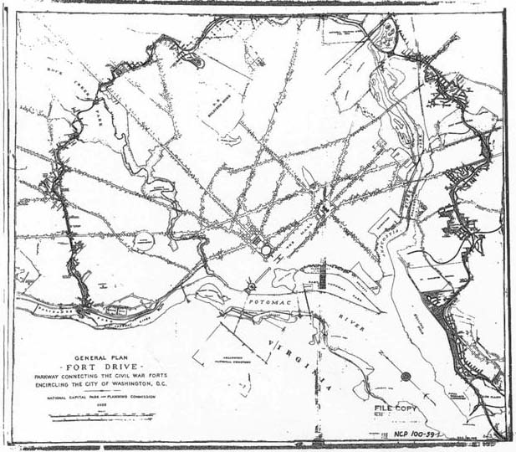
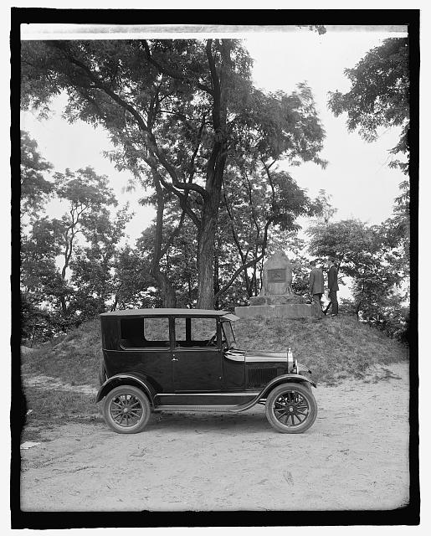
NCPPC Map of Fort Drive (1939)
E X P E R I E N C E Y O U R A M E R I C A
Notes:
In this 1939 plan by the Nation Capital Park and Planning Commission the Fort Drive concept is presented.
This precursor agency to the National Capital Planning Commission was, in large part, created to carry-out the early visions of the McMillian Commission, including the Fort Drive proposal.
The McMillian Commission’s recommendations for the city stated, “The views from these points are impressive in proportion to their commanding military positions and they are well worth acquirement as future local parks, in addition to any claim their historical and military interest may afford.”
8

Slide 9
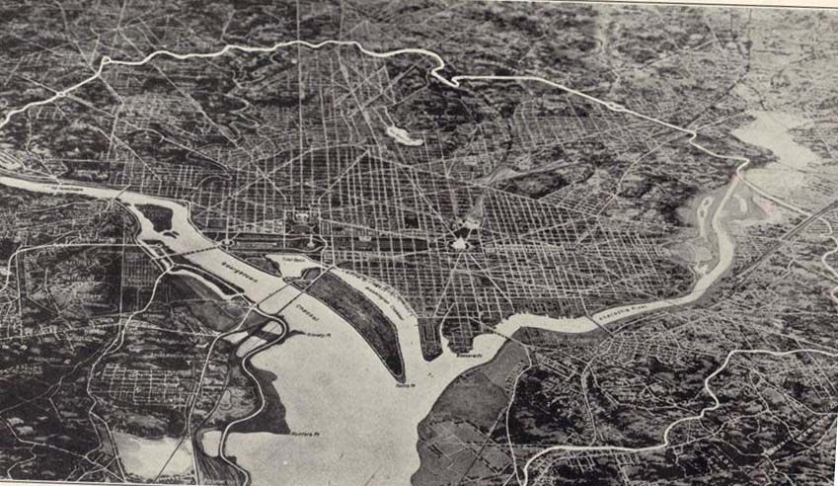
Composite Map of Proposed Fort Drive (1932)
E X P E R I E N C E Y O U R A M E R I C A
Notes:
These early parkways originally were provided a primarily scenic routes for slow vehicle traffic.
From the 1930s through the 1950s, planners and engineers continued to revise the plan for the 23 ½ mile Fort Drive.
Width of the road became steadily wider, moving away from the wooded, parkway concept and closer and closer to a limited access freeway.
As plans changed and the developed land increased in value, estimates for the project crept from $15 million in 1940 to
$37 million in 1947. These sums far eclipsed available funds for the District of Columbia.
Despite the lack of funding, the Fort Drive proposal was revised in 1950 as a “Thoroughfare Plan”
and in 1963, President Kennedy called for the “speedy construction of the 23 mile Fort Drive Parkway,” but Congress did not appropriate funds.
9

Slide 10
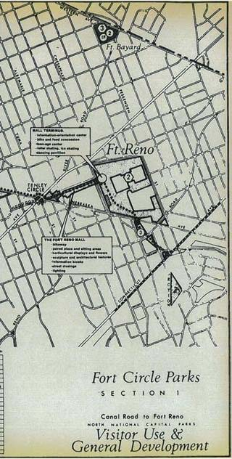
Fort Circle Parks Master Plan (1968)
By the 1960s, the concept of the Fort Drive plan as originally conceived was replaced with a vision for hiking trails, bike paths, and recreation areas.
In 2004 the NPS solidified the vision of a network of parks linked by a trail network.
E X P E R I E N C E Y O U R A M E R I C A
Notes:
By 1960, the Fort Drive was simply too costly, impractical, and now controversial in the face of so many established communities.
By the mid 1960s, both the National Capital Planning Commission and the National Park Service shifted their vision toward a ring of green space that would in fact provide a respite from cars. Thus, the Fort Circle Parks were anointed.
The National Park Service continues to embrace this vision seeks to tie the circle of forts together a recreational trail network.
10

Slide 11
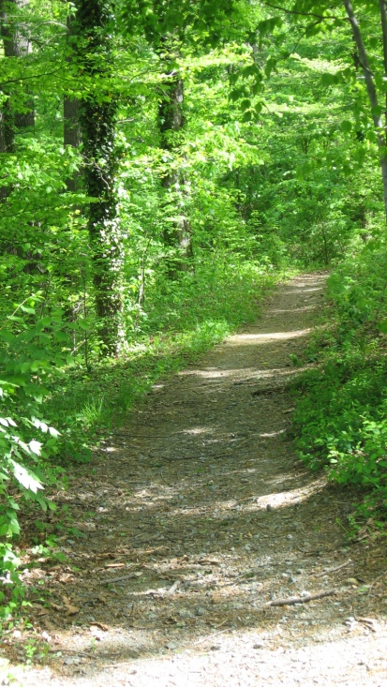
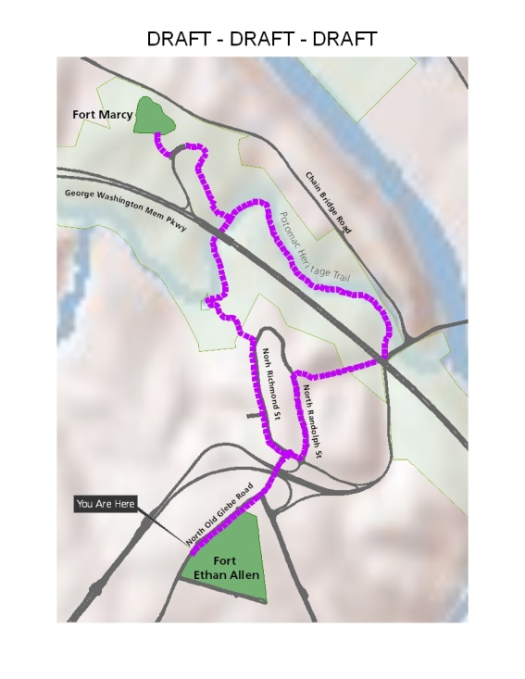
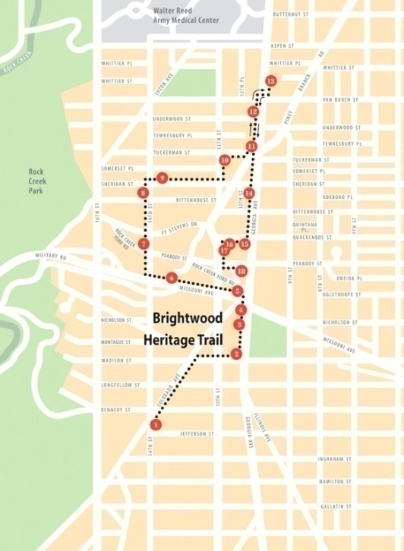
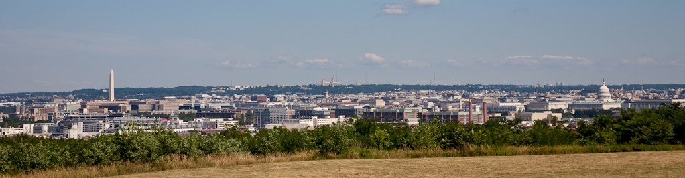
Establishing the Trail
Present Day View from Fort Stanton (SE, DC)
E X P E R I E N C E Y O U R A M E R I C A
Notes:
Some components of the trail network already exist, particularly along a 7 mile stretch in N.E. and S.E. Washington, D.C. along what is called the “Hiker-Biker trail” shown on the left.
In the center is a proposed walking route to connect Forts Marcy and Fort Ethan Allen (an Arlington Co. managed site) in Virginia.
And on the right is an existing signed walking route in N.W. Washington, DC associated with Fort Stevens and Battleground National Cemetery (the nearby resting place of 41 Union soldiers from the battle).
You can see here the view of Washington, DC from one of the fort locations – it give you a sense of the views afforded by these strategic military positions.
11

Slide 12
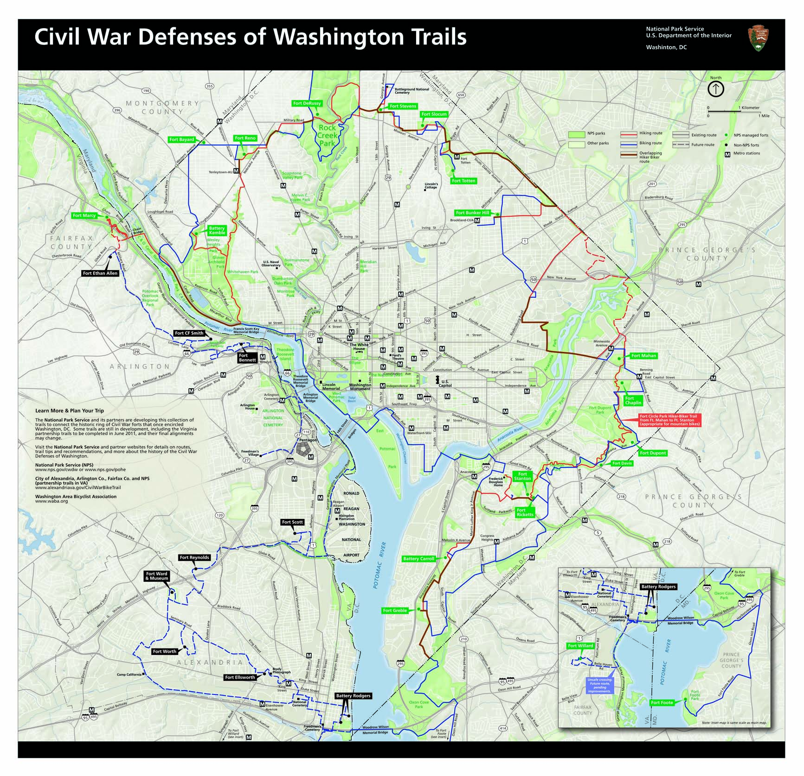
Expanded Vision
A partnership
network of hiking and biking trails connecting the forts in DC, MD and VA
E X P E R I E N C E Y O U R A M E R I C A
Notes:
In 2010, the NPS partnered with the
Washington Area Bicyclist Association
Potomac Heritage National Scenic Trail
City of Alexandria
Fairfax County, and
Arlington County
To publish this hiking and biking guide. These are largely self-guided routes presently.
12

Slide 13
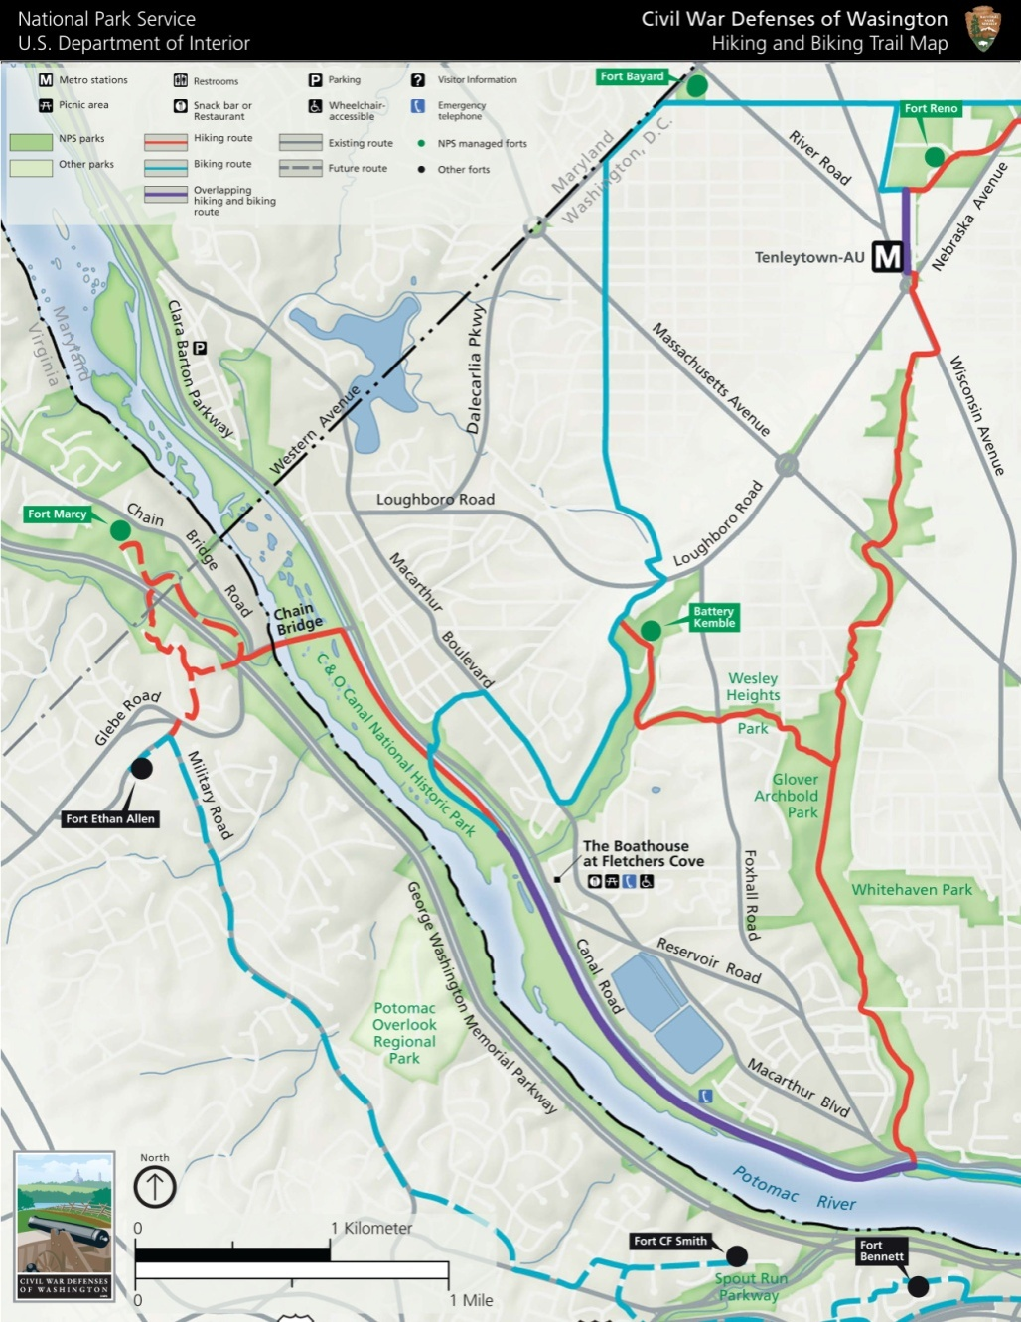
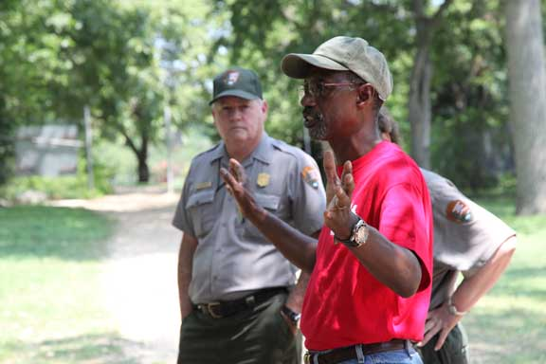
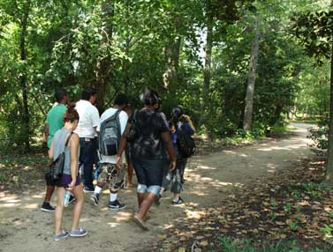
Establishing the Trail
Notes:
Detailed maps can be found on the CWDW website to help hikers and bikers travel between the forts, but the network is unmarked.
This evolution of the original vision for Fort Drive was a result of decades of planning initiatives that had failed to be realized, but which continues to capture the imagination of planning officials, Civil War advocates, the National Park Service, and local residents with a vested interested in the park network surrounding Washington, DC.

Slide 14
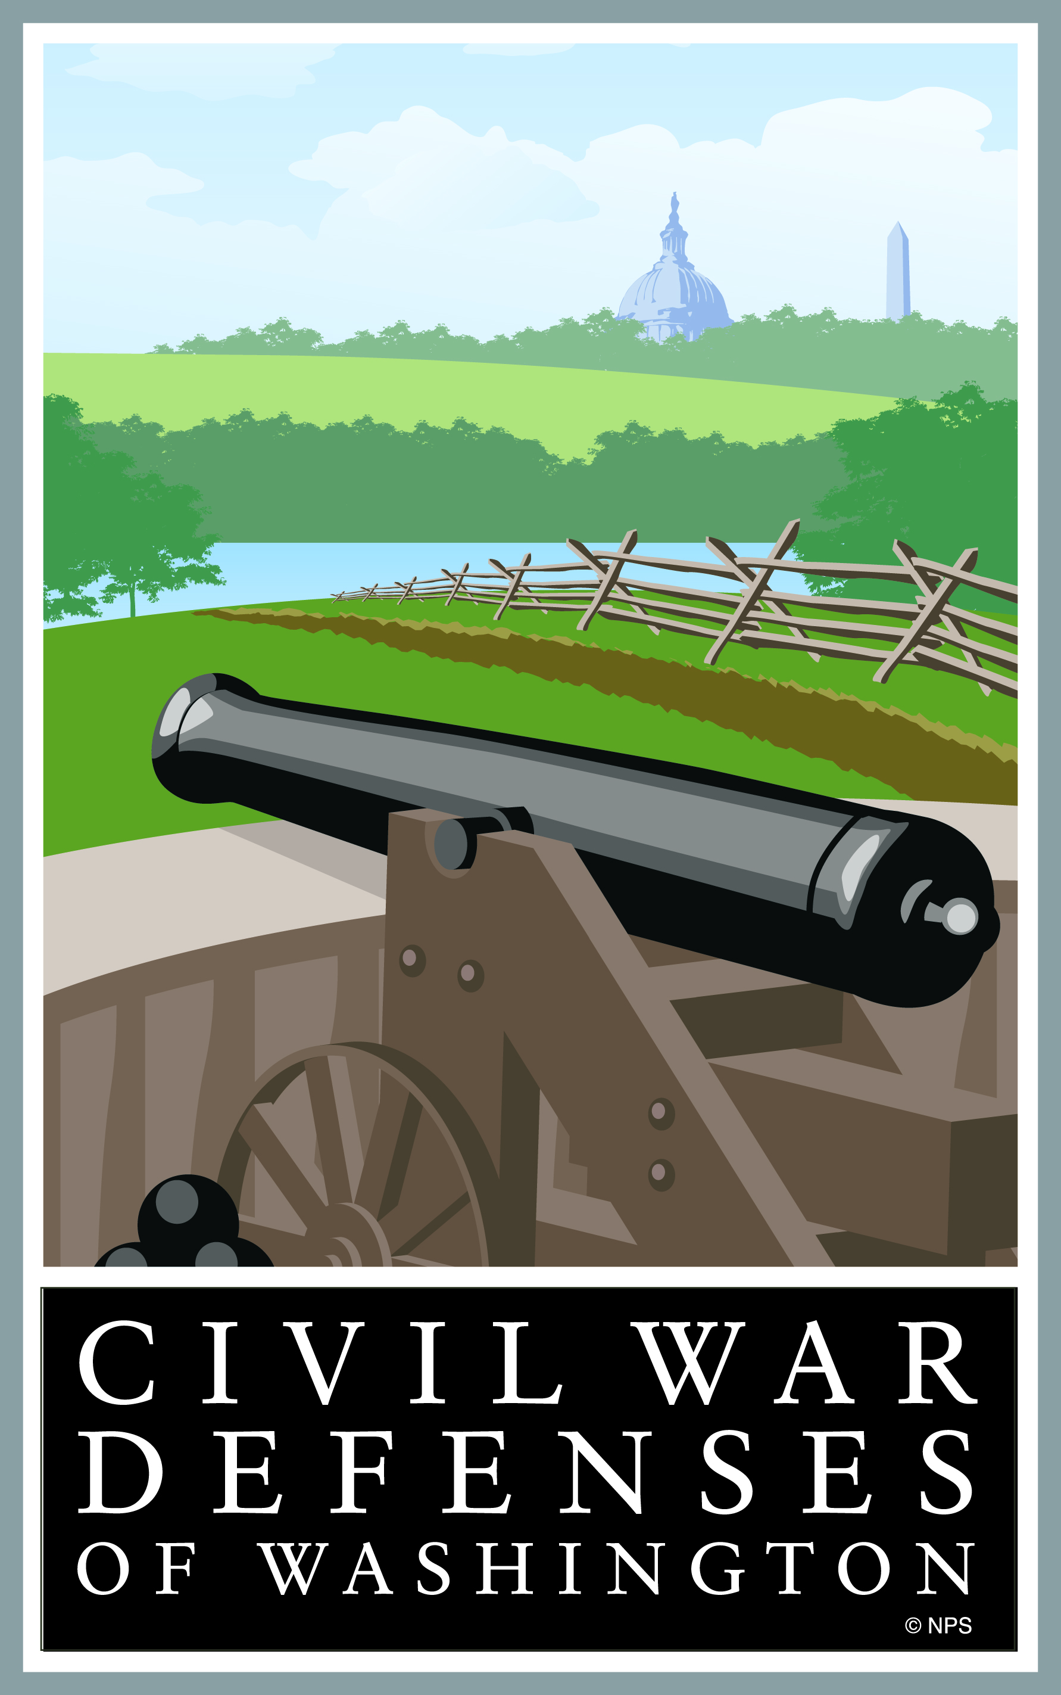
Reconnecting the Circle of Forts
www.nps.gov/cwdw
or
follow us on Facebook
Notes:
I’m happy to stay and answer questions about the forts, the trail planning, or the NPS plans to commemorate the 150th of the Civil War.

