Slide 1
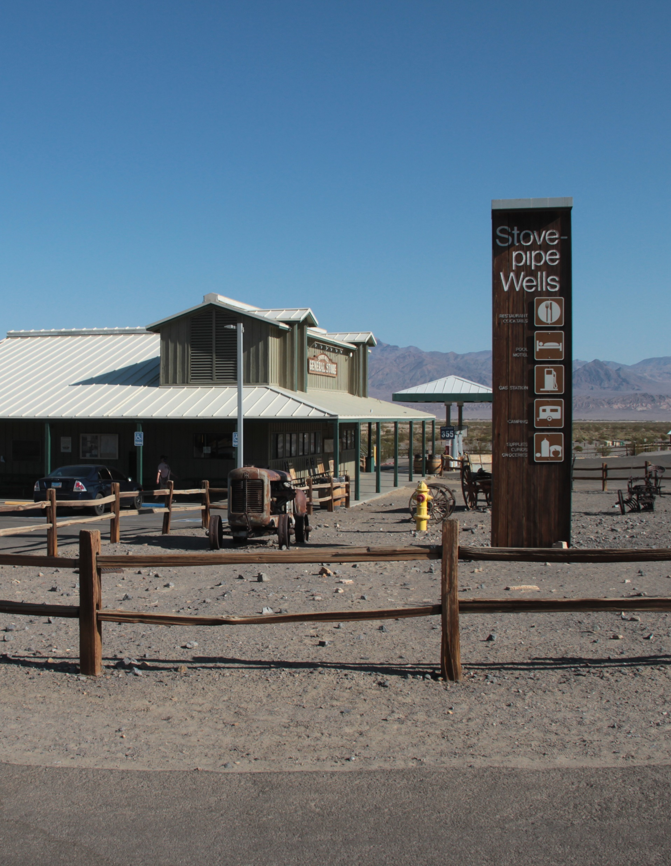

Stovepipe Wells Developed Area Improvement Project
Death Valley National Park
Public meeting
Feb. 9, 2022
Notes:
Matthew

Slide 2

Introductions
James Woosley
Acting Superintendent
Abby Wines
Management Assistant
Rob Wissinger
Chief Ranger
Matthew Yarbrough
Volunteer Coordinator /
Meeting facilitator
Notes:
Matthew, then James, then Abby, then Rob

Slide 3
Agenda
Meeting format
Presentation
  Context / timelines
  Park overview
  Preferred Alternative
  No Action Alternative
  How to Comment
Question and Answer Session
Notes:
Matthew

Slide 4
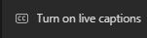
Meeting Format
  Slides can be downloaded at:
  parkplanning.nps.gov/StovepipeWellsPlan
  Captioning (auto-generated)
  Each attendee can turn on and off
  Captioning (better quality, by live person)
  https://www.streamtext.net/player?event=USNPS
  Questions:
  Type your questions into chat box. They will go to the presenters, not to all attendees.
  A moderator will combine similar questions.
  We will answer as many questions as we can before 7:30pm.
Notes:
Matthew

Slide 5
Context & Timeline
  Process:
  Environmental assessment (under NEPA, the National Environmental Policy Act)
    Broad-level review
  Project funding
    NPS fund sources are targeted for specific types of work
  Design each specific project
  Second-round of compliance review
    NEPA
    NHPA (National Historic Preservation Act)
    Timbisha Shoshone, wetlands, etc.
  Construction
Notes:
James

Slide 6
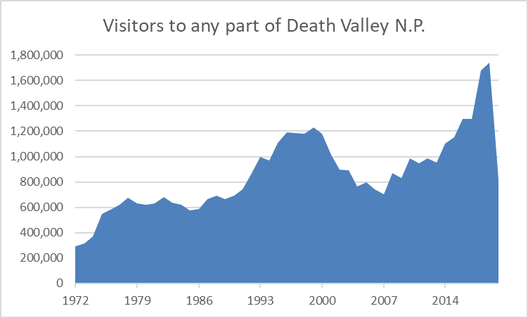
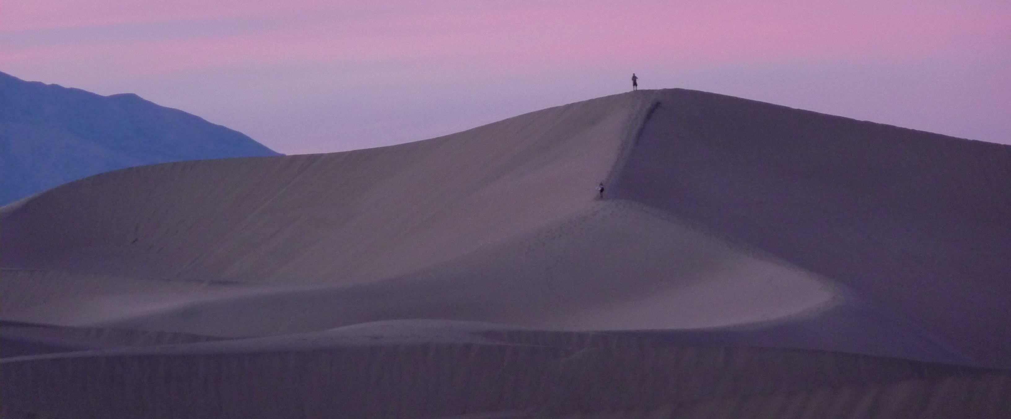
Park overview
3,400,000 acres
Infrastructure across the park that is under-sized and/or failing due to age
Budget:
  Operating: $10 million
  Projects: $14-25 million
Notes:
James

Slide 7
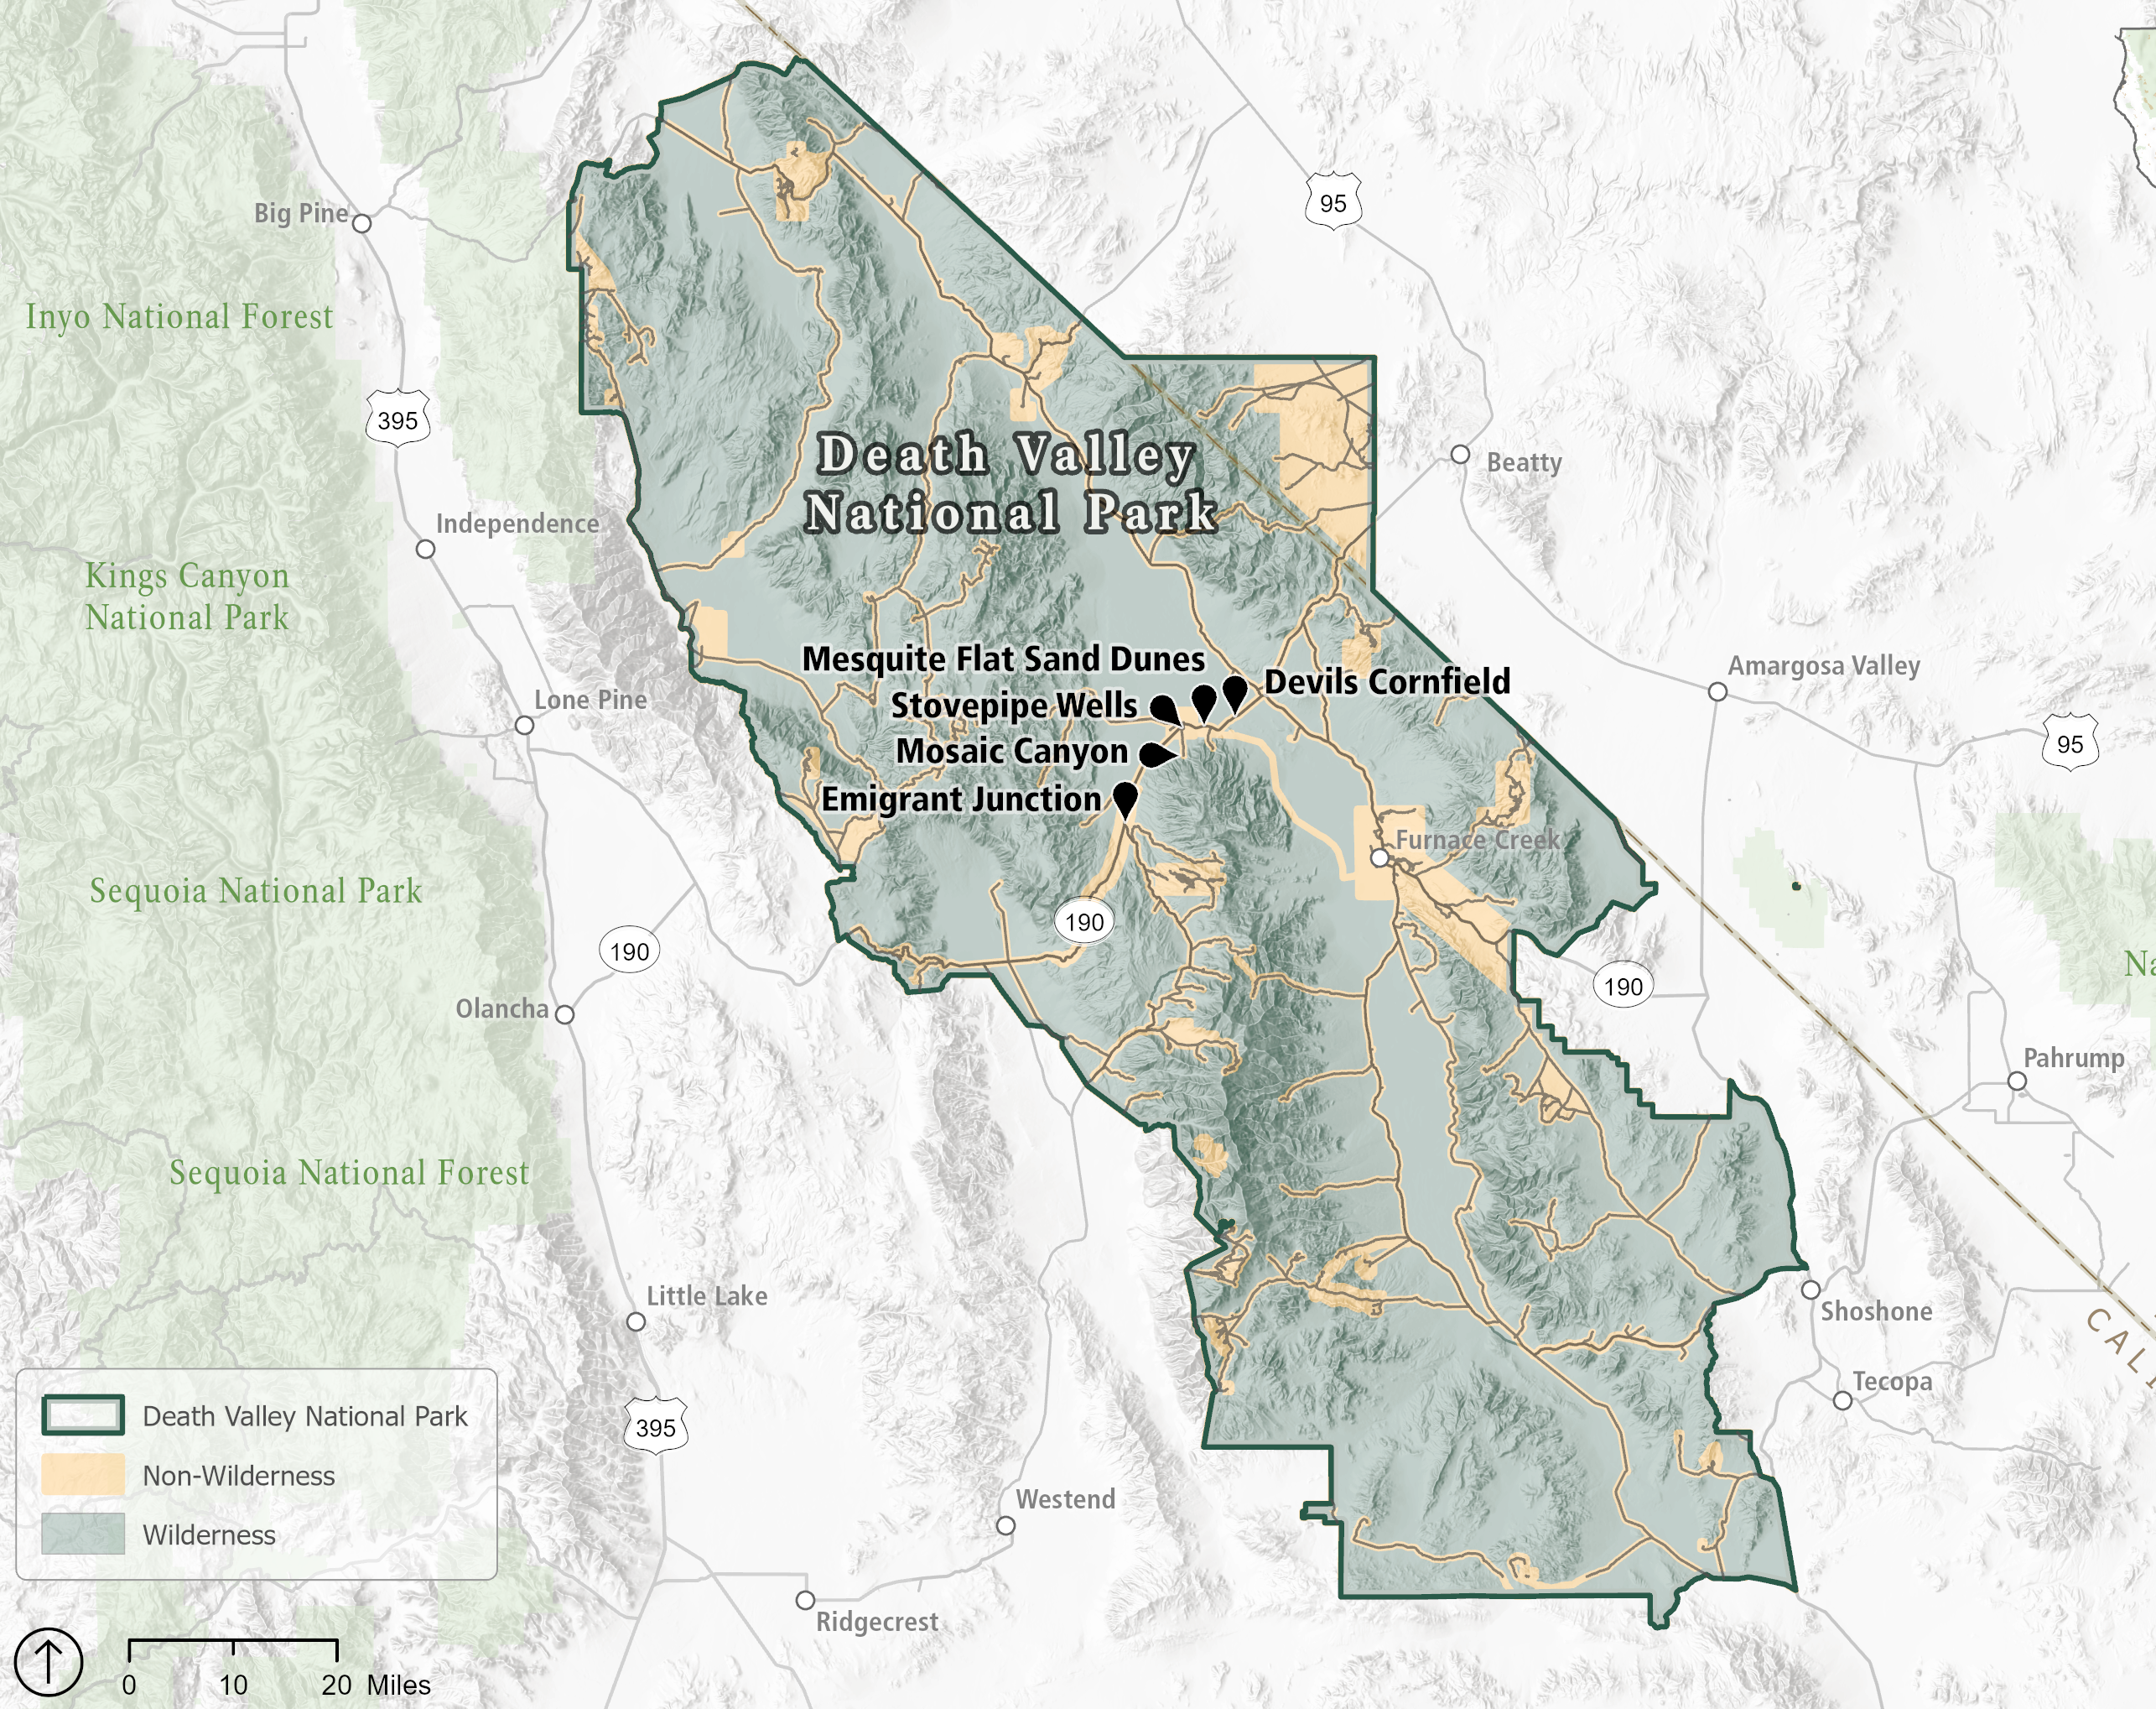
Stovepipe Wells Developed Area
Stovepipe Wells Village
Emigrant Junction
Mesquite Flat Sand Dunes trailhead
Mosaic Canyon Road and trailhead
Devils Cornfield parking pullout
Notes:
James

Slide 8
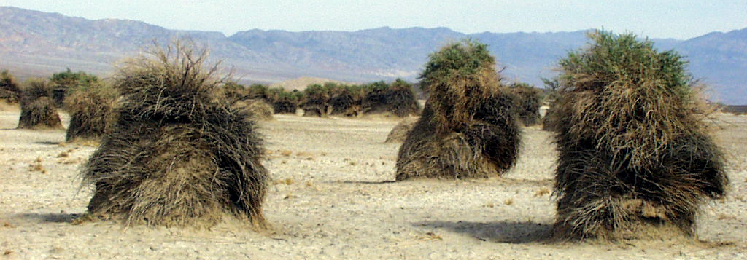
Along CA-190
Along CA-190 at Stovepipe Wells
  Improved warning signs as approaching developed area
  Pedestrian crosswalk with overhead lighting
  Flashing beacon to alert drivers to crosswalk
  If needed: mumble strips (quieter version of rumble strips)
Along CA-190 at Emigrant
  Signs, beacons, and/or other speed control features
  Improve delineation and signage between parking area and highway
2-mile accessible trail from Stovepipe Wells Village to Mesquite Flat Sand Dunes
Along CA-190 at Devils Cornfield
  Change to no-passing zone
  Advance signs (no lights or beacons)
  Replace boulders with more effective barrier to prevent off-road driving
Notes:
Abby

Slide 9
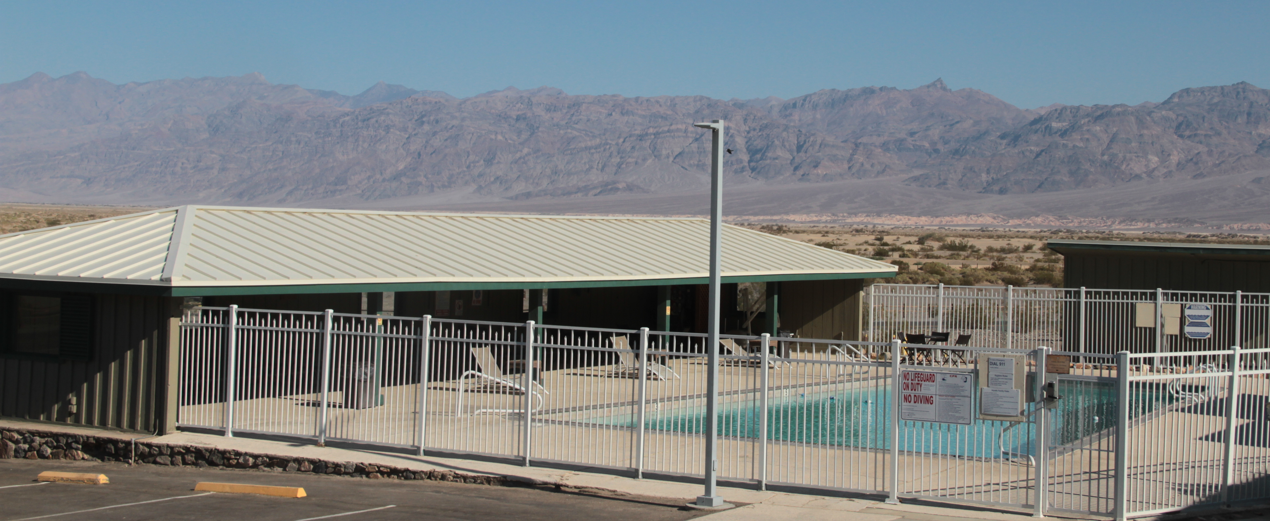
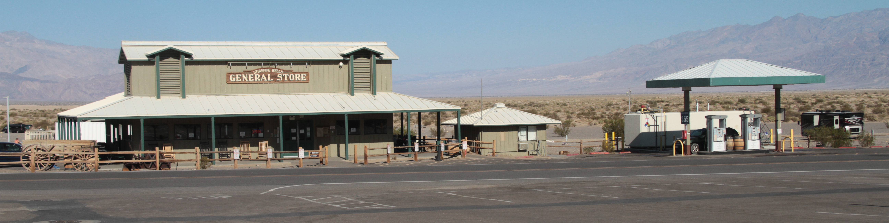
Stovepipe Wells Village
Add diesel fuel tank to public gas station
Improve and increase housing for concession employees
Fire suppression system for hotel registration area and gift shop
Seal the swimming pool and install new shade structures
Improve flood control
Notes:
Abby

Slide 10
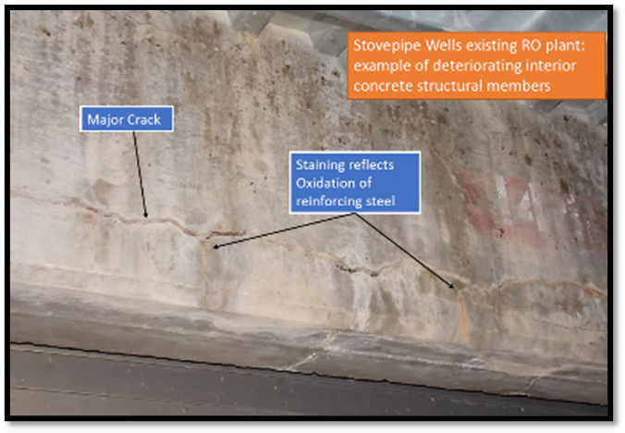
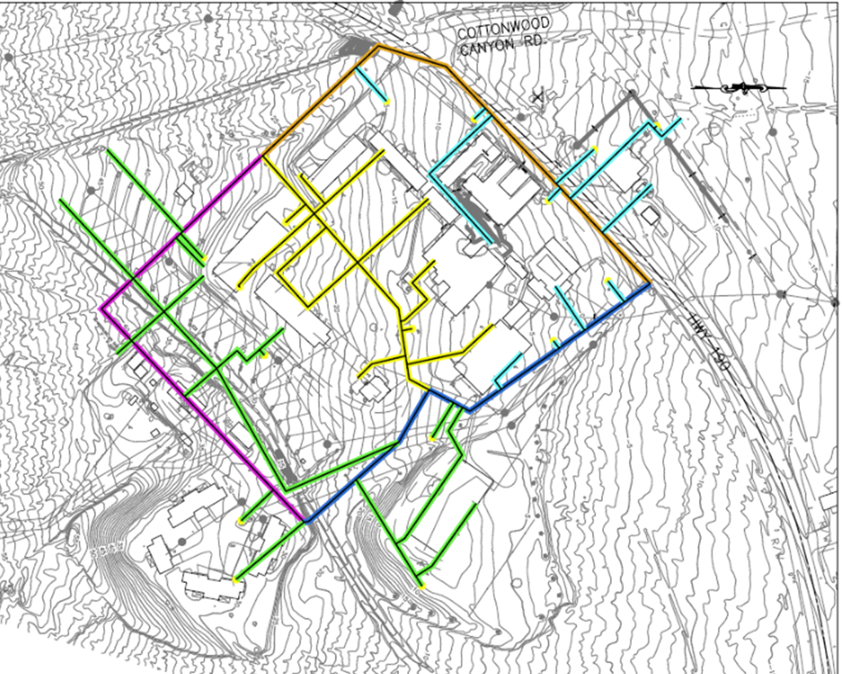
Water system at Stovepipe Wells
Replace water treatment building, which is collapsing
Replace distribution pipes, which are breaking frequently, causing outages, then boil-water orders
Notes:
Abby

Slide 11
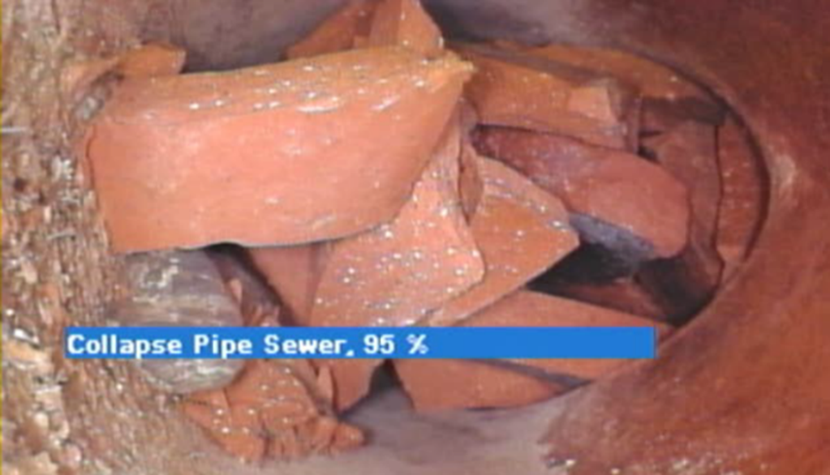
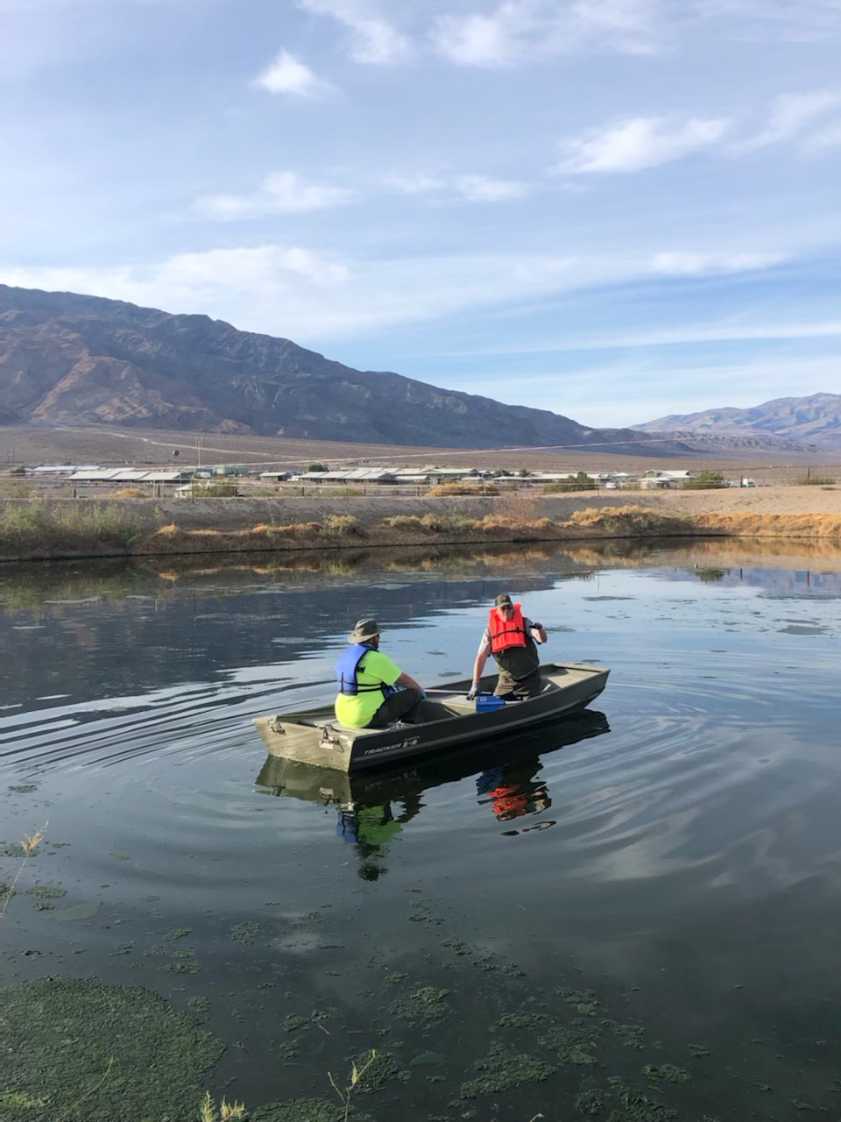
Wastewater system at Stovepipe Wells
Many components are 50 years old
Visitation doubled in past decade, need to increase treatment capacity
Frequent emergency repairs needed
Replace sewer lines
Consider additional sewage pond
Consider lowering elevation of intake to ponds to increase gravity flow
Notes:
Abby

Slide 12
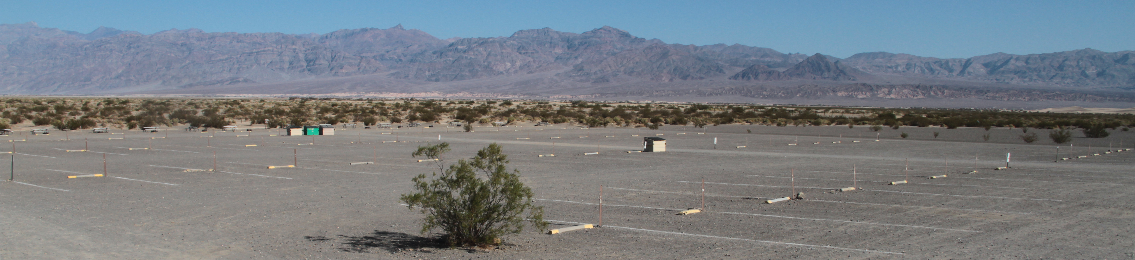
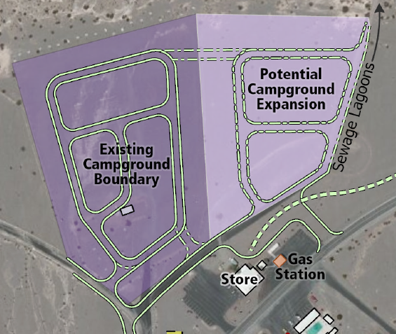
Stovepipe Wells Campground
Existing:
190 sites
1 comfort station
Propose:
Add picnic tables, fire grates, shade structures
Provide space between campsites (this would result in reduced number of sites)
Replace comfort station and add second
Address accessibility
Add group site
Add some RV hookups
Consider expanding campground to the east
Notes:
Abby

Slide 13
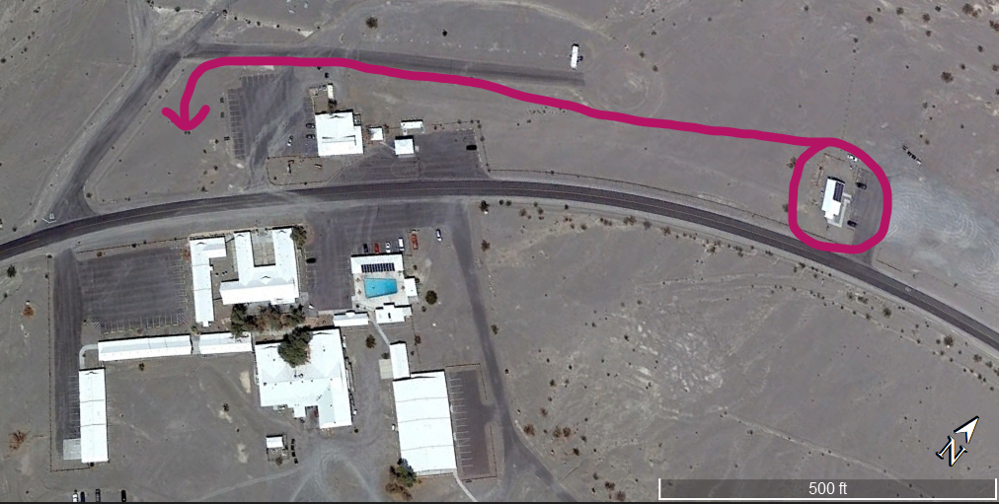
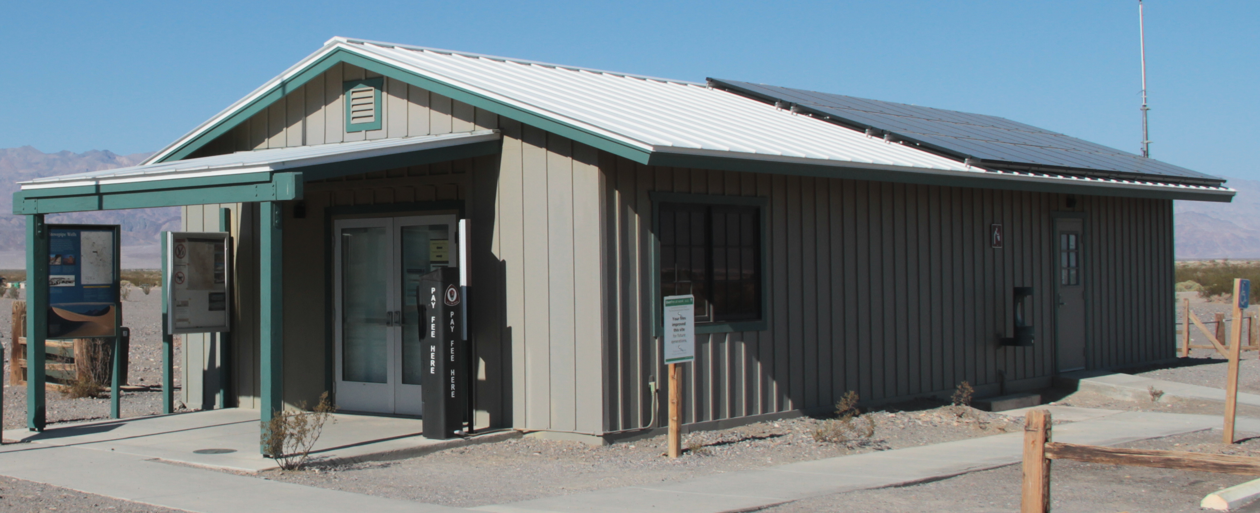
Visitor Contact Station
Propose:
Demolish existing visitor contact station
Build new one adjacent to General Store,
Day use area (picnic tables) with outdoor interpretive and orientation exhibits
Notes:
Abby

Slide 14
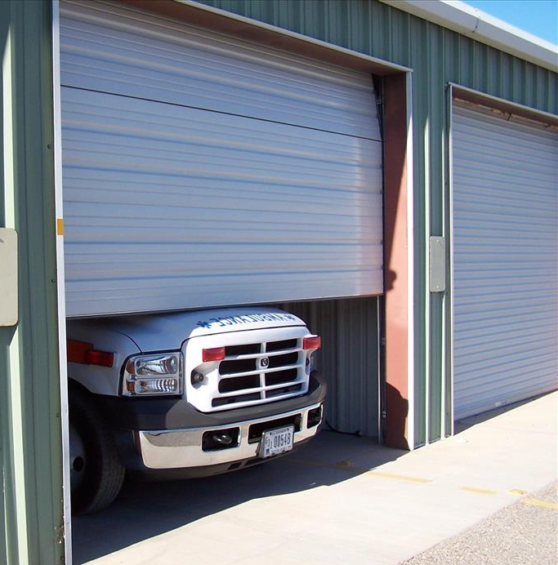
Fire & Medical response building
Problem:
  Smallest available ambulance doesn’t fit inside
Proposal:
  Replace in the same location
  Include staff offices currently in visitor contact station
Notes:
Abby

Slide 15
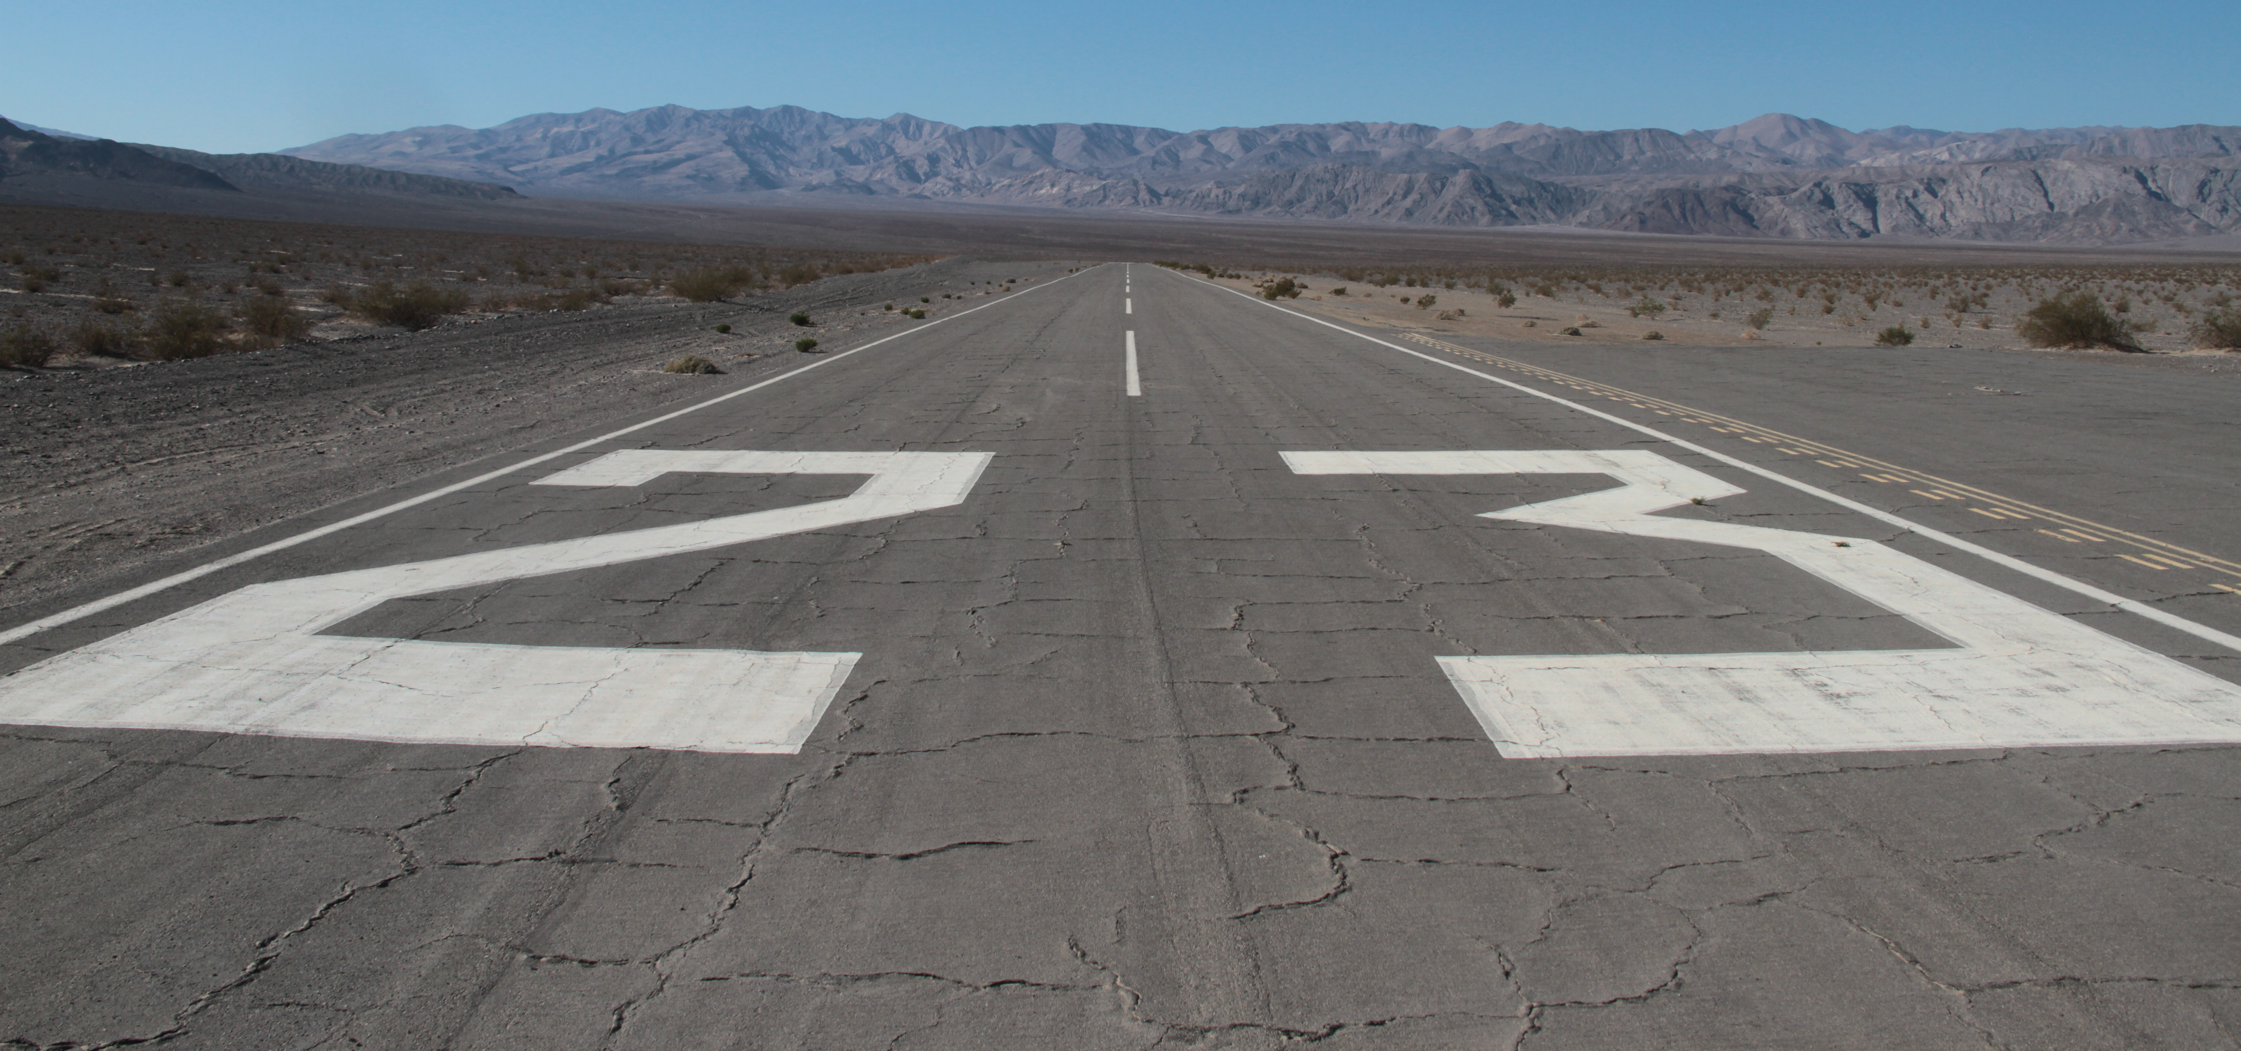
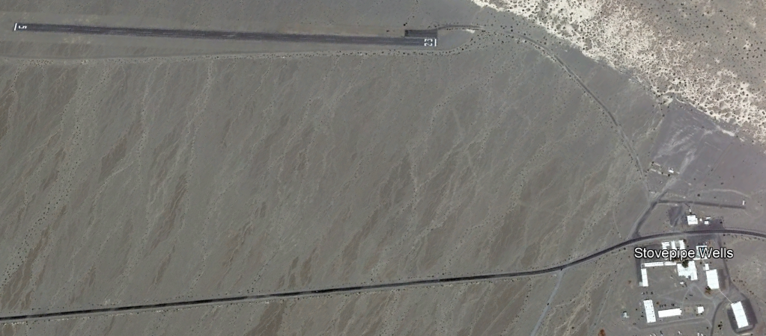
Stovepipe Wells airstrip
Problem:
  Paved airstrip needs $3 million in repairs
  Potential fund sources point to duplication in services with Furnace Creek airstrip (18 air miles away)
Proposal:
  Retain paved helipad
  Close/remove airstrip
    Restore most of disturbed
    area with native plants
    Consider development of
    east end as night-sky viewing area
    (with vault toilet, light barriers)
Notes:
Rob

Slide 16
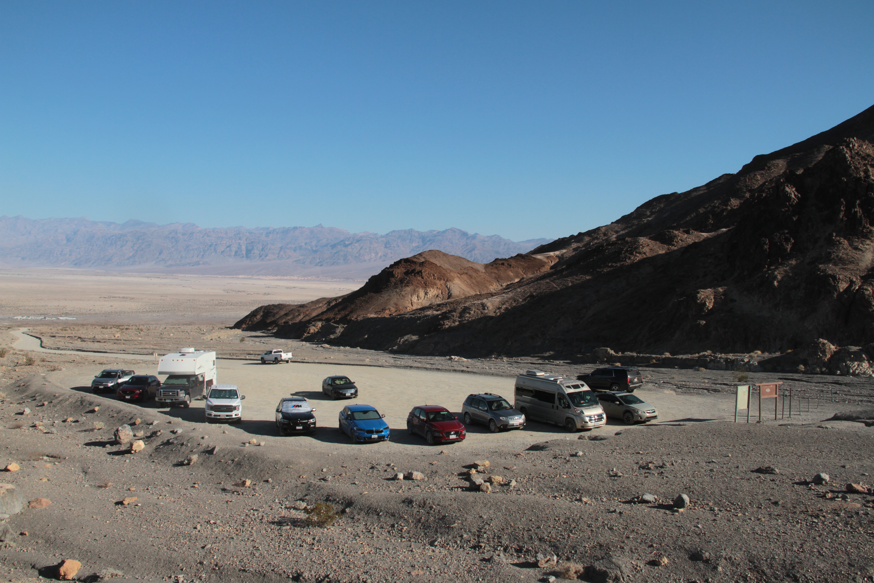
Mosaic Canyon Road & Trailhead
Road
  Fill could be added to bring up to grade
  Range of surfaces to be considered during design:
    soil cement
    decomposing granite
    Porous paving products
    gravel
    chip seal over gravel
    Asphalt
Parking area
  Same surface as road
  Delineate parking space to promote more efficient parking
  Add vault toilet
Notes:
Abby

Slide 17
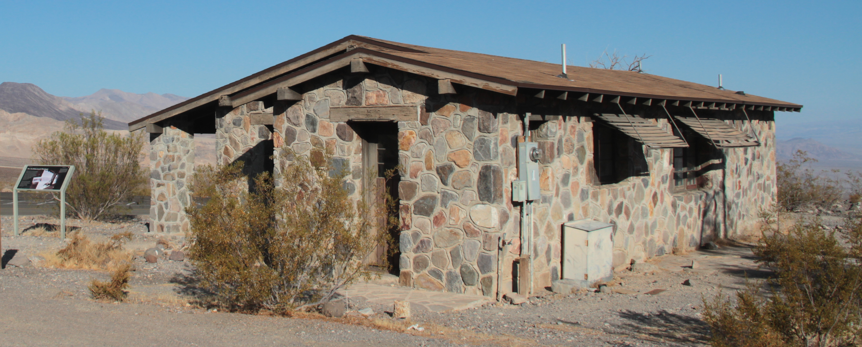
Emigrant Junction
Rehabilitate historic ranger station
Add a trail with interpretive signs
Two trailer pads behind ranger station for volunteers
Keep campground rustic
Renovate historic comfort station
  Make it unisex, with one room accessible
Solar power system for ranger station, comfort station, and volunteer trailer sites.
Notes:
Abby

Slide 18
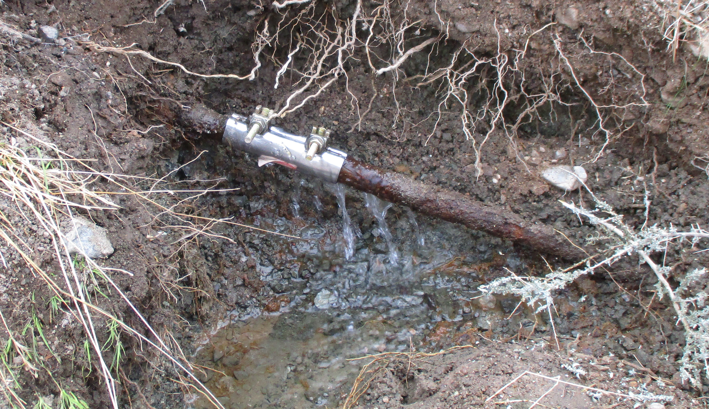
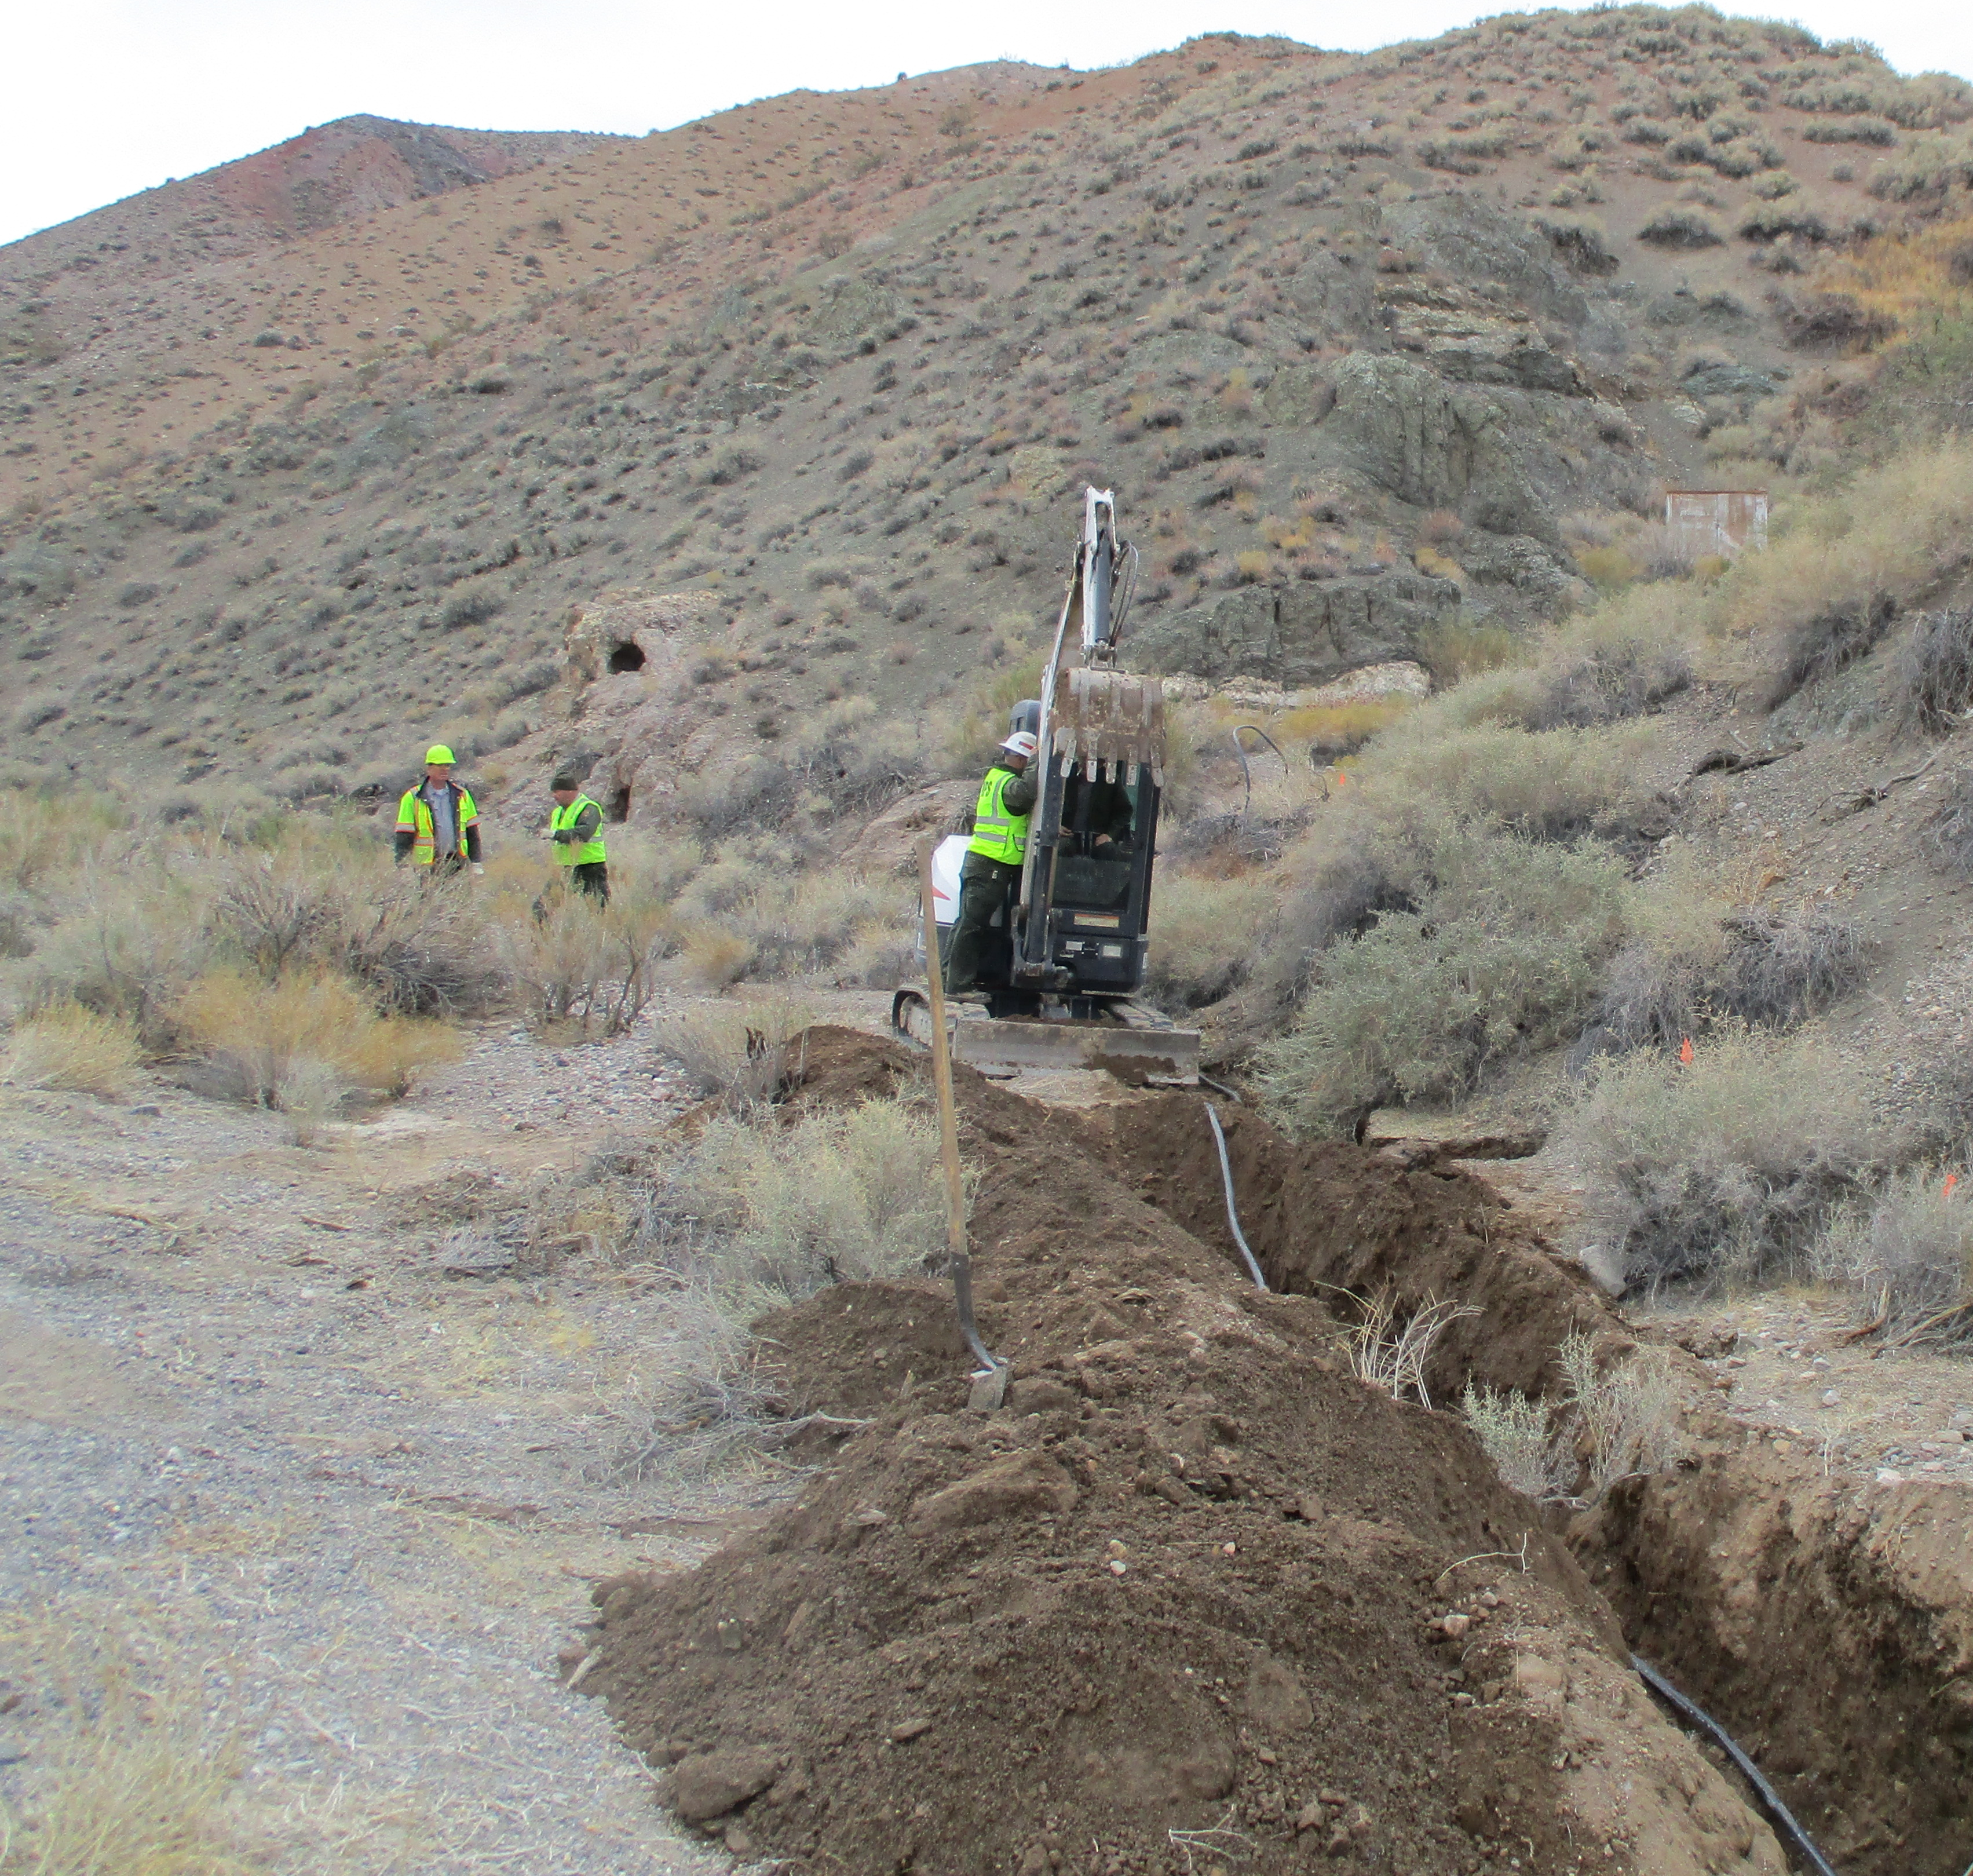
Water system at Emigrant Junction
Water system is no longer potable, due to damage
Replace 5 miles of water line
Notes:
Abby

Slide 19
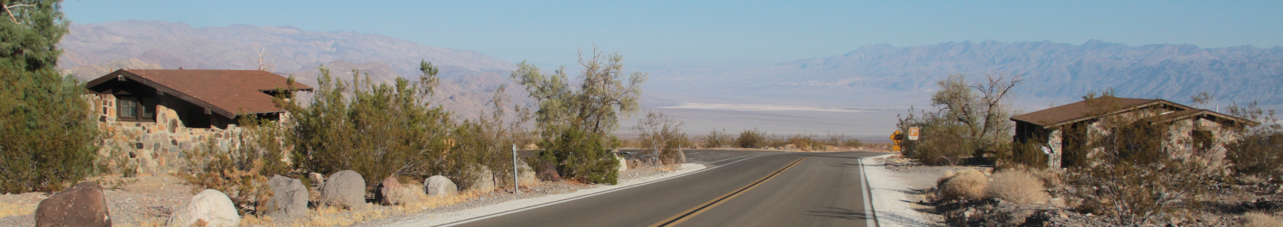
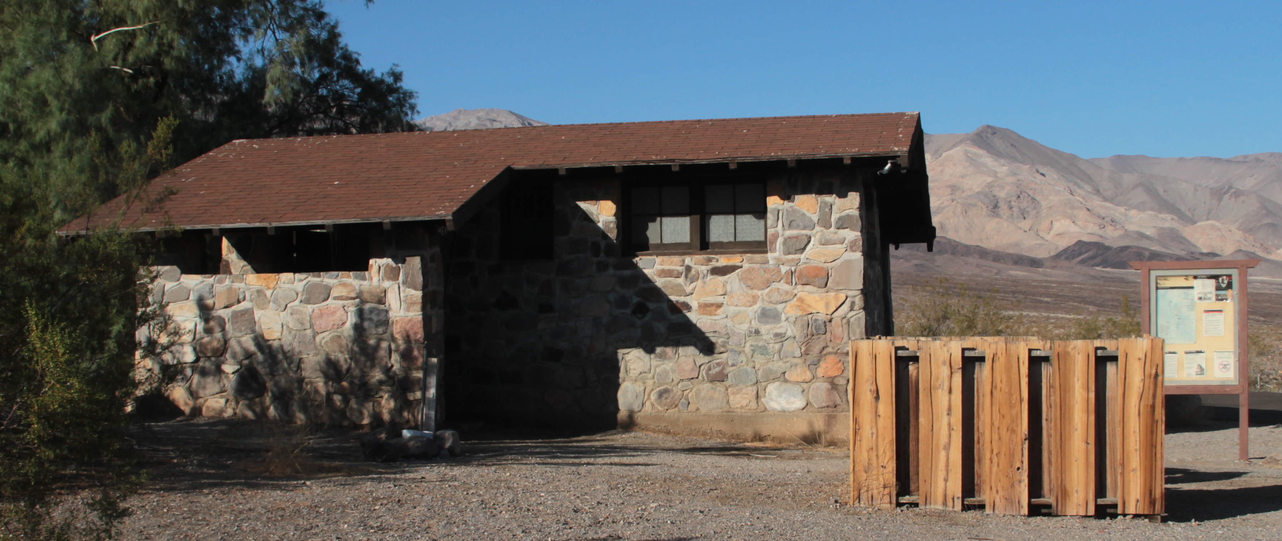
Wastewater system at Emigrant
Restroom serves Emigrant Campground and passers-by on CA-190
Existing leach field is in a wash
(risk for environmental contamination)
Remove septic system and replace in different location
Construct flood diversion structures
Notes:
Abby

Slide 20

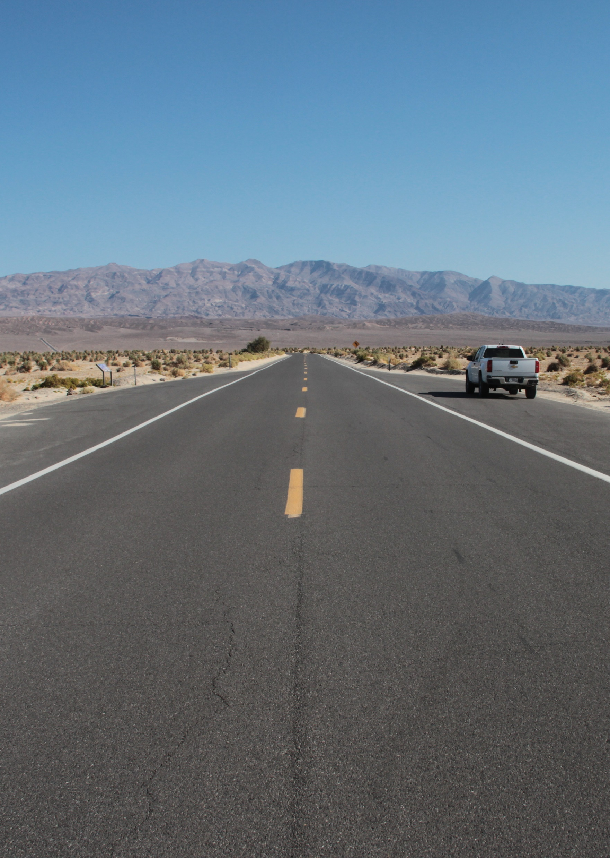
No-Action Alternative
Most facilities would remain in their current conditions, with some improvements and repairs
Repair flood diversion structures
Convert the airstrip to gravel
(2002 General Management Plan)
Improve the helipad
“no change in plans”
Notes:
Abby

Slide 21
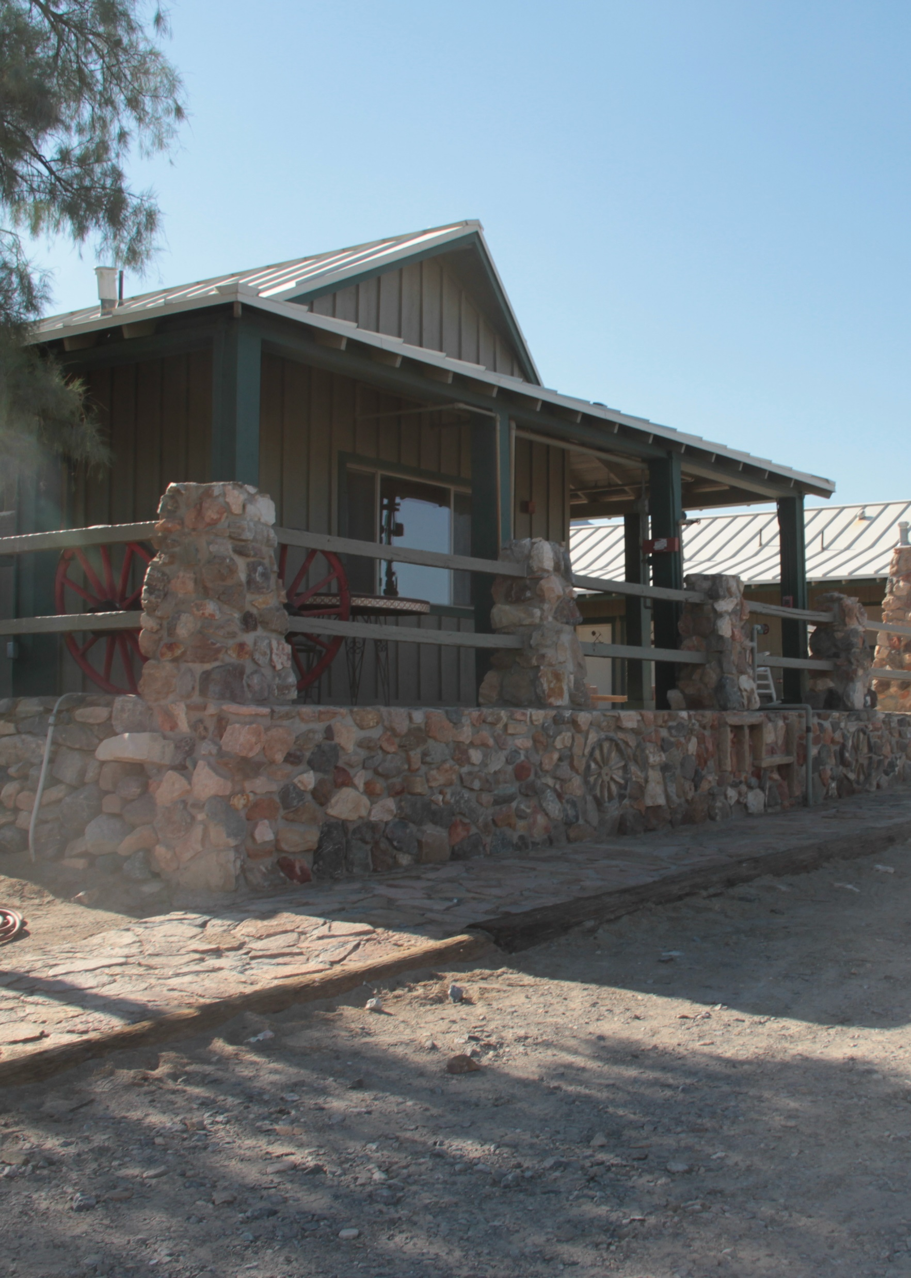
How to Comment
Public participation is an important element of the planning process. We invite you to review and comment on this EA by Feb. 28.
The full document is available at parkplanning.nps.gov/StovepipeWellsPlan
Please share your comments online at the same web address or mail your comments to:
Death Valley National Park
Attention: Compliance Office
P.O. Box 579
Death Valley, CA 92328
Please share your comments no later than February 28, 2022
Notes:
Matthew

Slide 22
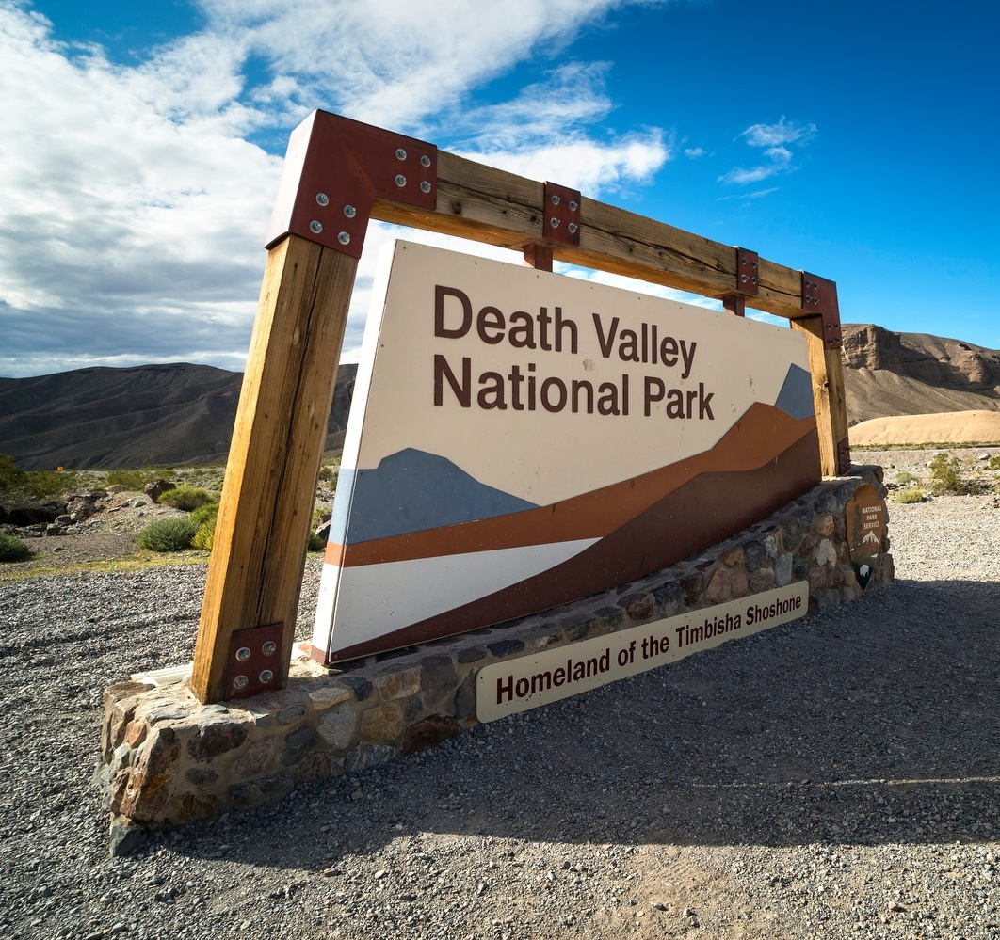
Questions?
Thanks for your time and participation
Notes:
Matthew

