Slide 1
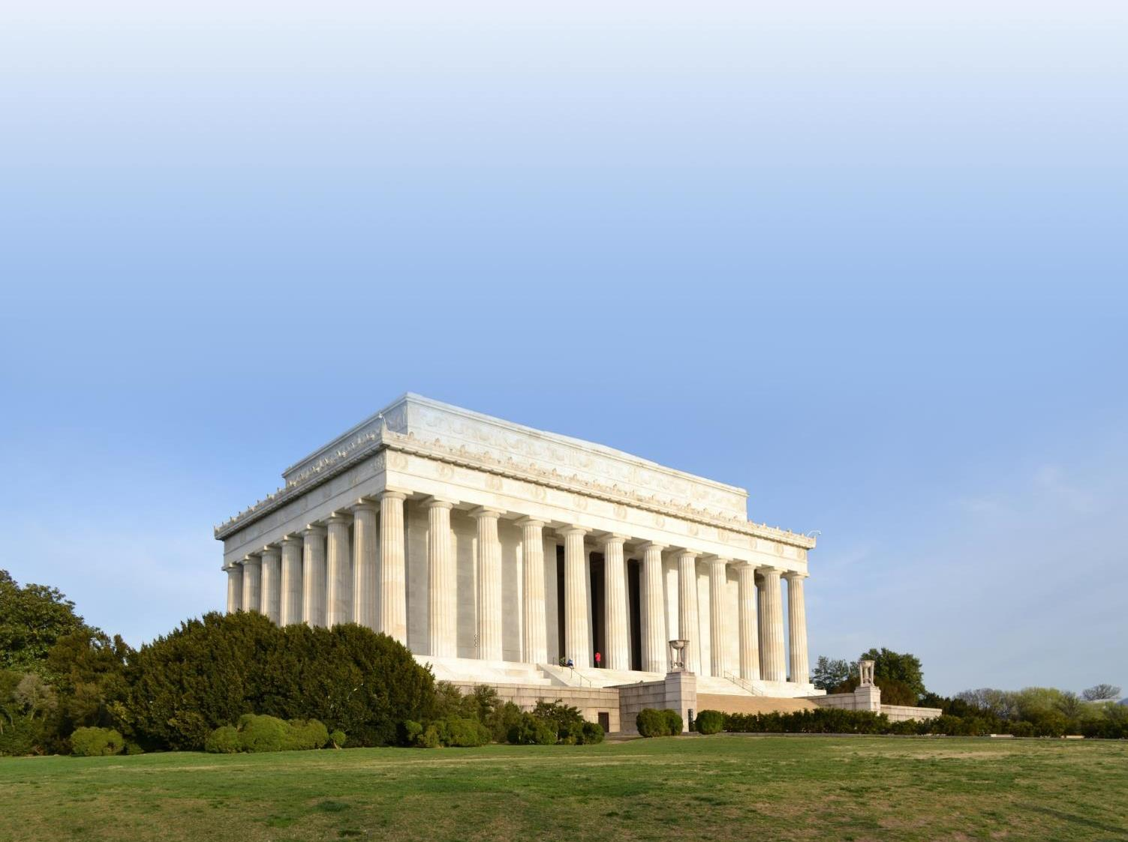
REHABILITATION OF LINCOLN MEMORIAL
Section 106 Consulting Parties Meeting
21 February 2018

Slide 2

AGENDA
PRESENTATION
WELCOME + INTRODUCTIONS
IDENTIFY HISTORIC RESOURCES
ALTERNATIVES
ASSESSMENT OF EFFECTS
DISCUSSION ON MITIGATION
NEXT STEPS

Slide 3
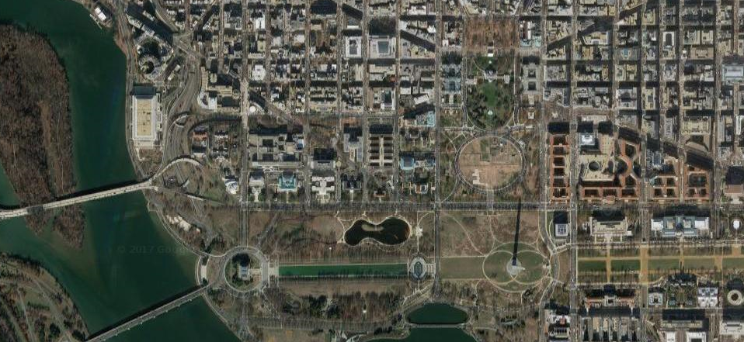
CONSTITUTION GARDENS, THE NATIONAL MALL, WASHINGTON D.C
LINCOLN MEMORIAL, WASHINGTON D.C
PROJECT AREA

Slide 4
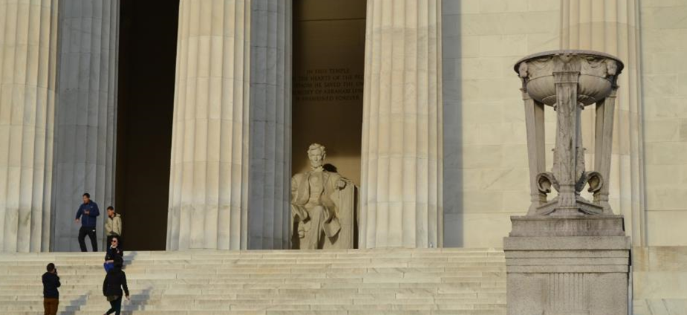
The purpose of this project is to expand overall interpretive and educational visitor experience at the Lincoln Memorial. Its needed because of current configuration of visitor services and park support facilities are insufficient.
PURPOSE + NEED

Slide 5
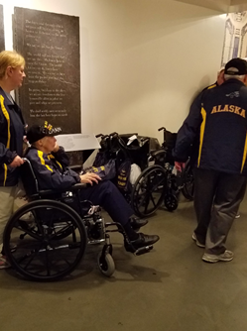
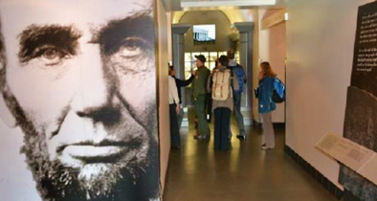
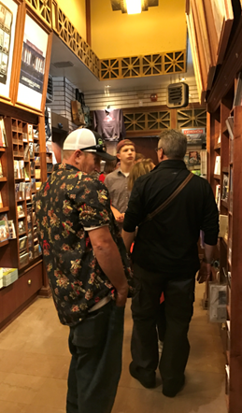
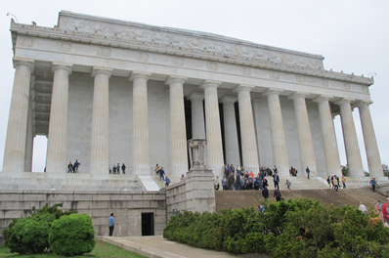
Restrooms outdated and require repairs
Only one elevator to the chamber and its unreliable
Egress to restrooms/exhibit space not current with life safety codes
Chamber bookstore too small
CURRENT CONDITIONS

Slide 6
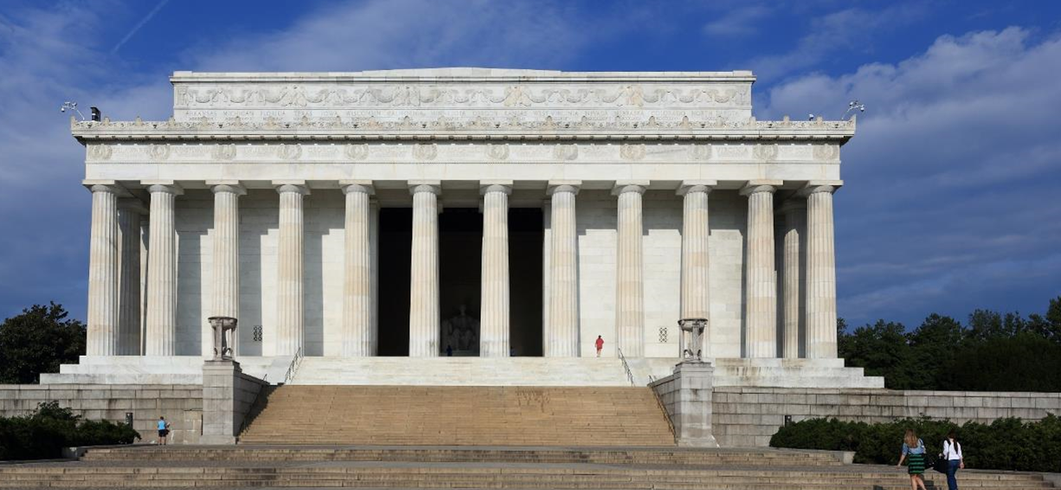
Memorial designed by Henry Bacon and sculpture created by Daniel Chester French;
Dedicated in 1922 in the style of an ancient Greek temple;
Located on a site identified by the McMillian Commission in its 1901-1902 plan for Washington;
Prominent setting for events such as Marian Anderson’s Easter Sunday concert (1939) and MLK’s “ I Have a Dream” speech (1963).
LINCOLN MEMORIAL
HISTORICAL OVERVIEW

Slide 7
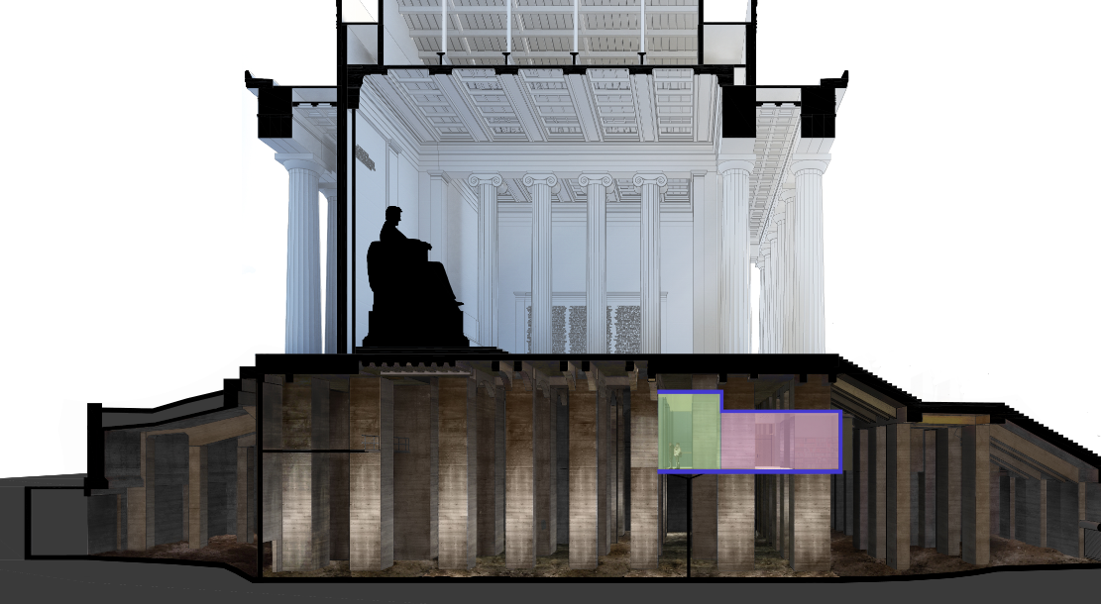
Set on a raised
HISTORICAL OVERVIEW

Slide 8
HISTORICAL OVERVIEW

Slide 9
NEPA PROCESS
Initiate NEPA Process
Prepare
EA for Public Review
Public Review & Comments on Draft EA
NEPA Decision Document
Public Scoping Meeting
Determine Environmental Consequences
Initiate Section
106
Section 106 Public Meeting
Identify Adverse Effects
Avoid, Minimize Adverse Effects
106 Input on Proposal
DOE
or
Prepare
MOA
Analyze Altern.
Identify Mitigation
MOA, if needed
SECTION 106 PROCESS
Public Scoping Meeting 6.27.17; EA released for comment (2/5-3/7);
SHPO and Tribal Section 106 Consultation Initiated on 3.17.17 and 2.15.18
SEC. 106 UPDATE

Slide 10
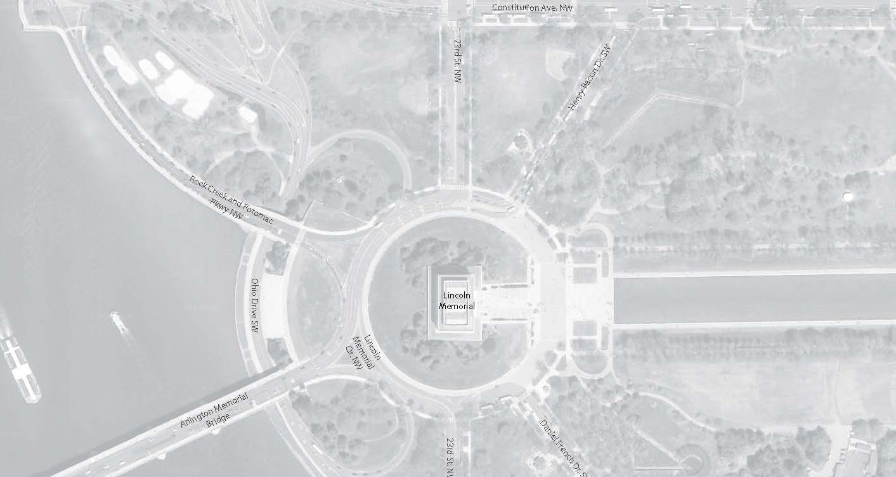
PROJECT AREA
DRAFT AREA OF POTENTIAL EFFECT (APE)
Cultural Resources in APE
1
LINCOLN MEMORIAL
2
LINCOLN MEMORIAL GROUNDS
EAST AND WEST POTOMAC PARKS AND
NATIONAL MALL NATIONAL REGISTER
HISTORIC DISTRICTS
1
2
AREA OF POTENTIAL EFFECT (APE)

Slide 11
Based on the findings of the Historic Structures Assessment report (2016):
Memorial exterior (including stylobate, colonnade, entablature, exterior decorations);
Memorial interior (including statuary chamber and rooms,
Chamber roof and skylight chamber;
Approachway and terrace;
Bronze doors in raised terrace retaining wall;
Lower and upper steps;
North and south tripods;
Raised terrace;
Undercroft (beneath statuary Chamber)
Lincoln Memorial, following completion of reflecting pool , May 1923 (LOC)
CONTRIBUTING FEATURES

Slide 12
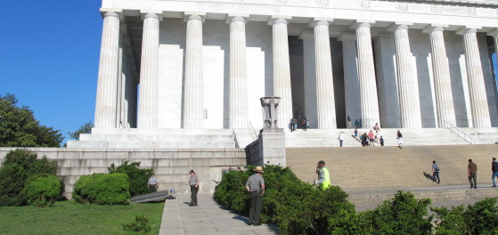
Based on the findings of the Historic Structures Assessment report (2016):
Upper and lower roof materials
North and south walkways and north and south plazas;
Undercroft (beneath approachway and raised Terrace).
NON-CONTRIBUTING FEATURES

Slide 13
ALTERNATIVES
ALTERNATIVE A- NO ACTION
ALTERNATIVE B-PROPOSED ACTION
ALTERNATIVE C- IMPROVE EXISTING

Slide 14
NO ACTION
No changes in egress; single 36” door connects to exhibit level
No changes in the existing interpretive area and restrooms
No views of the undercroft
Single outdated elevator remains
Retain existing retail area, USPP office, staff breakroom, single elevator lobby, and janitor’s closet
ALT. A

Slide 15
NO ACTION
No changes in egress; single 36” door connects to exhibit level
No changes in the existing interpretive area and restrooms
No views of the undercroft
Single outdated elevator remains
Retain existing retail area, USPP office, staff breakroom, single elevator lobby, and janitor’s closet
ALT. A

Slide 16
PROPOSED ACTION
Improved egress from exhibit level; south and north doors enlarged to 72” (both connect to exhibit level)
Exhibit level expanded for interpretive space, additional restrooms, new retail area
Curtain wall provides views of the undercroft
South elevator renovated and updated, new elevator added in the north
ALT. B

Slide 17
PROPOSED ACTION
Improved egress from exhibit level; south and north doors enlarged to 72” (both connect to exhibit level)
Exhibit level expanded for interpretive space, additional restrooms, new retail area
Curtain wall provides views of the undercroft
South elevator renovated and updated, new elevator added in the north
ALT. B

Slide 18
PROPOSED ACTION
Improved egress from exhibit level; south and north doors enlarged to 72” (both connect to exhibit level)
Exhibit level expanded for interpretive space, additional restrooms, new retail area
Curtain wall provides views of the undercroft
South elevator renovated and updated, new elevator added in the north
ALT. B

Slide 19
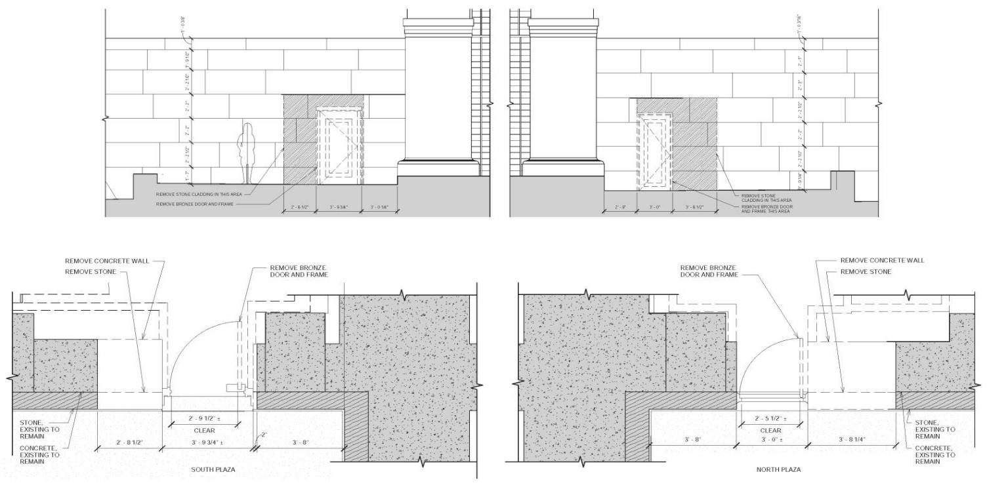
PROPOSED ACTION
Improved egress from exhibit level; south and north doors enlarged to 72” (both connect to exhibit level)
Exhibit level expanded for interpretive space, additional restrooms, new retail area
Curtain wall provides views of the undercroft
South elevator renovated and updated, new elevator added in the north
ALT. B

Slide 20
IMPROVE EXISTING
Slightly improved egress from exhibit level; north doors widened by 5” and connected to public space on exhibit level for 2nd egress point
Modest changes in the existing interpretive area and additional restrooms
Picture window into the undercroft
Retail space remains as is, no second elevator
ALT. C

Slide 21
IMPROVE EXISTING
Slightly improved egress from exhibit level; north doors widened by 5” and connected to public space on exhibit level for 2nd egress point
Modest changes in the existing interpretive area and additional restrooms
Picture window into the undercroft
Retail space remains as is, no second elevator
ALT. C

Slide 22
IMPROVE EXISTING
Slightly improved egress from exhibit level; north doors widened by 5” and connected to public space on exhibit level for 2nd egress point
Modest changes in the existing interpretive area and additional restrooms
Picture window into the undercroft
Retail space remains as is, no second elevator
ALT. C

Slide 23
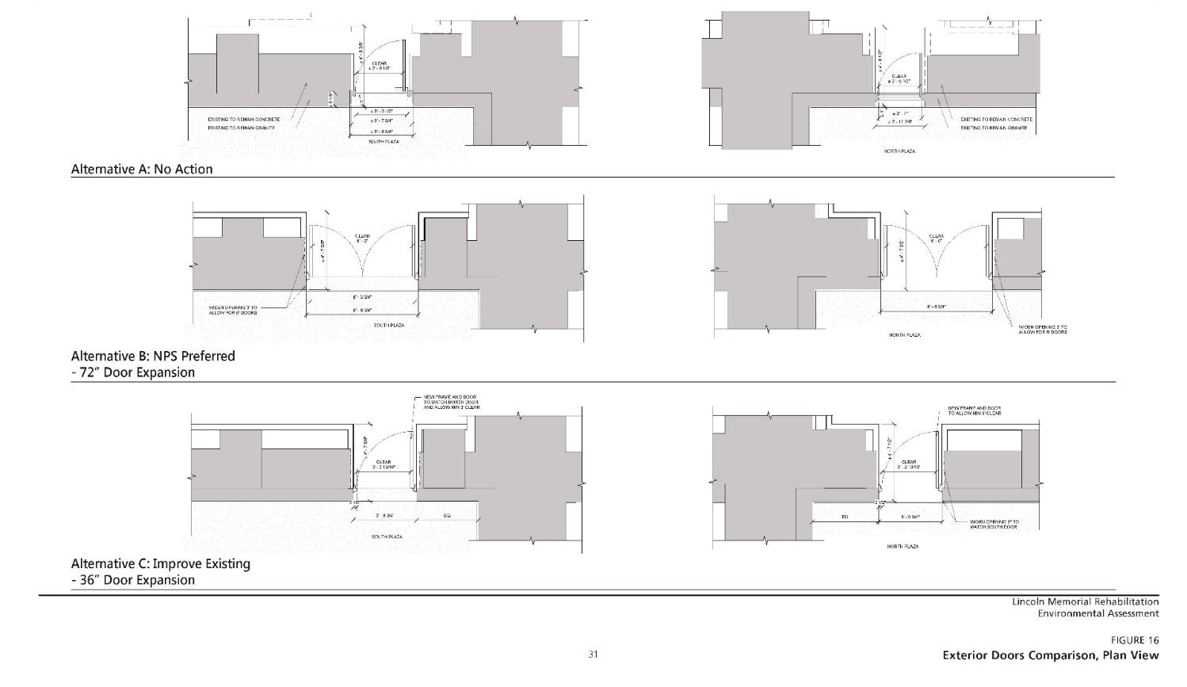
COMPARISONS

Slide 24
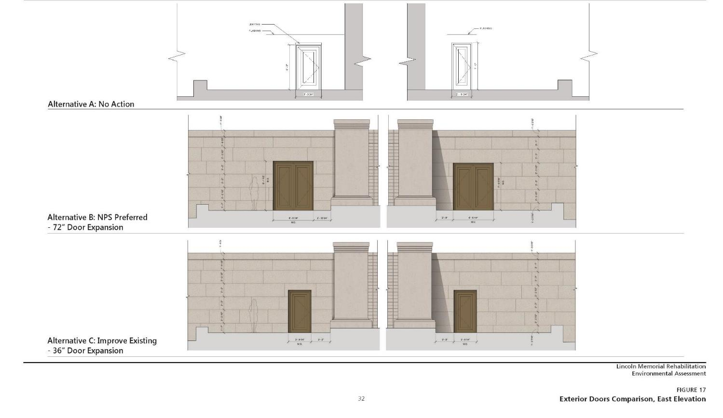
COMPARISONS

Slide 25
BRONZE DOORS, EAST ELEVATION
ALT. A

Slide 26
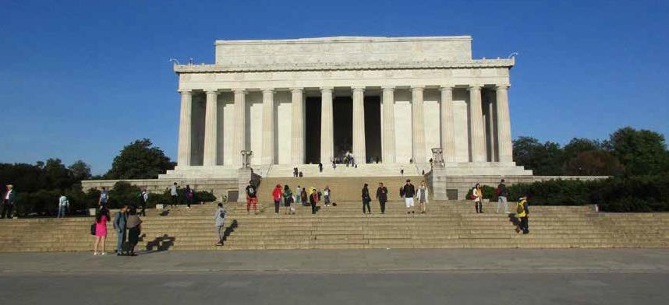
BRONZE DOORS, EAST ELEVATION
ALT. B

Slide 27

BRONZE DOORS, EAST ELEVATION
ALT. C

Slide 28
Adverse effect on Memorial Exterior
The doors on the east façade of the Lincoln Memorial would be replaced with larger doors of a sympathetic design.
A change in appearance of the main façade would occur and a loss of historic masonry would be required for the new doors
Adverse effect on Memorial Interior
Removal of historic material on the chamber level for new elevator and improved mechanical systems. This loss of material would be in areas not visible to the public.
Removal and replacement of historic material would be required on the exhibit level for new structural elements. The expanded exhibit level would result in a change in appearance of the undercroft and the introduction of modern materials.
Some historic character of the undercroft would be diminished with these changes. However, most of the changes would be concentrated within the non-character-defining raised terrace area.
EFFECTS-ALT B. (Preferred)

Slide 29
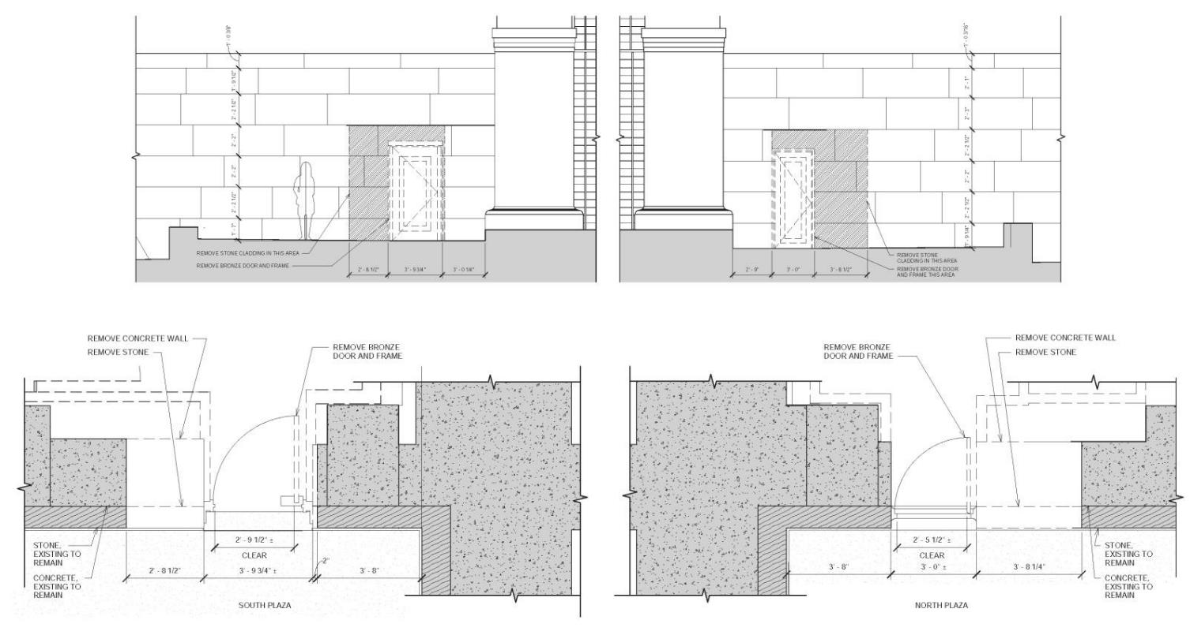
ALT B: 72’ OPENING (2x36”) DEMO PLAN, EAST ELEVATION
EFFECTS-ALT B. (Preferred)

Slide 30
72’ OPENING (2x36”) PHOTO SIMULATION, EAST ELEVATION
EFFECTS-ALT B. (Preferred)

Slide 31
72’ OPENING (2x36”) SIMULATION CLOSED, EAST ELEVATION
EFFECTS-ALT B. (Preferred)

Slide 32
72’ OPENING (2x36”) SIMULATION OPENED, EAST ELEVATION
EFFECTS-ALT B. (Preferred)

Slide 33
72’ OPENING (2x36”) SIMULATION OPENED, EAST ELEVATION
EFFECTS-ALT B. (Preferred)

Slide 34
72’ OPENING (2x36”) SIMULATION OPENED, EAST ELEVATION
EFFECTS-ALT B. (Preferred)

Slide 35
MITIGATION OPTIONS
POTENTIALLY ADD REMOVED STONE & BRONZE DOOR TO MUSEUM COLLECTION
UPDATE HABS DOCUMENTATION
PREPARTION OF INTERPRETATIVE MATERIALS ON MEMORIAL DEVELOPMENT
CONSERVE AND PROTECT HISTORIC GRAFFITI
COMPLETE CONDITION ASSESSMENT OF GUERIN MURALS
HISTORIC STRUCTURE/LANDSCAPE PRESERVATION MAINTENANCE PLAN

Slide 36
OPPORTUNITIES TO
COMMENT
Please submit comments at:
www.parkplanning.nps.gov/LincolnMemorialRehab
or mail to:
ATTN: Lincoln Memorial Rehabilitation
Superintendent, National Mall and Memorial Parks
900 Ohio Drive, SW Washington, DC 20024

